Slide 1


Wind energy power prediction using machine learning.
Group no: 14
Jyoti Vishwakarma_219320
Aniket Kamble_219321
Mr. Prashant Karhale Mr. Akshay Tilekar Centre Coordinator Project Guide

Slide 2
introduction

Slide 3


Slide 4
Problem Statement
We are facing the problem of finding renewable energy sources, which is why we need to properly utilize the sources which are available.
In this project we try to get accurate energy predictions of energy outputs based on the wind conditions at its surroundings.
We are providing an ML based solution in which we would give 72 hours of future prediction of power output.

Slide 5
Objective
We are given a dataset of a windmill which contains data of the year 2018.
It contains power generated by the windmill in every 10 minutes of the years.
Along with power we have measure of speed and direction of the wind at that time.
We will be developing an application which will predict the energy to be generated for next 72 hours based on these environmental conditions wind speed and direction.

Slide 6
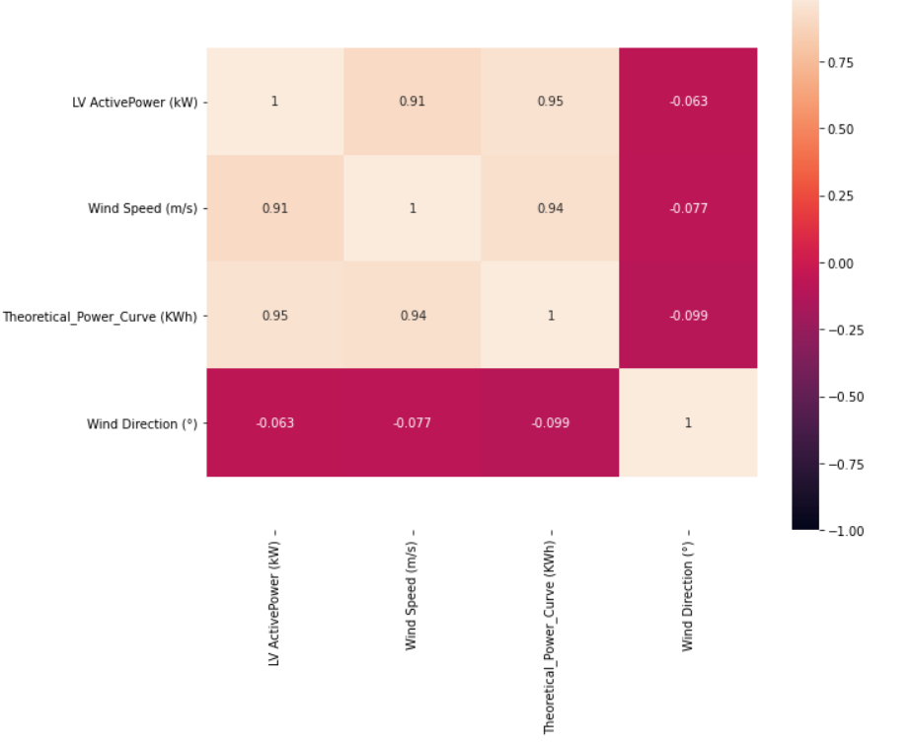
Correlation between features

Slide 7
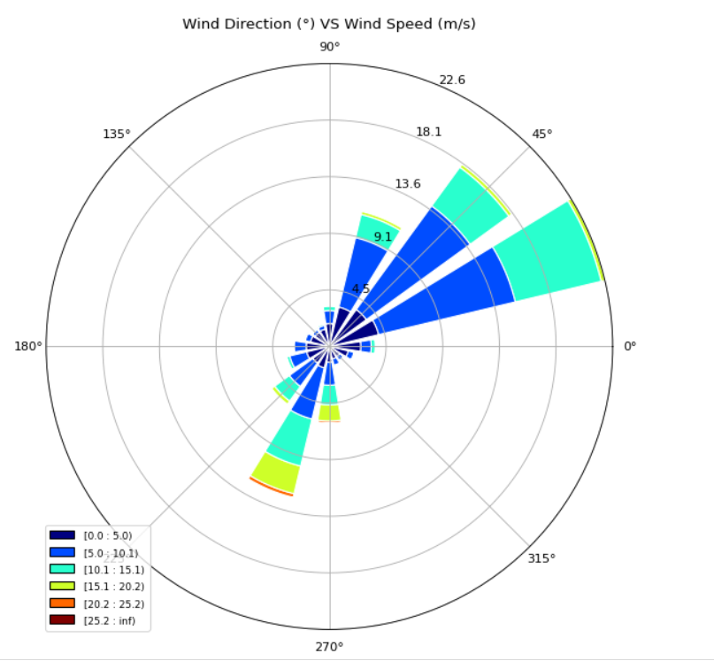
Pie chart of wind speed and wind direction

Slide 8
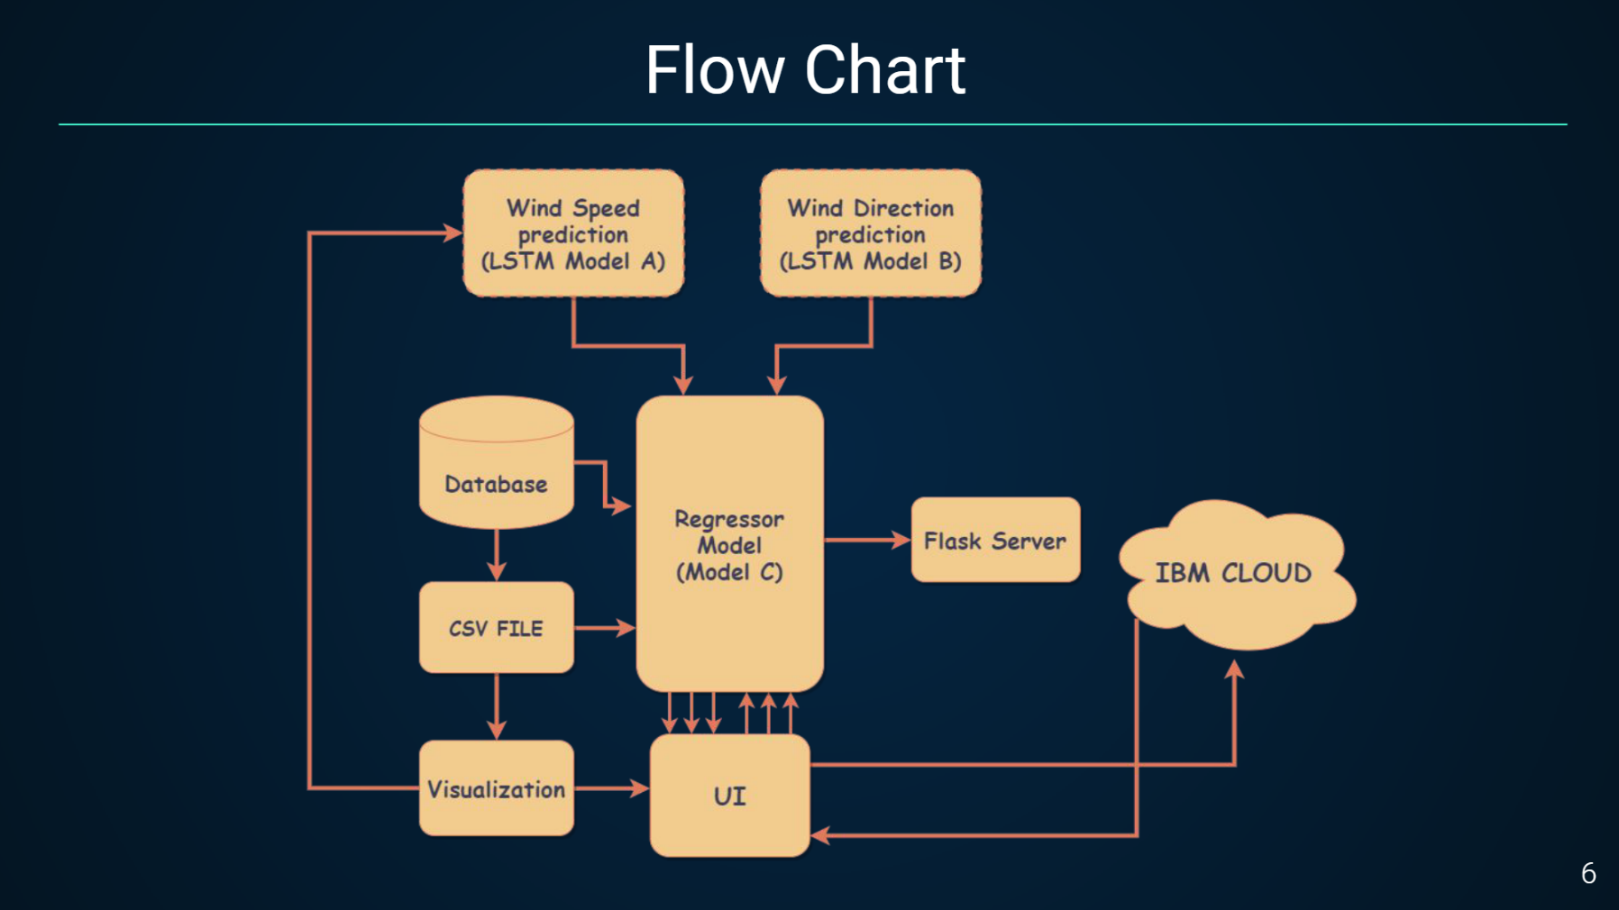
Proposed system

Slide 9
Models used for forecasting
LSTM
ARIMA
Support Vector Machine
Linear Regresion
Random Forest
XGBoost

Slide 10
Lstm model
It is a type of recurrent neural network
It is used for handling long term dependancies
In Lstm neural networks remember the previous output and use for processing the current input
Here we use two Lstm models.
We give wind speed and wind direction as input each to both the models.
Lstm models gives predicted wind speed and wind direction for the next 72 hours.
These predicted values are then given to the regression.

Slide 11
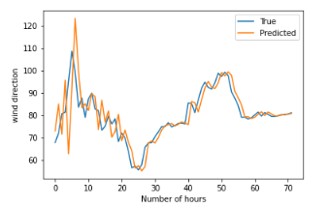
Wind direction true vs predicted

Slide 12
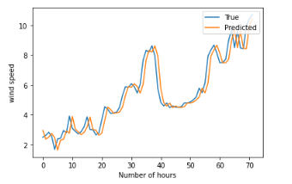
Wind speed true vs predicted

Slide 13
Regression Models

Slide 14
Linear regression
Linear Regression is used to find a relationship between a dependent(y) and one or more independent(x) variables.
It shows how the value of dependent variable changes with respect to independent variable
While representing the relationship between dependent and independent variable it provides a sloped straight line.

Slide 15
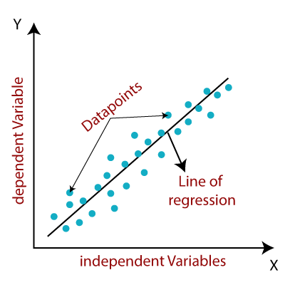

Slide 16
Decision Tree
It is tree structured classifier which contains nodes and branches.
It is used for getting possible solutions for the given problem.
Features of the dataset are represented by the internal nodes, decisions by the branches and outcome by the leaf nodes.
Decision tree splits itself based on the decision yes or no.

Slide 17


Slide 18
Random Forest
Random Forest is a classifier which is part of supervised learning.
It contains the list of decision trees which applied to the different subsets of the data.
The greater the decision trees higher the accuracy.
It is based on ensemble learning

Slide 19
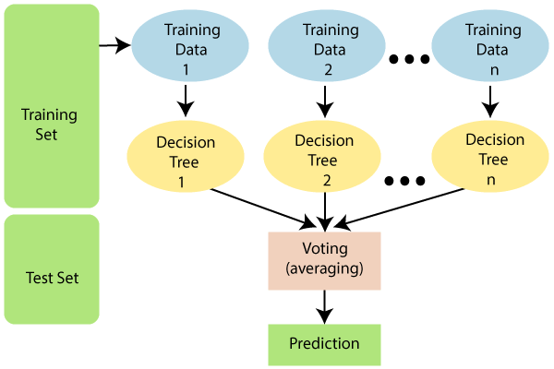

Slide 20
XGBoost
XGBoost is a decision-tree-based ensemble learning algorithm that uses a gradient boosting.
Here we use decision trees in sequential manner.
While giving input to the decision tree we assign weight to each input.
Decision tree predicts the result.
If the prediction is wrong then the weight is increased and again given to the next decision tree.
The steps get repeated and we get strong and precise ensemble model.

Slide 21
Ensemble Learning
It combines different machine learning models and the model with most accurate output is selected.
The primary principle behind the ensemble model is that a group of weak learners come together to form an active learner.
There are two techniques in ensemble learning.
Bagging
Boosting
All the repressor models used are combined with the help of voting regressor and it gives our output which is the prediction for the next 72 hours.

Slide 22
ARIMA Model
It is abbreviated as 'Auto Regressive Integrated Moving Average‘.
It is a class of models that gives forecasting on the time series problems based on previous values, lags and lagged errors.
Only stationary data can be used for the forecasting in ARIMA.
There are three components of ARIMA
p = the order of the AR term
q = the order of the MA term
d = the number of differences required to make the time series stationary

Slide 23
CONCLUSION
In this project, we have established the application to predict future wind power output values based on the regressor and deep learning models.
The UI provides a great deal of information to anyone who would like to know about the future power output presented in the form of visualizations.
Deploying it to the cloud makes it more scalable.

