Slide 1
Logistics

Slide 2
Connect to WIFI
HAL 9000
password: imsorrydave
Notes:
Do you know who is HAL 9000?

Slide 3
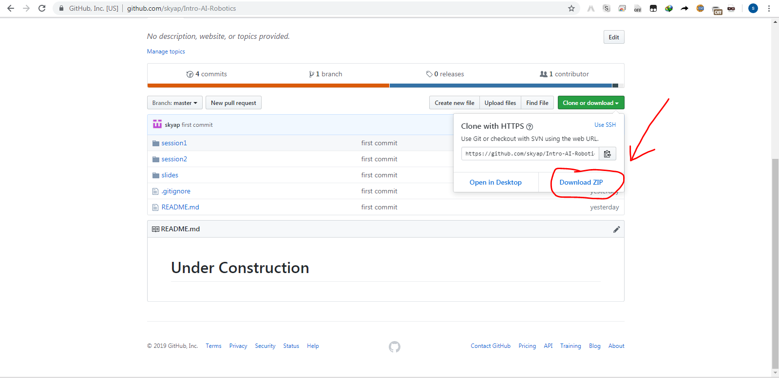
Cloning/ Downloading Slide from GitHub
git clone https://github.com/skyap/Intro-AI-Robotics.git
or

Slide 4
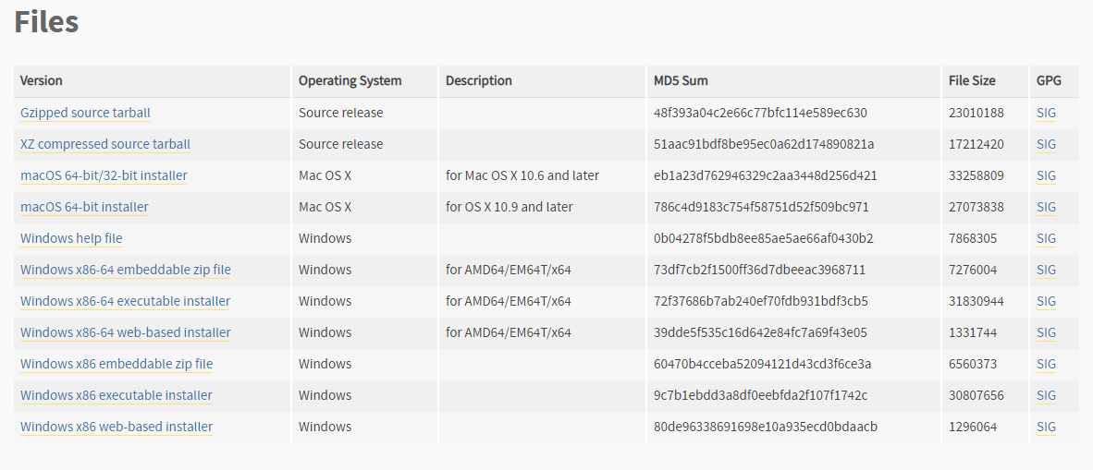
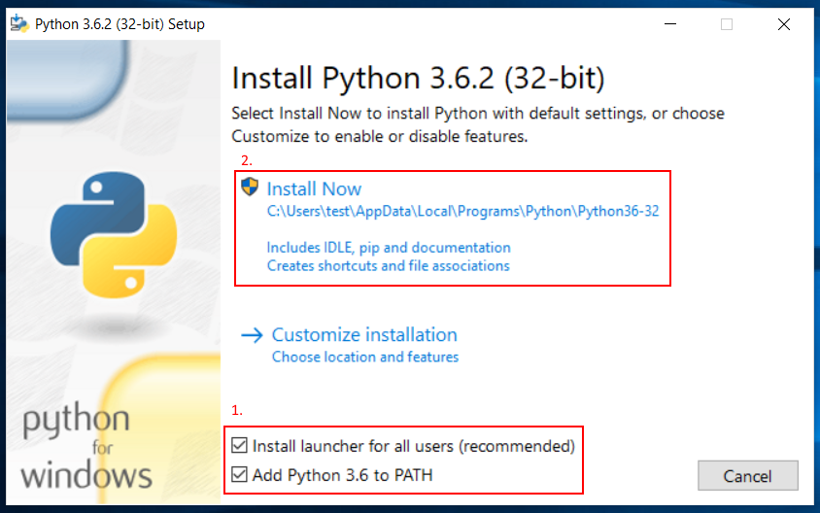
Install Python
Dowload Python 3.6.8 from https://www.python.org/downloads/windows/ or use the installer in Intro-AI-Robotics/python/
Remember to check “Add Python 3.6.8 to PATH”

Slide 5
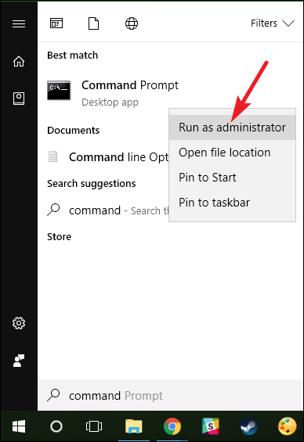
Open administrator command prompt
https://www.howtogeek.com/194041/how-to-open-the-command-prompt-as-administrator-in-windows-8.1/

Slide 6
Install gym-Duckietown
cd gym-duckietown
pip3 install -e .
pip3 install pyglet==1.3.2
python manual_control.py

Slide 7
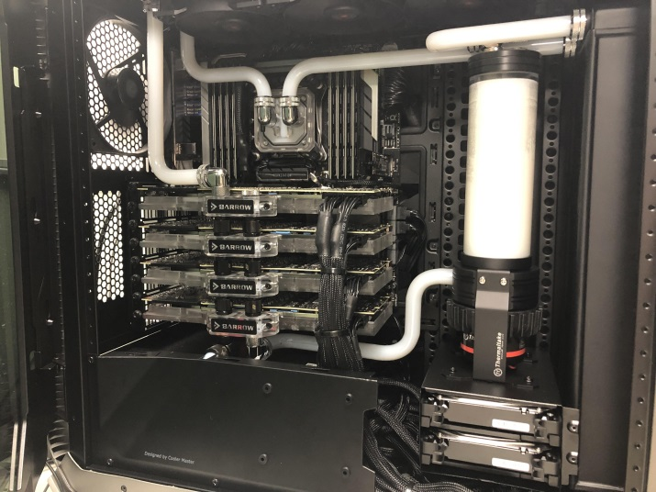
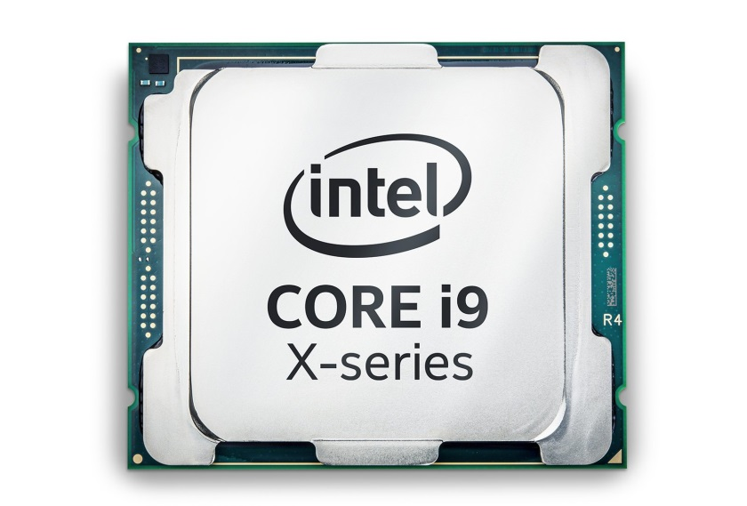
Install Tensorflow
if you have Nvidia-GPU
pip3 install tensorflow-gpu
if you don’t have Nvidia-GPU
pip3 install tensorflow
Notes:
because we need to install special driver for GPU

Slide 8
Other Installation
pip3 install jupyterlab
pip3 install scikit-learn
pip3 install tqdm

