Slide 1
Logistics

Slide 2
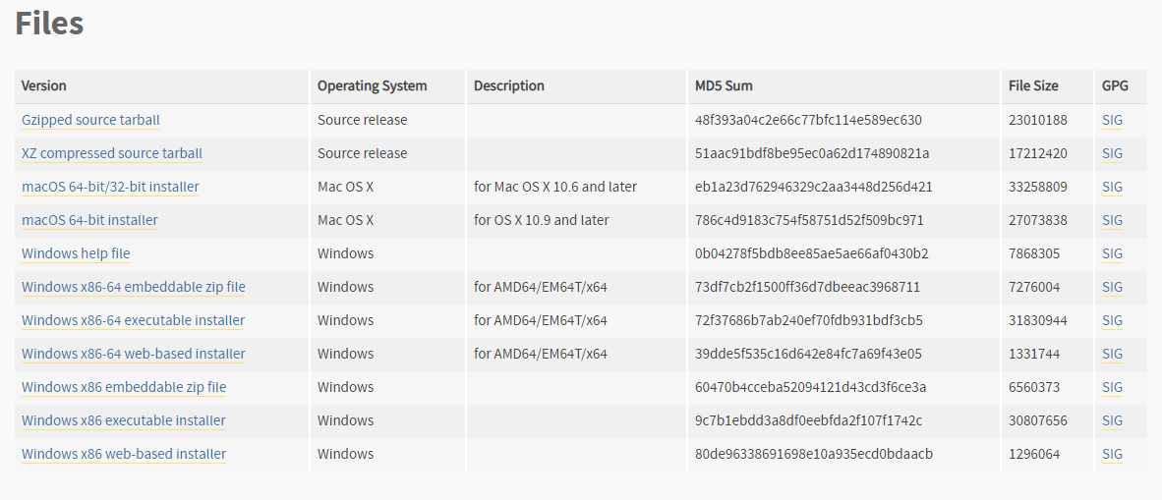
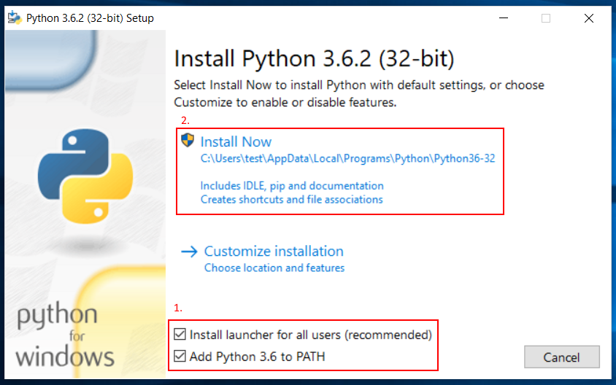
Install Python
Dowload Python 3.6.8 from https://www.python.org/downloads/windows/
Remember to check “Add Python 3.6.8 to PATH”

Slide 3
Install Alphabot2
pip install git+https://github.com/skyap/alphabot2.git

Slide 4
Install gym-Duckietown
git clone https://github.com/duckietown/gym-duckietown.git
cd gym-duckietown
pip install -e .
pip install pyglet==1.3.2
python manual_control.py

Slide 5
Install Tensorflow
if you have Nvidia-GPU
pip install tensorflow-gpu
if you don’t have Nvidia-GPU
pip install tensorflow

Slide 6
Other Installation
pip install jupyterlab
pip install scikit-learn

