Slide 1
Introduction to Deep Learning

Slide 2
Objectives
Linear Regression
Linear Regression with Neural Network
MNIST with Neural Network
Reinforcement Learning

Slide 3
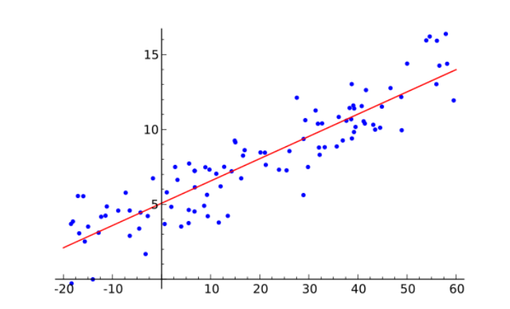
Simple Examples

Slide 4
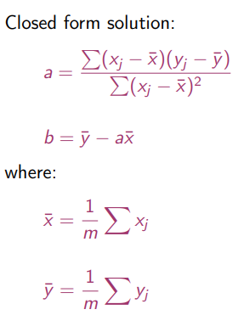
Linear Regression – Analytical Solution
We search for the line y = ax + b

Slide 5
Tutorial 1 – Program it

Slide 6
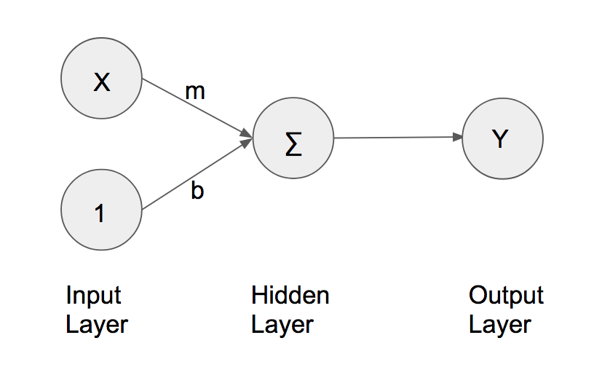
Linear Regression – Neural Network
From keras.layers import Dense

Slide 7
Compare results

Slide 8
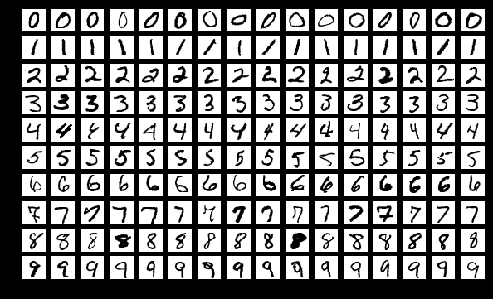
MNIST

Slide 9
x = Input(shape = (28*28,))
t = Dense(units = 689,activation=‘sigmoid’)(x)
y = Dense(units=10,activation=“softmax”)(t)
model = Model(inputs = x, outputs=y)
model.compile(optimizer=“adam”, loss=“mse”,metrics=[“accuracy”])
model.fit(x_train,y_train,batch_size = 100, epochs=20)
result = model.evaluate(x_test,y_test,batch_size=10000)
print(“Test Acc:”, result[1])
weights,biases = model.layers[1].get_weights()

Slide 10

What we going to do today

Slide 11




Scenario of Reinforcement Learning
Observation
Action
State
Change the environment
Agent
Don’t do that
Reward
Environment

Slide 12

Scenario of Reinforcement Learning
Agent learns to take actions to maximize expected reward.
Observation
Action
State
Change the environment
Agent
Thank you.
Reward
https://yoast.com/how-to-clean-site-structure/
Environment

