Slide 1
Introduction to Deep Learning

Slide 2
Objectives
Linear Regression
Linear Regression with Neural Network
MNIST with Neural Network
Reinforcement Learning

Slide 3
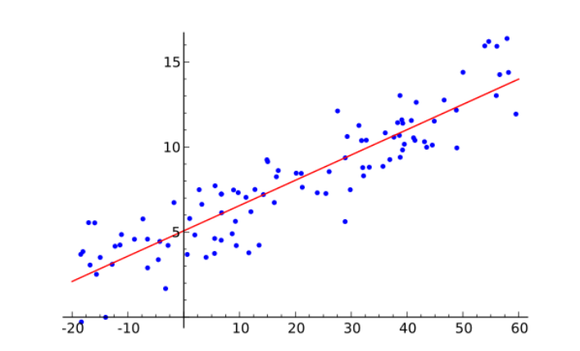
Simple Examples

Slide 4
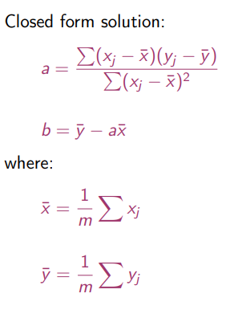
Linear Regression – Analytical Solution
We search for the line y = ax + b

Slide 5
Tutorial 1 – Program it

Slide 6
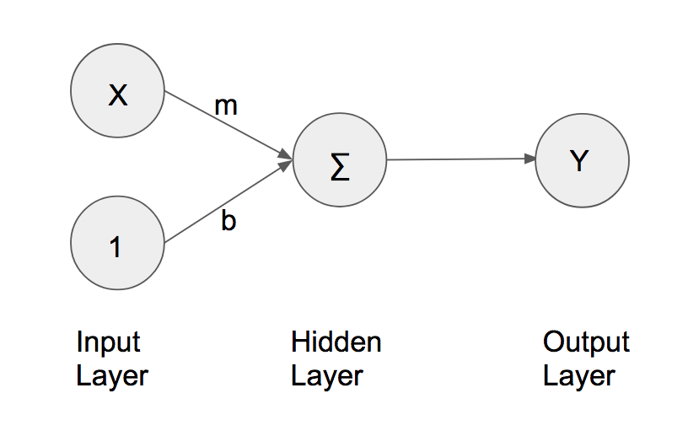
Linear Regression – Neural Network
From keras.layers import Dense

Slide 7
Compare results

Slide 8
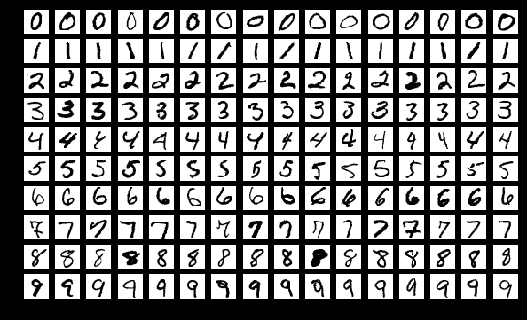
MNIST

Slide 9
x = Input(shape = (28*28,))
t = Dense(units = 689,activation=‘sigmoid’)(x)
y = Dense(units=10,activation=“softmax”)(t)
model = Model(inputs = x, outputs=y)
model.compile(optimizer=“adam”, loss=“mse”,metrics=[“accuracy”])
model.fit(x_train,y_train,batch_size = 100, epochs=20)
result = model.evaluate(x_test,y_test,batch_size=10000)
print(“Test Acc:”, result[1])
weights,biases = model.layers[1].get_weights()

