Slide 1
Azure Immersion Workshop:
Internet of Things – Hands-on Labs
CloudLabs
Spektra Systems

Slide 2
Azure Immersion Workshop
Process Overview
Spektra (pre-event)
Spektra
Setup Lab URLs a week ahead
Pre-event support
cloudlabs-support@spektrasystems.com
Event completion confirmation and environment cleanup.
01
02
03
04
05
MS Field
Spektra (during event)
Request lab from admin.cloudlabs.ai
Specify track, date, time, #seats
Associate instructors / proctors to request
Instant support through email / teams
Teams: http://bit.ly/cloudlabs-support

Slide 3
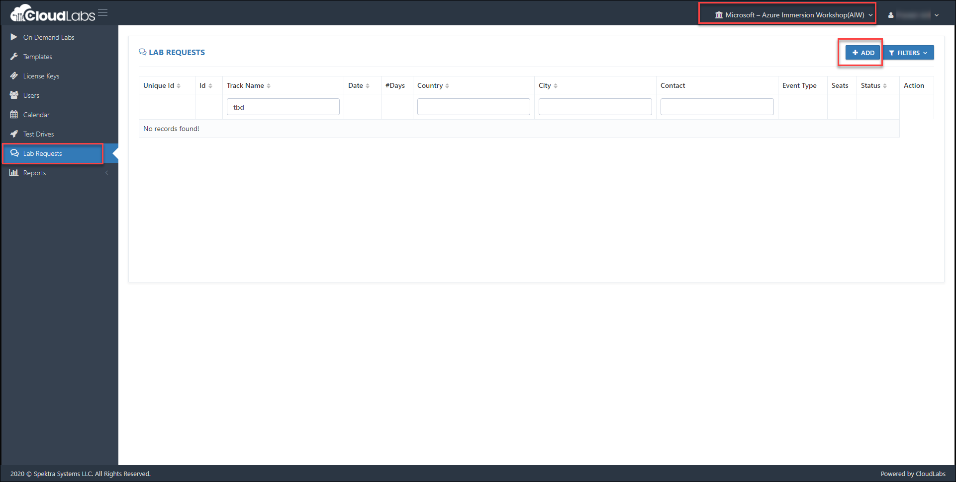
Azure Immersion Workshop
Lab Request Process
Navigate to https://admin.cloudlabs.ai
Ensure to select ‘Microsoft – Azure Immersion Workshop(AIW)’ tenant
Create a new lab request

Slide 4
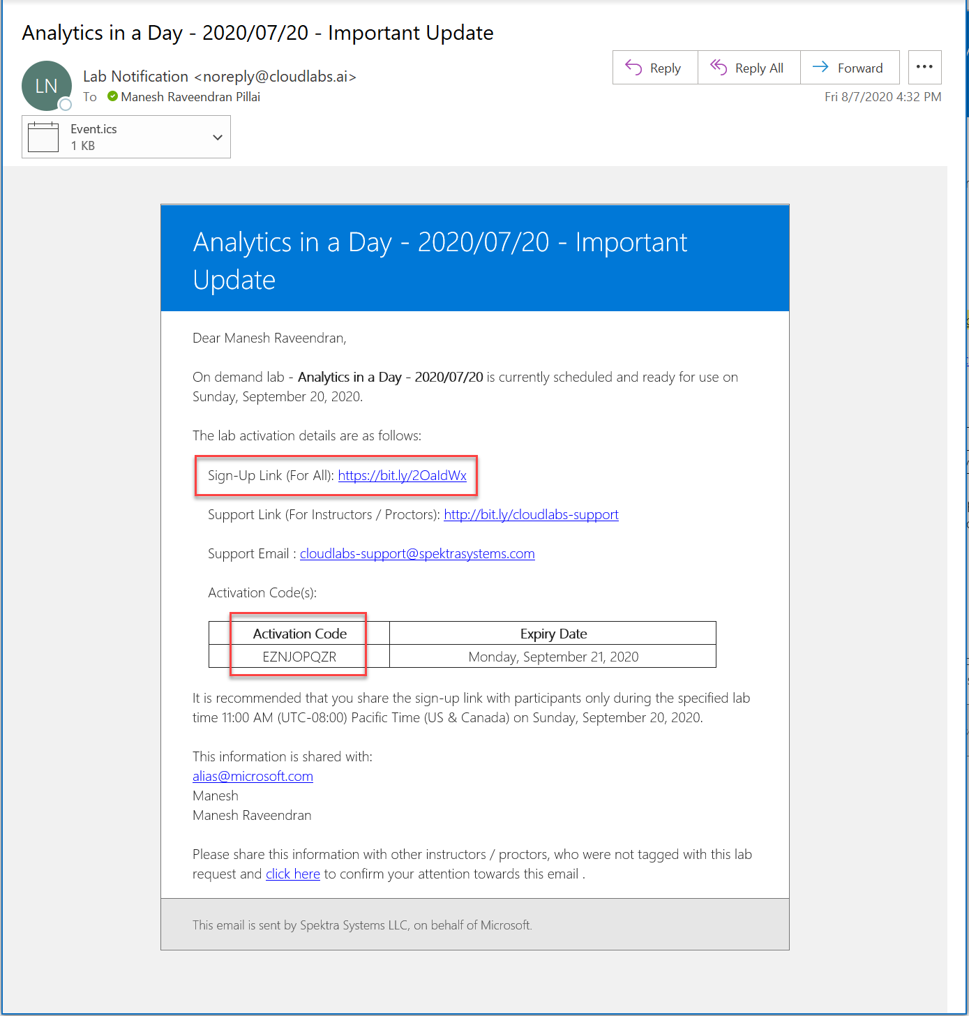
Azure Immersion Workshop
Lab Activation Details
Email notification is sent out to Requestor / Instructor / Proctor (T-7days)

Slide 5
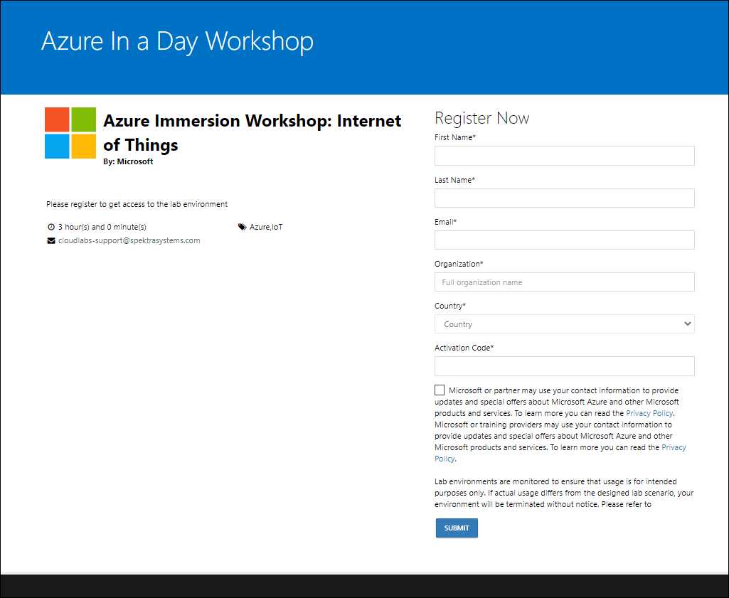
Azure Immersion Workshop
Event Day
Instructor share the bit.ly link and activation code during the session
DO NOT share the activation details prior to session
All attendees activate the lab instance using the same activation code
If you have change in the number of seats for lab, reach out to cloudlabs-support@spektasystems.com

Slide 6
Azure Immersion Workshop
Lab Activation Details
Instructor will share a bit.ly link and activation code during the event
Instructor share the details only when the labs are starting (not at the start of the day)
Attendee navigate to the bit.ly link and provide the required details
Its mandatory to give company email address and actual organization name
Once lab instance is assigned, details are also sent to attendee via email from noreply@cloudlabs.ai

Slide 7
Azure Immersion Workshop
Hands-on-Lab
Pre-created Environment
Azure IoT Hub
Azure Time Series Environment
Azure Stream Analytics
Simulated Devices on VM
Power BI Pro License
Storage Account
IoT Edge enabled Linux VM
Blob Storage
Logic App
Service Bus
Lab Instructions: Internet of Things - https://github.com/SpektraSystems/IoT-in-a-Day/tree/master/instructions

Slide 8
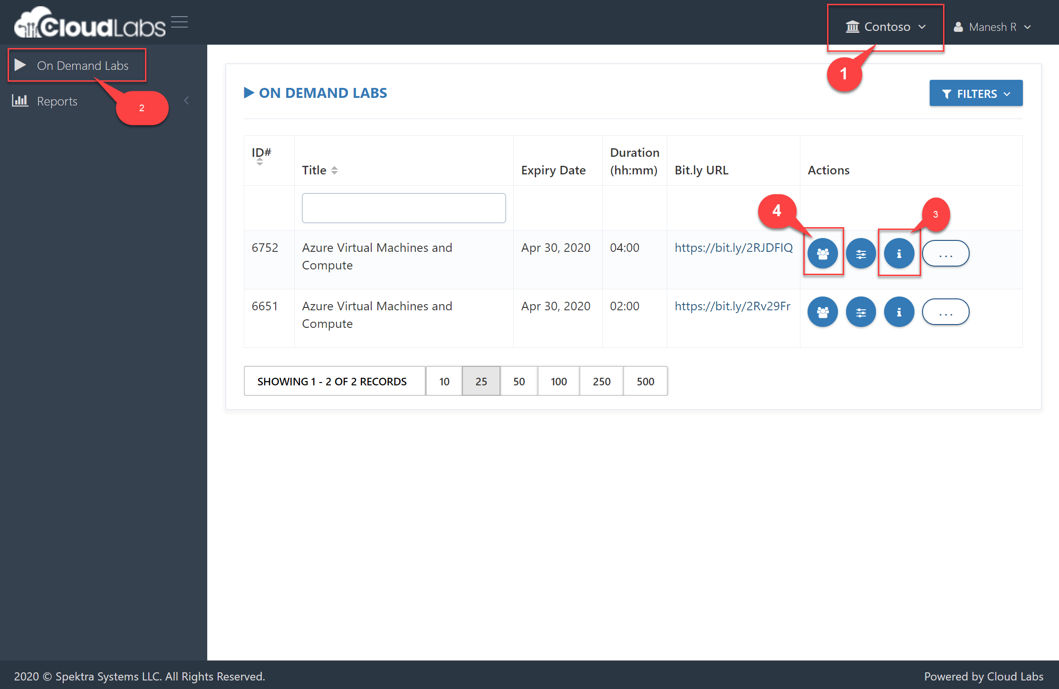
Spektra CloudLabs
Virtual Lab Experience for Instructors
1. Shadow with Instructor Credentials
Login to https://admin.cloudlabs.ai with your work account (alias@microsoft.com or alias@partner.com)
Upon login, on demand lab will be available for management.
Ensure to select the right CloudLabs tenant (Microsoft – In a Day)
Navigate to On Demand Labs
Your instructor credentials. With this credential you can access all the attendee’s azure environments.
List of lab users with their deployment id

Slide 9
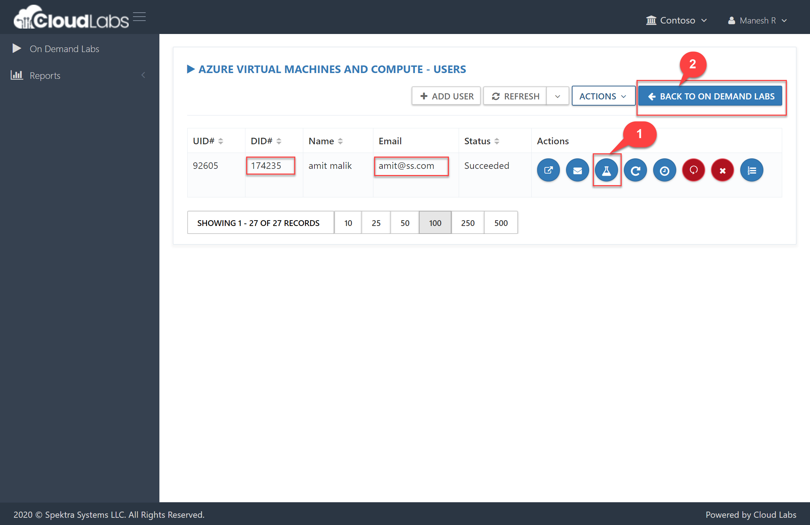
Spektra CloudLabs
Virtual Lab Experience for Instructors
2. Shadow with Attendee Credentials
Navigate to user's tab from actions
Check Deployment ID (DID) for each User (Email)
Deployment details for user (you can use azure credentials from this page to access attendee cloud environment)
Back to the Labs list page
You can manage attendees from this page
Add / Remove attendees
Each attendee is assigned a six-digit unique id to identify lab resource groups and jump VMs

Slide 10
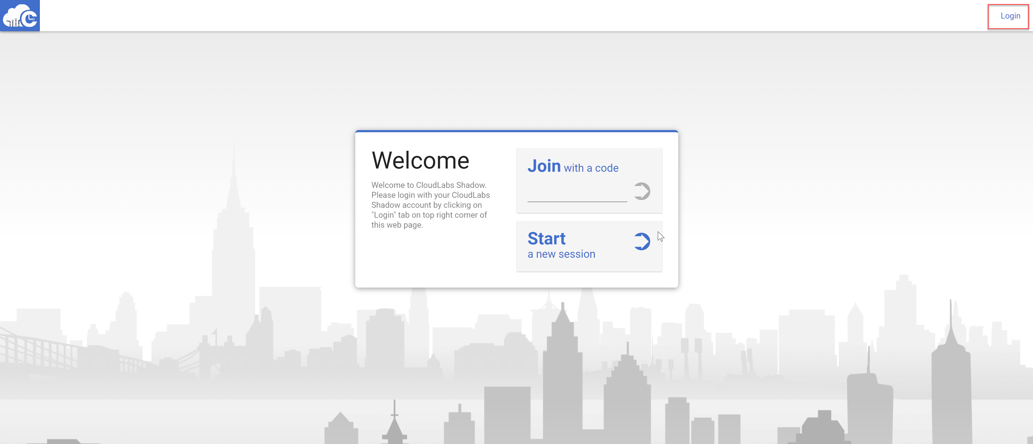
Spektra CloudLabs
Virtual Lab Experience for Instructors
3. Shadow Attendee Virtual Machine
Navigate to https://spektrasystems.screenconnect.com
Click on Login

Slide 11
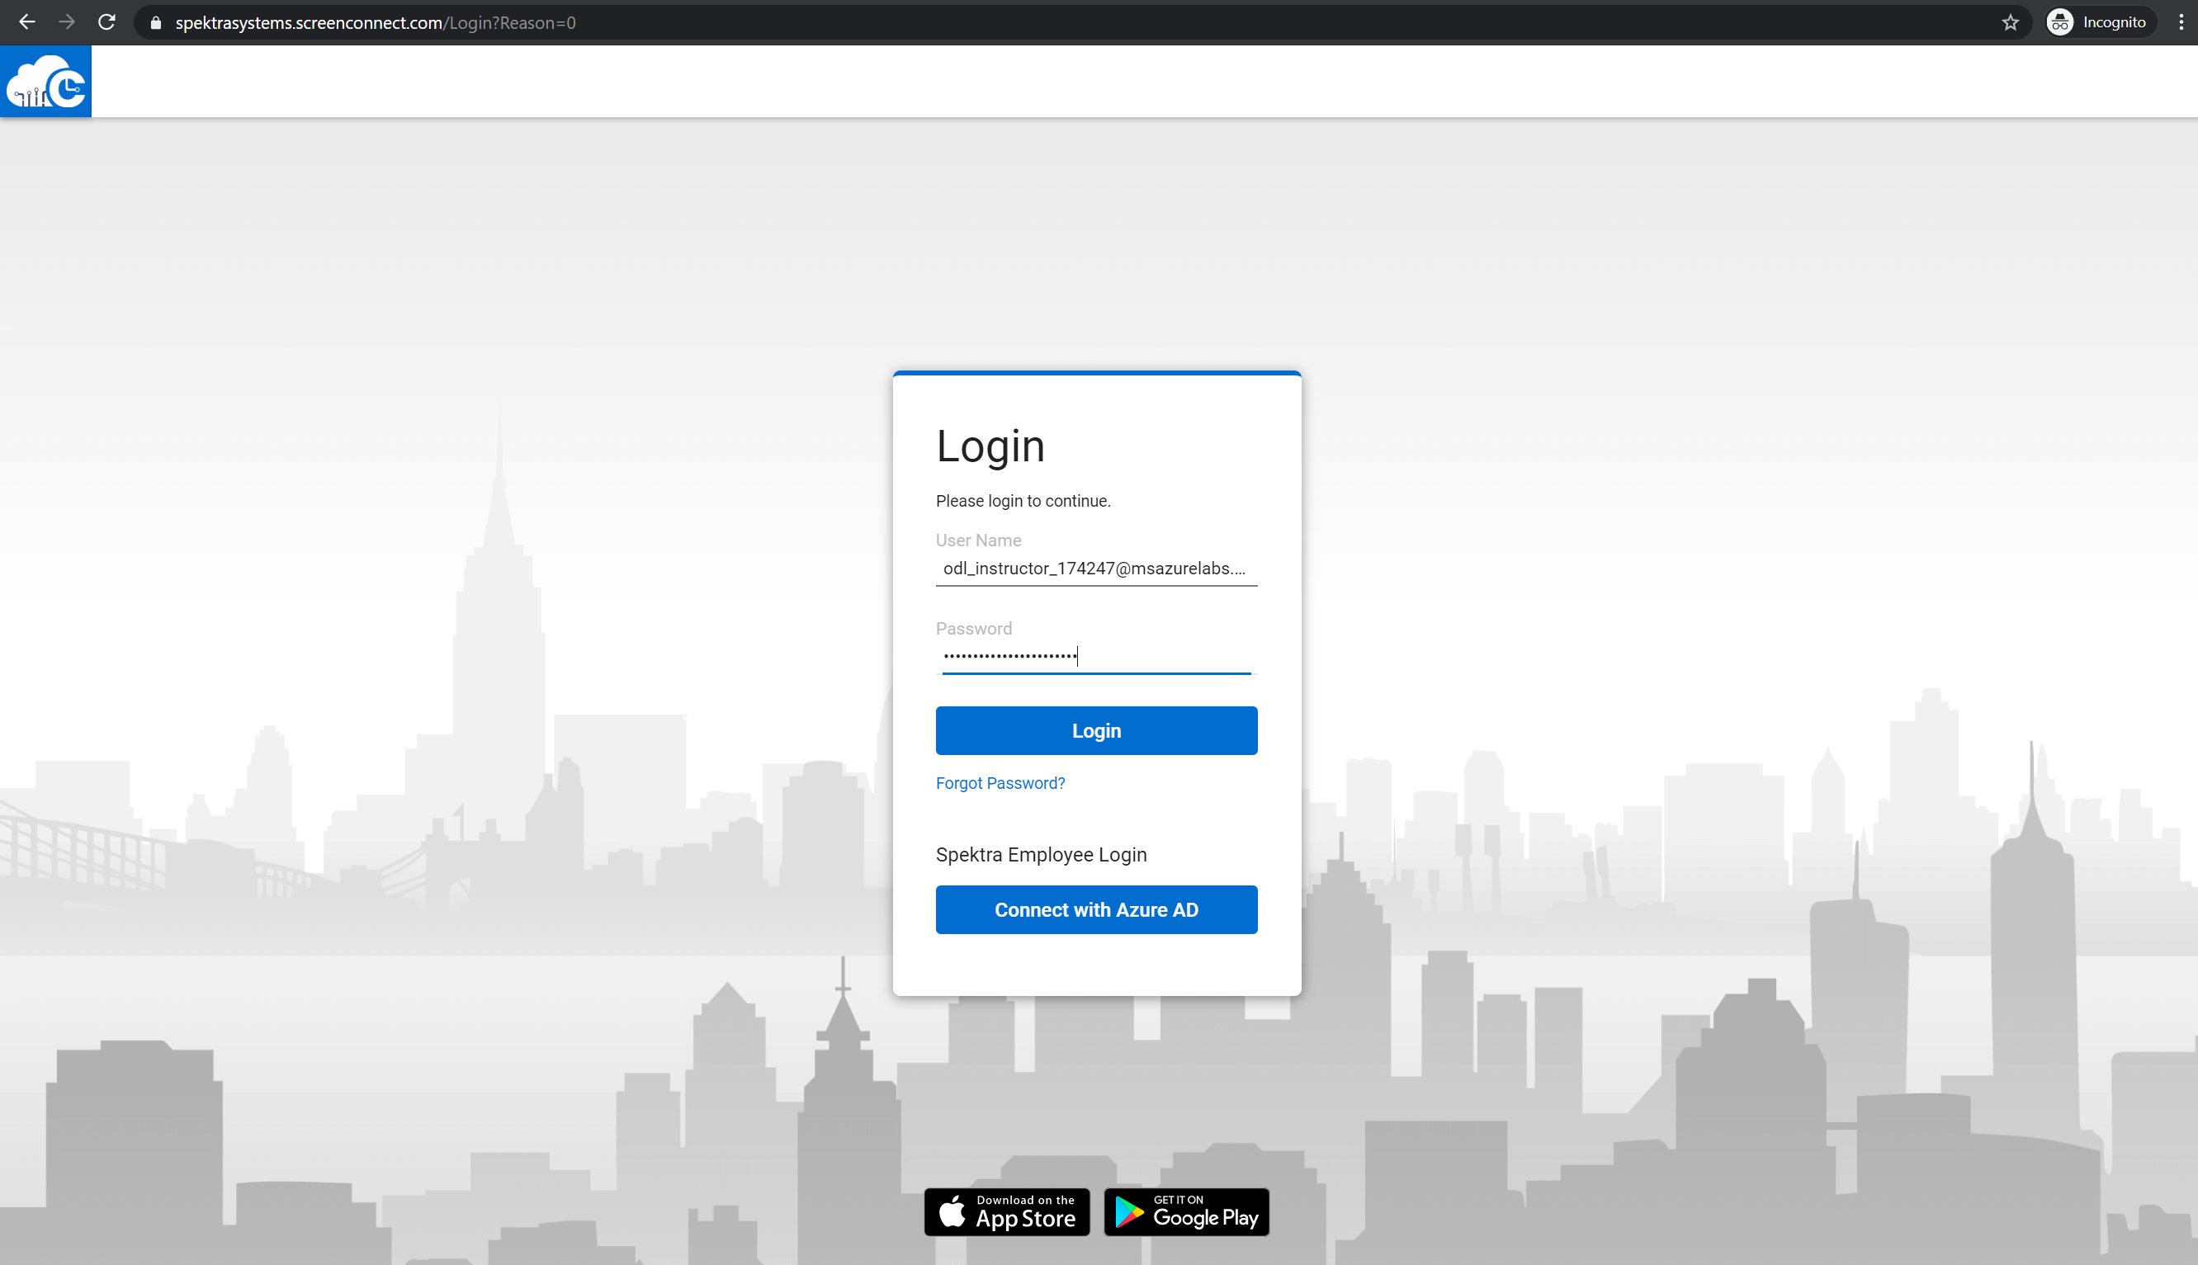
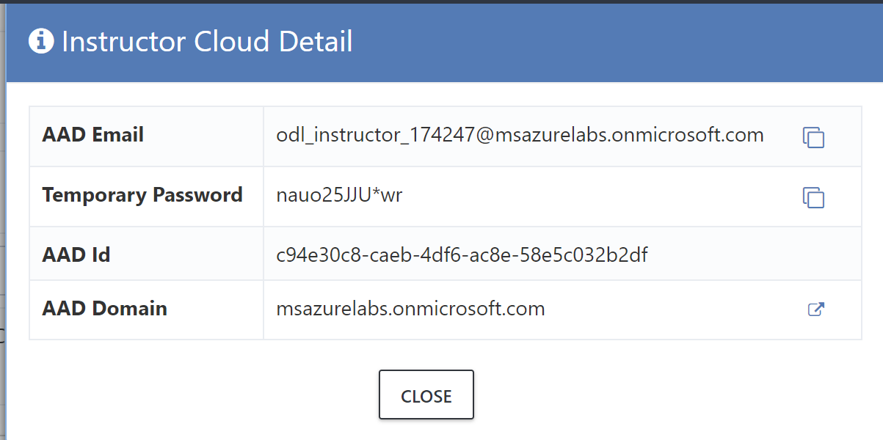
Spektra CloudLabs
Virtual Lab Experience for Instructors
3. Shadow Attendee Virtual Machine
Login with local account
DO NOT choose Azure AD
Use same username and password provided for Instructor Access

Slide 12
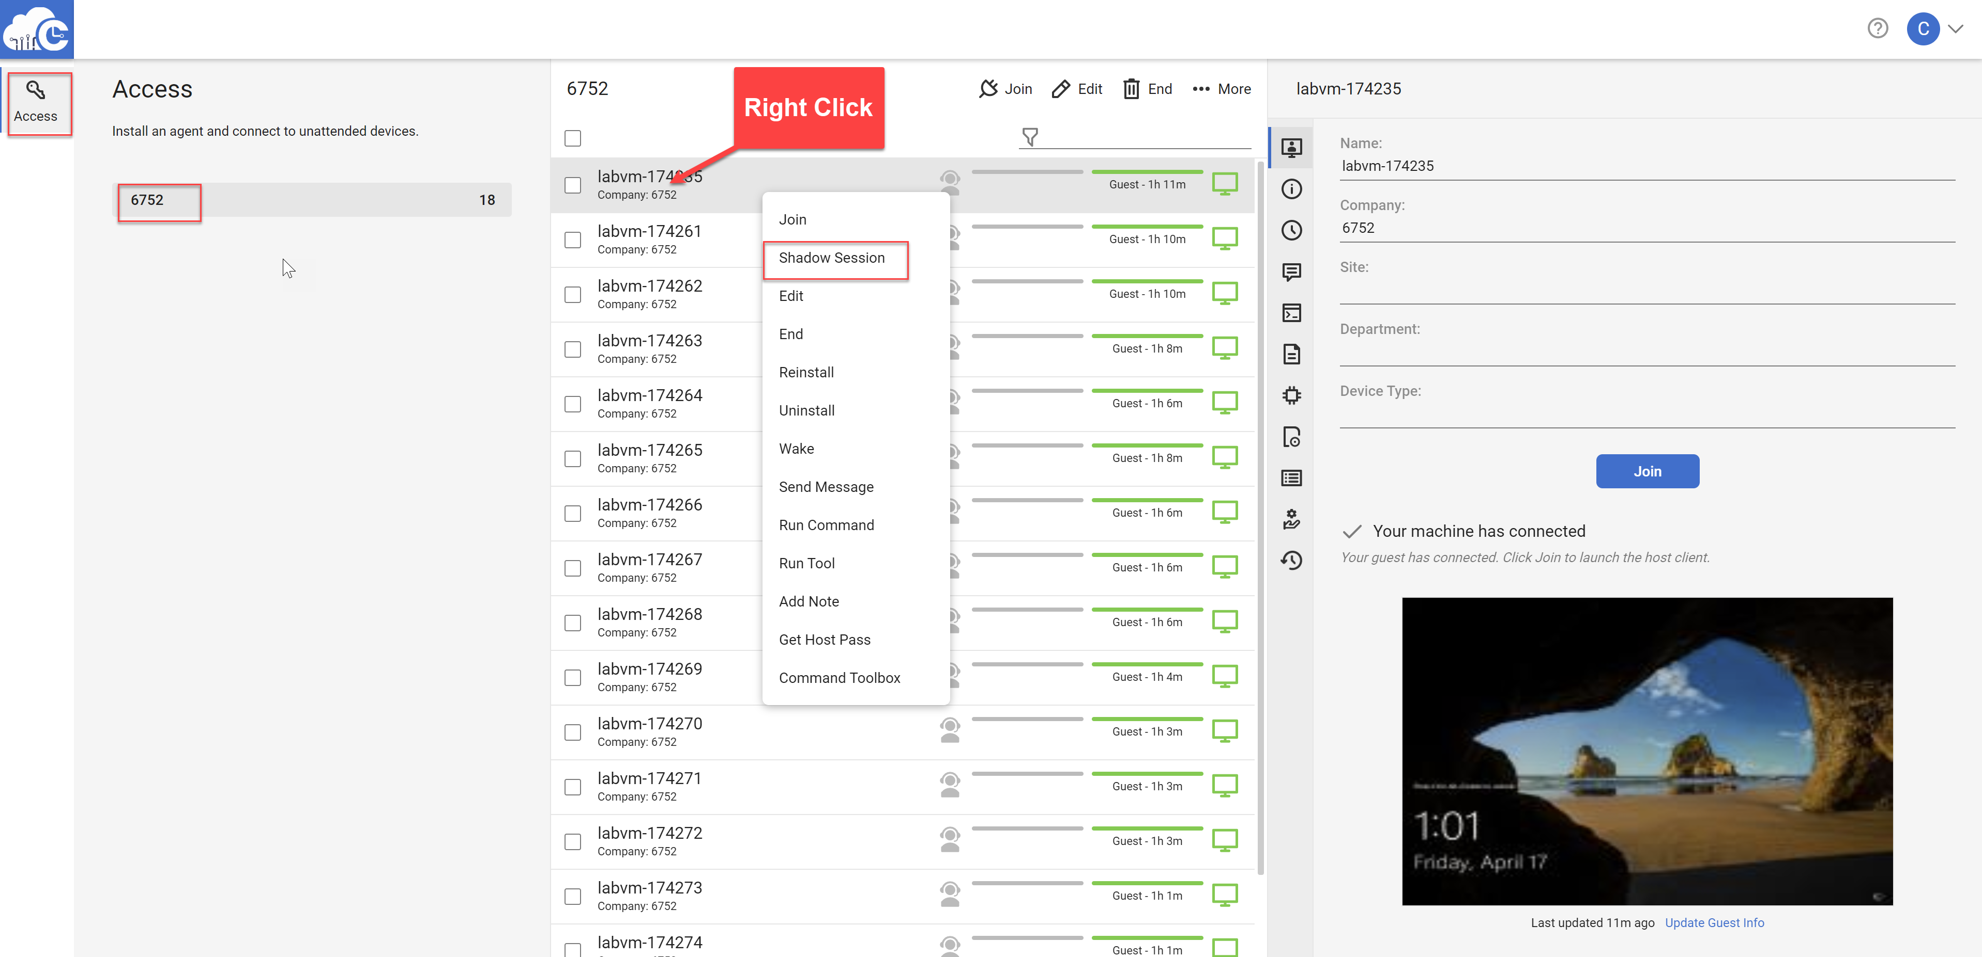
Spektra CloudLabs
Virtual Lab Experience for Instructors
3. Shadow Attendee Virtual Machine
Search for specific DID if needed
Right Click on Lab User VM (Identified by DID)
Select Shadow Session

Slide 13
Azure Immersion Workshop
Support
How can I reach out to Spektra CloudLabs support team?
Support Hours: 24x7
Email: cloudlabs-support@spektrasystems.com
MS Teams: http://bit.ly/cloudlabs-support

Slide 14
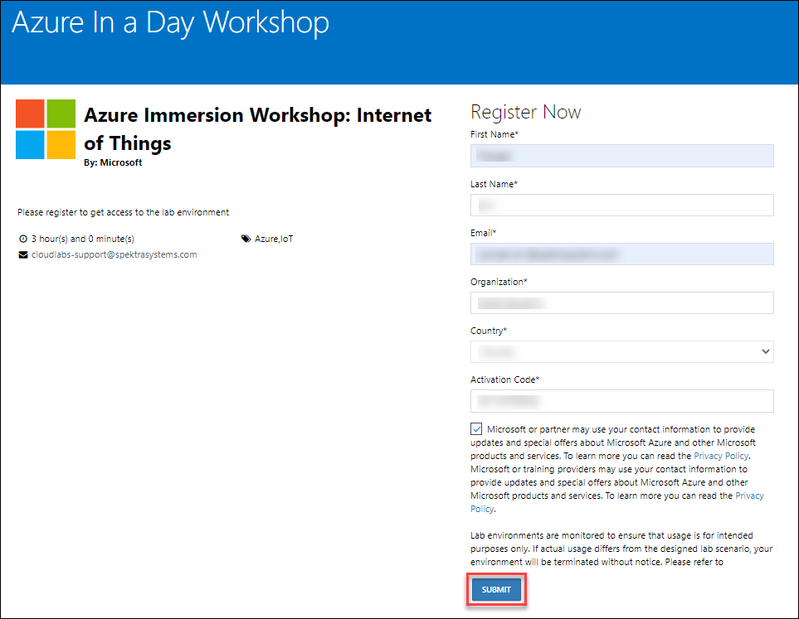
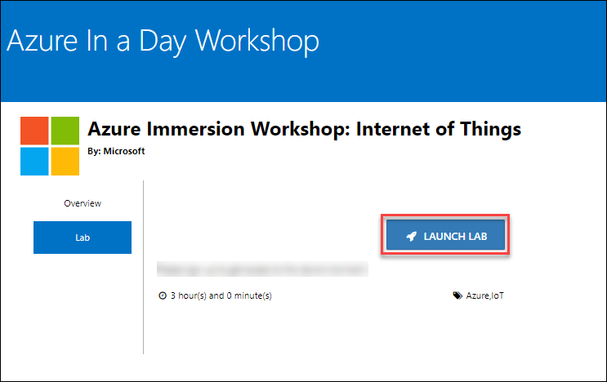
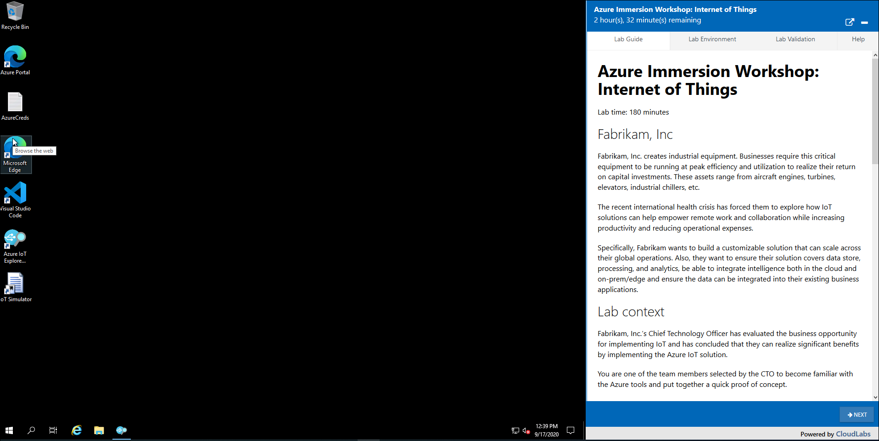
Azure Immersion Workshop
Hands-on-Lab
Lab Activation Details
Sign-up URL: https://bit.ly/2FPxKyw
Activation Code: ACTIVATE8638 Note: Once you click on Launch Lab, the environment provisioning will start and will take between 10 to 15 mins to complete

