Slide 1
01
Background

Slide 2
Alignment
Input:
reference、query
Process:
alignment tools(bowtie2、bwa、rfa、ema)
Output:
*.sam
*.bam
Binary type

Slide 3
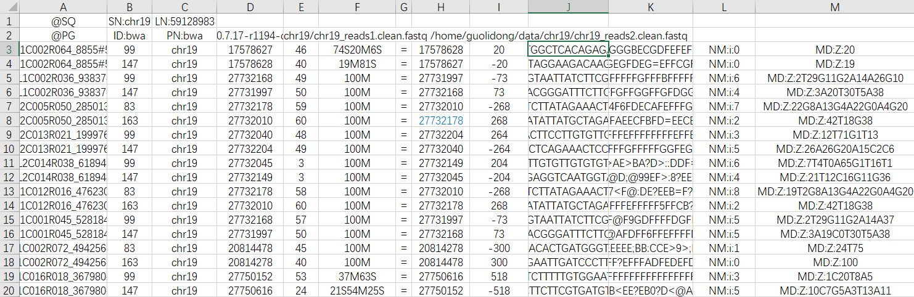
SAM File

Slide 4
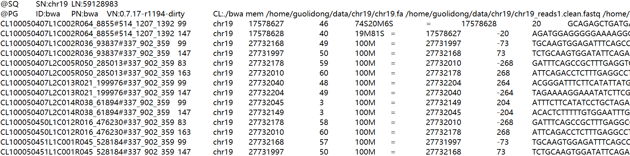
SAM File
SAM分为两部分:
注释信息（header section）, 可有可无，以@开头 @SQ，参考序列说明；@PG，使用的程序说明；
比对结果部分（alignment section）

Slide 5
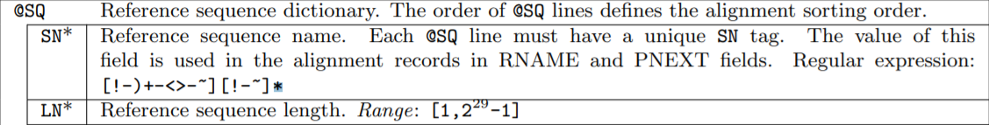
SAM File——Header Section
@SQ SN:chr19 LN:59128983
@PG ID:bwa PN:bwa VN:0.7.17-r1194-dirty
CL:./bwa mem /home/guolidong/data/chr19/chr19.fa /home/guolidong/data/chr19/chr19_reads1.clean.fastq /home/guolidong/data/chr19/chr19_reads2.clean.fastq

Slide 6
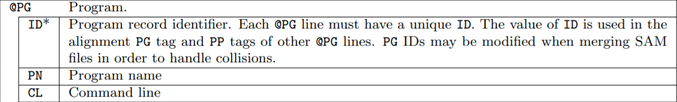
SAM File——Header Section
@SQ SN:chr19 LN:59128983
@PG ID:bwa PN:bwa VN:0.7.17-r1194-dirty
CL:./bwa mem /home/guolidong/data/chr19/chr19.fa /home/guolidong/data/chr19/chr19_reads1.clean.fastq /home/guolidong/data/chr19/chr19_reads2.clean.fastq

Slide 7
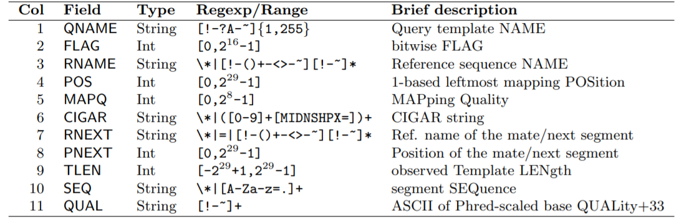
SAM File_Alignment Section_CIGAR
Q NAME | FLAG | RNAME | POS | MAPQ | CIGAR | R NEXT | P NEXT | TLEN | SEQ | QUAL | Optional fields
CL100… | 99 | chr19 | 17578627 | 46 | 74S20M6S | = | 17578628 | 20 | GCAG… | F>FG… | TAG:TYPE:VALUE
M：match
I： insert
D：deletion
N：skipped
S：soft clipping
H：hard clipping

Slide 8
SAM File_Alignment Section_FLAG
Q NAME | FLAG | RNAME | POS | MAPQ | CIGAR | R NEXT | P NEXT | TLEN | SEQ | QUAL | Optional fields
CL100… | 99 | chr19 | 17578627 | 46 | 74S20M6S | = | 17578628 | 20 | GCAG… | F>FG… | TAG:TYPE:VALUE
1：采用PE双端测序
2：序列和参考序列完全匹配，没有插入缺失
4：序列没有mapping到参考序列上
8：序列的另一端序列没有比对到参考序列上
16：序列比对到参考序列的负链上
32：序列对应的另一端序列比对到参考序列的负链上
64： 序列是R1端序列，read1
128: 序列是R2端序列，read2
256：序列不是主要的比对
512：序列在QC时失败了
1024: 序列是PCR重复序列
2048: 序列是补充的比对
99=64+32+2+1
read1
另一端比对到负链
完全匹配
双端测序

Slide 9
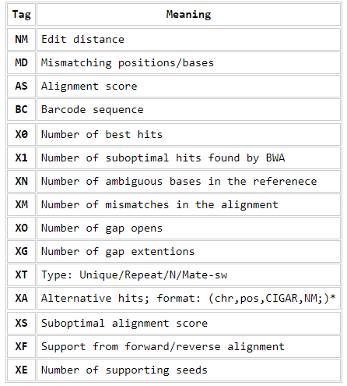
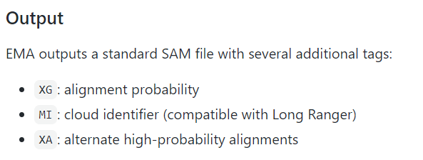
SAM File_Alignment Section_TAG
BWA
EMA

Slide 10
Chimeric read
An alignment of a read that cannot be represented as a linear alignment. Typically, one of the linear alignments in a chimeric alignment is considered the “representative” alignment, and the others are called “supplementary” and are distinguished by the supplementary alignment flag.
Chimeric reads are indicative of structural variation in DNA-seq and it may indicate the presence of chimeric genes.
In short, chimeric reads can be split in to two or more parts, each part would be mapped to reference(it’s not hard-clipped), the total length of the mapped part is longger than read length.

Slide 11
TAG:XA
BWA
SA:Other canonical alignments in a chimeric alignment
XA:alternate high-probability alignments
XA
ref
EMA
XG:alignment probability
MI:cloud identifier
XA:alternate high-probability alignments
√
XA
read:
XA的那条比对结果
一般不会出现在sam文件中
在bwa中可以通过-a将其输出
带有256的flag

Slide 12
TAG:SA
Chimeric reads are indicative of structural variation
In short, chimeric reads can be split in to two or more parts, each part would be mapped to reference(it’s not hard-clipped), the total length of the mapped part is longger than read length.
SA
ref
rep
sup
Chimeric read:
SA的那条比对结果
会在sam文件中出现
带有2048的flag

Slide 13
Nounce Explaination
Experiment
Alignment
ref
long fragment
well₀
sort
estimate
well₁
read
Read cloud
Read cloud
Read cloud
well₂

Slide 14
03
EMA

Slide 15
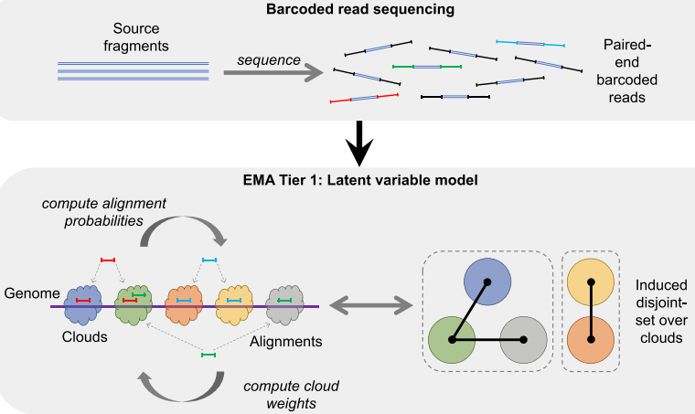
EMA Pipeline
reads聚类 Reads间距相近、相同barcode 构成candidate cloud
Cloud连接 如果一个read 可以比对到多个cloud中 则将两个cloud连接（joint）

Slide 16
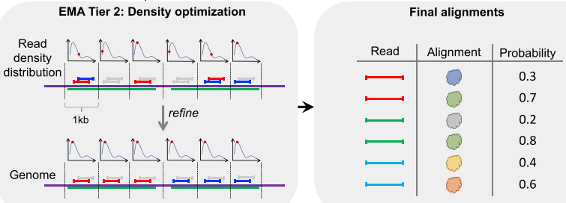
EMA Pipeline
根据read密度优化算法 决定最优匹配
并计算多比对read 分别的比对概率
总结：用cloud模拟LFR，计算多比对read比对到对应cloud可能性，选出最优

Slide 17
Pipline
stLFRread1.fastq
stLFRread2.fastq
reference.fasta
Input
stLFR
data
stLFR_to_ema
interleaved
data
ema
result
Process
interleaved.fastq
whitelist.txt
result.log
Output
ema_final.sam
*.log

Slide 18
EMA Software Pipline
interleaved.fastq
whitelist.txt
Input
EMA
count
EMA
preproc
EMA
align
sambamba
Process
*.fcnt
*.ncnt
ema_preproc
ema-000-bin
Output
ema-000-bin.bam
ema_final.bam

Slide 19
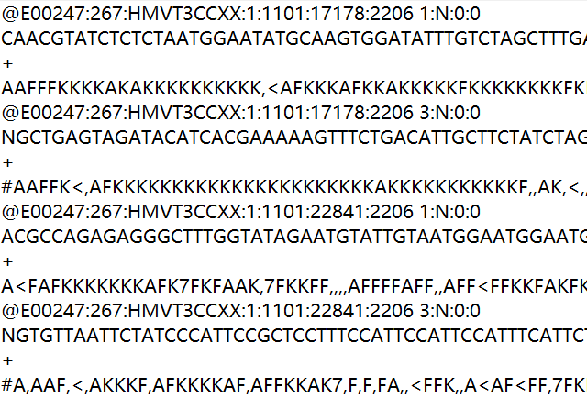
EMA——raw data
Input
Interleaved
ID Split(‘\space’)
1:N:0:0 3:N:0:0
Same barcode
Same well
whitelist

Slide 20
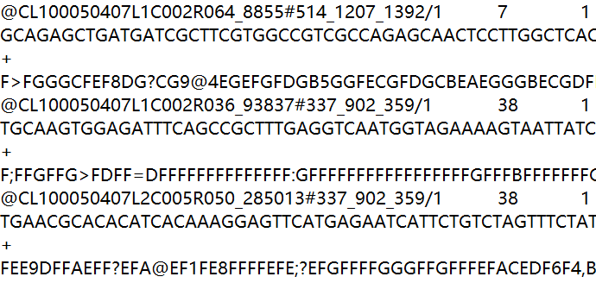
stLFR——clean data
Input
separated
ID Split(‘\t’)
/1 /2
same# same well
No barcode

Slide 21
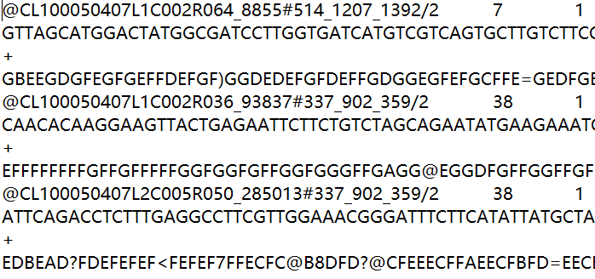
stLFR——clean data
Input
separated
ID Split(‘\t’)
/1 /2
same# same well
No barcode

Slide 22
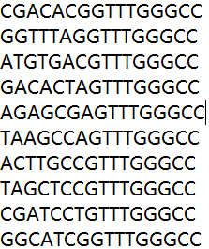
EMA——whitelist
Whitelist:16bp barcode
10x data:
151bp Read1= 128 read + 16 barcode + 7 addition
151bp Read2= 151 read
stLFR data:
100bp Read1= 100 read
100bp Read2= 100 read
stLFR_to_ema data:
123bp Read1= 100 read + 16 barcode + 7 addition
100bp Read2= 100 read

Slide 23
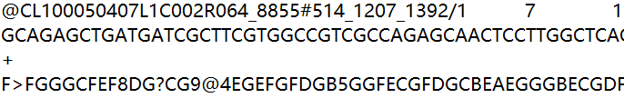
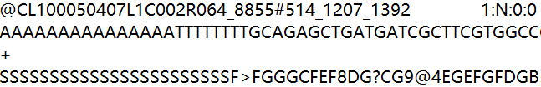
stLFR_to_EMA
Input: stLFR clean data
Process: 交叉、改ID、加16bp barcode、加7bp addition
Output: interleaved data
whitelist
AAAAAAAAAAAAAAAT

Slide 24
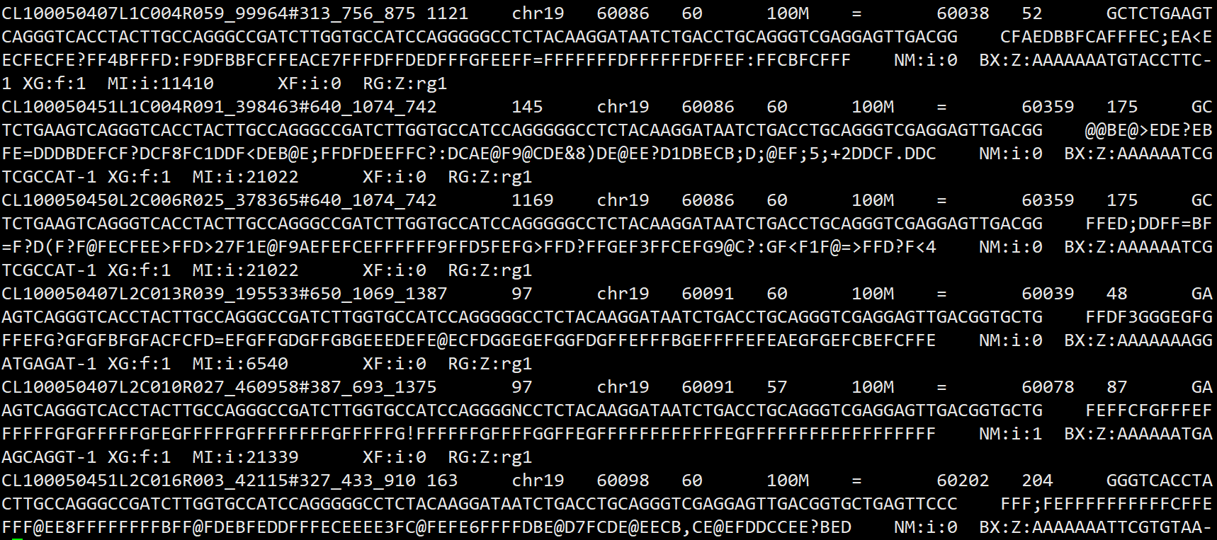
EMA_result

Slide 25
04
Result and Discussion

Slide 26
Using new tools
paper
original
sample data
test
user
sample data test
user
data
test
software
data
sample data
sample featured data
data feature
user data
featured data
figure out
workflow
test
compatibility
get
result

Slide 27
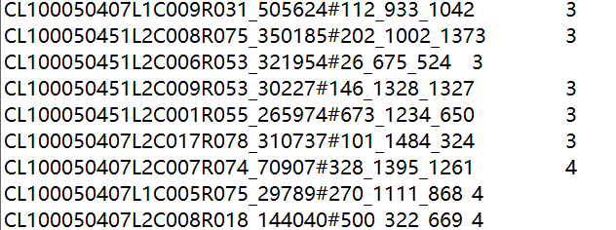
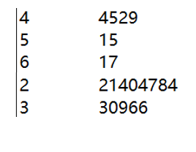

BWA_multi_alignment
Command:
awk '{sum[$1]+=1}END{for(i in sum)
if(sum[i]>4)
print i"\t"sum[i]}' bwa-mem-aln-pe.sam | tee bwa.mul
Command:
awk ‘{sum[$2]+=1}END{for(i in sum) print i“\t”sum[i]}’ bwa.mul | tee mulcount.txt
bwa
ema
ID
频次
频次
次数
频次
次数
统计每种频次出现的次数
频次为2最多，即sam中只含read1和read2
频次>2说明read1或read2含有补充比对（SA）
统计每种read ID在BWA.sam中出现的频次
可以通过添加红色部分筛选出现的频次

Slide 28
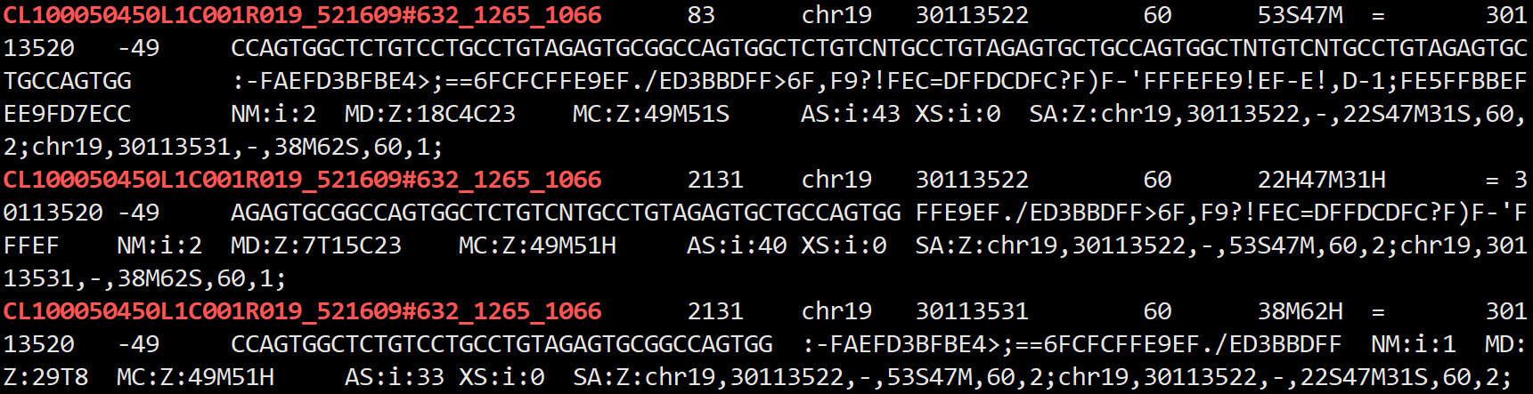
BWA_multi_alignment
Command: grep -C 2 'CL100050450L1C001R019_521609#632_1265_1066' --color bwa-mem-aln-pe.sam

Slide 29
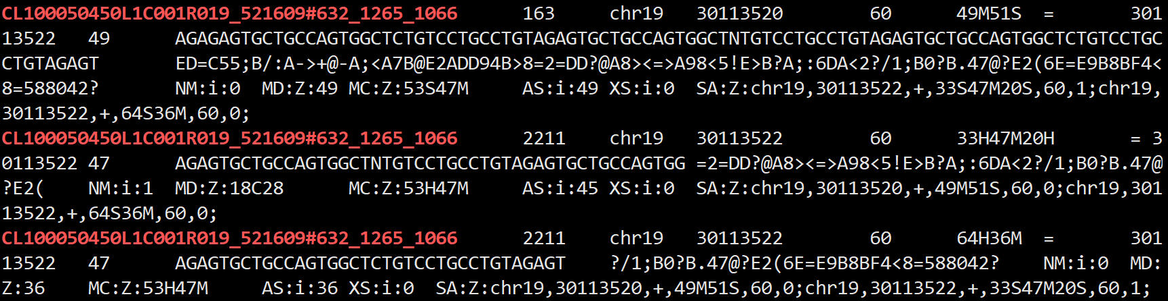
BWA_multi_alignment
Command: grep -C 2 'CL100050450L1C001R019_521609#632_1265_1066' --color bwa-mem-aln-pe.sam

Slide 30
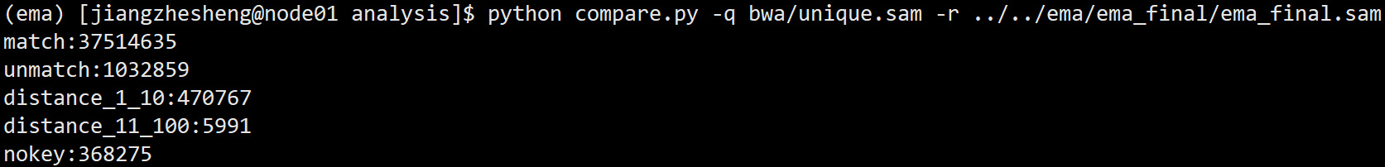
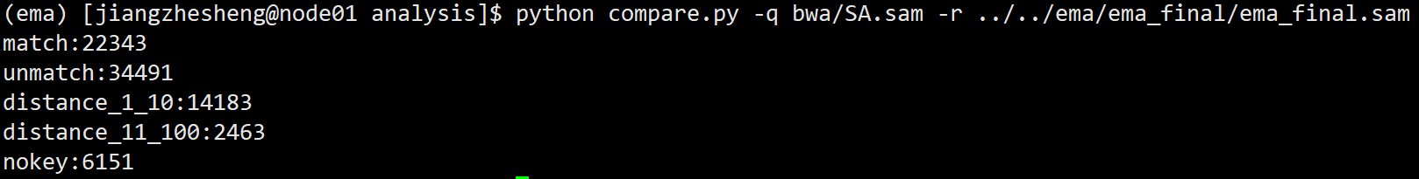
Analysis
Match: bwa与ema比对位置相同
Unmatch:distance_1_10:比对位置相差1到10
distance_11_100:比对位置相差11到100
Nokey:ema中没有此readID
在bwa和ema产生的sam文件中
提取相同read ID
根据比对位置进行分析

Slide 31
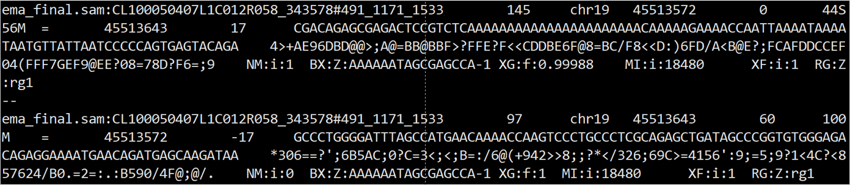
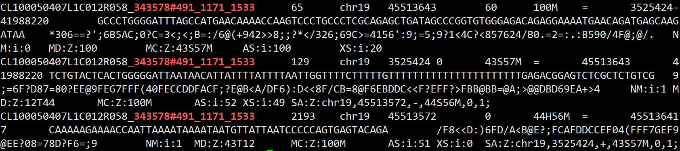
EMA
Analysis
BWA
Notes:
Bwa中对于read2有两条比对，ema选取了supplyment alignment作为主比对，并计算了比对概率，XG：f：0.99988

Slide 32
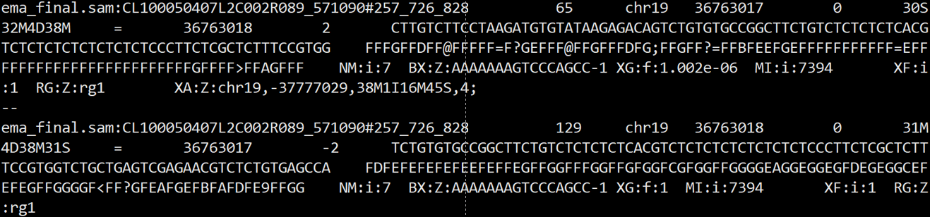
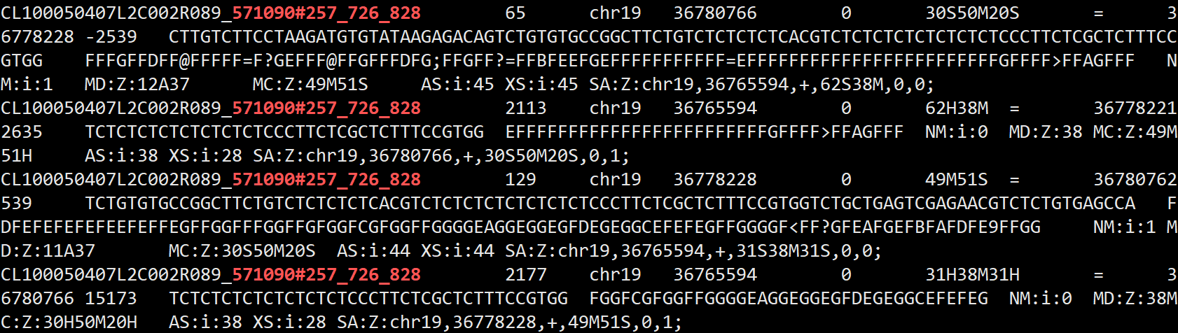
Notes:
Ema重新选取位置

