Slide 1
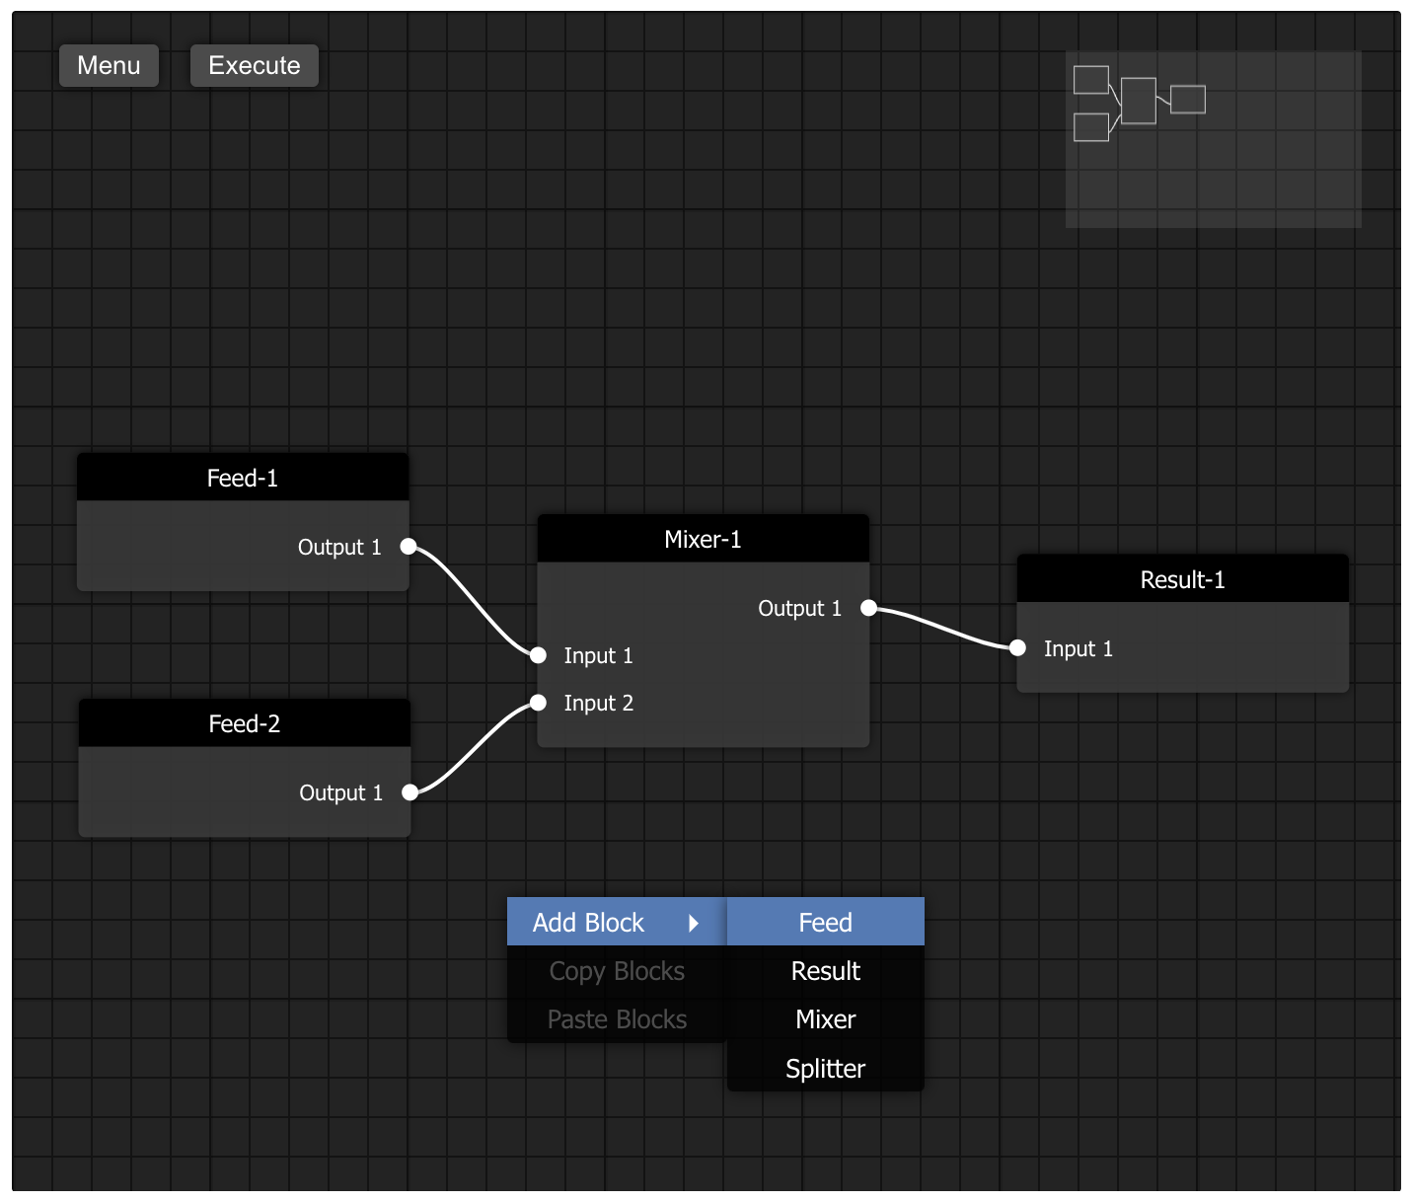
Editor
In-widget menu
Schema
Block
Input interface
Output interface
Connection
Blocks built from base Block: Feed
Right-click
context menu
Base blocks

