Slide 1
Dungeon RPG: Turn-Based Adventure Game
CE101 Object-Oriented Programming Project — Group S
A modular turn-based dungeon RPG designed using object-oriented programming principles across combat, map, inventory, magic, skills, loot, store, and save/load systems.
Abdul Aziz
Muharib Abdullah
M. Ameer Suhail
Map & Game State
Combat & Entities
Magic System
Ahmad Siddique
M. Asad Rauf
Items & Equipment
Skills & Loot

Slide 2

Problem Statement
A turn-based RPG requires several interconnected systems working in concert. Designing these in a procedural style would result in tightly coupled, unmaintainable code. The core challenge was to architect each subsystem as a focused, modular OOP component.
World & Navigation
Combat & Entities
Items & Economy
Dungeon map generation and distinct room types
Player and enemy turn-based battle logic
Weapons, armour, potions, store interaction, and loot rewards
Magic & Skills
Persistence
Spells, status effects, skill abilities, and stat modifiers
Save and load functionality via a common serialisable contract
Core design goal: each class carries a single, clear responsibility — eliminating mixed logic and enabling independent testing, debugging, and extension.

Slide 3
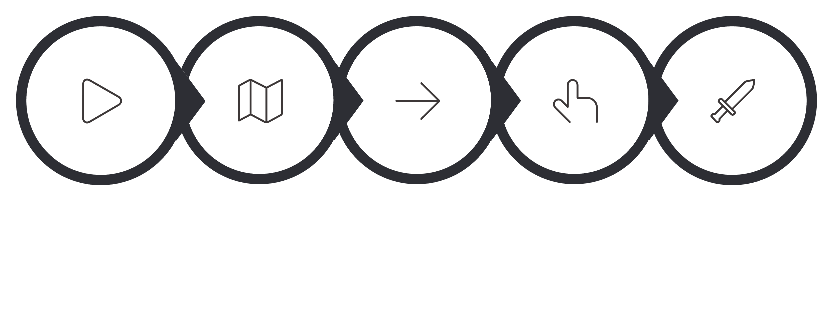


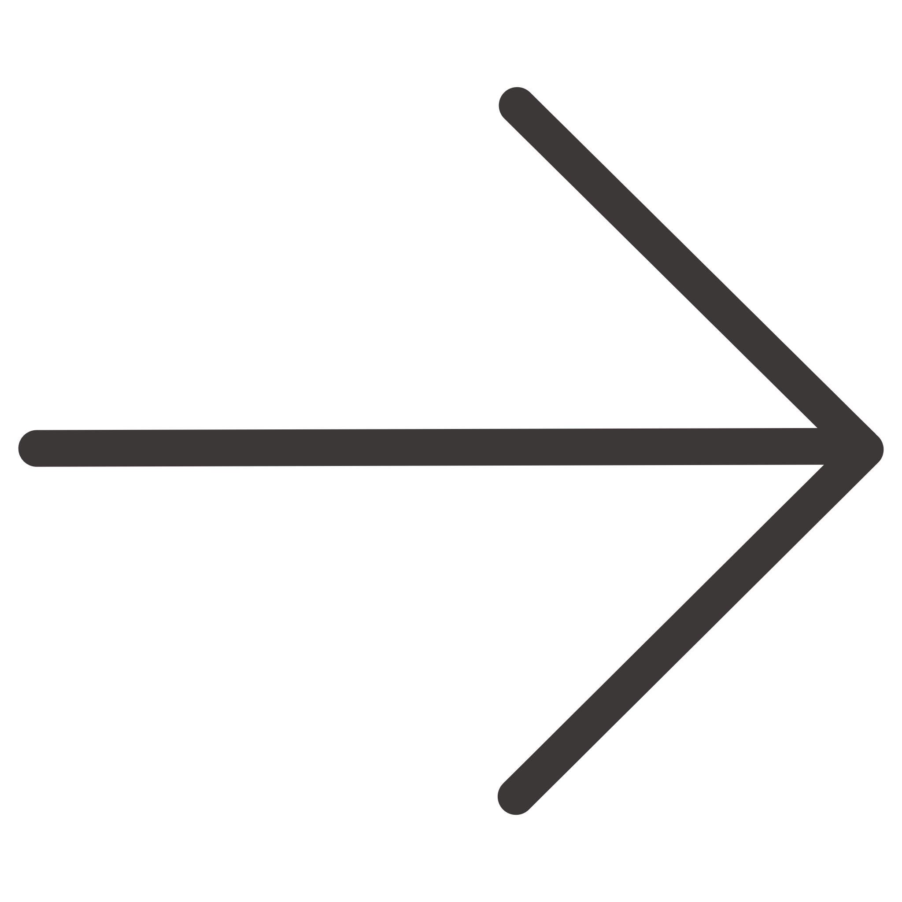


Project Overview and Gameplay Flow
The player explores a procedurally generated dungeon, moves through distinct room types, engages enemies in turn-based combat, collects loot, manages an inventory, casts spells, unlocks skills, visits stores, and progresses toward a boss encounter.
Generate Map
Room Interaction
Start
Move Rooms
Enter Battle

Slide 4
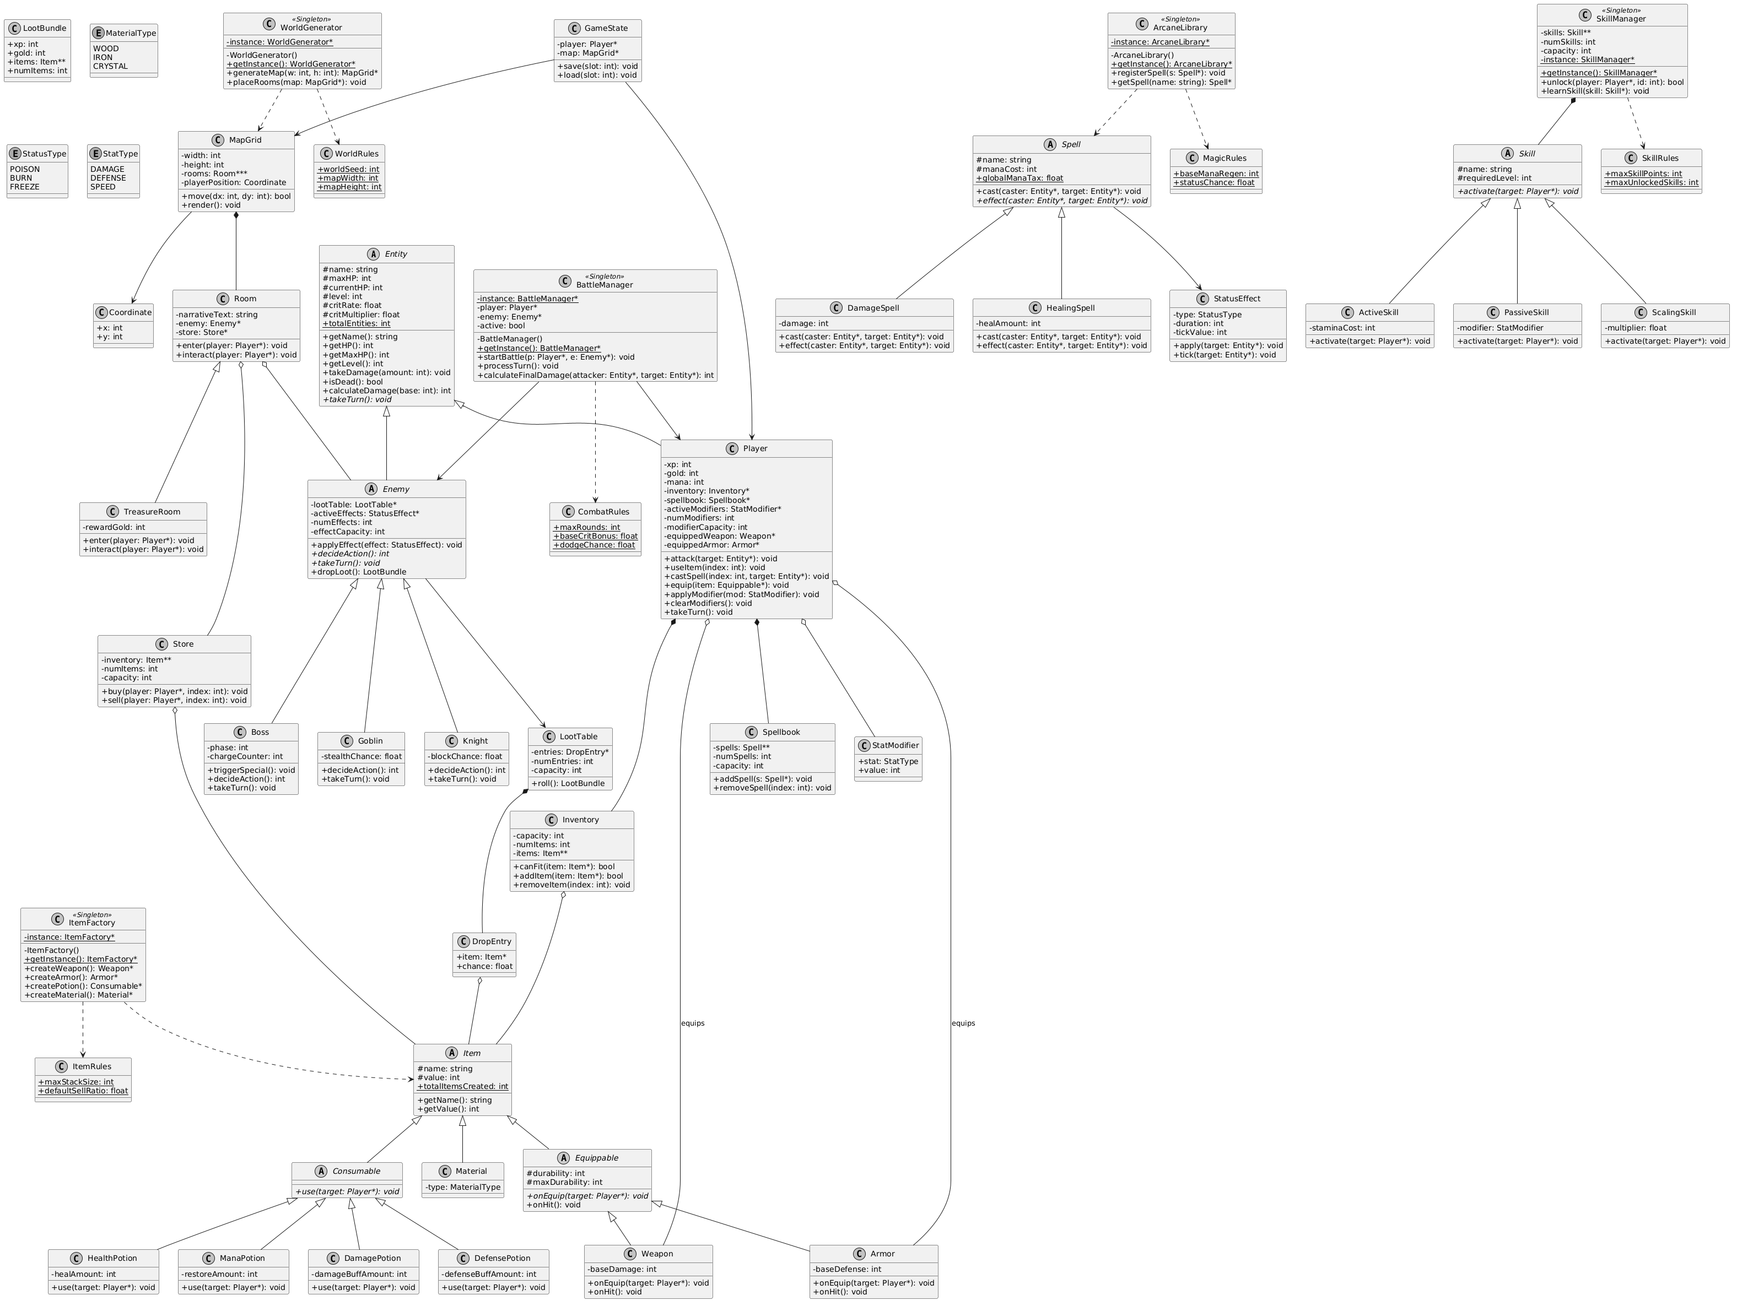
Overall UML — System Architecture

Slide 5
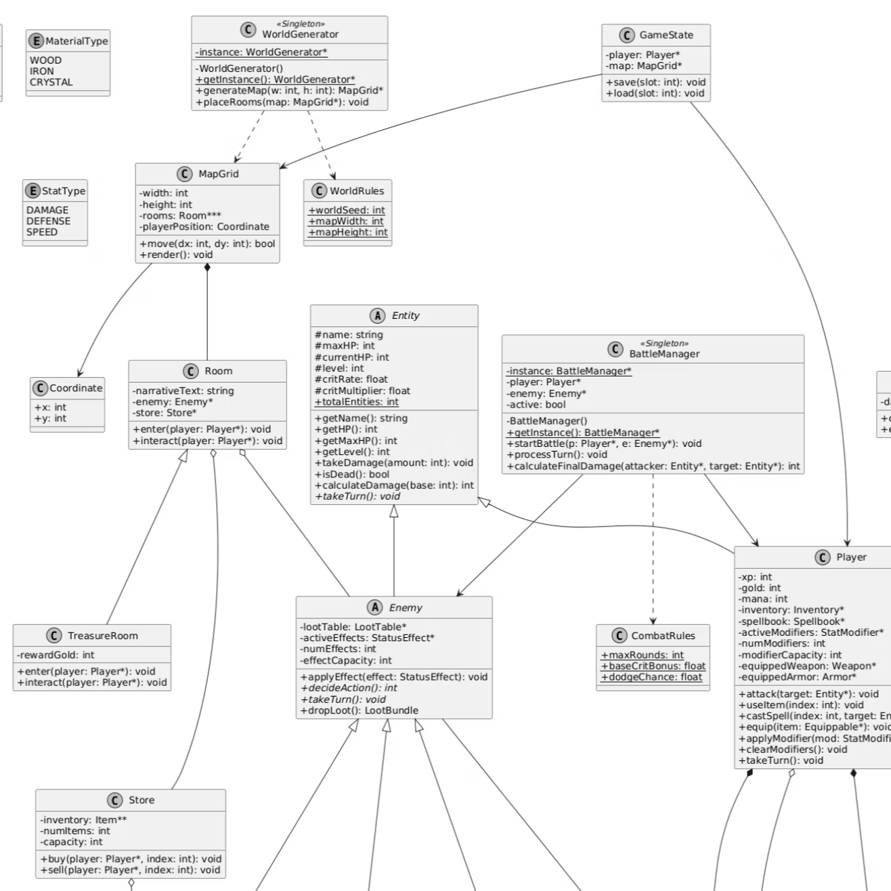
Map, Rooms, and Game State
WorldGenerator
MapGrid + Coordinate
Singleton — generates the dungeon layout once per session.
Stores Room objects; tracks player x/y position.
Room Hierarchy
Inventory & Store
Room (base) → EmptyRoom / CombatRoom / SaveRoom
Inventory manages item capacity; Store handles transactions.
GameState
Serializable
Aggregates Player and MapGrid for unified persistence.
contract enabling save/load behaviour.

Slide 6
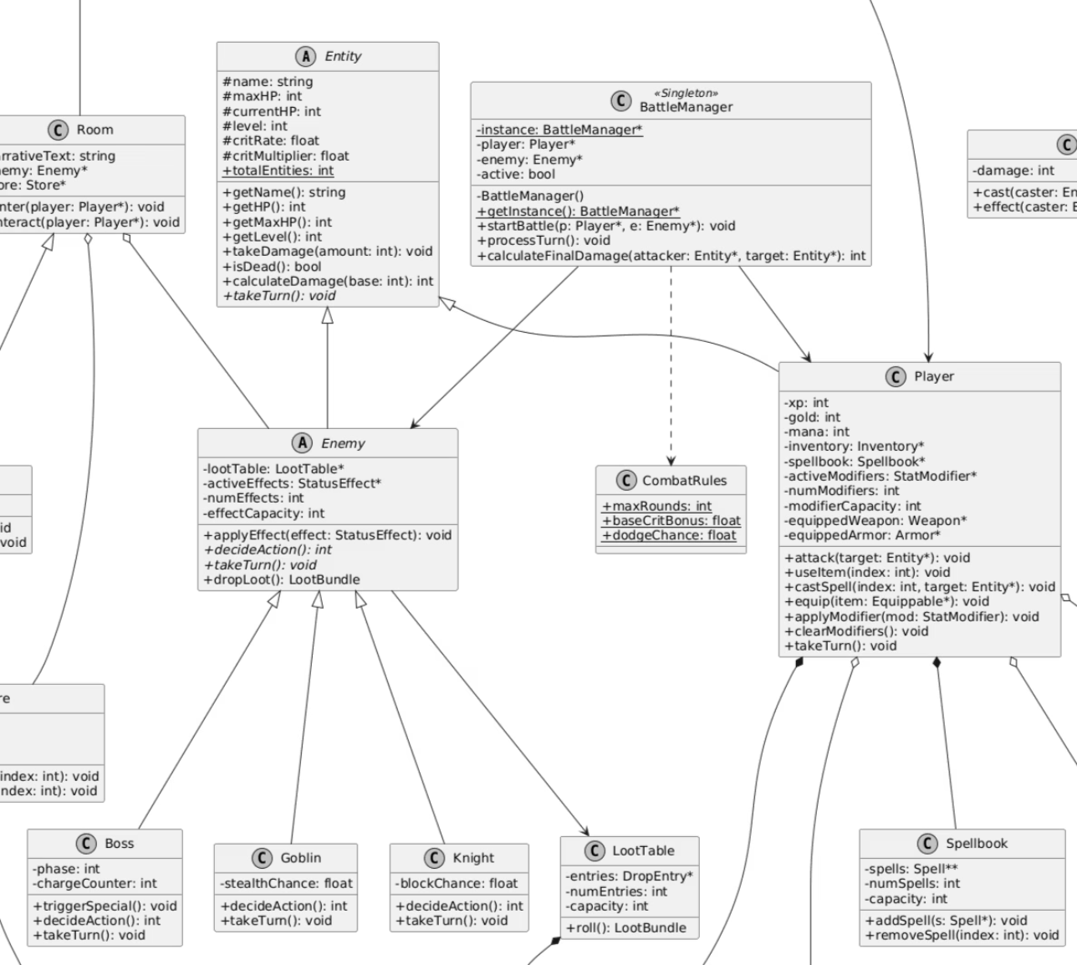

Combat System and Entity Hierarchy
1
Entity (Abstract)
Shared combat data: name, HP, level, critical rate, and damage calculation.
2
Player
Extends Entity; performs attack, use item, cast spell, equip item, apply modifier.
3
Enemy (Abstract)
Extends Entity; each subclass implements its own decideAction().
4
Boss / Goblin / Knight
Concrete enemy types with distinct behaviour and stat profiles.
5
BattleManager (Singleton)
Processes turns and calculates final damage. One instance per active battle.
CombatRules separates balancing constants from battle execution logic, keeping BattleManager clean and configurable.

Slide 7
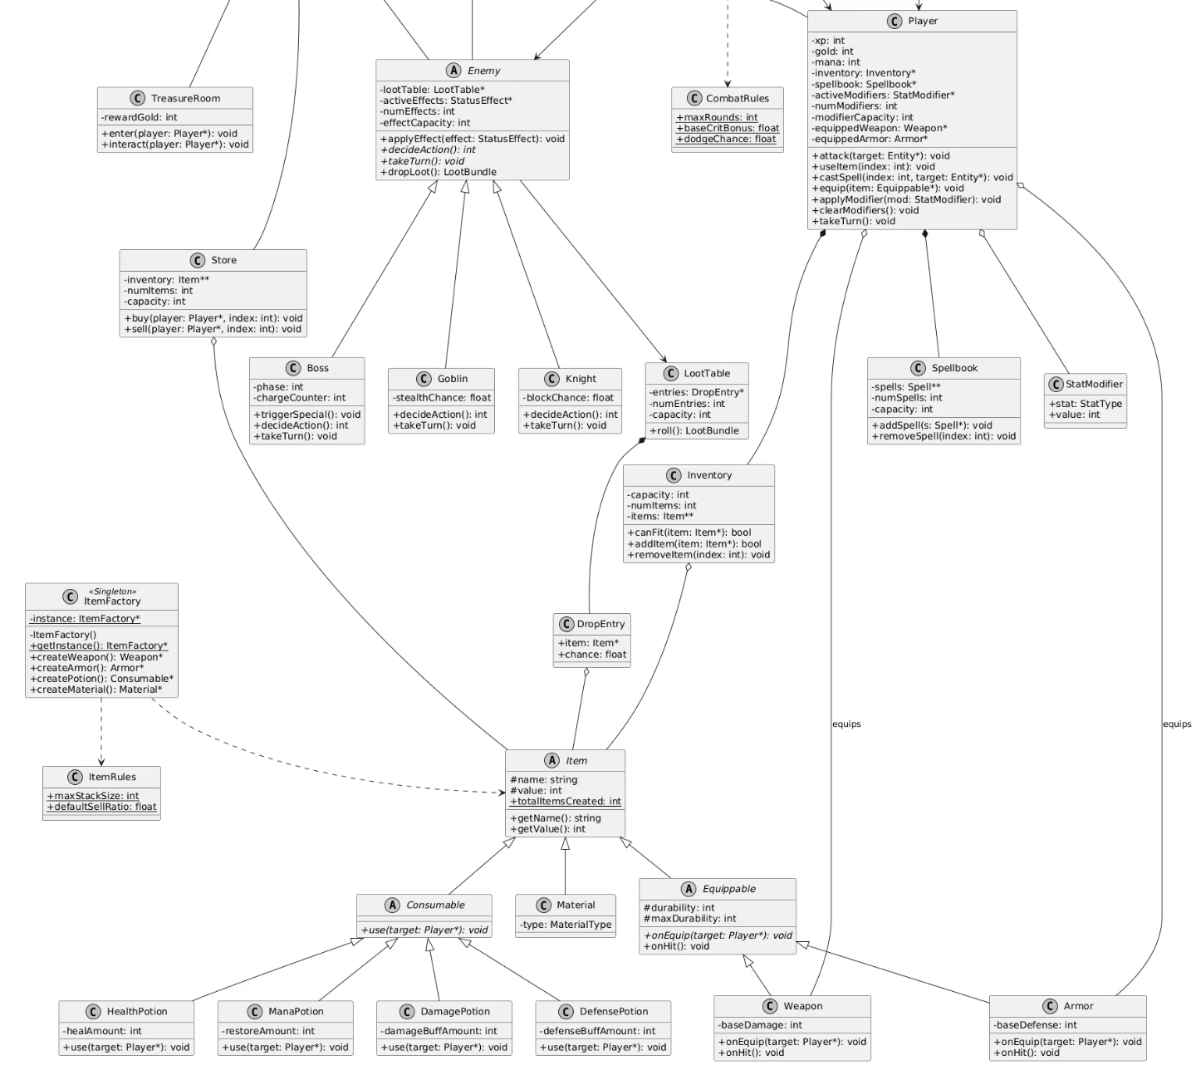
Items, Inventory, Store, and Loot
Branch
Classes
Consumable
HealthPotion, ManaPotion, DamagePotion, DefensePotion
Weapon
Sword, Axe, Dagger
Armor
Chainmail, PlateArmor
Material
Raw crafting or drop items
Factory
ItemFactory centralises all object creation
Loot
LootTable → DropEntry (probability) → LootBundle (XP, gold, items)
Inventory and Store interact with Item polymorphically — no type-specific branching required in transaction logic.

Slide 8
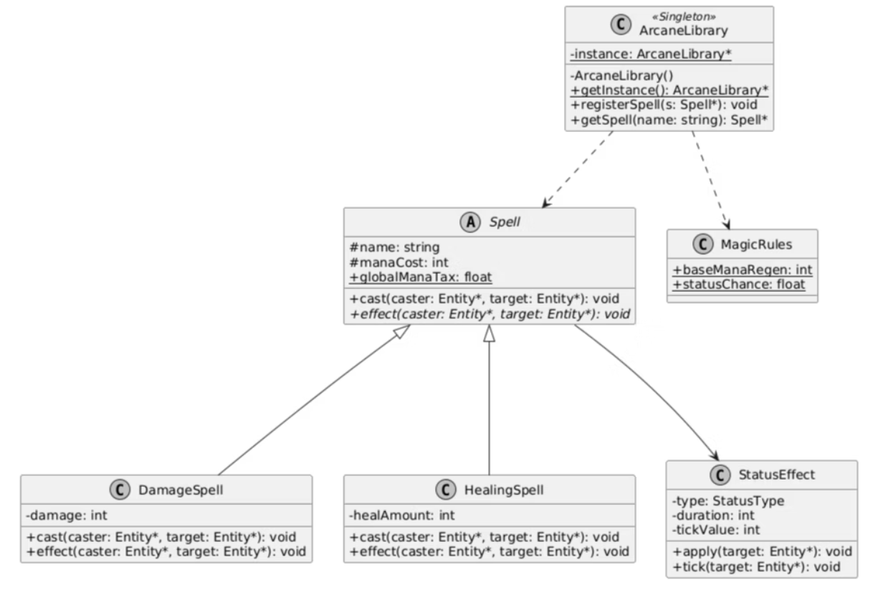

Magic System
Spell (Abstract)
DamageSpell
Shared fields: name, mana cost. Subclasses override effect().
Applies offensive damage on cast; overrides effect behaviour.
HealingSpell
StatusEffect
Restores player HP on cast; demonstrates polymorphism via same cast interface.
Applies conditions: poison, burn, freeze. Attached by a Spell on target.
Spellbook
ArcaneLibrary (Singleton)
Stores spells learned by the Player.
Central spell registry — retrieves and registers Spell objects.
MagicRules stores mana regeneration rates and status-effect probability constants, keeping Spell subclasses free of hard-coded balancing values.

Slide 9

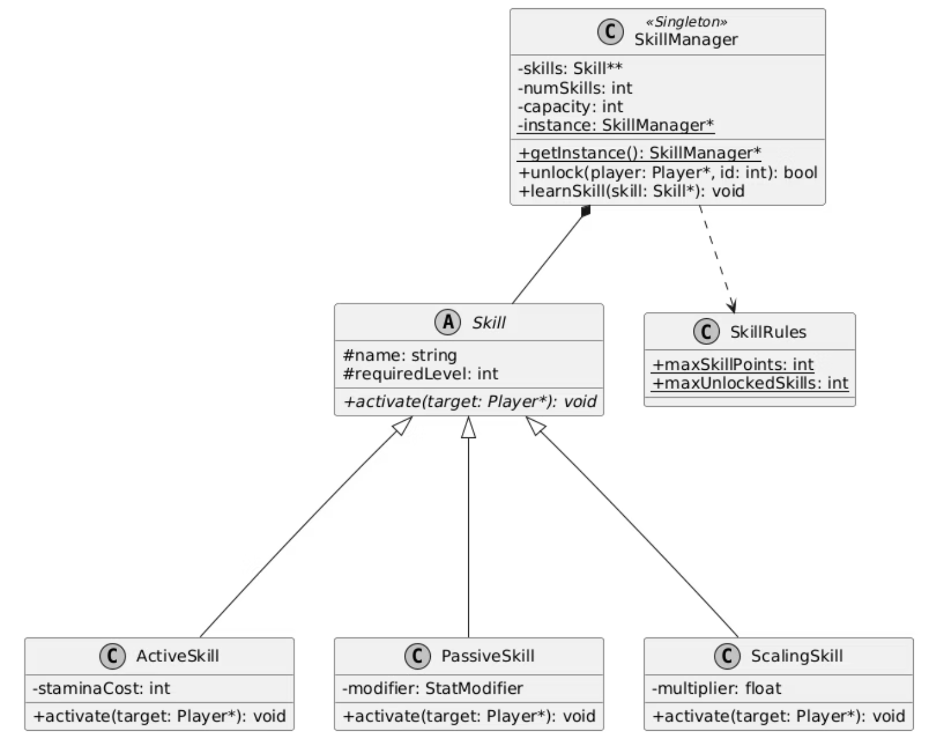
Skill System and Stat Modifiers
Skill (Abstract)
Common fields: name, required level. Subclasses define activation behaviour.
ActiveSkill
Has a cost; manually activated during gameplay by the player.
PassiveSkill
Holds a StatModifier; modifies player stats without repeated manual activation.
ScalingSkill
Uses a multiplier to scale effect with player level or stat value.
StatModifier
Stores affected stat type (damage / defense / speed) and delta value.
SkillManager (Singleton)
Central controller for learning, unlocking, and applying skills.

Slide 10
OOP Concepts Demonstrated
Encapsulation
Inheritance
Private and protected attributes accessed through public methods across all classes.
Entity → Player/Enemy; Item → Consumable/Equippable/Material; Spell → DamageSpell/HealingSpell; Skill → Active/Passive/Scaling
Polymorphism
Abstraction
takeTurn(), decideAction(), use(), activate(), effect().
Entity, Enemy, Item, Spell, and Skill act as abstract base classes — preventing direct instantiation of incomplete concepts.
Composition & Aggregation
Design Patterns
Player owns Inventory, Spellbook, Weapon, Armor, StatModifier. MapGrid contains Rooms. LootTable contains DropEntry objects.
Singleton: BattleManager, ArcaneLibrary, SkillManager, ItemFactory, WorldGenerator.
Factory: ItemFactory creates all weapon, armour, potion, and material instances.

Slide 11
Demo — Execution Flow
The following sequence traces a complete gameplay session from initialisation through combat resolution and persistence, mapping each step to its responsible class or method.
01
02
GameState initialises Player and MapGrid
WorldGenerator builds the dungeon
Creates or loads a saved session.
Singleton populates MapGrid with Room objects.
03
04
Player moves; Coordinate is updated
Room::enter() triggers interaction
MapGrid resolves the target Room.
CombatRoom starts BattleManager if an enemy is present.
05
06
BattleManager processes turns
Enemy defeat → dropLoot()
Player selects attack / item / spell / skill; Enemy calls decideAction().
LootTable::roll() returns a LootBundle (XP, gold, items).
07
08
Inventory receives items
GameState handles save/load
Capacity check enforced; Store handles buy/sell interaction.
Serializable contract persists Player and MapGrid state.

Slide 12

Work Division by Subsystem
Responsibilities were allocated by connected subsystem rather than arbitrary class assignment, ensuring each member could design cohesive intra-module relationships independently.
Team Member
Core System Responsibilities
Abdul Aziz
GameState, Coordinate, WorldGenerator, MapGrid, Room, EmptyRoom, CombatRoom, SaveRoom, Inventory, Store, Serializable
Muharib Abdullah
BattleManager (Singleton), Entity, Player, Enemy, CombatRules, Boss, Goblin, Knight
M. Ameer Suhail
ArcaneLibrary (Singleton), Spell, MagicRules, DamageSpell, HealingSpell, StatusEffect, Spellbook
Ahmad Siddique
ItemRules, Item, Consumable, HealthPotion, ManaPotion, DamagePotion, DefensePotion, Material, Equippable, Weapon, Sword, Axe, Dagger, Armor, Chainmail, PlateArmor, ItemFactory
M. Asad Rauf
SkillManager (Singleton), Skill, SkillRules, ActiveSkill, PassiveSkill, ScalingSkill, LootTable, DropEntry, StatModifier, LootBundle
Each subsystem boundary aligns with a logical OOP module boundary — members owned the full vertical slice of their system from base class to manager.

Slide 13

Improvements and Future Scope
Gameplay Extensions
Technical Improvements
Additional enemy types by extending Enemy and overriding decideAction()
Expanded spell catalogue and status effect variety
More active, passive, and scaling skill definitions
Branching narrative choices and multiple dungeon biomes
GUI and animation layer as a separate presentation module — no change to core logic
Sound effects integrated at the BattleManager and Room event level
Multiple save slots and configurable difficulty settings via CombatRules, MagicRules, and SkillRules
Combat balancing via LootTable probability tuning
New items creatable through ItemFactory without modifying existing classes
The modular OOP architecture means most extensions require adding new subclasses — not modifying existing ones — aligning with the Open/Closed Principle.

Slide 14
Conclusion
Dungeon RPG demonstrates how OOP principles can organise a complex, multi-system game into reusable, maintainable, and independently testable modules. The design is both a functional game concept and a rigorous OOP engineering exercise.
Clear Responsibilities
Deep Inheritance
Each class owns a single concern — no logic mixing across modules.
Abstract base classes eliminate duplication across Entity, Item, Spell, and Skill hierarchies.
Polymorphic Design
Design Patterns
Uniform interfaces dispatch correctly to concrete implementations at runtime.
Singleton managers and Factory creation enforce structural discipline throughout the system.
The UML shows how modules communicate while keeping responsibilities separated — making this project extensible, debuggable, and ready for future development.

