Slide 1

Relational Multi-task Learning:
Modeling Relations between Data and Tasks
Presented by M.-D. Nguyen Pusan National University
May 4th, 2023

Slide 2
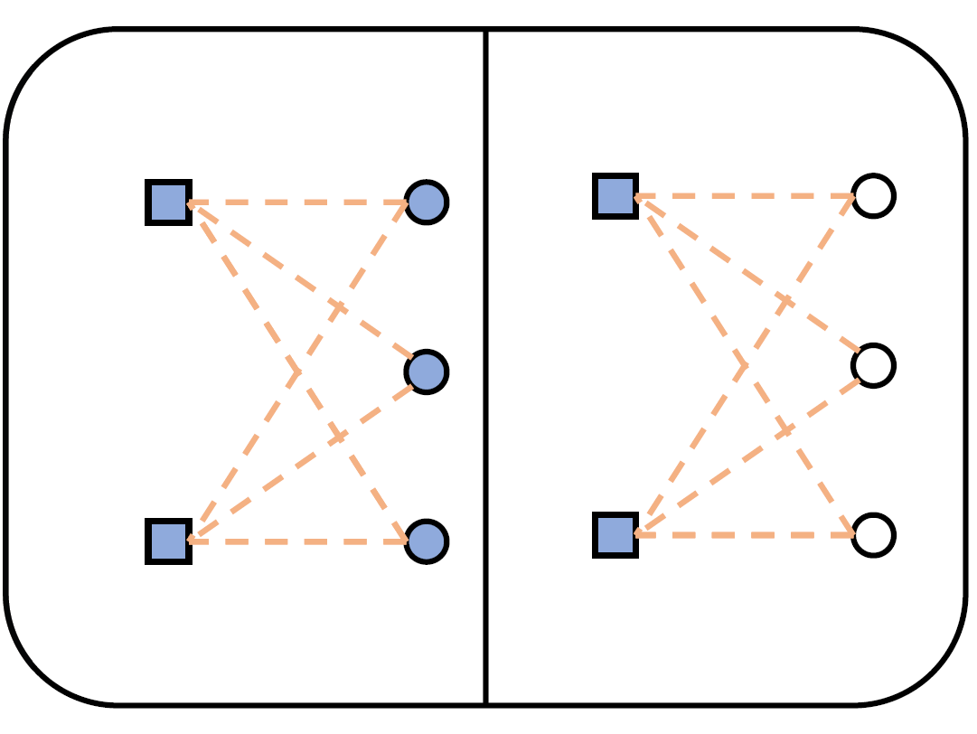
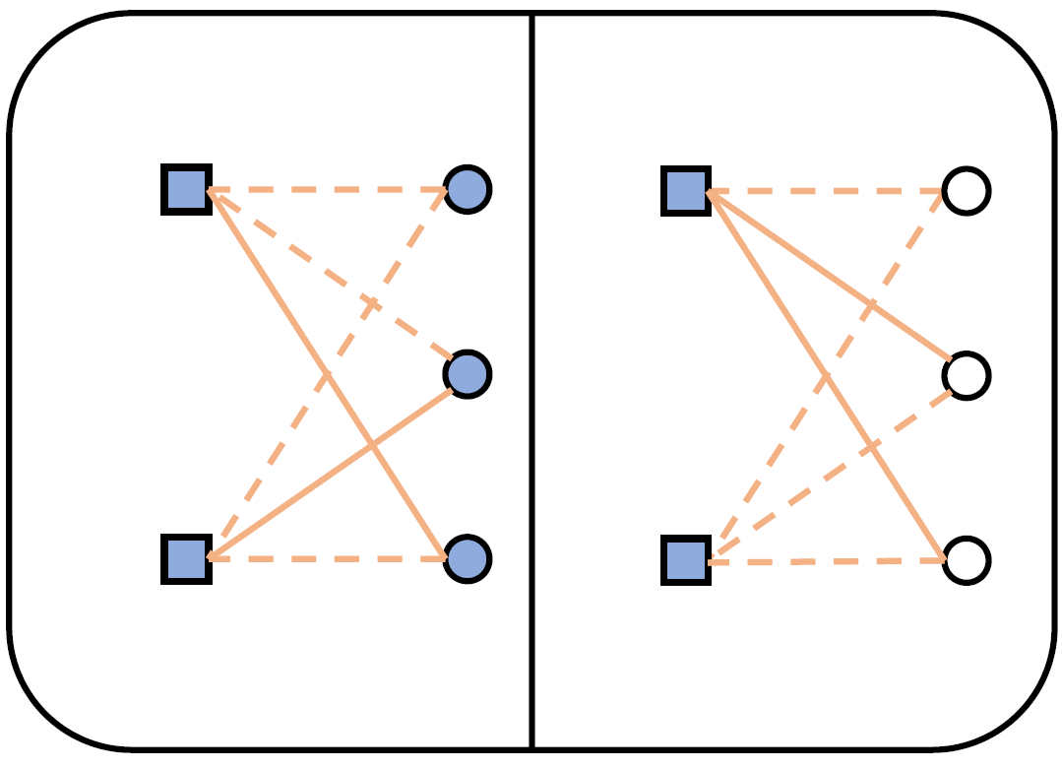
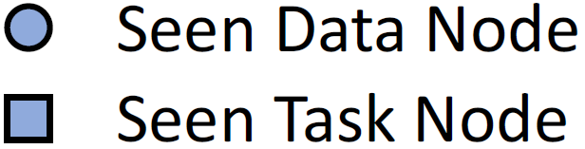
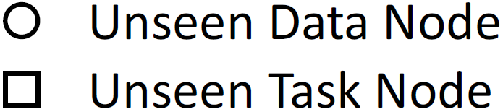

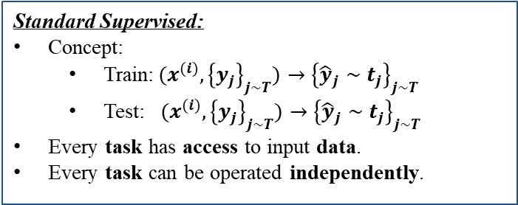
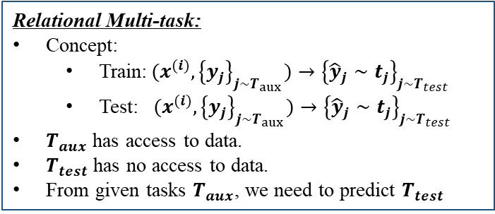
1. Preliminaries: Standard Supervised & Relational multi-task
Train
Test
Standard Supervised:
Concept:
Train:${ (x}^{(i)},{\left\{y_{j}\right\}}_{j∼T})→{\left\{{\hat{y}}_{j}∼t_{j}\right\}}_{j∼T}$
Test: ${ (x}^{(i)},{\left\{y_{j}\right\}}_{j∼T})→{\left\{{\hat{y}}_{j}∼t_{j}\right\}}_{j∼T}$
Every task has access to input data.
Every task can be operated independently.
Relational Multi-task:
Concept:
Train:${ (x}^{(i)},{\left\{y_{j}\right\}}_{j∼T_{aux}})→{\left\{{\hat{y}}_{j}∼t_{j}\right\}}_{j∼T_{test}}$
Test: ${ (x}^{(i)},{\left\{y_{j}\right\}}_{j∼T_{aux}})→{\left\{{\hat{y}}_{j}∼t_{j}\right\}}_{j∼T_{test}}$
$T_{aux}$ has access to data.
$T_{test}$ has no access to data.
From given tasks $T_{aux}$, we need to predict $T_{test}$
Train
Test

Slide 3
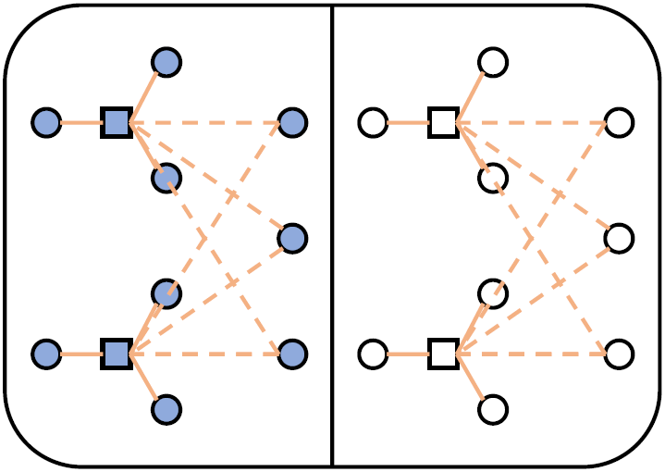
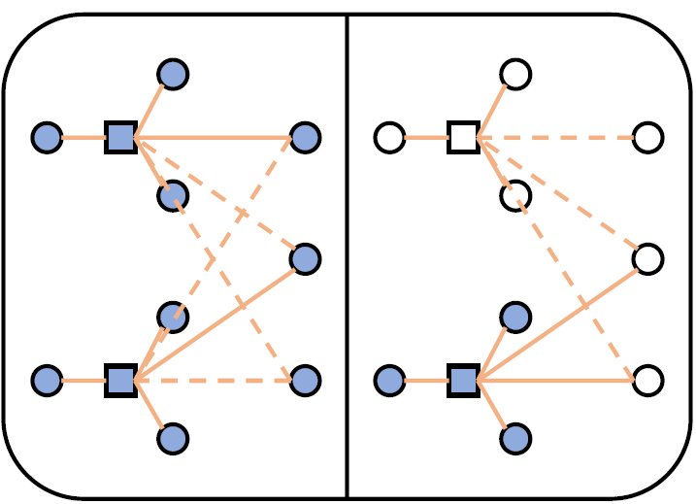
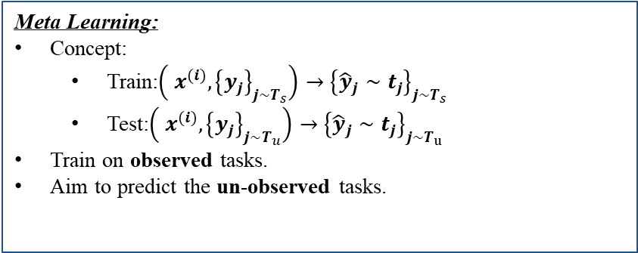
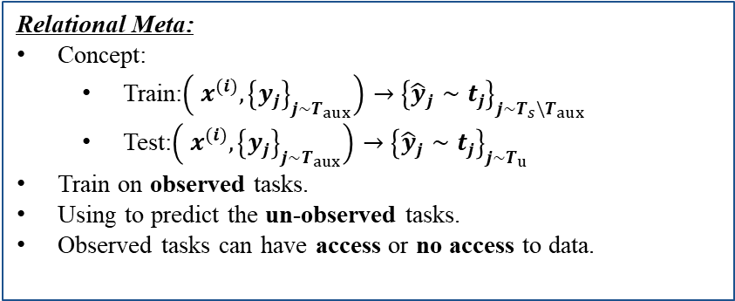
1. Preliminaries: Meta & Relational-Meta
Meta Learning:
Concept:
Train:$\left({ x}^{(i)},{\left\{y_{j}\right\}}_{j∼T_{s}}\right)→{\left\{{\hat{y}}_{j}∼t_{j}\right\}}_{j∼T_{s}}$
Test:$\left({ x}^{(i)},{\left\{y_{j}\right\}}_{j∼T_{u}}\right)→{\left\{{\hat{y}}_{j}∼t_{j}\right\}}_{j∼T_{u}}$
Train on observed tasks.
Aim to predict the un-observed tasks.
Train
Test
Relational Meta:
Concept:
Train:$\left({ x}^{(i)},{\left\{y_{j}\right\}}_{j∼T_{aux}}\right)→{\left\{{\hat{y}}_{j}∼t_{j}\right\}}_{j∼T_{s}\backslash T_{aux}}$
Test:$\left({ x}^{(i)},{\left\{y_{j}\right\}}_{j∼T_{aux}}\right)→{\left\{{\hat{y}}_{j}∼t_{j}\right\}}_{j∼T_{u}}$
Train on observed tasks.
Using to predict the un-observed tasks.
Observed tasks can have access or no access to data.
Train
Test

Slide 4
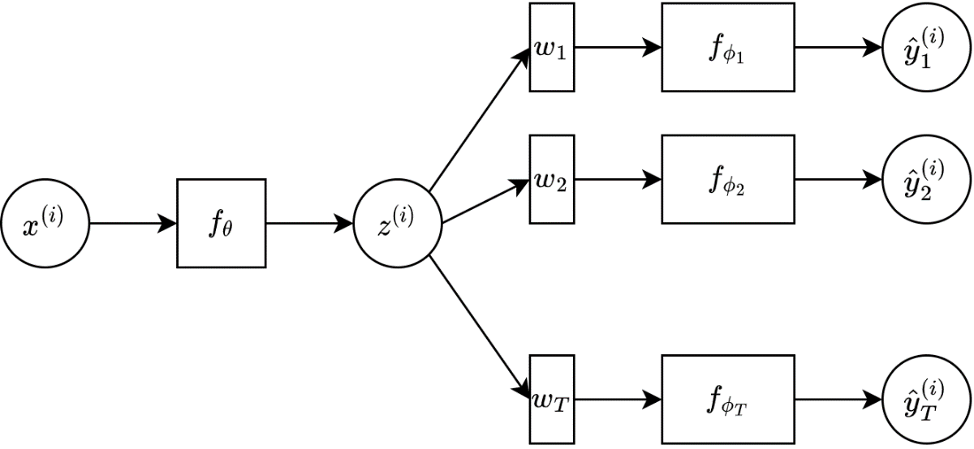
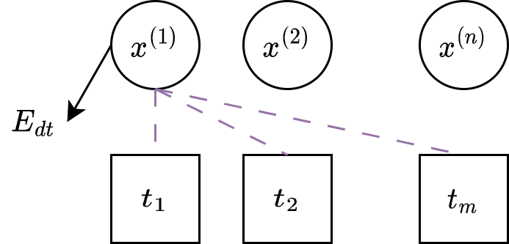
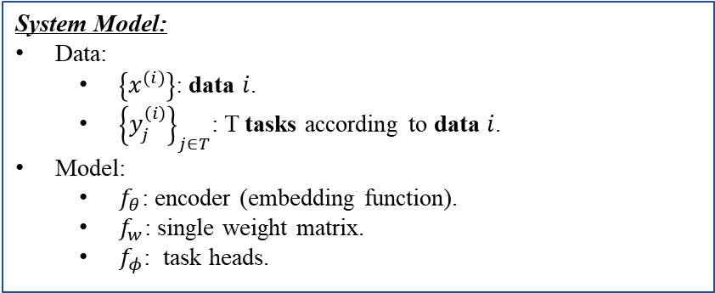
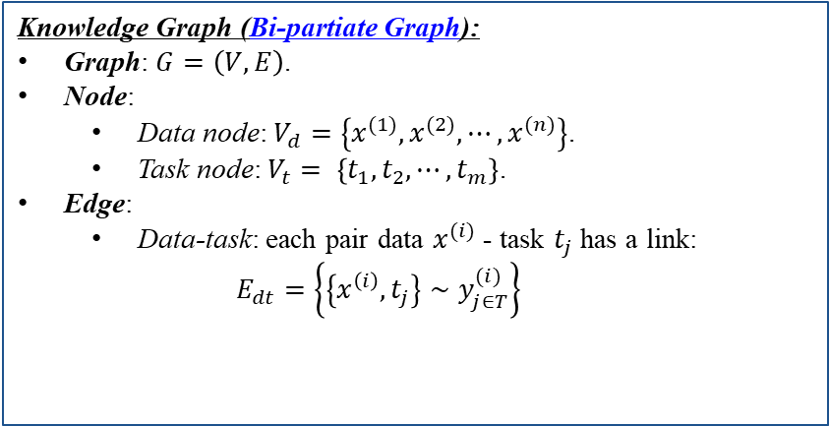
2. MetaLink: Graph design
System Model:
Data:
$\left\{x^{(i)}\right\}$: data $i$.
${\left\{y_{j}^{\left(i\right)}\right\}}_{j∈T}$: T tasks according to data $i$.
Model:
$f_{θ}$: encoder (embedding function).
$f_{w}$: single weight matrix.
$f_{φ}$: task heads.
Knowledge Graph (Bi-partiate Graph):
Graph: $G=\left(V,E\right)$.
Node:
Data node: $V_{d}=\left\{x^{(1)},x^{(2)},⋯,x^{(n)}\right\}$.
Task node: $V_{t}= \left\{t_{1}, t_{2}, ⋯,t_{m}\right\}$.
Edge:
Data-task: each pair data $x^{(i)}$ - task $t_{j}$ has a link:
$$E_{dt}=\left\{\left\{x^{\left(i\right)},t_{j}\right\}∼y_{j∈T}^{(i)}\right\}$$

Slide 5
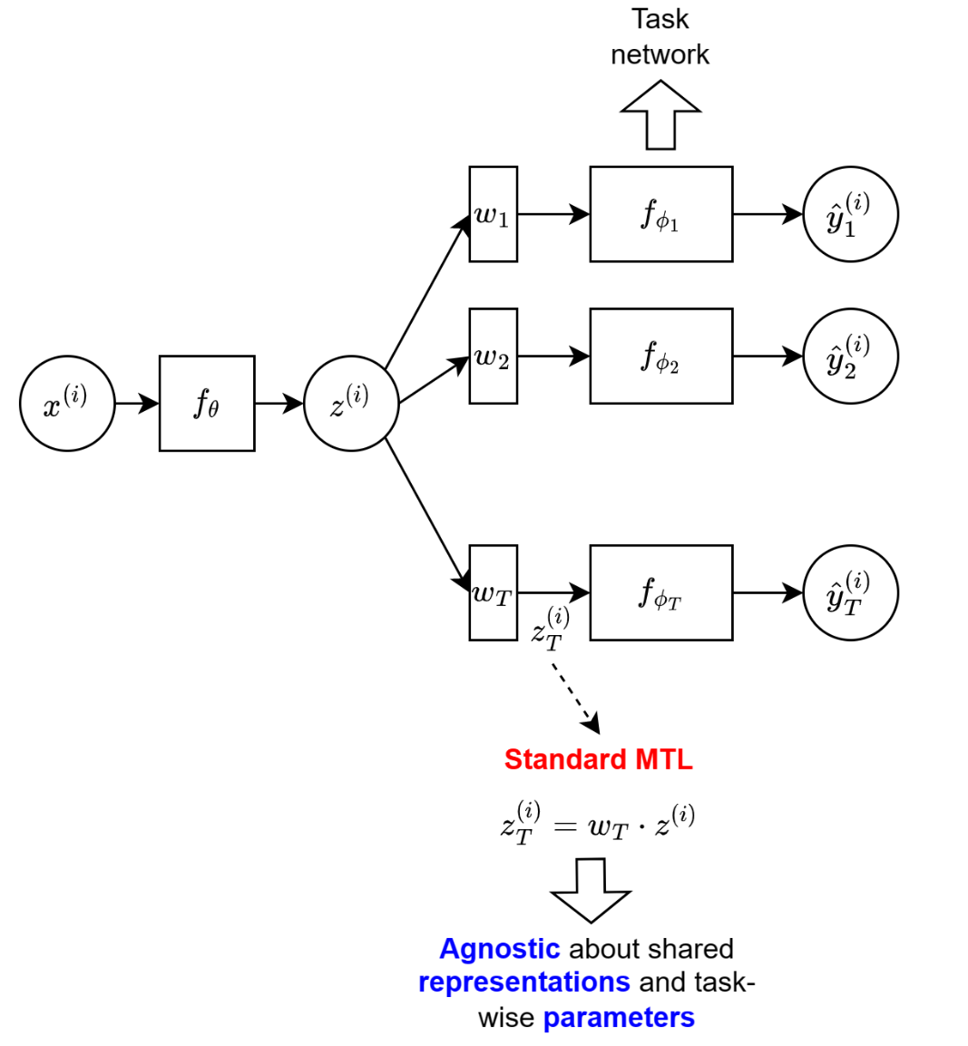
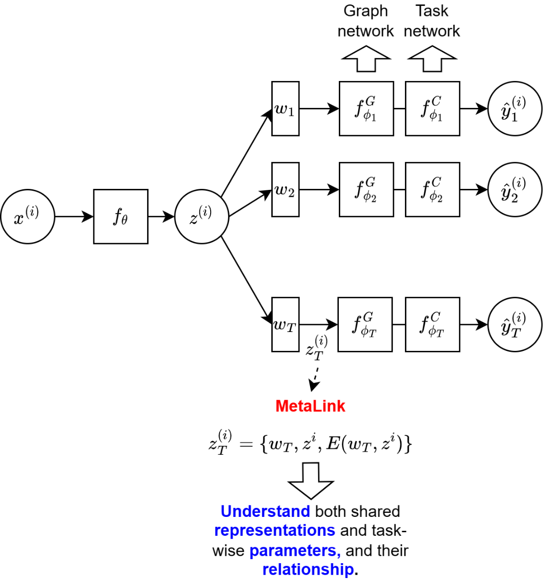
2. MetaLink: Architecture

Slide 6
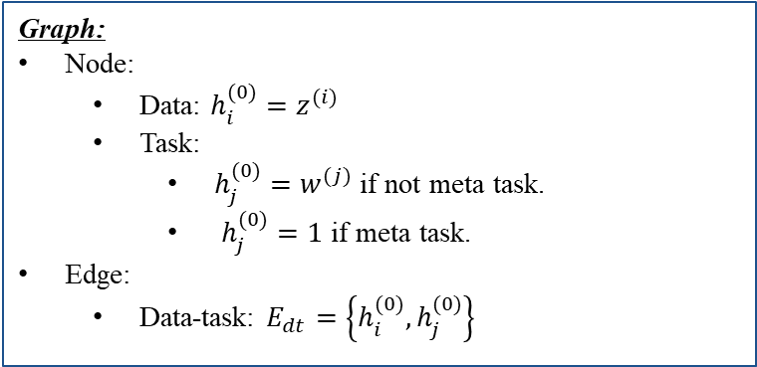
2. MetaLink: Node Initialization
Graph:
Node:
Data: $h_{i}^{(0)}=z^{(i)}$
Task:
$h_{j}^{(0)}=w^{(j)}$ if not meta task.
$h_{j}^{(0)}=1$ if meta task.
Edge:
Data-task: $E_{dt}=\left\{h_{i}^{(0)},h_{j}^{(0)}\right\}$

Slide 7
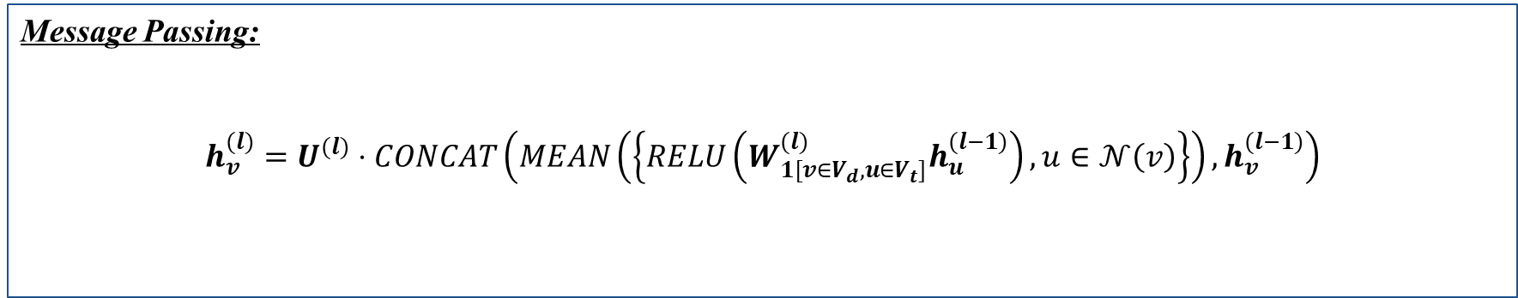

3. GNN-MetaLink: Graph embedding network
Message Passing:
$$h_{v}^{(l)}=U^{(l)}⋅CONCAT\left(MEAN\left(\left\{RELU\left(W_{1[v∈V_{d},u∈V_{t}]}^{(l)}h_{u}^{(l−1)}\right),u∈𝒩\left(v\right)\right\}\right),h_{v}^{(l−1)}\right)$$
Trainable parameters
Trainable parameters
Reduce info loss
Message Passing (aggregate task output):
$$h_{v}^{(l)}=U^{(l)}⋅CONCAT\left(MEAN\left(\left\{RELU\left(W_{1[v∈V_{d},u∈V_{t}]}^{(l)}h_{u}^{(l−1)}+O^{(l)}y_{v}^{(u)}\right),u∈𝒩\left(v\right)\right\}\right),h_{v}^{(l−1)}\right)$$

Slide 8
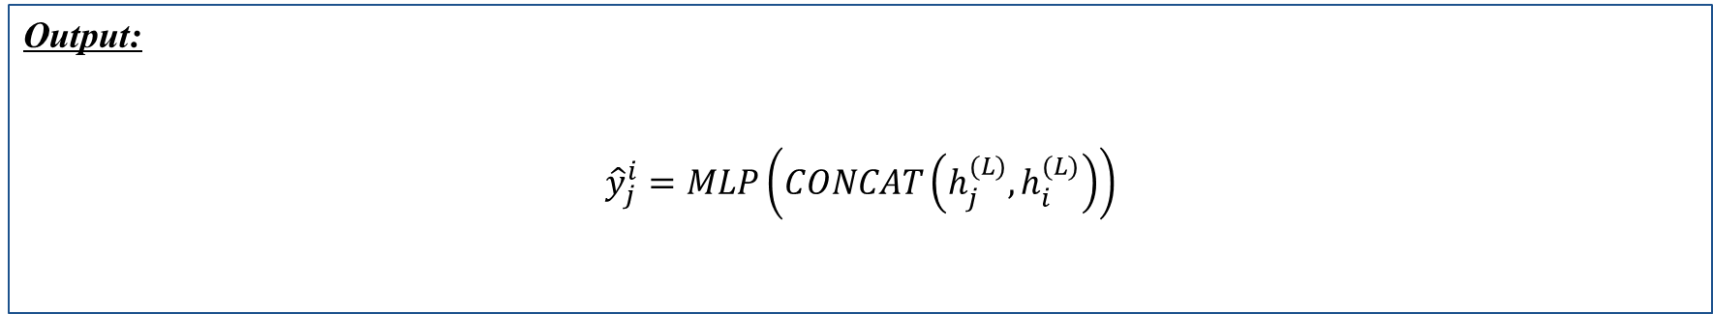
3. GNN-MetaLink: Edge Predictor
Output:
$${\hat{y}}_{j}^{i}=MLP\left(CONCAT\left(h_{j}^{(L)},h_{i}^{(L)}\right)\right)$$
Aggregate task node, data node
Classifier
Classifier

Slide 9
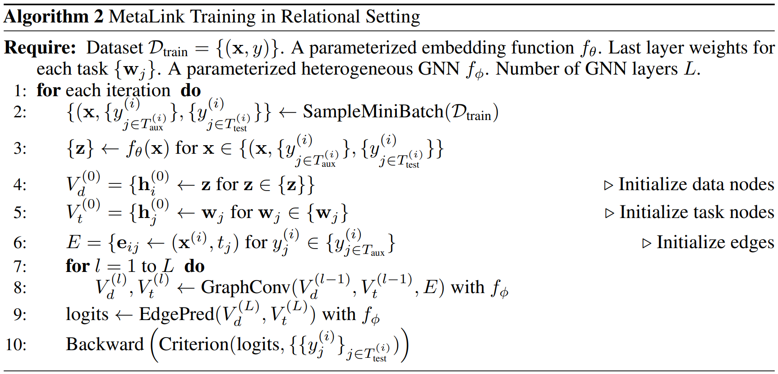
3. GNN-MetaLink: Relational Training Process
Graph size depends on batch size

Slide 10
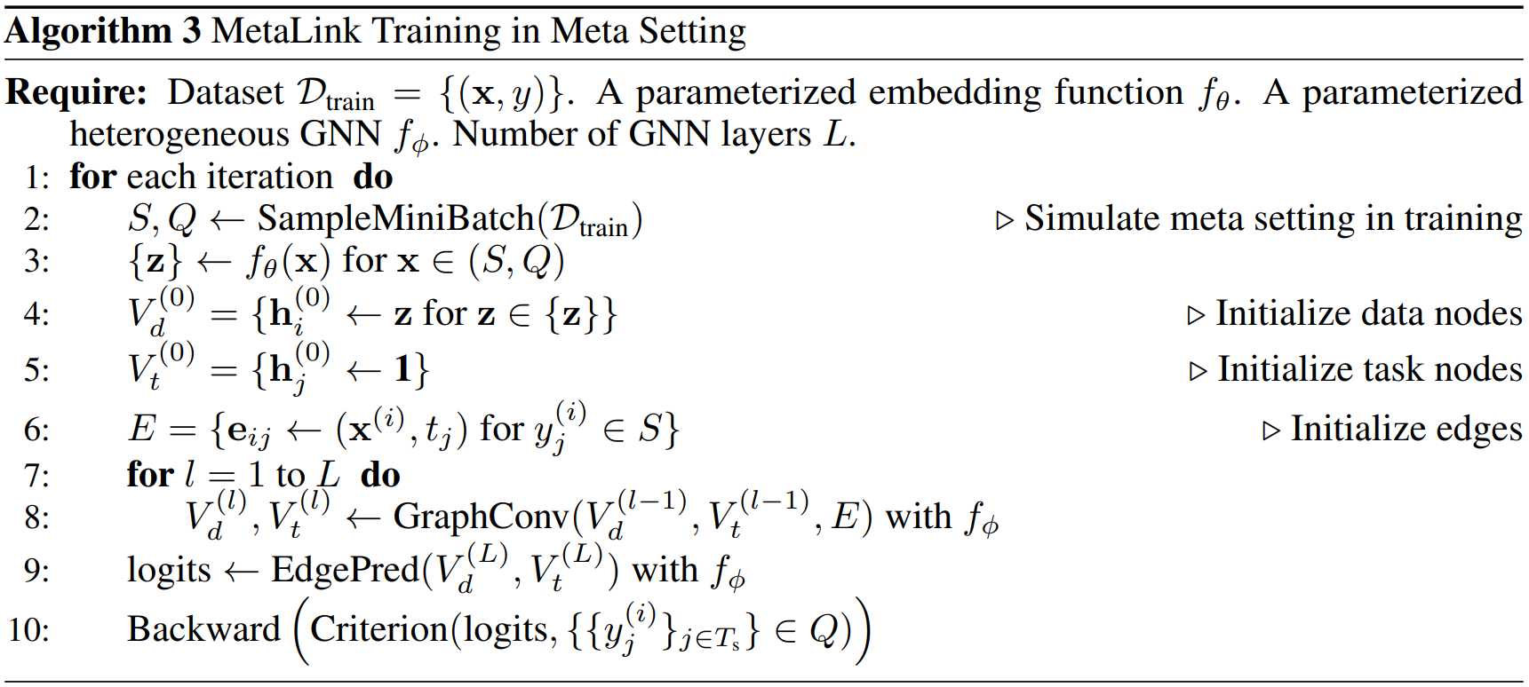
3. GNN-MetaLink: Training Process
All tasks are meta
edges of support set
SGD on query set

Slide 11
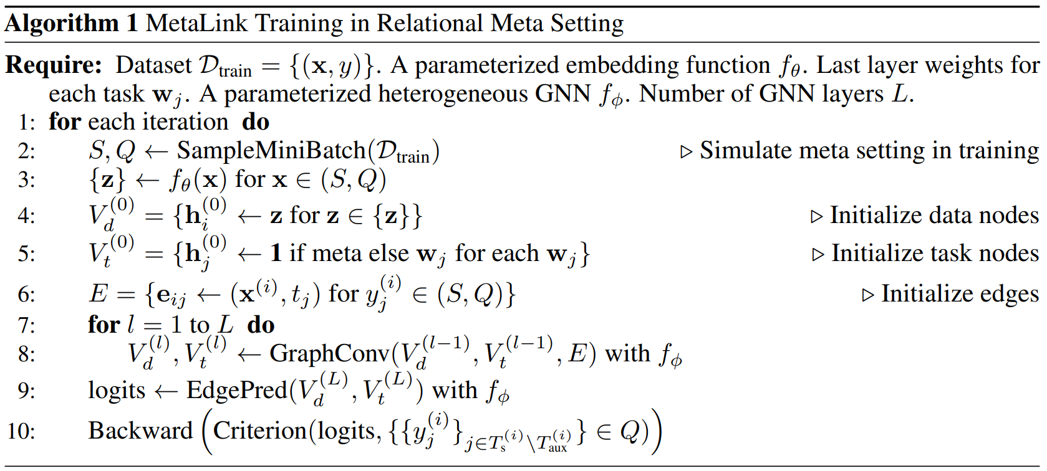
3. GNN-MetaLink: Training Process
generalize to meta tasks
Train only on unseen tasks

Slide 12
Thank you

