Slide 1
CZQM • CONTROLLER TRAINING
TopSky 2.6
A New User's Walkthrough
Menu items and core functions of the EuroScope plugin — explained one screen at a time.
Based on the official TopSky plugin documentation set
v2.6 • 2026

Slide 2
What is TopSky?
An ATC-system simulation plugin for EuroScope
TopSky is a plugin for EuroScope that recreates the look and feel of the TopSky ATM system used in real-world ACCs.
Customised aircraft tag items and tag menus
Graphical elements on the radar display
Coordination, conflict probe and safety nets
CPDLC data-link messaging support
TopSky 2.6 | COOPANS Setup B | CZQM
1

Slide 3
How to read this deck
A guided tour, not a manual replacement
ORIENT
DRIVE
Where things live
How you operate
Global Menu, radar display, track labels, windows.
Left/right click conventions, menu folders, toggles.
COORD
REFER
Talk to other sectors
Where to dig deeper
PEL/COPN, XFL/COPX, releases, HOP, ROF, RTI/TIP.
Section + page references back to the official PDFs.
If a screen is shown — that's what you'll see in the sim. If a menu path is in quotes — that's exactly what you'll click.
TopSky 2.6 | COOPANS Setup B | CZQM
2

Slide 4
01
SECTION
Orientation
The Global Menu and Air Situation Display

Slide 5
The Global Menu
Your starting point — across the top of the radar screen
If you don't see this bar, the plugin isn't loaded
16:21:40 | UTC clock — opens Clock Window
Setup | Master configuration menu (covered next)
AMS | Airspace Management — activate / deactivate areas
FData | Flight data tools — flight plan list, predicted traffic
Tools | Operational tools — Notepad, Message In/Out, ATC Msgs
MET | Weather — winds, weather messages, weather radar
[x] | Numeric brackets are configurable client-specific menus
Info / MSG / STS | Information windows, messages, status displays
RR | Radar Ranges (sector/airspace selection)
M000-999 | Mach number / SSR code group selection
TopSky 2.6 | COOPANS Setup B | CZQM
3

Slide 6
Setup menu
Where you tune what the plugin shows you
ASD (Air Situation Display)
Track Control
Background brightness, label settings, fonts, vector lengths.
Which fields appear on tracks for selected vs. unselected aircraft.
Safety Nets
MTCD / TCT
STCA, MSAW, APW, AIW toggles and inhibition settings.
Conflict detection and tactical controller tools on/off.
CPDLC
Save / Load
Data link callsign filters and message presentation options.
Persist your personal layout — windows, label fields, brightness.
Tip: Save your Setup once you have it tuned — it loads automatically when you next sign on.
TopSky 2.6 | COOPANS Setup B | CZQM
4

Slide 7
Other Global Menu folders
Each opens a sub-menu of windows and toggles
AMS
FData
Tools
Airspace Management
Flight Data
Operational Tools
Activate, schedule and deactivate restricted/danger areas. Open the AM window from here.
Flight Plan window, Predicted Traffic, Group SSR code window, departure tools.
Notepad, ATC Messages, Message In / Out (coordination), Stack Manager, CARD.
MET
Info
STS
Weather
Information
Status displays
Weather Messages, Upper Winds, weather radar overlay on the ASD.
Airfield Data, Misc Information, NOTAM list, General Info.
Safety Nets Status, TCT Status, MTCD Status, Divergence Detection Status.
TopSky 2.6 | COOPANS Setup B | CZQM
5

Slide 8
02
SECTION
Air Situation Display
Tracks, the radar picture, and the Radar Menu

Slide 9

Track presentation on the ASD
Every aircraft is drawn as a track + label
Click the callsign to open the Callsign menu — the most-used menu in the plugin.
Click any data field (CFL, RFL, AHDG, ASP, etc.) to change just that value.
Right-click in empty space on the ASD to open the Radar Menu.
Drag a track or its leader-line to reposition the label.
A standard 3-line tag. Each piece of text is clickable.
Read the doc:
General § 5 Air Situation Display, § 6 Track label menus, Appendix 1 (Label field descriptions).
TopSky 2.6 | COOPANS Setup B | CZQM
6

Slide 10
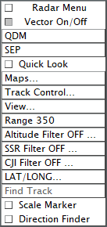
The Radar Menu
Right-click on empty space anywhere on the ASD
QDM — bearing/distance from cursor.
SEP — separation tool between two tracks.
Quick Look — temporarily reveal hidden tracks.
Maps… — toggle which sector-file maps are drawn.
Track Control… — choose label fields per state.
View… — saved view positions / zoom presets.
Range / Altitude / SSR / CJI / LAT-LONG — picture filters.
Find Track — search by callsign.
Scale Marker / Direction Finder — display add-ons.
This menu controls the radar picture itself, not individual aircraft.
TopSky 2.6 | COOPANS Setup B | CZQM
7

Slide 11
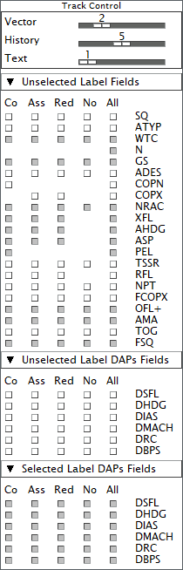
Track Control
Decide which fields appear on the tag for each track state
Vector / History / Text — sliders for trail and label thickness.
Five state columns: Co (concerned), Ass (assumed), Red (redundant), No (not concerned), All.
For each label field, tick which states it shows on.
DAPs Fields = Downlinked Aircraft Parameters (selected vs. unselected).
Save your Setup once configured — your label preferences persist.
TopSky 2.6 | COOPANS Setup B | CZQM
8

Slide 12
03
SECTION
Track Label Menus
What every clickable field on a tag does

Slide 13
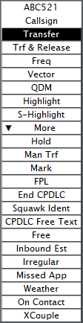
Callsign menu
The single most-used menu in the plugin
Transfer — start hand-off to next sector.
Trf & Release — transfer with a release condition.
Freq — give the aircraft a frequency.
Vector / QDM — show vector / bearing line.
Highlight / S-Highlight — visual emphasis.
Hold — open the Hold menu.
Man Trf — manual transfer to a chosen controller.
Mark — drop a private marker on the track.
FPL — open the Flight Plan window.
End CPDLC / Squawk Ident — direct actions.
CPDLC Free Text — send custom uplink.
Inbound Est / Irregular / Missed App — status.
Weather / On Contact / XCouple — extras.
More ▼ — opens the secondary folder.
TopSky 2.6 | COOPANS Setup B | CZQM
9

Slide 14
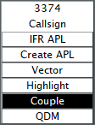
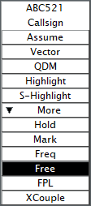
Sequence and Waypoint menus
Quick clicks on the route fields of a tag
Sequence number menu
Used by the Stack Manager — set or remove arrival sequence numbers, build holding patterns.
Sequence number
Waypoint menu
Click any waypoint in the route. Direct-to, insert, delete, or use Probe to coordinate a new entry/exit point with the next sector.
Waypoint
TopSky 2.6 | COOPANS Setup B | CZQM
10

Slide 15



Level menus — AFL, CFL, RFL
Three different fields, three different menus
Level field cheat-sheet
AFL — what the radar reports right now.
CFL — what you've cleared the aircraft to.
RFL — what's filed in the flight plan.
Click each to open its own picker.
RFL also offers Mach selection on oceanic.
CFL — Cleared
AFL — Actual
RFL — Requested
TopSky 2.6 | COOPANS Setup B | CZQM
11

Slide 16


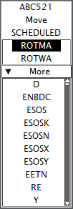
Tactical menus — AHDG, ASP, ARC
Headings, speeds, and rates of climb/descent
AHDG — assign or vector a heading. 'Point' lets you direct-to a fix.
ASP — assign IAS, Mach, or speed restrictions.
ARC — Assigned Rate of Climb/Descent — a rate clearance.
Each menu has a More ▼ folder containing HOP, RTI, TIP for sector coordination.
ASP — speed
ARC — rate
AHDG — heading
TopSky 2.6 | COOPANS Setup B | CZQM
12

Slide 17



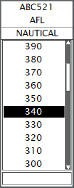
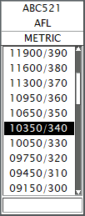
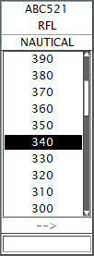
Other field menus at a glance
Less-used clickable fields, all on the tag
SSR Code
Combined Transfer
Aerodrome
Assign or change the assigned squawk.
Resolve a HOP coordination in one place.
Departure/destination quick edit.
Time
Departure Seq.
GAP
Estimate/ATD/ATA editing for the FPL.
Order departing traffic.
Insert a separation gap into a sequence.
TopSky 2.6 | COOPANS Setup B | CZQM
13

Slide 18
04
SECTION
Windows
The pop-up panels you'll keep open at all times

Slide 19
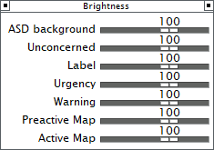
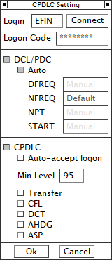
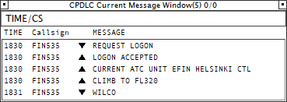
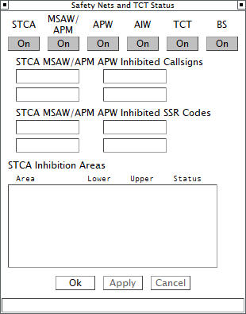
Recommended always-open windows
If you only open four, open these four
Clock Window
Message In Window — incoming coordinations
Brightness Control
Clock — UTC reference; click to open larger.
Brightness — drag ASD background up/down without leaving sim.
Message In — every incoming PEL / XFL / HOP arrives here.
ATC Messages — broadcast text traffic on your sector.
ATC Messages
TopSky 2.6 | COOPANS Setup B | CZQM
14

Slide 20
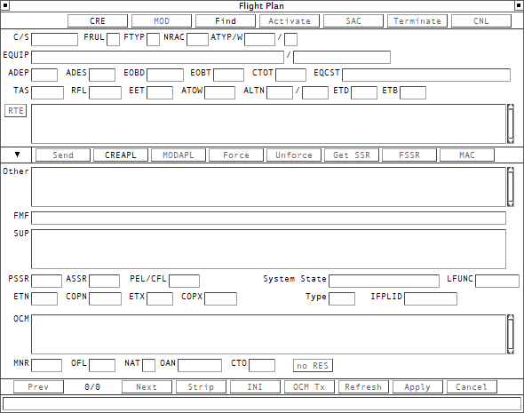
Flight data windows
Open from FData / Tools / Callsign menu
Tour
Top buttons — CRE, MOD, Find, Activate, SAC, Terminate, CNL.
C/S, RTE — callsign and full route editing.
Send / CREAPL / MODAPL — push the FPL to the network.
Bottom row — Strip, INI, OCM Tx, Refresh, Apply, Cancel.
Open via FPL on the Callsign menu, or FData → FPL Selection.
Flight Plan window — full FPL editor
TopSky 2.6 | COOPANS Setup B | CZQM
15

Slide 21
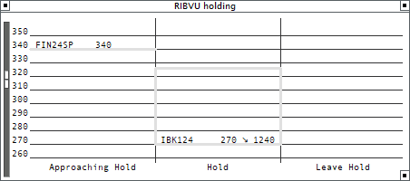
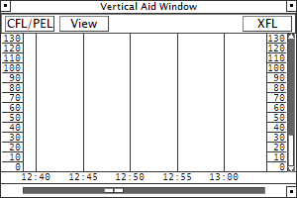
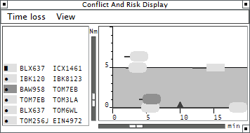
Route & sequence helpers
Visualise routes, build holds, see conflicts
When to use
Complete Route — full string and waypoints in time order.
Stack Manager — assemble and re-order arrival sequences.
CARD — surface MTCD-detected conflicts with one row per pair.
Complete Route
CARD — Conflict And Risk Display
Stack Manager
TopSky 2.6 | COOPANS Setup B | CZQM
16

Slide 22
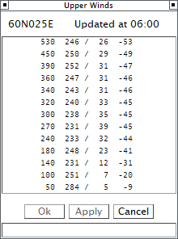
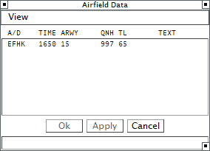
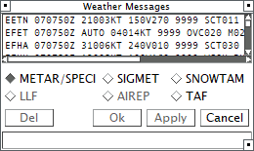
CPDLC windows
Data link messaging — see Data Link doc for full set
Current — open exchanges, awaiting your action.
History — completed and timed-out messages.
Both filterable by aircraft state.
Free Text and standard uplinks come from the Callsign menu's CPDLC items.
Open the CPDLC Setting Window from Setup to tune callsign filters.
History
Current Message Window
Microphone Check
TopSky 2.6 | COOPANS Setup B | CZQM
17

Slide 23
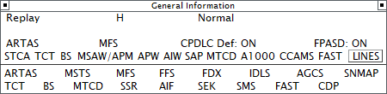
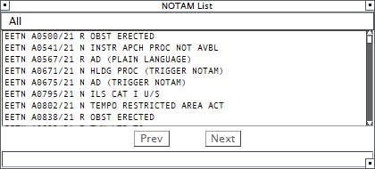
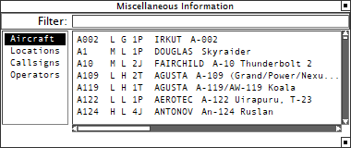
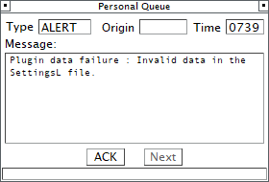
MET and Info windows
Weather and reference data
Weather Messages — METAR/TAF and SIGMET feed.
Upper Winds — winds aloft summary.
Airfield Data — runway, QNH, transition level.
Misc Info — multipurpose panel for sector-specific data.
Weather Messages
Airfield Data
Upper Winds
Misc Information
TopSky 2.6 | COOPANS Setup B | CZQM
18

Slide 24
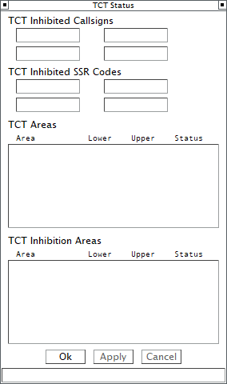
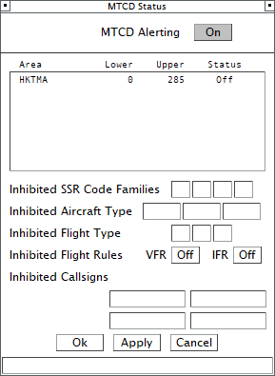
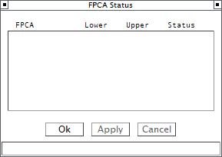
Status windows
Open from STS — show what's enabled and inhibited
Each safety-net (STCA, MSAW, APW, AIW, TCT, BS) has an On/Off toggle here.
Inhibit specific callsigns or SSR codes — useful for VFR trainers.
Inhibition Areas list — geographic exclusions.
If something looks broken, this is the first place to check.
Divergence Detection
TCT Status
Safety Nets & TCT Status
TopSky 2.6 | COOPANS Setup B | CZQM
19

Slide 25
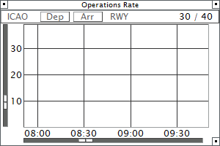
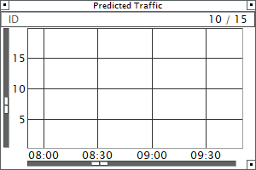
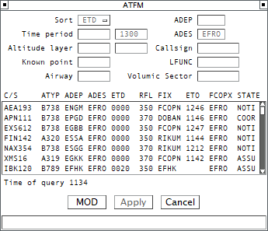
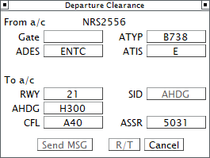
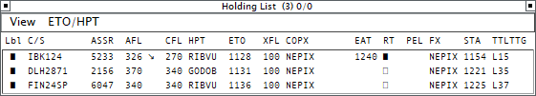
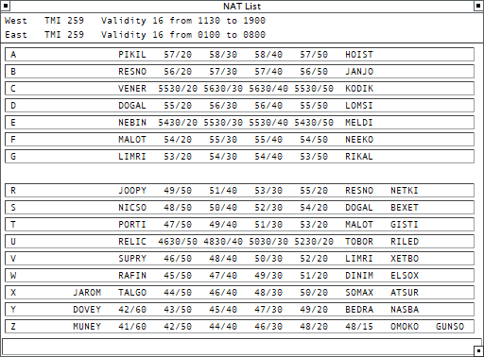
More windows you'll meet
Different windows for different roles — Tower, Approach, Area, Oceanic
Operations Rate
Predicted Traffic
ATFM
Departure Clearance
Holding List
NAT List (oceanic)
Open them only when you need them — every window adds a refresh-rate cost.
TopSky 2.6 | COOPANS Setup B | CZQM
20

Slide 26
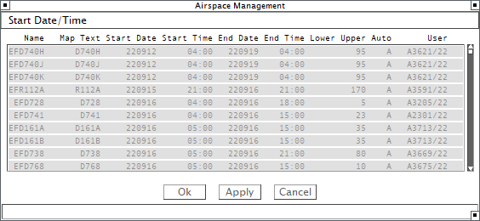
Airspace Management
Activate, schedule and end restricted areas
Workflow
Open from the AMS folder.
Each row = one airspace block.
Start/End columns drive when it's drawn on the ASD.
Lower / Upper limits in flight levels.
Auto column for scheduled activations.
Apply to commit changes.
Airspace Management — start dates / times by area
TopSky 2.6 | COOPANS Setup B | CZQM
21

Slide 27
05
SECTION
Lists & Safety Nets
Aircraft lists, shortcuts, and the alerts that watch your sector

Slide 28
Aircraft lists
Same fields as a tag, in row form
Sector List | All flights currently in your sector.
Load Factor List | Sector loading and complexity metrics.
Resectorisation List | Aircraft affected by a planned re-sec.
ETWR List | Estimates To Way-points (your boundary fixes).
Uncontrolled List 1 / 2 | Tracks not yet assumed by anyone.
Lost List | Tracks gone radar-out.
Traffic Mgmt List 1 / 2 | TMA-style configurable filters.
Holding List | Aircraft in holding patterns.
FAST List | Final Approach Sequencing Tool list.
Most lists let you click a row callsign to open the same menus you'd get on the radar tag.
TopSky 2.6 | COOPANS Setup B | CZQM
22

Slide 29
Safety nets at a glance
Automatic alerts. Toggle from STS or Setup → Safety Nets.
STCA
Short Term Conflict Alert
MSAW
Minimum Safe Altitude Warning
Imminent loss of separation between two tracks.
Aircraft predicted below MSA.
APW
Area Proximity Warning
AIW
Airspace Infringement Warning
Predicted entry into a restricted/danger area.
Aircraft has entered an area without clearance.
Read the doc: General § 10 Safety Nets.
TopSky 2.6 | COOPANS Setup B | CZQM
23

Slide 30
Monitoring aids and conflict probe
Tools that watch traffic for you
TCT
Tactical Controller Tool
CLAM
Cleared Level Adherence Mon.
Solo-tracker tagged display for clearance writing — one aircraft, one screen area.
Alerts when an aircraft drifts off its CFL.
RAM
Route Adherence Monitoring
MTCD
Medium Term Conflict Detection
Alerts when an aircraft drifts off its filed/cleared route.
Probes the next ~20 min of flight plans for conflicts.
SAP
Segregated Area Probe
BS
Blind Spot
Probes flight plans against active areas (D/R/etc.).
Highlights tracks the radar coverage doesn't actually see.
TopSky 2.6 | COOPANS Setup B | CZQM
24

Slide 31
Keyboard shortcuts
A handful you'll use every session
KEY | ACTION
F1 / F2 / … | Open / focus the configured plugin window for that slot.
Hold Shift + Click | Multi-select, or extend an action to multiple tracks.
Ctrl + Click | Modifier on most menu items — alternate behaviours.
Right-click empty ASD | Open the Radar Menu.
Right-click a track | Open the track context menu (varies by setup).
Esc | Close most pop-up menus and message dialogs.
See General § 9 Keyboard shortcuts for the full set — your local profile may add more.
TopSky 2.6 | COOPANS Setup B | CZQM
25

Slide 32
06
SECTION
Coordination
Talking to the next sector through the plugin

Slide 33
How coordination works
Two controllers, two label colours
Transferring controller
Accepting controller
ABC123 IDA
100 ^ OLDPT
180
ABC123 IDT
100 ^ OLDPT
180
Coordinations colour-code values you propose (Out) and values proposed to you (In).
Reply by clicking the proposed value and choosing Accept, Refuse or Change.
Always keep the Message In window open — that's where incoming coordinations land.
Some coords (ROF, RTI, TIP) need a TopSky-using counterpart; otherwise fall back to text/voice.
TopSky 2.6 | COOPANS Setup B | CZQM
26

Slide 34
Levels & points — PEL/COPN and XFL/COPX
The two everyday entry/exit coordinations
PEL / COPN
XFL / COPX
Planned Entry Level / Entry Point
Exit Flight Level / Exit Point
Click the PEL value → choose new level.
Click COPN value → Waypoint menu → Probe → choose point.
Other side answers Accept / Refuse / Change.
Click the XFL value → choose new level.
Click COPX value → Waypoint menu → Probe → choose point.
Watch the colour change confirm your proposal.
TopSky 2.6 | COOPANS Setup B | CZQM
27

Slide 35
Releases
Granting the next sector freedom to climb / descend / vector
A 'Release' is given by the transferring controller to allow the accepting controller to climb, descend, or change heading before the standard handoff conditions apply.
Released for climb — accepting controller may climb the aircraft early.
Released for descent — same idea, the other way.
Released for turn — heading changes permitted.
Issued via Trf & Release on the Callsign menu, or as part of HOP.
Visible in the label until the transfer completes.
TopSky 2.6 | COOPANS Setup B | CZQM
28

Slide 36
HOP and ROF
Hand-Over Proposal and Request On Frequency
HOP
ROF
Hand-Over Proposal
Request On Frequency
Sent by transferring controller to propose a transfer.
Send via Callsign → HOP — or AHDG/ASP → More → HOP for a conditional.
Three answers: ROF, Accept, or Combined Transfer.
If the recipient isn't on TopSky, only your label is updated.
Sent by accepting controller — "the aircraft is on my frequency".
Doubles as an answer to HOP.
Send via Callsign → ROF.
Indications: ROF in In/Out colour, removed on Transfer or Trf & Release.
TopSky 2.6 | COOPANS Setup B | CZQM
29

Slide 37
RTI and TIP
Tactical instruction coordination
Use these when one controller wants the other to apply a heading/speed/rate or arc clearance before the formal handoff.
RTI
TIP
Request Tactical Instruction
Tactical Instruction Proposal
Initiated by accepting controller. "Please vector / restrict speed before sending."
Initiated by transferring controller. "I propose this restriction before the handoff."
Send via AHDG / ASP / ARC → More → RTI or TIP. Answers come back in the Message In window.
TopSky 2.6 | COOPANS Setup B | CZQM
30

Slide 38
07
SECTION
Operating tips
Performance, common pitfalls, and where to read more

Slide 39
Performance considerations
Keep refresh rates high while panning and zooming
DO
AVOID
Display only the maps you actively need.
Set ASD background brightness to 100% if it lags.
Close windows you aren't currently using.
Filter Track Control labels by state — fewer fields = smoother panning.
Leaving the Weather Map on at low altitudes when not needed.
Loading every active area when only a few apply.
Running with all Safety Nets and CARD open on a low-end machine.
Editing settings mid-session — restart EuroScope after big changes.
Read the doc: General § 3 Performance considerations.
TopSky 2.6 | COOPANS Setup B | CZQM
31

Slide 40
Common pitfalls for new users
If something looks wrong, start here
No Global Menu visible
Coordination greyed out in menu
Plugin not loaded, or Setup A active. Check COOPANS=1 in plugin settings.
Conditions not met — try again, or use text/voice as a fallback.
Track has no label fields
Safety Net not firing
Open Track Control and tick fields against the right state column.
Check Safety Nets Status — it may be inhibited for callsign or area.
CPDLC items disabled
Setup keeps resetting
Aircraft may not be CPDLC-equipped; check FPL equipment fields.
You haven't saved it — Save in Setup once you have it tuned.
TopSky 2.6 | COOPANS Setup B | CZQM
32

Slide 41
Where to read more
Three documents in your TopSky 2.6 manual set
GENERAL
COORD
DATALINK
General Information (B)
Coordination (B)
Data Link Functions (B)
132 pages
9 pages
10 pages
Full reference for menus, windows, lists, safety nets, monitoring aids, label fields, colour values.
Detailed walkthrough of PEL/COPN, XFL/COPX, releases, HOP, ROF, RTI/TIP.
CPDLC logon, ADS-C contracts, free-text uplinks, message lifecycle.
TopSky 2.6 | COOPANS Setup B | CZQM
33

Slide 42
That's the tour.
Open EuroScope, load TopSky, click around — that's where it all clicks.
Questions, additions, or corrections — bring them to the CZQM training team.
CZQM • Controller Training • TopSky 2.6 (COOPANS Setup B)

