Slide 1
PROJ 216 Software Project Concepts
Day 1

Slide 2
“Every minute you spend in planning saves 10 minutes in execution; this gives you a 1,000 percent return on energy!”
— Brian Tracy

Slide 3
Topics
Project Management Concepts
Request for Proposal
Proposal
Project Initiation Document (Project Charter)

Slide 4
Project Definition
Project vs. Process
A project is a temporary endeavor designed to produce a unique product, service or result with a defined beginning and end (usually time-constrained, and often constrained by funding or staffing) undertaken to meet unique goals and objectives, typically to bring about beneficial change or added value
In contrast, a process (operations) - repetitive, permanent, or semi-permanent functional activities to produce products or services
https://en.wikipedia.org/wiki/Project_management

Slide 5
Projects vs. Processes – Similarities
Planned, executes, and controlled
Performed by people
Resource constrained

Slide 6
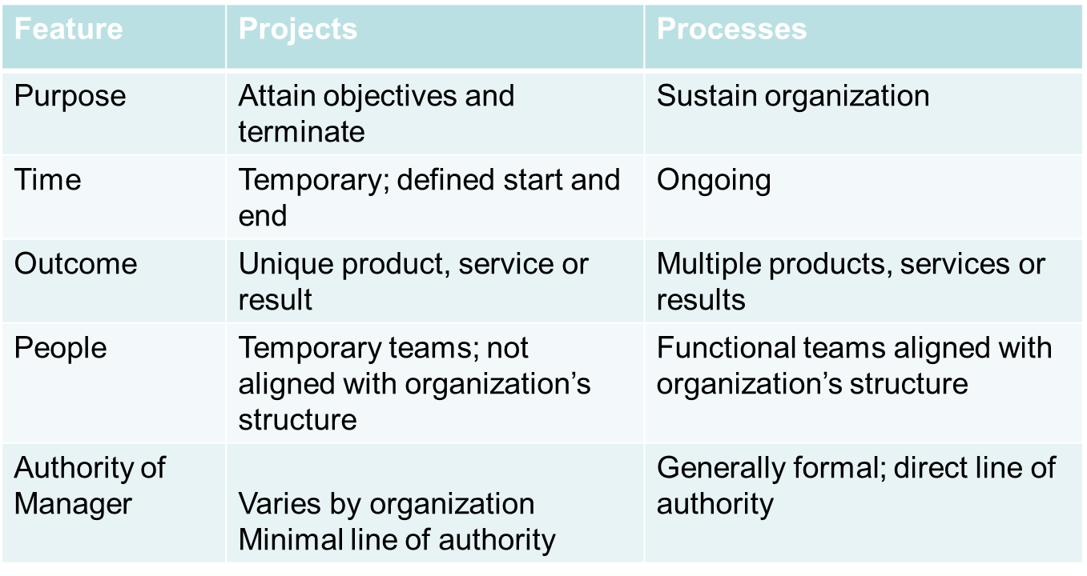
Projects vs. Processes – Differences
(Horine, 2013)

Slide 7
Project Characteristics
A set of tasks which may be performed concurrently and/or in sequence, to achieve a goal or objective
A distinct start and finish date
A limited set of resources which may be used on more than one project
Give examples of projects and processes

Slide 8
Project Goals & Objectives
A goal is an achievable outcome that is generally broad and long-term while an objective defines measurable actions to achieve the overall goal
Objectives for a checklist that keep the project on track
Objectives should be SMART:
Specific
Measurable
Achievable
Realistic
Time-bound
https://www.smartsheet.com/content/project-goals

Slide 9
Why are project goals and objectives important?
Provide direction for the project
Enhance team’s motivation
Help to keep project on track
Help to evaluate project success

Slide 10
Project Management
Project management is the practice of leading the work of a project team to achieve goals and meet success criteria at a specified time
The objective of project management is to produce a complete project which complies with the client’s objectives (which often includes assistance in shaping the client’s objectives)
(https://en.wikipedia.org/wiki/Project_management)

Slide 11
Project Management InstitIute (PMI)
Project Management Institute: www.pmi.org
Certifications:
Project Management Professional (PMP) – education, work experience, exam
CompTIA Project+ certification and PMI CAPM (Certified Associate in Project Management) do not require work experience
PM Body o Knowledge (PMBOK)
Code of ethics
Local chapters – Southern Alberta: www.pmisac.com

Slide 12
History of Project Management
Egyptian pyramids, Great Wall of China, …
Manhattan Project (U.S. military leading to develop an atomic bomb during the WWII) to be the first project to use “modern” project management
This 3-year, $2 billion (in 1946 dollars) project had a separate project manager and a technical manager
1917 – Henry Gantt developed the Gantt chart for scheduling work in factories
In the 1990s, many companies started creating Project Management Offices (PMO) to handle increasing number and complexity of projects

Slide 13
IT Projects - CHAOS Report
In 1995, the Standish Group published a study “The CHAOS Report”
They surveyed 365 IT executive managers in the U.S. who managed more than 8,380 IT application projects
The surveyors defined success as meeting project goals on time and on budget
Overall success rate of IT projects was reported at 16.2%
More than 31% of IT projects were cancelled before completion (cost more than $81 billion)
This study played an important role in making senior executives pay attention to the importance of IT project management

Slide 14
Question
What makes IT projects “special”?

Slide 15
Project Success
There are several ways to define project success:
The project met scope, time, and cost goals
The project satisfied the customer/sponsor
The results of the project met its main objective, such as making or saving a certain amount of money, providing a good return on investment, or simply making the sponsors happy

Slide 16
Stakeholders
Stakeholders are the people or organizations involved in or affected by project activities:
The project sponsor(s)
Legal stakeholder(s) (e.g. bank that issues loan)
The project manager
The project team
Support staff
Customers, users
Suppliers
Opponents to the project

Slide 17
Project Constraints
Scope
What work will be done?
What unique product, service, or result does the customer or sponsor expect?
How will the scope be verified?
Time
How long should it take to complete the project?
What is the project’s schedule? How it will be tracked? Who will approve changes?
Cost
What should it cost to complete the project?
What is the project’s budget? How will the cost be tracked? Who will approve changes?

Slide 18
Triple Constraint
Scope / Quality
Time
Cost

Slide 19
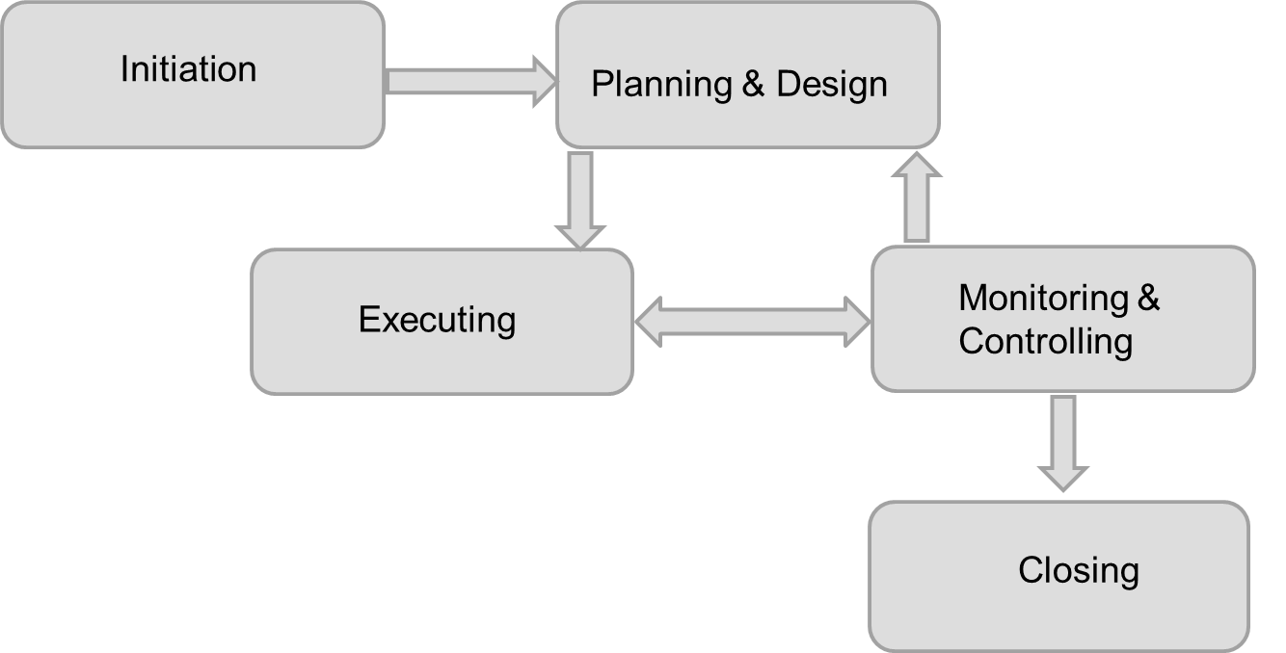
Project Management Process Groups (Phases)

Slide 20
PM Knowledge Areas
Distinct aspects of project management
PM knowledge areas coincide with the process groups: initiation, planning, execution, monitoring & controlling, and project closing
Process groups – one dimension, knowledge areas – another dimension
There are 4 core knowledge areas, 5 facilitating knowledge areas, and 1 knowledge area (project integration management) that affects and is affected by all other knowledge areas
All knowledge areas are important

Slide 21
10 Knowledge Areas
Project Integration Management
Core Functions
Scope Management
Quality Management
Time Management
Cost Management
Facilitating Functions
HR Management
Communications Management
Risk Management
Procurement Management
Stakeholders Management

Slide 22
Research Exercise – 45 minutes
In your project teams, research assigned knowledge area(s) and prepare a short (5 minutes) presentation
What is it about? What are the processes in it? Why is it important?
Team 1: Scope, Quality, Time, Cost
Team 2: HR, Communications, Risk
Team 3: Procurement, Stakeholders, Integration

Slide 23
Standish Group Annual Studies
Follow-up on the initial CHAOS Report from 1994
Annual CHAOS Reports used to be publicly available; now availability by paid membership
In 2020, the number of successful projects increased to 31% (from 16% in 1995)
In 2020, the number of failed projects decreased to 19% (from 31% in 1995)
Also, Agile projects ate more twice as likely to succeed comparing projects that use traditional management methods
https://hennyportman.files.wordpress.com/2021/01/project-success-qrc-standish-group-chaos-report-2020.pdf
“The increase in success is a result of several factors, including looking at the entire project environment of processes, methods, skills, costs, tools, decisions, optimization, internal and external influences, and team chemistry. Advances in the understanding of the skills needed to be a good executive sponsor have proved to be very valuable for increasing success rates. Increases in project management as a profession and trained project management professionals can be tied directly to increases in success rates” (Standish Group, 2013)

Slide 24
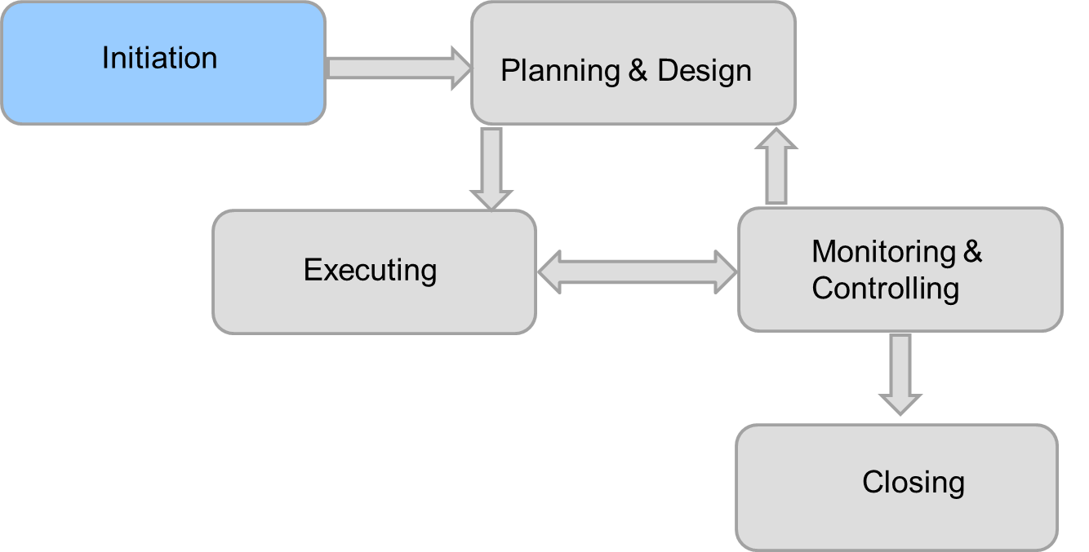
Project Initiation

Slide 25
Project Initiation
“Starting up”
Business case
Feasibility study
Terms of reference
Request for proposal
Proposal
Project Definition (a.k.a. Project Charter)

Slide 26
Request For Proposal (RFP)
Produced after current system is understood and requirements have been gathered
Sent to vendors
Describes situation, expectations, problem to be solved, details of what the vendor is expected to provide
Sets guidelines for proposal structure
Vendor prepares a proposal following guidelines in RFP

Slide 27
Proposal
Document that defines the objectives and requirements of a project
Purpose: to convince the project sponsor that the project is worth the time, money, and effort
If produced as a response to RFP, it must follow the format guidelines
May be written without an RFP
https://www.projectmanager.com/blog/how-to-create-a-project-proposal

Slide 28
Project Definition (Charter)
A detailed document that defines the project
Produced after the project has been accepted
Serves as a reference for the project team and stakeholders
Living document; any changes must be signed by the same set of stakeholders who signed the original

Slide 29
Elements of Project Definition
Purpose / problem / opportunity
Goals & objectives
Estimated duration (start & end dates)
Estimated cost
Scope
Key stakeholders
Assumptions and constraints
Success criteria
Risks

Slide 30
References
Horine, G. (2013). Absolute Beginner’s Guide to Project Management (3 ed.)
Schwalbe, K. (2018). Information Technology Project Management (9 ed.)
Standish Group (2013). CHAOS Manifesto 2013: Think Big, Act Small

Slide 31
Introducing Group Assignment 1

