Slide 1

Research Exercise
HR | Communications | Risk
This presentation will cover what the above topics are, how they operate, and why they are important.
Skye Waddell | Neil Adavan | Omar Charanek | Ben

Slide 2
Human Resources
HR

Slide 3
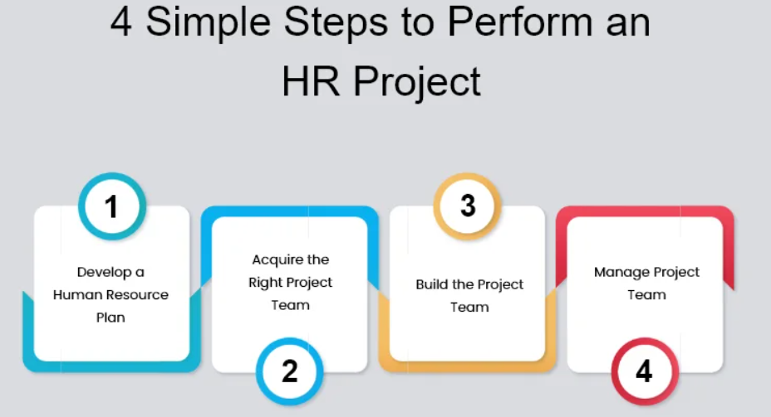
https://www.proprofsproject.com/blog/project-human-resource-management/

Slide 4
Human Resources / HR
What is Human Resources?
HR is usually a department in where they organize a companies interests and relations with labor laws, employee standards, interviewing and selection, performance management, admins of employee benefits, organizing of employee files, and some aspects of employee recruitment/offboarding.

Slide 5
Human Resources / HR
What are the processes in it?
Human resources is often the link for a company’s management to their employees.
Duties that human resources deals with can also include payroll, organizing resumes/job applications, scheduling interviews, ensuring background checks. Including payroll, HR is usually responsible for vacation, and sick pay.

Slide 6
Human Resources / HR
What are the processes in it?
HR can also help with employees directly by offering services such as Employee Counselling.

Slide 7
Human Resources / HR
What are the processes in it?
HR may also be delegated into managing, and regular maintenance. Including making sure files, and databases are current, as well as managing the employee benefits and employment statuses.

Slide 8
Human Resources / HR
Why is it important?
To help your business be most focused, you can have another department which does all the paperwork, manages employees, and payroll, and government regulated processes that every business must follow. This gives the company less stress to work on processes they may not be proficient in and focus on what the company actually develops.

Slide 9
Communications

Slide 10
Communications
What is communications
Project communication management is a collection of processes that help make sure the right messages are sent, received, and understood by the right people.

Slide 11
Communications
Why is it important?
Creates a bridge between diverse resources
Allows to establish and maintain interpersonal relationships
Gain additional information needed.

Slide 12
Communications
What are the processes in it?
Plan Communications Management
Manage Communications
Control/Monitor Communications

Slide 13
Communications
Plan communication management
The process of developing an appropriate approach and plan for project communications based on stakeholder's information needs and requirements, and available organizational assets.

Slide 14
Communications
Manage Communication
The process of creating, collecting, distributing, storing, retrieving and the ultimate disposition of project information in accordance with the communications management plan.

Slide 15
Communications
Control/Monitor Communication
The process of monitoring and controlling communications throughout the entire project life cycle to ensure the information needs of the project stakeholders are met.

Slide 16
Risk Management
a risk management plan is important so we can plan when things go wrong and be prepared for it, so minimize the negative impact.

Slide 17
Risk Management
What is Risk Management?
The 5 steps of Risk Management:
- Risk Identification
- Risk Analysis
- Risk Control
- Risk Finances
- Claims Management

Slide 18
Risk Management
Risk Identification
-Identify the risks that can happen, how it can affect shareholders, employees, organization.
Ex: driving a car, could crash, damage property. How it can affect my employees

Slide 19
Risk Management
Risk Analysis
-Analyze the risk ( If risks happen, who/how does it effect company)
What are the chances it happens, percentages.
Ex: driving car example, what are the odds of crashing, car breaking down. If risk happens, how can it affect company, my employees.

Slide 20
Risk Management
Risk Control
-What can I do to prevent said risks?
Ex: driving, how can I prevent a crash? What can I do to prevent risks happening and protecting the organization.

Slide 21
Risk Management
Risk Finances
-back up plan to cover expenses if risk controls don’t work. How can we financially recover.
Car ex: insurance, just in case we crash.

Slide 22
Risk Management
Claims Management
-managing the harm done, when things don’t go our way.
Ex: making an insurance claim.

