Slide 1
Team number: 1 Week number: 25/02/2025
Enter agreed team session objectives and related assignment task (add rows as needed)
Session Objective | Related assignment task
To incorporate & test Kalman Filters within laptop.py ​ | Uncertainty Code (EKF)​
To incorporate & test Kalman Filters within laptop.py ​ ​ | Updated Motion Model​

Slide 2
Individual contribution log
Name: Connor Costa Student ID: 31662951
Personal Reflection: Reviewed Kalman filters and completed Tutorial 5 from Friday’s session to ensure a thorough understanding and alignment with the course content. Completed
Reviewed Kalman filters and completed Tutorial 5 from Friday’s session to ensure a thorough understanding and alignment with the course content.
The team split into two sub-teams tackling following tasks: Uncertainty Model Coding – Danae Topi & Costa Connot – Worked together to implement and test the EKF that works with our main laptop.py code and shares the same class structure.
Full Motion Model, aligned with uncertainty code – Skye Mckechnie
Parse & Code Logging – Marwan Ismail
Code doesn’t work and take too long to debug before next Tuesday's session

Slide 3
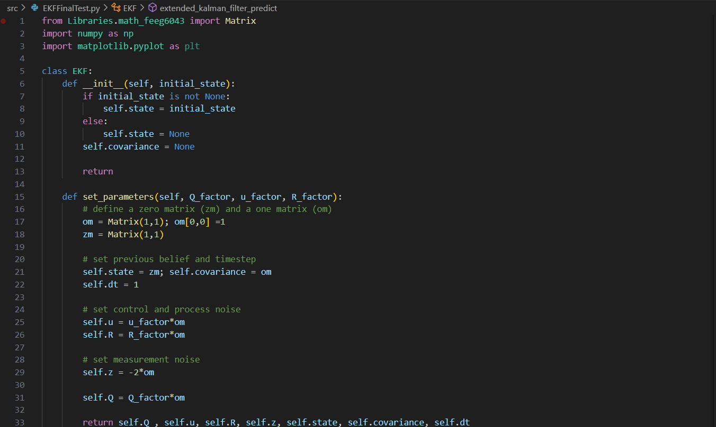
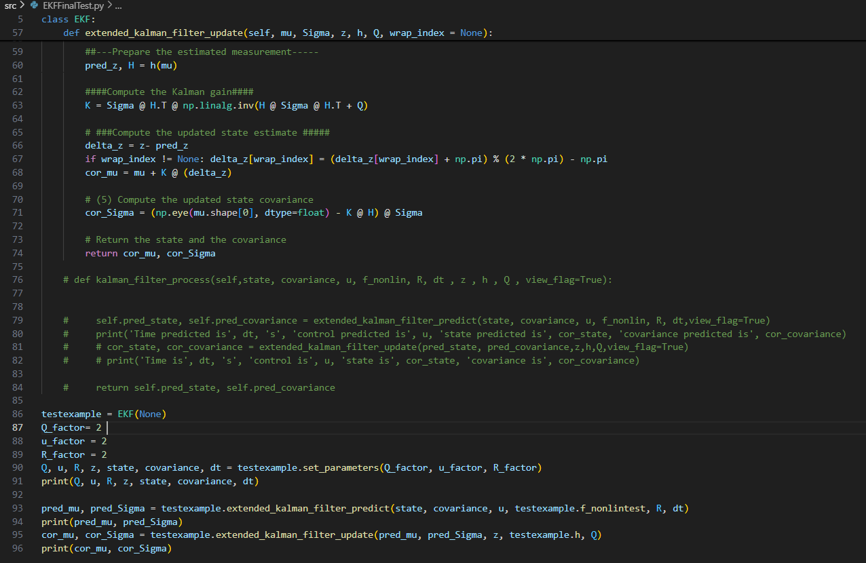
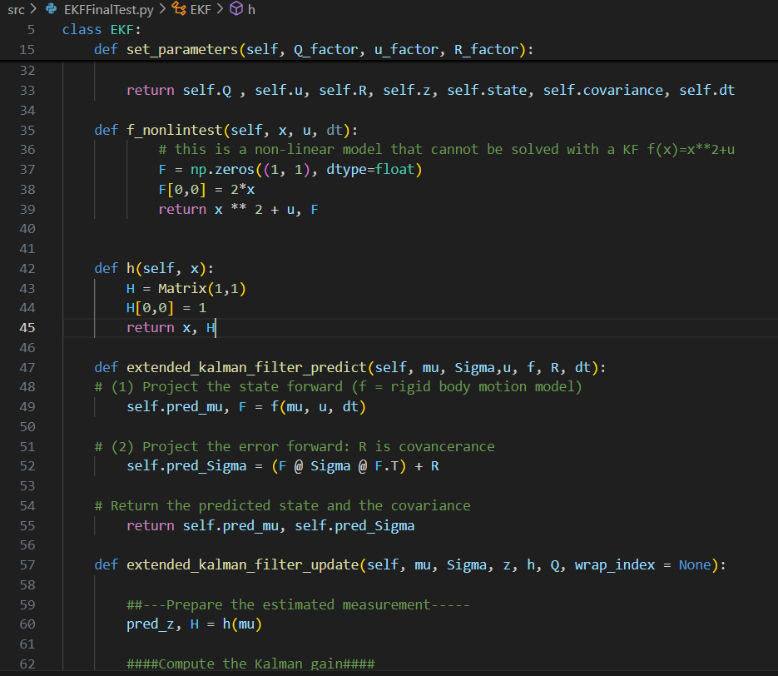
Evidence of technical contribution (1 sheet only):

