Slide 1
Analysis of Family planning
Bipul

Slide 2
Problem:
We have survey data for women aged 15-49 years.
We want to compare the age of women when she gave birth to first child.
We divided our data into 4 categories: Women born in 1991-2000, 1981-1990, 1071-1980, 1961-1970.
But in this case comparing the age of women of age 11-19 during their first child birth with the age of women of age 20-29 because for the former women only got 20 years for child birth time.

Slide 3
Modelling solutions:
Generate proportional samples and add it to our dataset.
We want to find out situation as if we would have done the survey 10 years ahead for women born in 1971-1980.
Similarly for survey 20 years ahead for women born in 1981-1990 and survey done at 30 years ahead for women born in 1991-2000.
Only consider samples till mothers of age<20.
We want to find out situation if survey had been done 10 years back for women born in 1981-1990.
Similarly for survey done 20 years back for born in 1971-1980 and survey done 30 years back for women born in 1961-1970.

Slide 4
Only consider samples till mothers of age<20:
Conclusions (from graph at next slide):
Most of the women born in 1961-1970 had their first baby at the age of 18.
But the fraction of such women is decreasing over period. As we can see almost equal fraction of women born in 1971-1980 had their first child at age 18 and age 19.
We can also see for women born in 1981-1990, there is very subtle peak at 18 but eventually most of women prefer 19 as their age of motherhood.
Women born in 1991 onwards prefer to become mother at age 19.

Slide 5
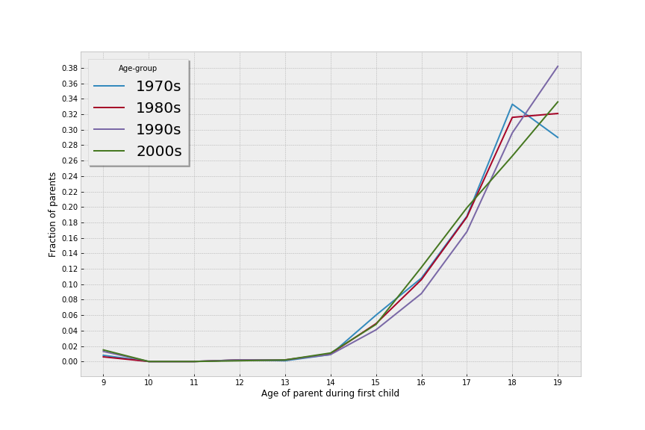

Slide 6
Generate proportional samples and add it to our dataset:
For women born in 1971-1980:
Their max age is 40. As they were interviewed in 2011.
So we will add new samples who will be born in 1971-1980 but will probably have their first child at the age of 41.
We will do similarly for ages 42 to 49.
For adding new samples we would find the fraction of women who born in 1961-1970 and multiply with the no of women of age 1971-1980.
This will give us coarse approximation.
We can make it fine grained if instead of 10-yeared samples we use 1year samples. What it means is:
for finding fraction of women who will have their first child at age 41 and were born in year 1971, we consider the women born in 1961.

Slide 7
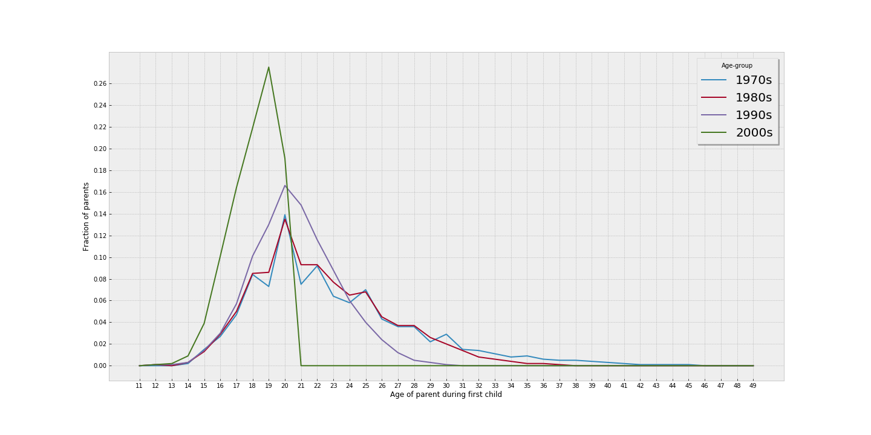

Slide 8
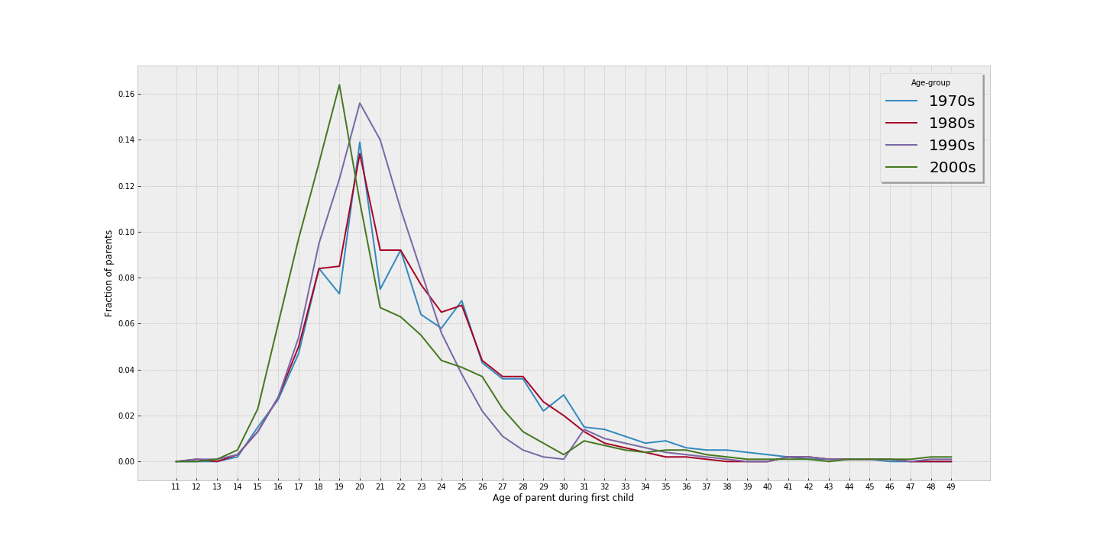

Slide 9
Generate proportional samples and add it to our dataset:
Conclusions:
Most of women became mother between age of 18 and 25 years.
Most women born in 1961-1990 became mother at the age of 20 years.
Women born in year 1991-2000 appear to become mother 1 year earlier.
It seems that modern women are becoming mother earlier. But our dataset is biased in the sense that the women who were interviewed were already mothers. So we could not get later peaks and hence we don’t know the relative fraction of women who would choose to become mother after 19 years.

