Slide 1
Connecting the digital worlds
HACK THE WOOD Berlin 2019

Slide 2


The Idea
+
Notes:
IF I like a music video on YouTube THEN add it to my Spotify library.
IF my vacuum cleaner is stuck somewhere THEN send me a push notification.
IF my CNC machine set off an alarm THEN safe the last 5 minutes of the video feed of my webcam which was monitoring the machine.

Slide 3
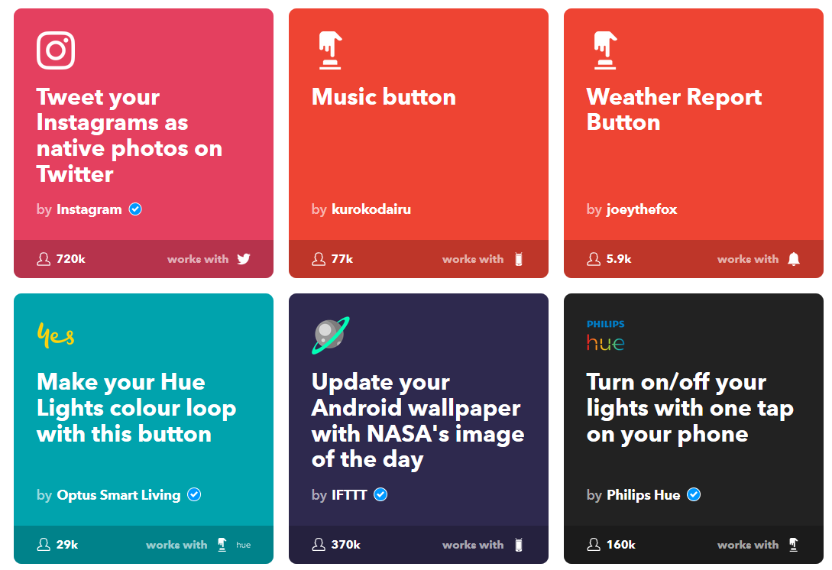
Applets

Slide 4
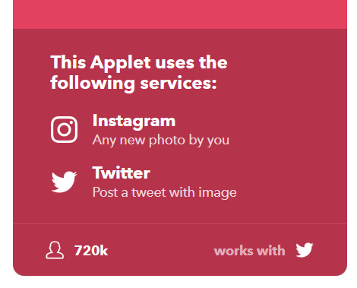
Triggers & Actions
Notes:
Applets bestehen aus Triggern und Actions von Services

Slide 5
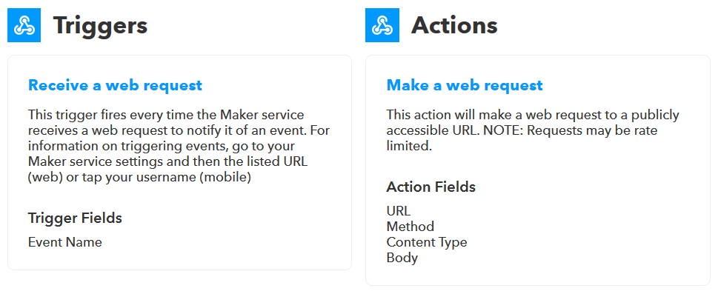
Webhook- instead of Service-Integration

Slide 6
Concept
RPi3
w/ CC & OPCUA Server
I/O
PIR
RGB LED
Services
Salesforce
Philips Hue
Dropbox
Google Assistant
Office 365
Facebook
Instagram
Square
…
Webhooks
EventHub StateAPI
tapio
IFTTT
Connector

Slide 7
TODO
Demo Machine
Setup tapio CloudConnector
Setup OPC UA Server
Connect I/O with OPC UA
Connector
Build component which accepts events form:
IFTTT
EventHub
(StateAPI polling)
Build component which forwards events to:
IFTTT
EventHub
(StateAPI)

Slide 8
Thank you very much!
Simon Eßlinger
Simon.Esslinger@homag.com
HOMAG Group AG
Homagstraße 3-5
D-72296 Schopfloch
www.homag.com

