Slide 1
SIFT
報告人:黃于修
指導教授:虞台文
日期:2017/02/22
Notes:
本地尺度不變特徵的對象識別
http://www.cs.ubc.ca/~lowe/papers/iccv99.pdf
參考文獻
https://www.quora.com/What-does-octave-in-SIFT-means-Is-it-different-resolutions-of-the-image
http://ff320232.blogspot.tw/2013/06/opencv-face-detection.html
https://www.researchgate.net/figure/233941136_fig8_SIFT-feature-points-extracted-from-two-consecutive-frames-yellow-marks-Feature
http://www.cmap.polytechnique.fr/~yu/research/ASIFT/demo.html

Slide 2
Introduction
Matching features across different images in a common problem in computer vision.
When all images are similar in nature (same scale, orientation, etc) simple corner detectors can work.
But when you have images of different scales and rotations, you need to use the Scale Invariant Feature Transform.

Slide 3
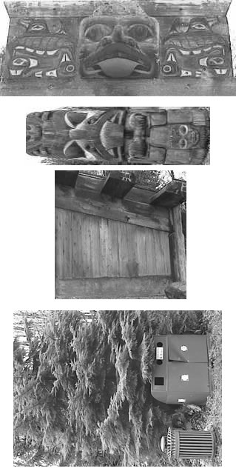
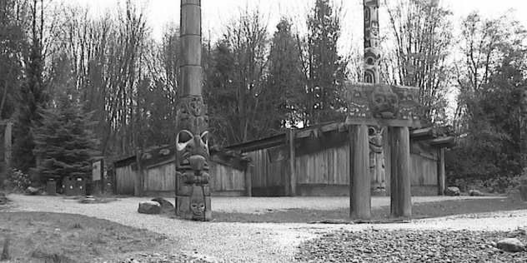
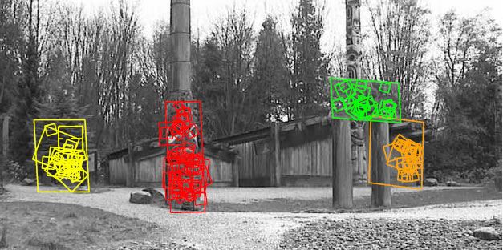
SIFT
SIFT isn't just scale invariant.
change the following and still get
good results:
Scale (duh)
Rotation
Illumination
Viewpoint

Slide 4
The algorithm
Constructing a scale space
LoG Approximation
Finding keypoints
Get rid of bad key points
Assigning an orientation to the keypoints
Generate SIFT features
Notes:
輸入圖像首先使用FFF與高斯函數進行卷積以給出圖像A.然後，通過FFF的進一步增量平滑來重複第二次，以給出新圖像B，其現在具有FFF的有效平滑。 高斯函數的差通過從A中減去圖像B獲得，得到兩個高斯之間的FFF的比率

Slide 5
Constructing a scale space
This is the initial preparation. You create internal representations of the original image to ensure scale invariance. This is done by generating a "scale space

Slide 6
LoG Approximation
The Laplacian of Gaussian is great for finding interesting points (or key points) in an image. But it's computationally expensive. So we cheat and approximate it using the representation created earlier

Slide 7
Finding keypoints
With the super fast approximation, we now try to find key points. These are maxima and minima in the Difference of Gaussian image we calculate in step 2.

Slide 8
Get rid of bad key points
Edges and low contrast regions are bad keypoints. Eliminating these makes the algorithm efficient and robust. A technique similar to the Harris Corner Detector is used here.

Slide 9
Assigning an orientation
An orientation is calculated for each key point. Any further calculations are done relative to this orientation. This effectively cancels out the effect of orientation, making it rotation invariant.

Slide 10
Generate SIFT features
Finally, with scale and rotation invariance in place, one more representation is generated. This helps uniquely identify features. Lets say you have 50,000 features. With this representation, you can easily identify the feature you're looking for (say, a particular eye, or a sign board).

Slide 11
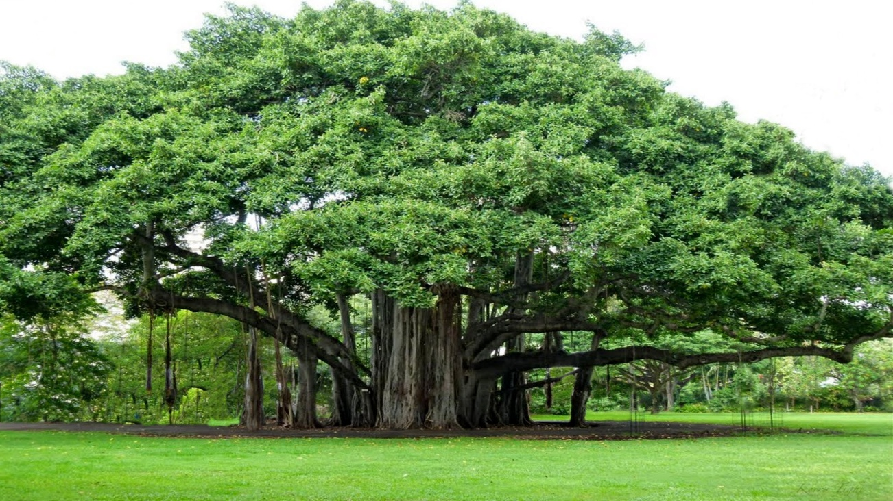
The scale space
Real world objects are meaningful only at a certain scale.
Do you want to look at a leaf or the entire tree? If it's a tree, get rid of some detail from the image (like the leaves, twigs, etc) intentionally.

Slide 12
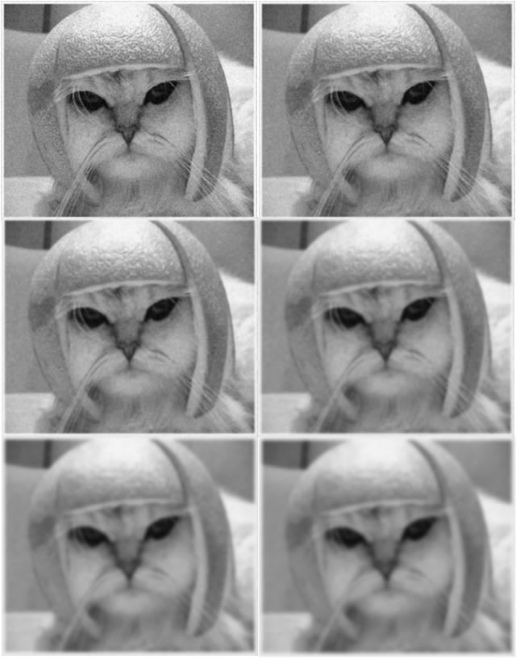
The scale space
While getting rid of these details, you must ensure that you do not introduce new false details.
The only way to do that is with the Gaussian Blur.
It was proved mathematically, under several reasonable assumptions.

Slide 13
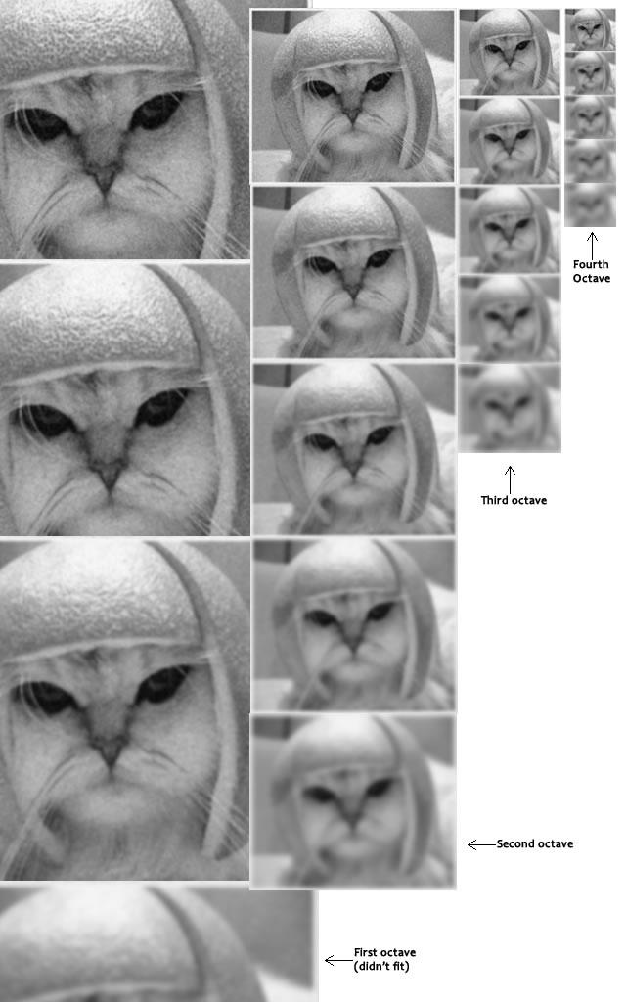
The scale space in SIFT
SIFT takes scale spaces to the next level.
Take the original image, and generate progressively blurred out images.
Resize the original image to half size.
Generate blurred out images again.
Keep repeating.

Slide 14
The technical details
The number of octaves and scale depends on the size of the original image.
The creator of SIFT suggests that 4 octaves and 5 blur levels are ideal for the algorithm.
If the original image is doubled in size and antialiased a bit (by blurring it) then the algorithm produces more four times more keypoints. The more the keypoints, the better!

Slide 15
Blurring
Mathematically, "blurring" is referred to as the convolution of the gaussian operator and the image. Gaussian blur has a particular expression or "operator" that is applied to each pixel. What results is the blurred image.

Slide 16
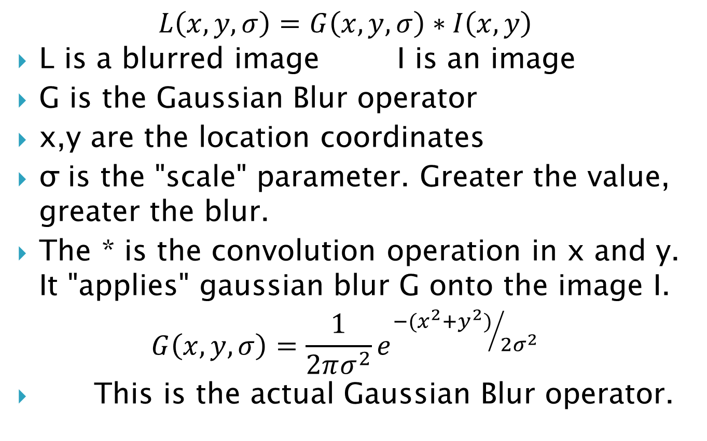
Blurring
$$L\left(x,y,σ\right)=G\left(x,y,σ\right)∗I\left(x,y\right)$$
L is a blurred image I is an image
G is the Gaussian Blur operator
x,y are the location coordinates
σ is the "scale" parameter. Greater the value, greater the blur.
The * is the convolution operation in x and y. It "applies" gaussian blur G onto the image I.
$$G\left(x,y,σ\right)=\frac{1}{2πσ^{2}}e^{{−(x^{2}+y^{2})}/{2σ^{2}}}$$
This is the actual Gaussian Blur operator.

Slide 17
Amount of blurring
The amount of blurring in each image is important.
Assume the amount of blur in a particular image is σ.
Then, the amount of blur in the next image will be k*σ.

Slide 18
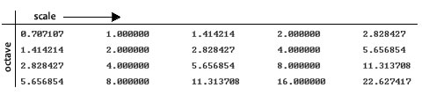

Amount of blurring
This is a table of σ's for my current example. See how each σ differs by a factor$\sqrt{2}$ from the previous one.

Slide 19
Summary
In the first step of SIFT, you generate several octaves of the original image.
Each octave's image size is half the previous one.
Within an octave, images are progressively blurred using the Gaussian Blur operator.
In the next step, we'll use all these octaves to generate Difference of Gaussian images.

Slide 20
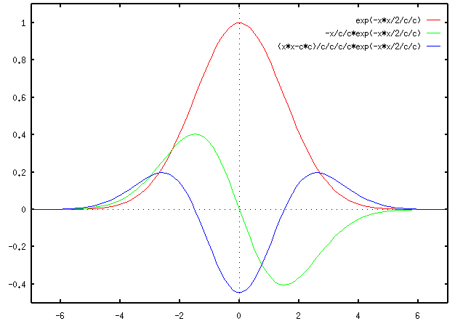
LoG approximations
Use those blurred images to generate another set of images, the Difference of Gaussians (DoG).
These DoG images are a great for finding out interesting key points in the image.

Slide 21
Laplacian of Gaussian(LoG)
The Laplacian of Gaussian (LoG) operation goes like this.
Take an image, and blur it a little.
Calculate second order derivatives on it (or, the "laplacian").
This locates edges and corners on the image.
These edges and corners are good for finding keypoints.

Slide 22
Laplacian of Gaussian(LoG)
The second order derivative is extremely sensitive to noise.
The blur smoothes it out the noise and stabilizes the second order derivative.
But calculating all those second order derivatives is computationally intensive.
Notes:
二階導數對雜訊極為敏感

Slide 23
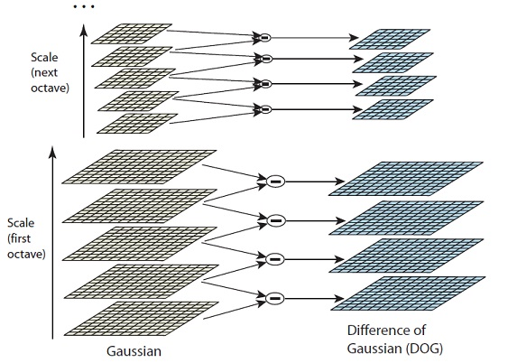
The Con
To generate Laplacian of Guassian images quickly, we use the scale space.
We calculate the difference between two consecutive scales/Difference of Gaussians.

Slide 24
The Con
These Difference of Gaussian images are approximately equivalent to the Laplacian of Gaussian.
These approximations are also "scale invariant".

Slide 25
The Benefits
Just the Laplacian of Gaussian images aren't great(not scale invariant).
That is, they depend on the amount of blur you do. This is because of the Gaussian expression.

Slide 26

The Benefits
$$G\left(x,y,σ\right)=\frac{1}{2πσ^{2}}e^{{−(x^{2}+y^{2})}/{2σ^{2}} }$$
$σ^{2} is \text{the} \text{scale}$.
If we somehow get rid of it, we'll have true scale independence.

Slide 27
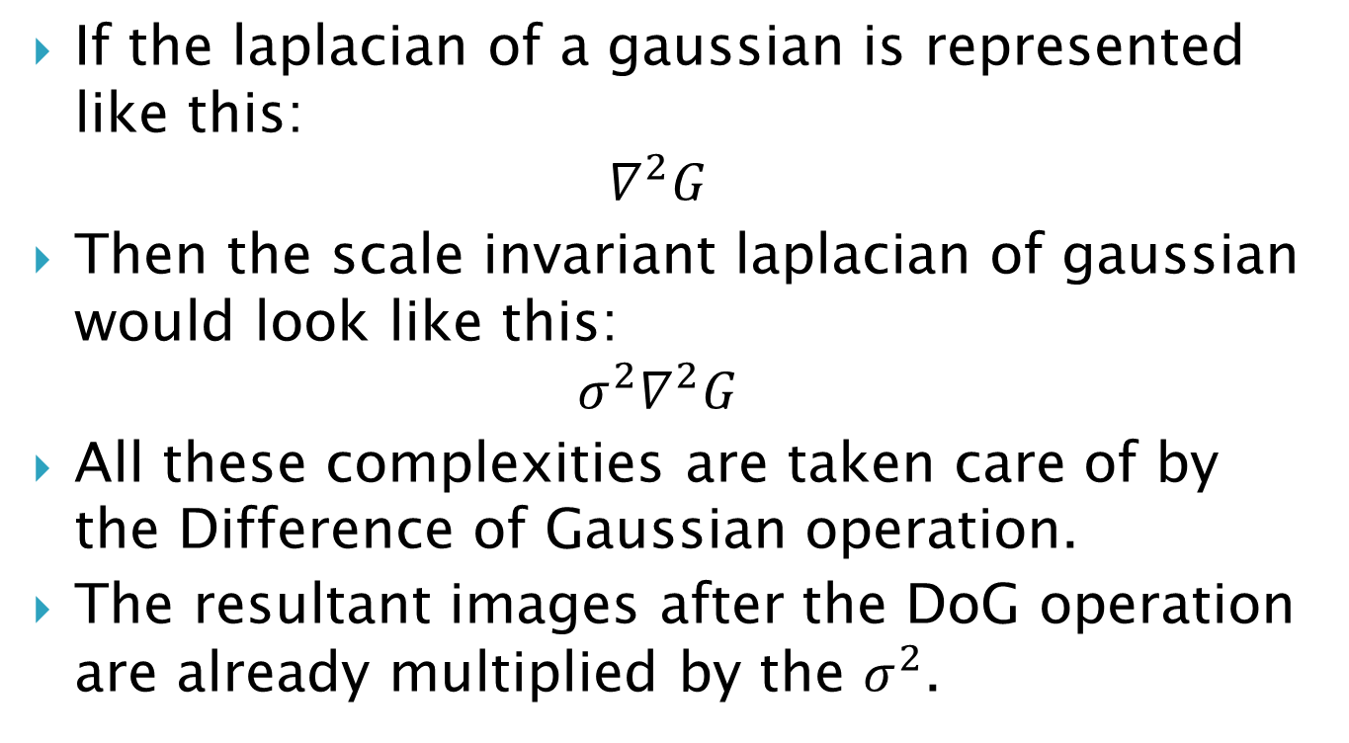
The Benefits
If the laplacian of a gaussian is represented like this:
$$∇^{2}G$$
Then the scale invariant laplacian of gaussian would look like this:
$$σ^{2}∇^{2}G$$
All these complexities are taken care of by the Difference of Gaussian operation.
The resultant images after the DoG operation are already multiplied by the $σ^{2}$.

Slide 28
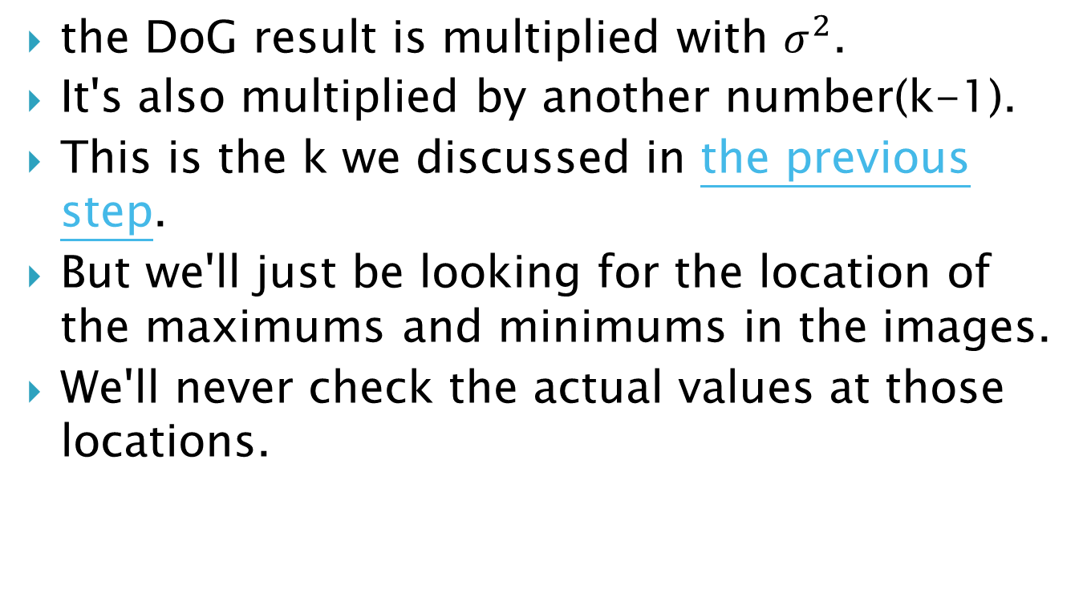
Side effects
the DoG result is multiplied with $σ^{2}$.
It's also multiplied by another number(k-1).
This is the k we discussed in the previous step.
But we'll just be looking for the location of the maximums and minimums in the images.
We'll never check the actual values at those locations.

Slide 29
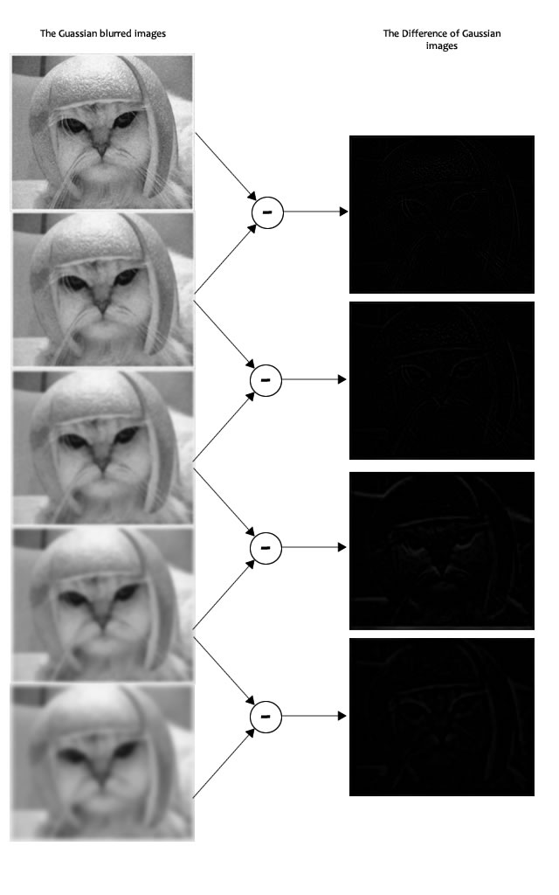
Example
In the image, I've done the subtraction for just one octave.
The same thing is done for all octaves.

Slide 30
Finding keypoints
Finding key points is a two part process
Locate maxima/minima in DoG images
Find subpixel maxima/minima

Slide 31
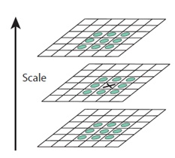
Locate maxima/minima in DoG images
iterate through each pixel and check all it's neighbours.
The check is done within the current image, and also the one above and below it. Something like this.
X marks the current pixel.
The green circles mark the
neighbours.
X is marked as a "key point"
if it is the greatest or least of
all 26 neighbours.

Slide 32
Locate maxima/minima in DoG images
Usually, a non-maxima or non-minima position won't have to go through all 26 checks.
Note that keypoints are not detected in the lowermost and topmost scales. There simply aren't enough neighbours to do the comparison.

Slide 33
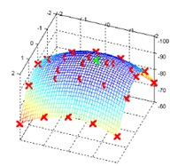
Locate maxima/minima in DoG images
The marked points are the approximate maxima and minima.
Because the maxima/ minima almost never lies exactly on a pixel. It lies somewhere between the pixel.
we must mathematically locate the subpixel location.

Slide 34
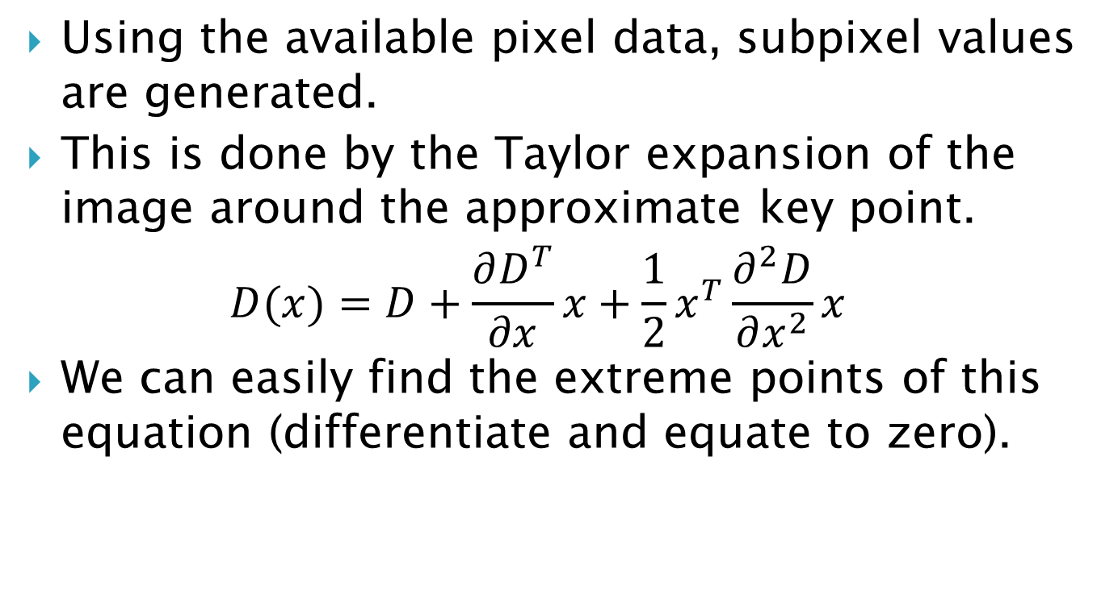
Find subpixel maxima/minima
Using the available pixel data, subpixel values are generated.
This is done by the Taylor expansion of the image around the approximate key point.
$$D(x)=D+\frac{∂D^{T}}{∂x}x+\frac{1}{2}x^{T}\frac{∂^{2}D}{∂x^{2}}x$$
We can easily find the extreme points of this equation (differentiate and equate to zero).

Slide 35
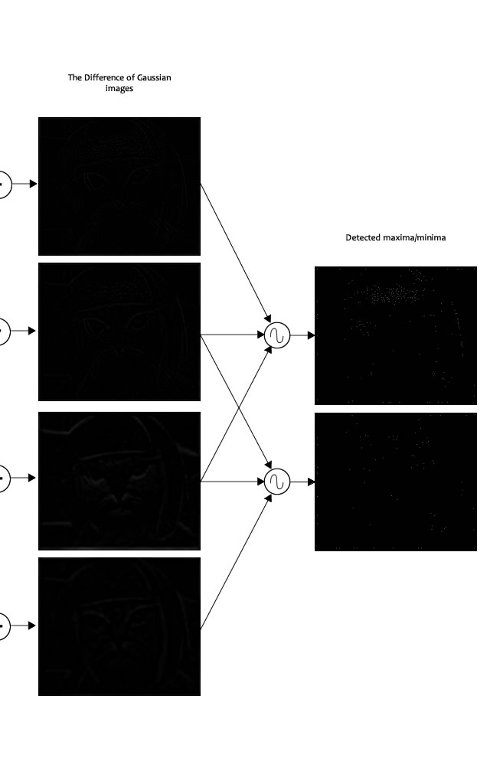
Find subpixel maxima/minima
On solving, we'll get subpixel key point locations.
These subpixel values increase chances of matching and stability of the algorithm.

Slide 37
Find subpixel maxima/minima
The author of SIFT recommends generating two such extrema images. So, you need exactly 4 DoG images.
To generate 4 DoG images, you need 5 Gaussian blurred images. Hence the 5 level of blurs in each octave.

Slide 38
Getting rid of low contrast keypoints
Key points generated in the previous step produce a lot of key points.
Some of them lie along an edge, or they don't have enough contrast.
The approach is similar to the one used in the Harris Corner Detector for removing edge features.
For low contrast features, we simply check their intensities.

Slide 39
Removing low contrast features
If the magnitude of the intensity (i.e., without sign) at the current pixel in the DoG image (that is being checked for minima/maxima) is less than a certain value, it is rejected.
Because we have subpixel keypoints (we used the Taylor expansion to refine keypoints), we again need to use the taylor expansion to get the intensity value at subpixel locations. If it's magnitude is less than a certain value, we reject the keypoint.

Slide 40
Removing edges
The idea is to calculate two gradients at the keypoint.
Both perpendicular to each other.
Based on the image around the keypoint, three possibilities exist.
A flat region: If this is the case, both gradients will be small.
An edge: Here, one gradient will be big (perpendicular to the edge) and the other will be small (along the edge)
A "corner": Here, both gradients will be big.

Slide 41
Removing edges
Corners are great keypoints. So we want just corners.
If both gradients are big enough, we let it pass as a key point.
Mathematically, this is achieved by the Hessian Matrix.
In the Harris Corner Detector, two eigenvalues are calculated.
Efficiency is increased by just calculating the ratio of these two eigenvalues. You never need to calculate the actual eigenvalues.
Notes:
Harris Corner Detector
http://aishack.in/tutorials/harris-corner-detector/

Slide 42
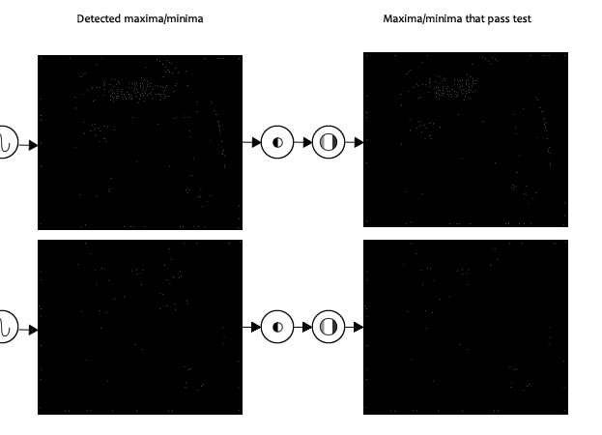
Removing edges
Both extrema images go through the two tests: the contrast test and the edge test.
We're left with a lower number of keypoints to deal with.

Slide 44
Keypoint orientations
We have legitimate key points.They've been tested to be stable.
The next thing is to assign an orientation to each keypoint.
This orientation provides rotation invariance. The more invariance you have the better it is.
Notes:
Legitimate 合法

Slide 45
The idea
The idea is
To collect gradient directions and magnitudes around each keypoint.
Figure out the most prominent orientation(s) in that region.
Assign this orientation(s) to the keypoint.
Notes:
Gradient 梯度
Magnitudes 大小、量綱
Prominent 突出
Region 地區

Slide 46
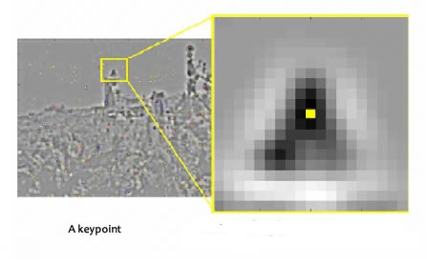
The idea
Any later calculations are done relative to this orientation. This ensures rotation invariance.
The size of the "orientation collection region" around the keypoint depends on it's scale.
The bigger the scale, the bigger the collection region.
Notes:
Relative 相對的、關係
Gradient 梯度
Magnitudes 大小、量綱
Prominent 突出
Region 地區

Slide 47
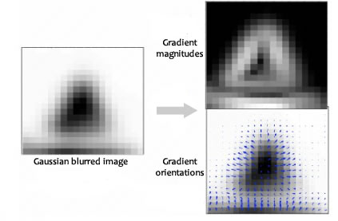
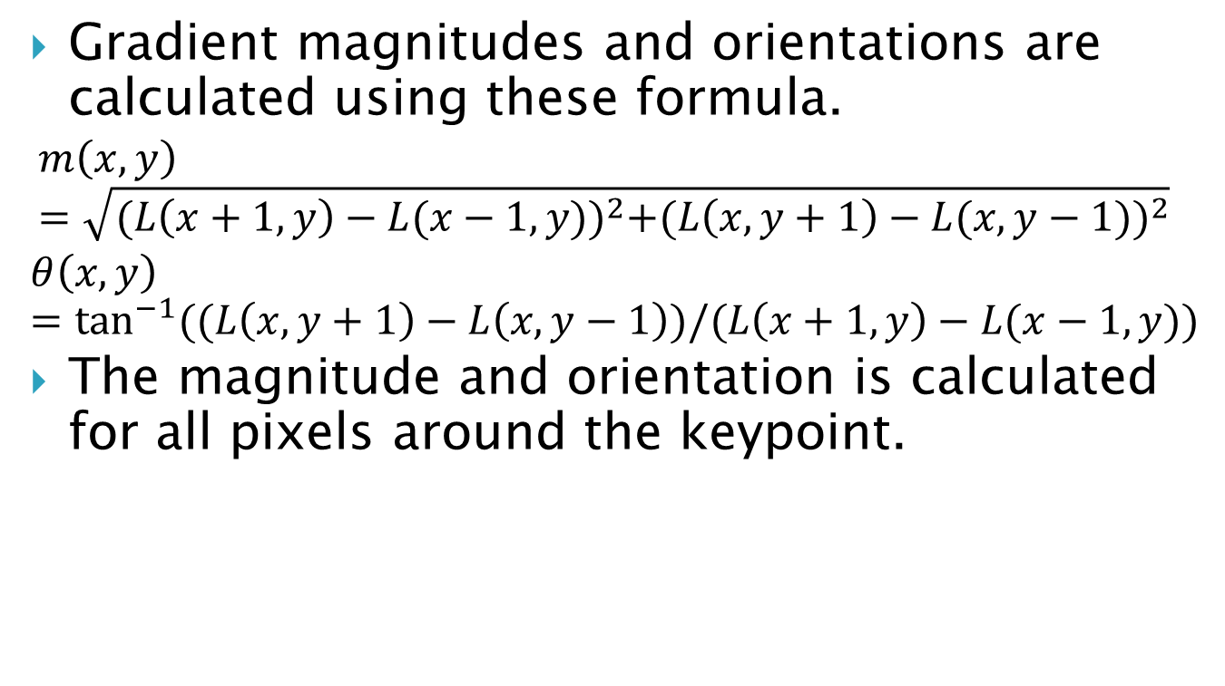
The details
Gradient magnitudes and orientations are calculated using these formula.
$$m\left(x,y\right)=\sqrt{(L\left(x+1,y\right)−L{(x−1,y))}^{2}+(L\left(x,y+1\right)−L{(x,y−1))}^{2}}$$
$$θ\left(x,y\right)=\tan^{−1}{((L\left(x,y+1\right)−L\left(x,y−1\right))/(L\left(x+1,y\right)−L(x−1,y))}$$
The magnitude and orientation is calculated for all pixels around the keypoint.
Notes:
Gradient 梯度
Magnitudes 大小、量綱
Prominent 突出
Region 地區

Slide 48
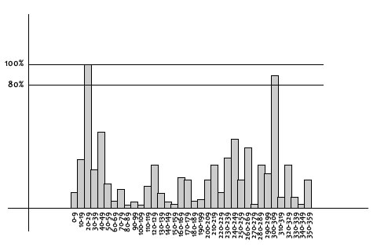
The details
Lets say the gradient direction at a certain point (in the "orientation collection region") is 18.759 degrees, then it will go into the 10-19 degree bin. And the "amount" that is added to the bin is proportional to the magnitude of gradient at that point.
Notes:
In this histogram, the 360 degrees of orientation are broken into 36 bins (each 10 degrees).
Gradient 梯度
Magnitudes 大小、量綱
Amount 量
proportional 成比例的

Slide 49
The details
Once you've done this for all pixels around the keypoint, the histogram will have a peak at some point.
Above, you see the histogram peaks at 20-29 degrees. So, the keypoint is assigned orientation 3 (the third bin)
Notes:
histogram 直方圖
peak 峰
assigned 分配

Slide 50
The details
Also, any peaks above 80% of the highest peak are converted into a new keypoint.
This new keypoint has the same location and scale as the original.
But it's orientation is equal to the other peak.
So, orientation can split up one keypoint into multiple keypoints.
Notes:
histogram 直方圖
peak 峰
split 分裂

Slide 51
The Technical Details
Magnitudes
Saw the gradient magnitude image above? In SIFT, you need to blur it by an amount of 1.5*sigma.
Size of the window
The window size, or the "orientation collection region", is equal to the size of the kernel for Gaussian Blur of amount 1.5*sigma.
Notes:
Magnitudes 大小、量綱

Slide 52
Generating a feature
Create a fingerprint for each keypoint to identify a keypoint.
By using these fingerprints, we'll be able to distinguish it from other keypoints.
Notes:
distinguish 區分

Slide 53
The idea
It should be easy to calculate to generate a very unique fingerprint for the keypoint.
We also want it to be relatively lenient when it is being compared against other keypoints.
Notes:
generate 生成
relatively 相對
lenient 寬容
against 對著

Slide 54
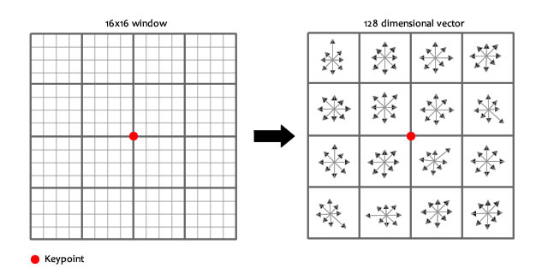
Generating a feature
A 16x16 window around the keypoint will be broken into sixteen 4x4 windows.

Slide 55
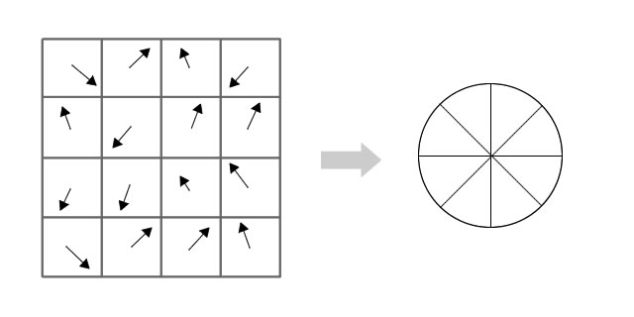
Generating a feature
Within each 4x4 window, gradient magnitudes and orientations are calculated.
These orientations are put into an 8 bin histogram.
Notes:
gradient magnitudes 向量大小
histogram 直方圖

Slide 56
The idea
Any gradient orientation in the range
0-44 degrees add to the first bin.
45-89 add to the next bin.
And so on.
And (as always) the amount added to the bin depends on the magnitude of the gradient.
Notes:
orientations 方向
amount 量、合計
depends 依靠
magnitude 大小
gradient 向量

Slide 57
The idea
Unlike the past, the amount added also depends on the distance from the keypoint.
So gradients that are far away from the keypoint will add smaller values to the histogram.
This is done using a "gaussian weighting function".
Notes:
amount 量、合計
depends 依靠
distance 距離
gradient 向量

Slide 58
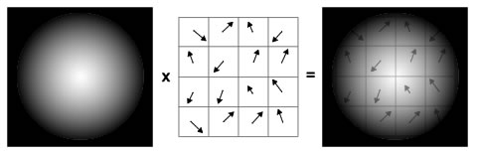
The idea
Gaussian weighting function simply generates a gradient (it's like a 2D bell curve).
Multiple it with the magnitude of orientations, and it will get a weighted thingy.
Notes:
bell curve 鐘形曲線
weighted thingy 加權的東西(啄?)

Slide 59
The idea
Doing this for all 16 pixels, you would have "compiled" 16 totally random orientations into 8 predetermined bins.
Do this for all sixteen 4x4 regions. It will end up with 4x4x8 = 128 numbers.
Normalize them.
These 128 numbers form the "feature vector".
This keypoint is uniquely identified by this feature vector.
Notes:
predetermined 預定
(4 x 4 =)16等份 x 8份的圓餅
feature vector 特徵向量
identified 決定

Slide 60
Problems
This feature vector introduces a few complications. We need to get rid of them before finalizing the fingerprint :
Rotation dependence
Illumination dependence
Notes:
introduces 衍生
complications 併發症
dependence 依賴
rotation 旋轉
illumination 亮度

Slide 61
1. Rotation dependence
The feature vector uses gradient orientations. Clearly, if you rotate the image, everything changes. All gradient orientations also change. To achieve rotation independence, the keypoint's rotation is subtracted from each orientation. Thus each gradient orientation is relative to the keypoint's orientation.
Notes:
gradient 向量
orientations 方向
achieve 實現
independence 獨立
subtracted 扣除

Slide 62
2.Illumination dependence
If we threshold numbers that are big, we can achieve illumination independence. So, any number (of the 128) greater than 0.2 is changed to 0.2. This resultant feature vector is normalized again. And now you have an illumination independent feature vector!
Notes:
threshold 門檻
achieve 實現
illumination 亮度
independence 獨立
128 = 4 x 4 x 8
resultant 得到

