Slide 1
Object Recognition from Local Scale-Invariant Features David G. Lowe
報告人:黃于修
指導教授:虞台文
日期:2017/02/22
Notes:
本地尺度不變特徵的對象識別
http://www.cs.ubc.ca/~lowe/papers/iccv99.pdf
參考文獻
https://www.quora.com/What-does-octave-in-SIFT-means-Is-it-different-resolutions-of-the-image
http://ff320232.blogspot.tw/2013/06/opencv-face-detection.html
https://www.researchgate.net/figure/233941136_fig8_SIFT-feature-points-extracted-from-two-consecutive-frames-yellow-marks-Feature
http://www.cmap.polytechnique.fr/~yu/research/ASIFT/demo.html

Slide 2
Key localization(1/3)
Lindeberg曾發表高斯函數及其導數是尺度空間分析的唯一可能的平滑函數
為了實現旋轉不變性和高水平的效率，我們選擇在尺度空間中應用的高斯函數的差的最大值和最小值處選擇關鍵位置
通過在每個級別之間重建採樣來構建圖像金字塔來計算

Slide 3
Key localization(2/3)
由於2D高斯函數是可分離的，因此可以在水平和垂直方向上各應用一次1D高斯函數，公式:
所有平滑操作都是用 來完成
which can be approximated with sufficient accuracy using a 1D kernel with 7 sample points.

Slide 4
Key localization(3/3)
The input image is first convolved with the Gaussian function using = p 2 to give an image A. This is then repeated a second time with a further incremental smoothing of = p 2 to give a new image, B, which now has an effective smoothing of = 2. The difference of Gaussian function is obtained by subtracting image B from A, resulting in a ratio of 2/ = between the two Gaussians.
Notes:
輸入圖像首先使用FFF與高斯函數進行卷積以給出圖像A.然後，通過FFF的進一步增量平滑來重複第二次，以給出新圖像B，其現在具有FFF的有效平滑。 高斯函數的差通過從A中減去圖像B獲得，得到兩個高斯之間的FFF的比率

Slide 5
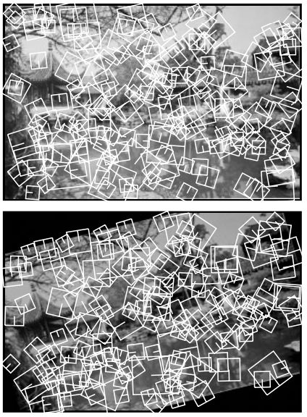
SIFT key stability(1/)

Slide 6
SIFT key stability(/)

