Slide 2
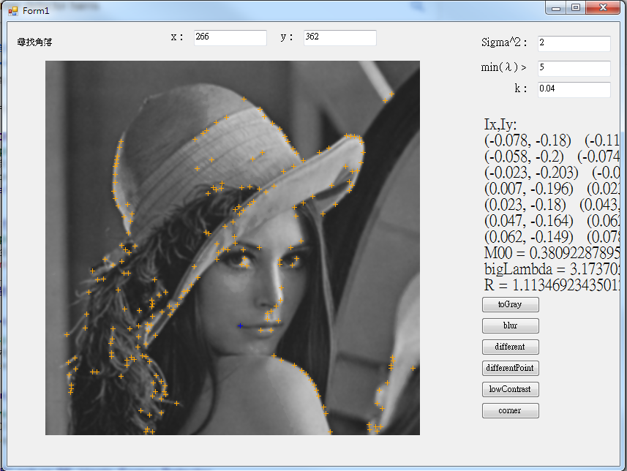
>128*1.02;<128*0.98

Slide 3
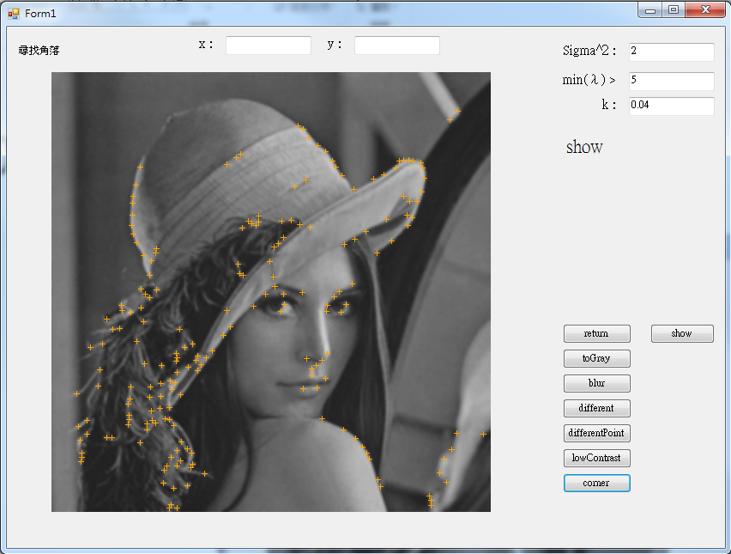
<128*1.02;>128*0.98

Slide 4
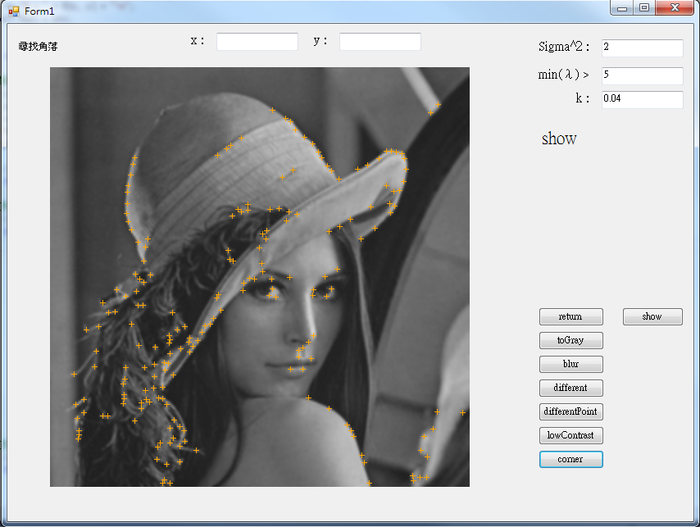
0

