Slide 1
LHCb Grid Simulation

Slide 2
Goals and problems
Try to develop smarter algorithms for
    Data management
    Predict anomalies
    Job scheduling
Need a simulator to test such things
Use grid simulation to optimize algorithms/compare with existing ones
Have a feedback from you

Slide 3
Strategy
Develop and run
simulator
Try to improve
collected metrics
Collect metrics
from existing algorithms

Slide 4
Simulation process
Generate input
job stream
Simulate execution
of job stream
Measure metrics
Plot results

Slide 5
Current state of the project
More real input jobs
Storage
Real links
Multi-core (1job per core)
Tracing metrics

Slide 6
Input job parameters
Name
Type (User, MC, Reconstruction, Stripping , … )
Time of job submission to queue
Amount of flops needed to execute job
Name of input dataset file
  Size of dataset
  Number of available replicas
  Types (disk or tape) of available replicas
  Locations of dataset
Name of output dataset
  Size of dataset
  Number of output replicas
  Locations and storage type (disk or tape) of output replicas
Maybe something else?

Slide 7
Network
Tier0-Tier1 links
Link Id | T1 | Use | Bandwidth
CERN-CNAF-LHCOPN-001 | CNAF | Primary | 10G
CERN-GRIDKA-LHCOPN-001 | GRIDKA | Primary | 10G
CERN-IN2P3-LHCOPN-001 | IN2P3 | Primary | 10G
CERN-PIC-LHCOPN-001 | PIC | Primary | 10G
CERN-RAL-LHCOPN-001 | RAL | Primary | 10G
CERN-SARA-LHCOPN-001 | SARA | Primary | 10G
CERN-RRCK1-LHCOPN-001 | RRCKI | Primary | 2G
CERN-RAL-LHCOPN-002 | RAL | Backup | 10G
CERN-PIC-LHCOPN-002 | PIC | Backup | 1G
Tier1-Tier1 links
RAL
RRCKI
Link Id | Bandwidth
CNAF-GRIDKA-LHCOPN-001 | 10G
GRIDKA-IN2P3-LHCOPN-001 | 10G
GRIDKA-SARA-LHCOPN-001 | 10G
CERN
IN2P3
PIC
DE-KIT
CNAF
SARA
Data taken from https://twiki.cern.ch/twiki/bin/view/LHCOPN/NamingConventionAndLinksIDs

Slide 8
Tier
Number of cores
Flops per core
Anomalies
  Schedule of anomalies
Links
Storage
  Disk
  Tape

Slide 9
Storage
Each tier has
  1 attached disk
  1 attached tape
  7 mounted disk (remote access to another Tier1s’ storages)
  7 mounted tape (remote access)
Each storage is characterized by write/read/connection rate
Each storage has a file content catalog which contains name and size of datasets

Slide 10
Data popularity
Data management: how increase or decrease in the number of replicas affects job’s wall time
Optimizing disk space by deleting less popular files. Different strategies can be tested
  LRU
  LFU
Namenode contains all relevant info about file popularity:
  Filename
  File size
  Array of clock times when file was requested
Every N days file-deleter seeks for less popular files

Slide 11
Grid topology
ScotGrid
GRIF
LAPP
CPPM
Tier0
7 Tier1
16 Tier2s
Currently known:
  Tier0-Tier1 links
  Tier1-Tier1 links
  Tier0/1/2 storage
  Tier0/1/2 CPU
Currently unknown
  Tier0-Tier2 links
  Tier1-Tier2 links
  {Tier2s} belong to Tier1
  Multi-links
LPC
DESY
SouthGr
RAL
SARA
INFN
RRCKI
CERN
LAF
IN2P3
PTF
PIC
DE-KIT
CNAF
RTF
NorthGrid
London
RDIGrid
CHIPP
LHCbF

Slide 12
Processes or job life-cycle
Scheduler
Tier
Tier(Task receiver
launches task executor)
CSV contains
info about all
jobs in simulation
Tier (Job Requester)
Create replicas
Failed task
Task executor
Copying
tape → disk
Download data,
if necessary
Execute job
Create replicas
Rescheduling
Create replicas

Slide 13

Anomalies
Links
  Decreasing of bandwidth (CERN-PIC, CERN-RAL)
  Link break
Host
  Core’s break by schedule
Rescheduling?
RAL
SARA
RRCKI
CERN
IN2P3
PIC
DE-KIT
CNAF
Not all links are shown here

Slide 14
Algorithms of scheduling
Simple
  Distributes task by “place” in the queue
Data Availability Matching (DAM)
  It accounts for the availability of data on the requesting tier. If there are no suitable jobs DAM becomes simple algorithm

Slide 15
Tracing metrics
Link workload
Number of running cores per site
Time of job execution
Time of job scheduling
Tier efficiency
Total number of datasets on disks/tapes per site (daily)
Total occupied space on disks/tapes per site (daily)
Cumulative input/output data per site (daily)
Cumulative transferred data
Number of job failures per site
Transfer failures per site

Slide 16
Backup

Slide 17
Processes or job life-cycle
Scheduler
Tier
Tier (Job Requester)
Tier(Task receiver
launches task executor)
CSV contains
info about all
jobs in simulation
Rescheduling
Task executor
Failed task
Replicator
Replicator
Replicator

Slide 18
Links
RAL
RRCKI
CERN
IN2P3
PIC
DE-KIT
CNAF
SARA

Slide 19
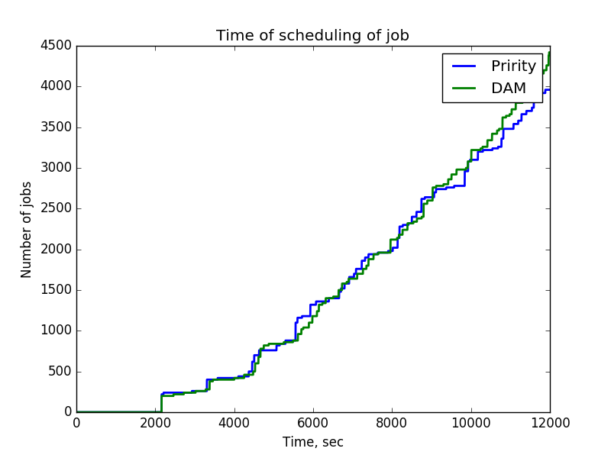
Plots

Slide 20
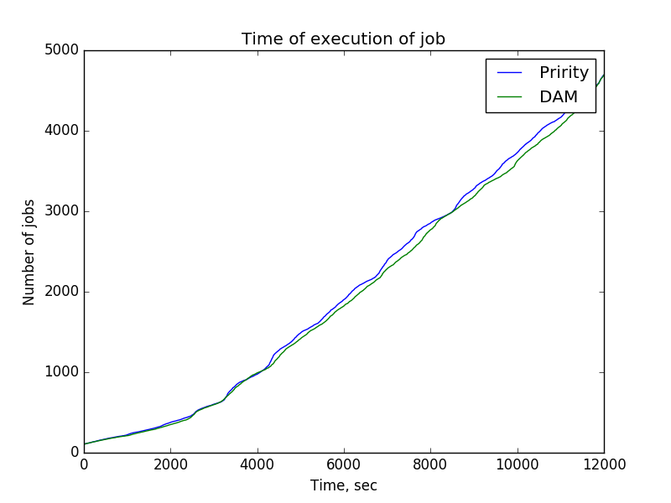

Slide 21
job_requester()
scheduler()
1
matcher()
0.a
2
3
0.
parse_job_bkk()
rescheduling()
executor_launcher()
4
executor()
copy_from_tape_to_disk
download_read_file
task_executor
data_replicator
uploader

