Slide 1
A Phonetician’s Guide to Audio Formats
Chilin Shih
University of Illinois at Urbana Champaign
LSA 2006
January 5-8, 2006

Slide 2

Digital Sound Files
Sound signal in the real world is continuous (analog).
Computers on today’s market cannot handle a continuous signal.
Sound files in our computers have discrete values. They are digital files.

Slide 3
Analog/Digital Conversion
The process of converting speech waves into computer-readable format is called digitization, or A/D conversion.
Our computers convert the digital signal back to analog (D/A conversion) to play back a sound file for us.

Slide 4
Sound File Formats
A digitized sound file may have different
  Sampling rate (96K, 48K, 44.1K … 8K)
  Sample size (32 bits, 24 bits, 16 bits, 8 bits)
  Number of channels (mono, stereo, …)
  Coding methods (linear, log, and many others compression methods), typically indicated by file name suffixes such as .au, .aiff, .wav, .mp3 …
  Byte order (big endian, small endian)

Slide 5
The Structure of a Digital Sound File
Filename
  Indicates coding methods
    .au
    .wav
Header
  Keeps information such as sampling rate, sampling size, coding methods, etc.
Data

Slide 6

Compress or not Compress?
Some compression formats such as mp3 will result in a loss of sound quality. Though the degradation may not be obvious without the support of an ideal listening environment.
If possible, buy disk rather than saving space by using lossy compression.
Disk storage costs about $1 per gigabyte.

Slide 7
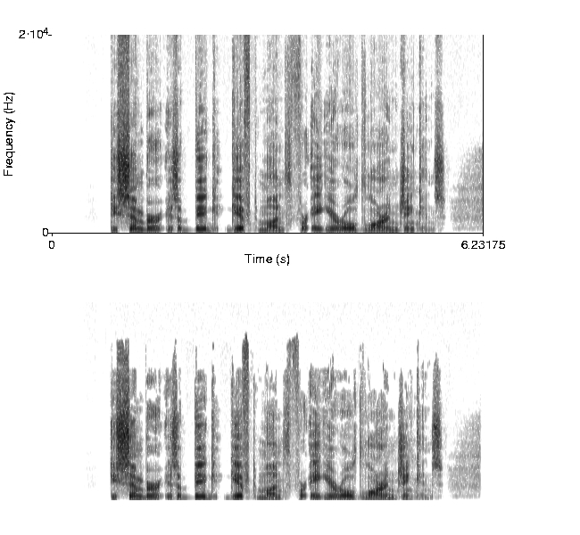


WAV and MP3
wav 550K
mp3 51K
wav->mp3->wav
Conversion by lame

Slide 8
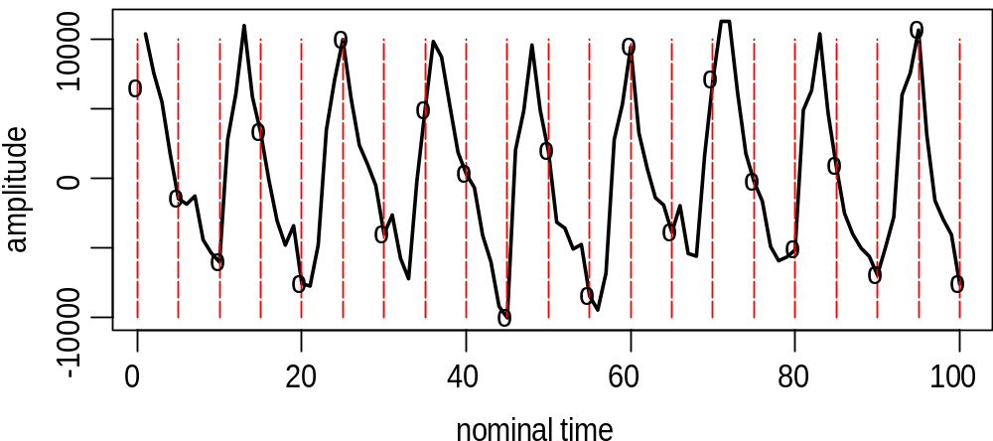
Sampling Rate
High sampling rate preserves sound quality.
Low sampling rate saves disk space.

Slide 9
What Sampling Rate Should I Choose?
  Digitize speech file at minimally twice the frequency range that you are interested in. This is known as the Nyquist rate, or the sampling theorem, proposed by Nyquist in 1928 and proven by Shannon in 1949.
  For example, if you plan to analyze spectrogram information at 8K Hz, you need to digitize speech at 16K Hz.

Slide 10
Sampling Rate Demo
44100 Hz
22050 Hz
11025 Hz (watch out for [s])
8000 Hz
5000 Hz

Slide 11
Sample Size
Larger sample size can represent a bigger range of values (dynamic range).
  8 bits can represent 256 values (2⁸)
  16 bits can represent 65536 values (2¹⁶)
Let’s see what happens if we use a sample size of 2 bits (quantization into 4 values, 2²) to code the previous example.

Slide 12
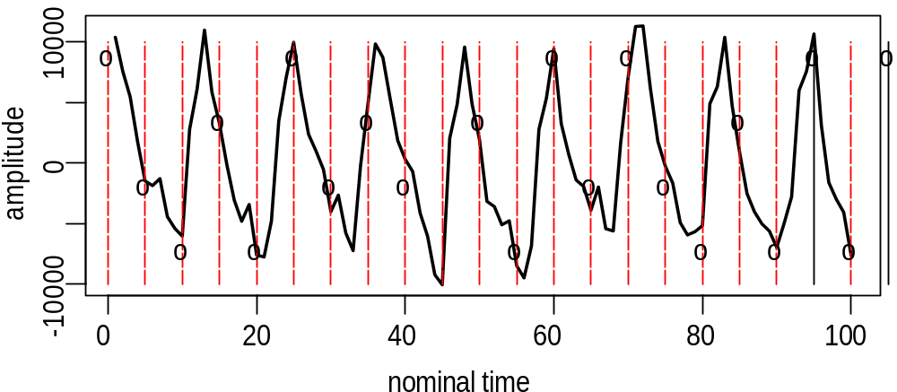
Sample Size Example
We lose information when the sample size is too small, given the same sampling rate.

Slide 13

Sample Size Demo
11k 16 bits
11k 8 bits
8k 16 bits
8k 8bits (telephone)
Listen to the quantization noise in the 8K files.
16-bit has a signal-to-noise ratio of 98dB.
8-bit has a signal-to-noise ratio of 50 dB.It is about
8 times as noisy.

Slide 14
Recording Quality
Clipping
Signal to Noise Ratio (SNR)

Slide 15
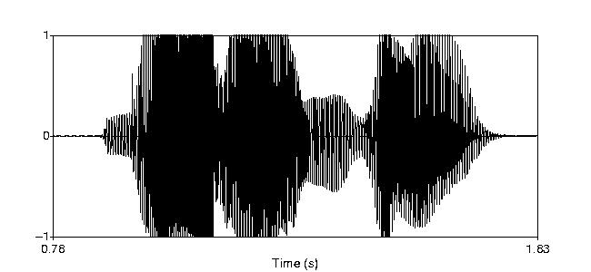
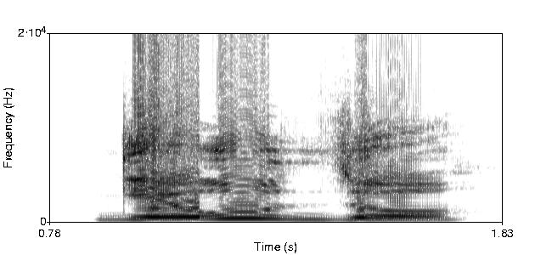
Clipping—Example 1
The sound is too
loud for one or
more components
in the recording setup.

Slide 16
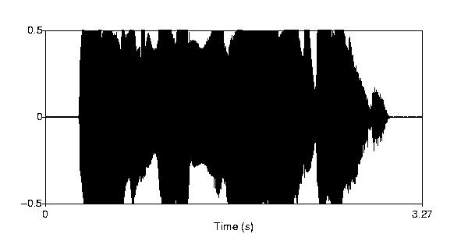
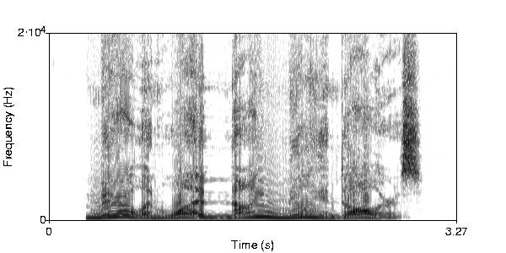
Clipping—Example 2

Slide 17
Signal to Noise Ratio
Signal strength relative to background noise.
The bigger the number, the better.
The SNR limit of 16-bit recording is 98 dB.
S/N = 20 log₁₀ (Vs/Nn)

Slide 18
Three Examples
Classroom recording (SNR 29 dB)
Laptop recording (SNR 44 dB)
Professional recording (SNR 90 dB)

Slide 19
Classroom Recording
A recording sample of 29 dB SNR
  Recorded in a classroom that can accommodate 30 student.
  Classroom floor and walls were bare.
  Build-in microphone on Sony High Definition Digital Camcorder placed in the back of the classroom.
  Microphone to speaker distance is estimated to be 15 feet.
  There were 15 students in the room, scattered between the microphone and the speaker.

Slide 20
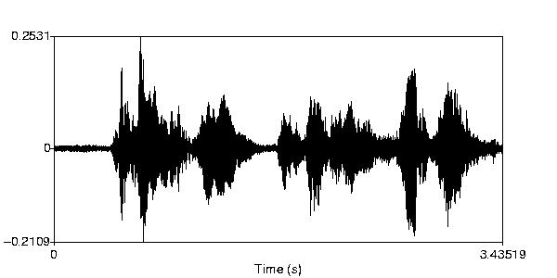
Waveform
Classroom recording. SNR 29dB

Slide 21
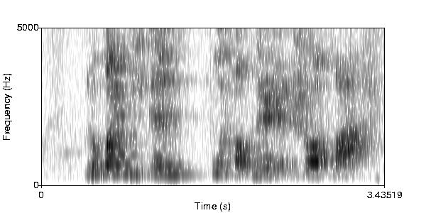
Spectrogram
Classroom recording. SNR 29dB

Slide 22
Laptop Recording
A recording sample of 44 dB SNR
  Recorded in a leaky soundproof room.
  Shure58 Dynamic Microphone ($100)
  Microphone to speaker distance is estimated to be 1.5 feet.
  Sound file digitized on this laptop (IBM Thinkpad with SoundMAX Digital Audio).

Slide 23
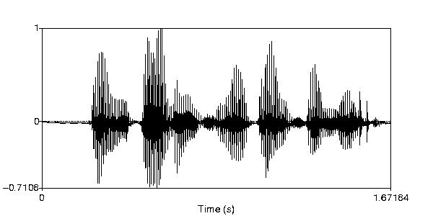
Waveform
Laptop recording. SNR 44 dB

Slide 24
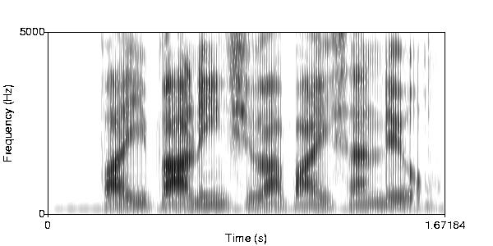
Spectrogram
Laptop recording. SNR 44 dB

Slide 25
An Example of Professional Recording
Produced by Voice Factory International
  Recorded in an anechoic chamber (estimated cost 1 million)
  Brüel &Kjær 4006 omni-directional condenser microphone with flat frequency from 2 Hz to 30 KHz
  Earthworks ZDT 1021 microphone preamp.

Slide 26
Anechoic Chamber
The foundation is designed to absorb ultra-low frequency vibration with 6 tons of sand.
The innermost floor on which the inner chamber is built floats on 40 high-tension steel springs.
No two materials of the same kind come directly in contact.
All surfaces are constructed at oblique angles.

Slide 27
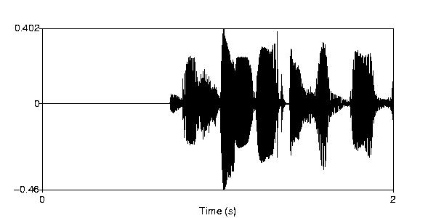
Waveform (female)
Professional recording from VFI. 90dB SNR

Slide 28
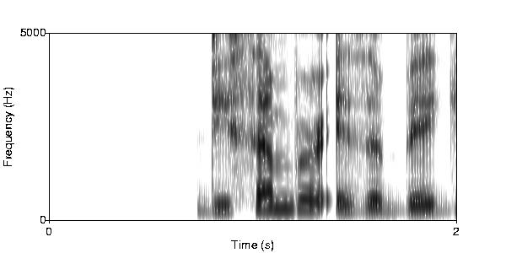
Spectrogram (female)
Professional recording from VFI. 90dB SNR

Slide 29
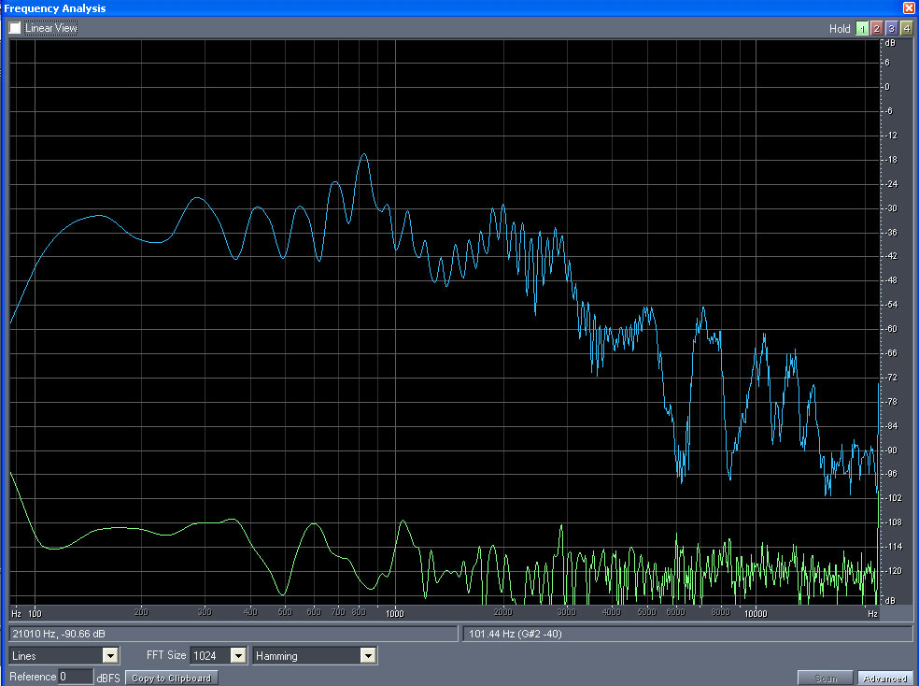
Professional Recording
90dB SNR
-30
-60
-120

Slide 30
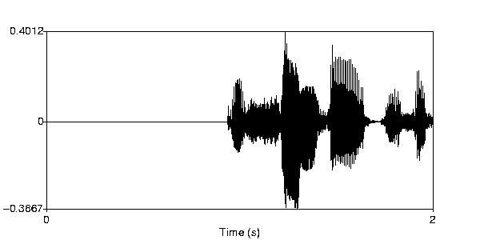
Waveform (male)
Professional recording from VFI. 90dB SNR

Slide 31
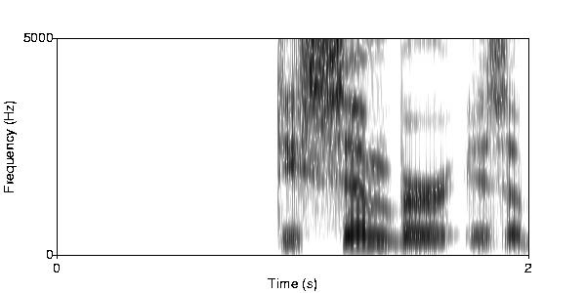
Spectrogram (male)
Professional recording from VFI. 90dB SNR

Slide 32
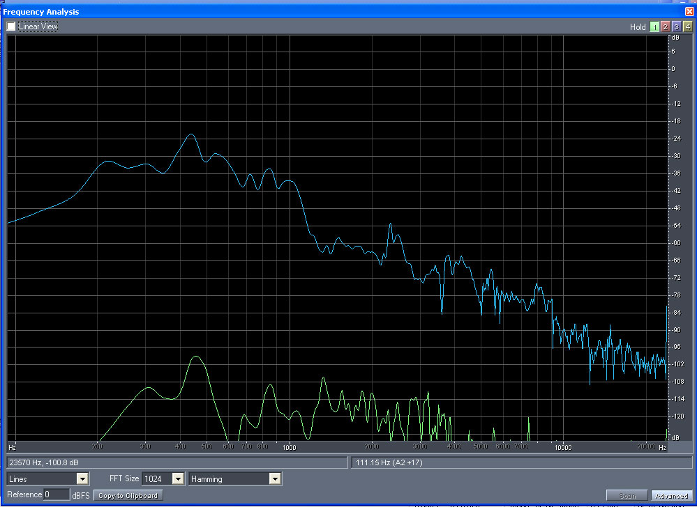
Professional Recording
90dB SNR
-24
-60
-120

Slide 33
Summary
High sampling rate. Large sample size.
Highest signal-to-noise ratio without clipping.
Use compatible equipments.
Do not digitize twice.
Do not use lossy compression—or keep the original if you do.

