Slide 1

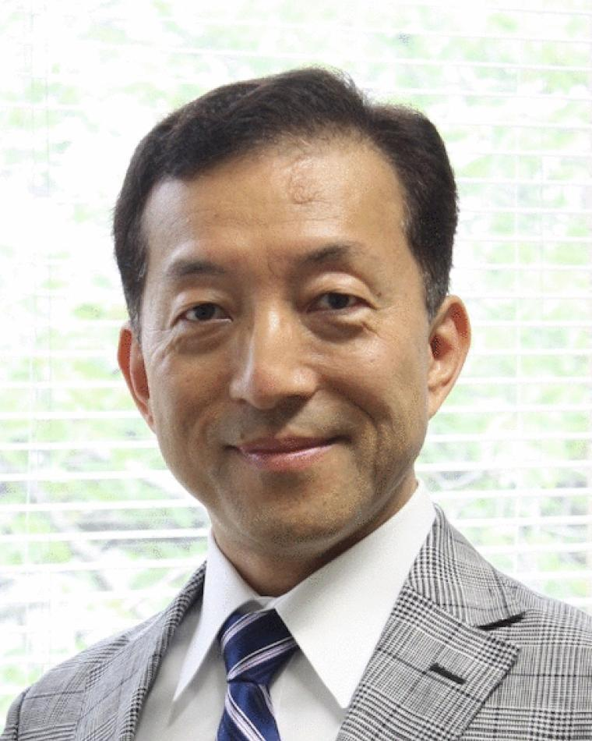
IEEE MAGNETIC Distinguished Lecturer Yoichiro Tanaka (Tohoku University)

