Slide 1

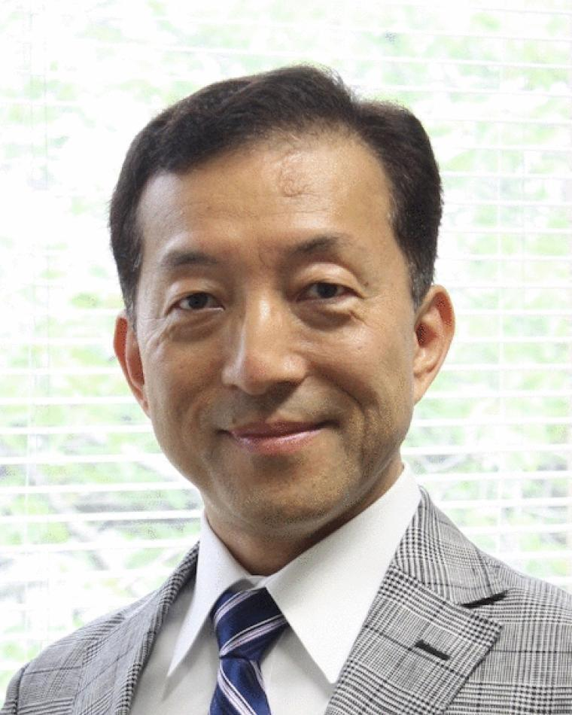
IEEE MAGNETICS Distinguished Lecturer Yoichiro Tanaka (Tohoku University)

