Slide 1
PPT Toolkit
©2014 Sky JIA
v1.0

Slide 2
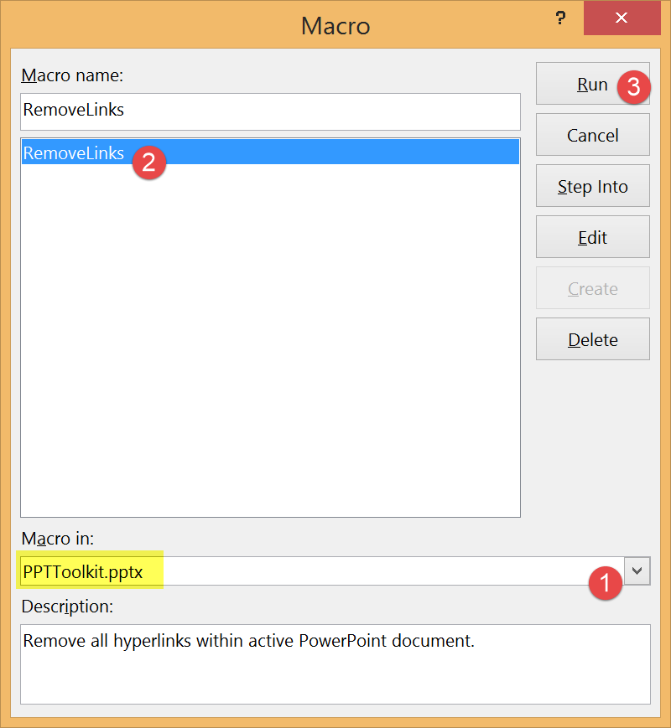
Usage Guide
Open your slides file.
Open this Toolkit file.
Switch to your slides file.
Press Alt+F8 keys to launch Macro dialog.
Do as steps shown in left figure.
Done & enjoy your work!
Latest version: http://goo.gl/Aai4zu
Click Raw to download.

