Slide 1
Definitive Guide to Disney Infinity NFC cards
By Rafa71791

Slide 2
Before You Do Anything
This guide only applies to the PS3, PS4, PS5, Wii, Wii U, Xbox 360, and 3ds versions of the games. The Xbox One games do not work with this guide unfortunately. It is most likely due to a difference in the Infinity Base compared to the other versions.
Also this guide was adapted from this one and if my guide doesn’t help you, you should try that one.

Slide 3
What you need
ACR122U NFC Reader/Writer
Mifare Mini S20 UID 7 byte rewritable 13.56mhz rfid Card (Not the same as ones used for skylanders)
PCSC_Mifare (The zip password is: mtoolstec.com)
Mifare Card Programming
DITool
.bin file dumps (From the DI Discord)
A hexadecimal editor to view the file data (You can use hexed.it)
Willpower

Slide 4
How Disney Infinity Works Intro
The next three slides explain how the figure data works for disney infinity. The guide on how to write this data to a nfc card is after these but I highly encourage you to read this section and try understand how the figures work so you have a better understanding of how a nfc card clones one.

Slide 5
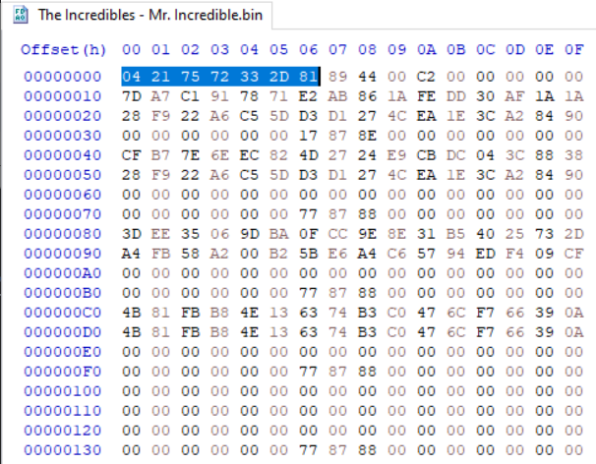
How Disney Infinity Works Part 1
Every single figure has a UID (Unique Identifier). An example would this Mr Incredible dump:
The blue highlighted area is the UID. This is unique for every single figure. So two Mr Incredibles will have unique IDs from each other.
Every figure has 89 44 C2 00 00 00 00 00 after their UID. I do not know if this is true but I saw somewhere while doing research that this is the copyright “logo” in each figure’s data.

Slide 6
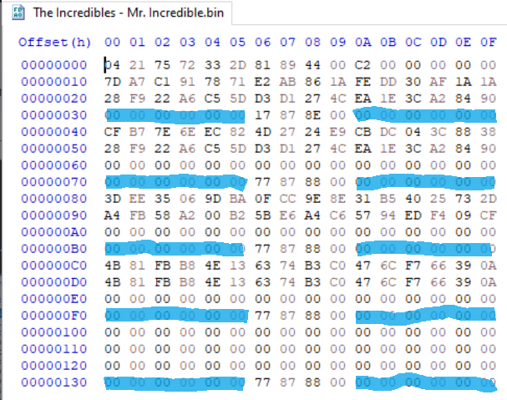
How Disney Infinity Works Part 2
In order for the game to properly read and write the figure, it needs to have its key. In this dump the key is missing (where the key would be copy and pasted is highlighted in blue), however since we have the UID we can calculate the key using this python program (You can use Online Python to run it if you do not have python on your computer). Just paste in your UID and it will give you your Key which must be pasted in where the blue highlights are (before and after 17 87 8E 00 and 77 87 88 00).

Slide 7
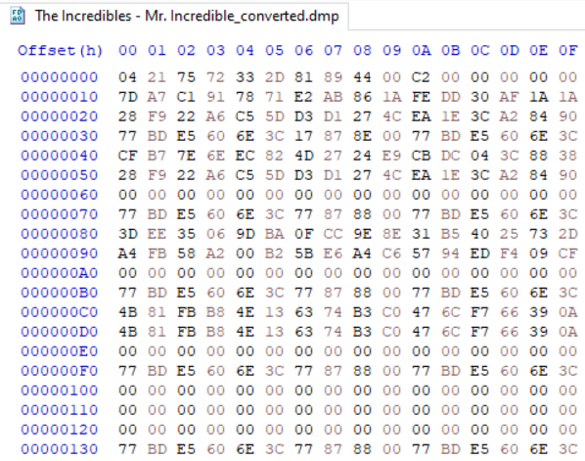
How Disney Infinity Works Part 3
The picture here is a decrypted Mr.Incredible dump that will fully work when put on the nfc card. Any other data besides the UID and Keys is the character’s level, skill tree, and experience. This data is not as important to the functionality of the character as the UID and Keys are. I don’t believe anyone has figured out how to edit these values but it doesn’t matter as those values are stored on the console as well. Editing them would only affect the game if you’re playing on a system/save that has not previously used that figure before.

Slide 8
On to the NFC guide!

Slide 9
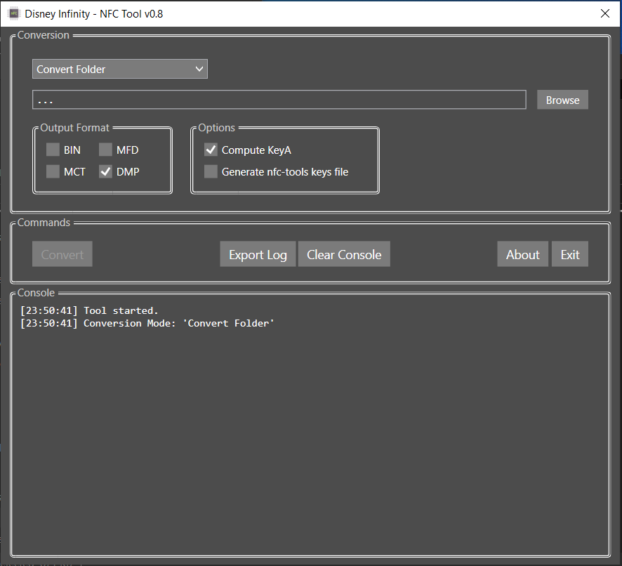
Decrypting the dumps
So once you have downloaded and unzipped everything, the first thing you must do is run the DITool-v0.8.exe. You should be greeted with something like this over here → You should check the boxes I have in the picture (Output: DMP and Options: Compute KeyA) and then click browse at the top right and select the NFC Infinity folder you extracted earlier. It should take a minute or two to make _converted versions of every .bin file as .dmp files.

Slide 10
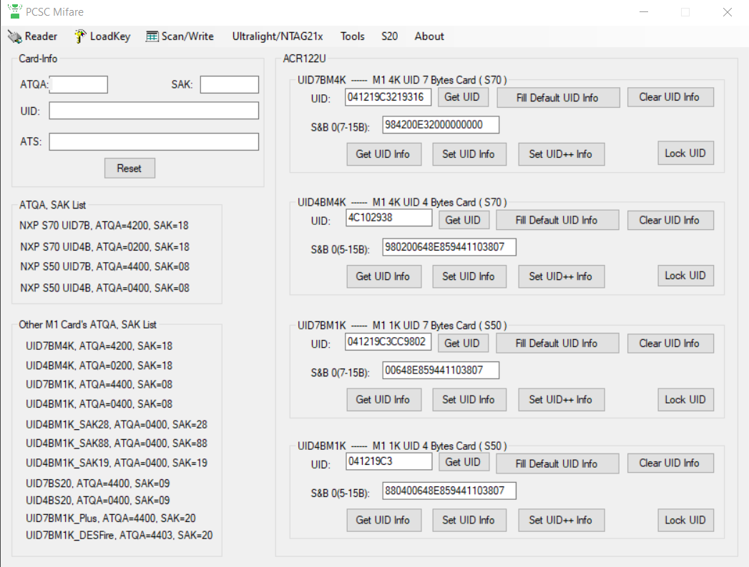
Writing the UID Part 1
Make sure your ACR122U is plugged in and the card is on it. Now open the PCSC Mifare program. You should see the image on top left. Now click the reset button and your ACR122U should beep and then it should display the information in the top left of the program. The ATQA should be 4400 and the SAK should be 09 if it is a Mifare Mini S20 UID 7 byte card.

Slide 11
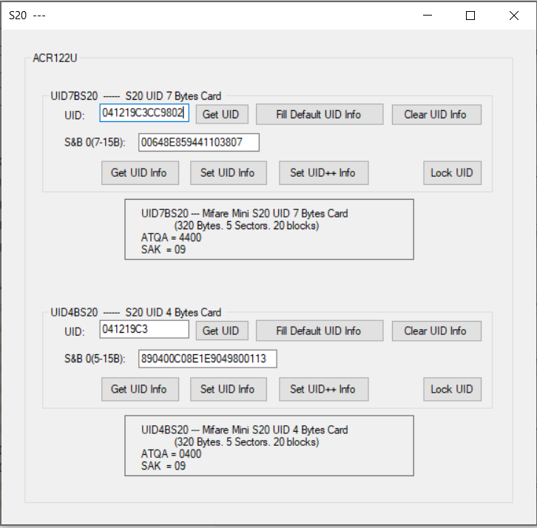
Writing the UID Part 2
Now you’re going to want to click on S20 button on the top bar and it should bring up this menu. -> Focus on top section and ignore the bottom part. Now open the _converted.dmp of the character you want to put onto the NFC card and find the first row of numbers.

Slide 12
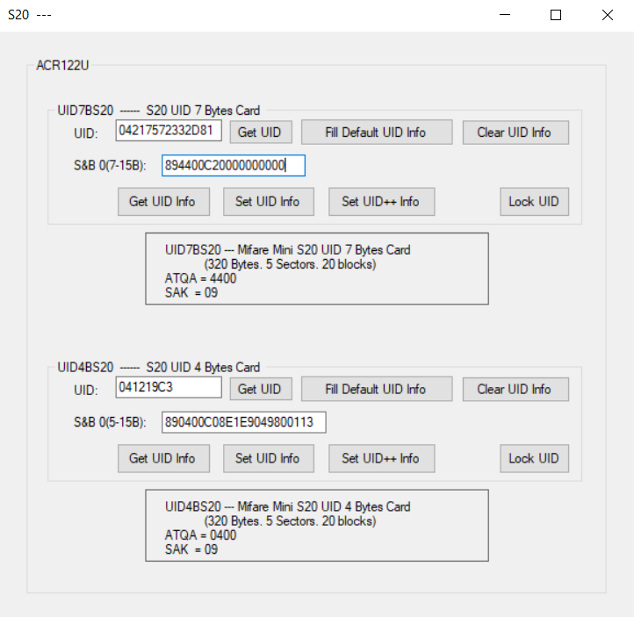
Writing the UID Part 3
Take the first 14 numbers from the first row and put them into the UID box with no spaces. Then put the rest of the numbers (which should be 89 44 00 C2 00 00 00 00 00) without spaces into the S&B box below the UID box. It should look like my example on the right. Then you should click the Set UID Info button. Your ACR122U should beep and it should say SET UID Info Success

Slide 13
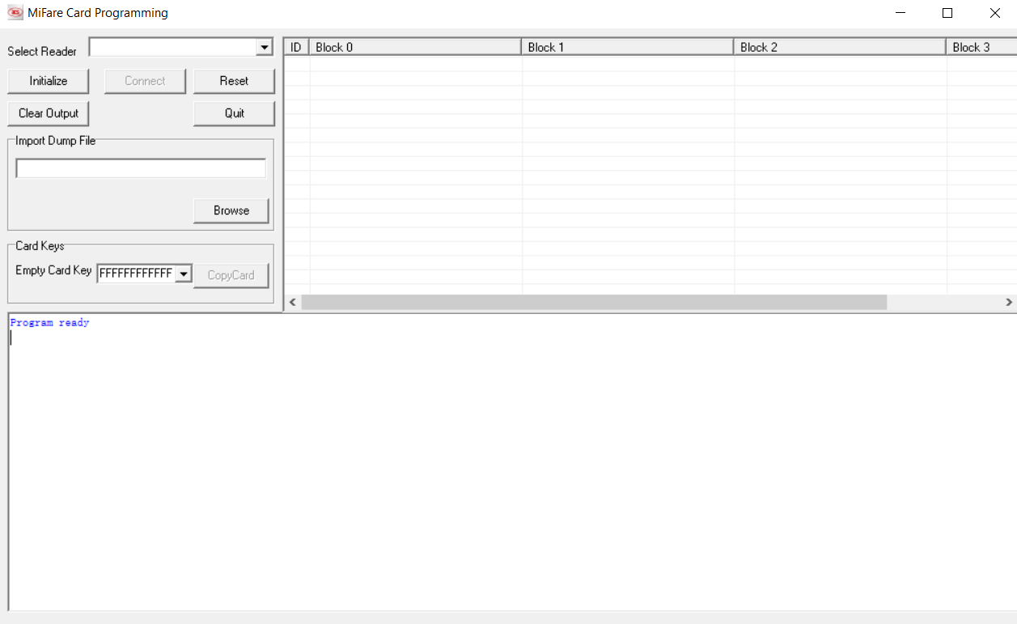

Inserting Keys and Extra Data
You are almost done. Now open the Mifare Card Programming Program and put the card on your ACR122U. Then after the light turns green, in this order, click "Initialize", "Connect" buttons and "Browse". Then navigate to the .dmp file that you want to clone and click on it. Leave the Empty Card Key section as is. Press CopyCard and it should work and at the end it will give this error here -> That actually means that it worked and your card should now work.

Slide 14
Common Issues
If the numbers in the Mifare Card Programming App just say error when trying to write the .dmp file, wait a few seconds until it's done giving errors, the ACR122U should beep, and then click the "Initialize" then "Connect" button. Then just click CopyCard again and it should work. If it does not work again close the program and unplug your ACR122U. Then plug it back in and try the steps from the start of Mifare Card Programming section again.
When it comes to using the card on the base, you might have to hold it about 1cm above the base for a second or two before the game recognizes it properly.

Slide 15
Sources
Nfc.toys - Although this site does not provide the info on how to make the nfc cards work it provides the insight on how to read the data from the figure, calculate the keys, and write your own data to your own figures.
Forum Post as PDF - This guide I found on the DI Discord provided by Wings Of Freedom. If they didn’t put this pdf file in the discord I don’t think I would have ever figured this out.
Random Researcher - On the Nfc.toys site the decryption method is attributed to a random researcher. I have searched high and wide but I could not find who this researcher was. Whoever they were I put a thanks here for making this possible!

