Slide 1
Aβ or not Aβ?… That is the Question
Skylar Suarez & Larry Baker
BIOE 5100 Spring 2025

Slide 2
Notes:
In AD, there is a protein called amyloid beta that misfolds, becomes sticky, aggregates together, and forms “plaques”.
The plaques deposit themselves in neural tissue and interfere with normal function, eventually leading to the dementia and memory loss characteristic of AD.
My job is to come up with a way to image these plaques without any external dyes or stains.
I was moderately successful by using excitation of near-UV wavelengths.

Slide 3
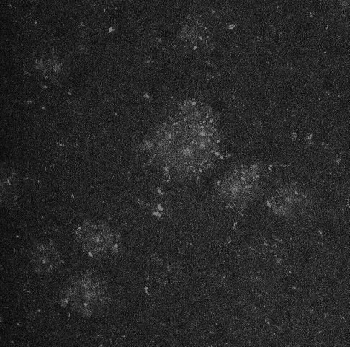
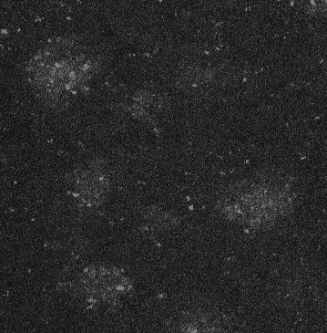
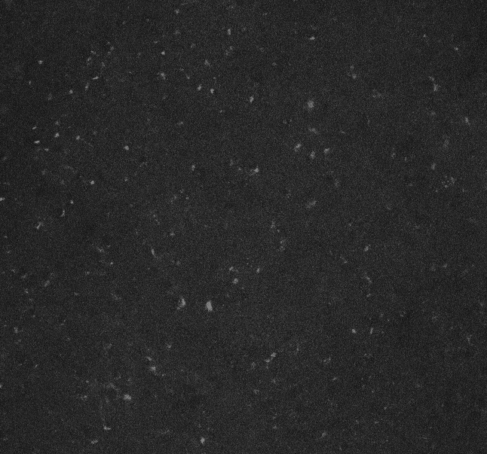
The Problem
5xFAD (AD mouse model) Hippocampus
C57 (control, no AD) Hippocampus
Notes:
These images were taken on a confocal microscope using a DAP excitation and emission filter (ex 405 em 425-475). They are part of a proof-of-concept project I worked on last year.
These are slices of hippocampus brain tissue from 5xFAD transgenic mice – they get plaques starting at 5 months old.
The “blobs” you see are allegedly AB plaques. They may be hard to see at times, but they are there. I have a collection of ~40 of these images, all from various slices from 3 different mice.
THE GOAL: to classify the images between AD and not AD.

Slide 4
Roadblocks
Notes:
This image is an example of our control: the same hippocampus region, but of a C57 wildtype mouse without AD, taken with the same microscope and under the same conditions as the AB images from before.
No blobs.
Both AD and control images have noise in the form of speckling. This speckling comes from some proteins that we cannot really avoid because they autofluoresce when imaging using certain wavelengths of light.
Also, the images are all different sizes.

