Slide 1
Aβ or not Aβ?… That is the Question!
Skylar Suarez & Larry Baker
BIOE 5100 Spring 2025

Slide 2
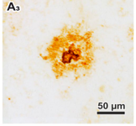
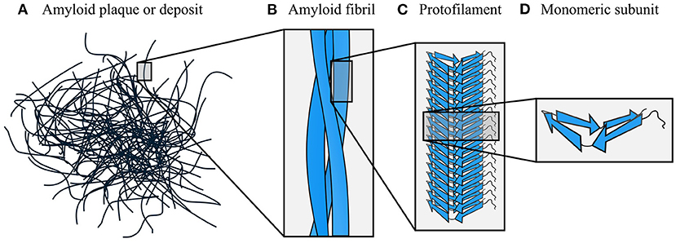
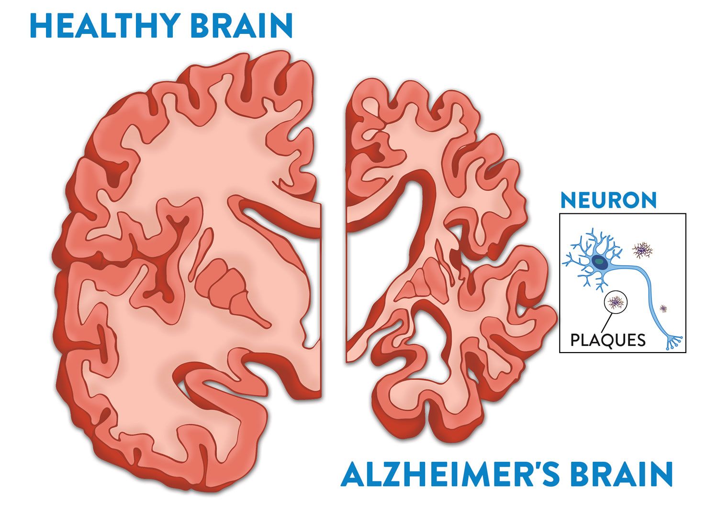
Amyloid-β (Aβ)
Monomeric Subunit Protofilament Amyloid Fibril Plaque
Rohr [2]
Taylor [1]
Big picture goal: to come up with a way to image these plaques without any stains or dyes.
So far, we have seen moderate success by exciting using light of near-UV wavelengths (300-450 nm).
Notes:
In AD, there is a protein called amyloid beta that misfolds, becomes sticky, aggregates together, and forms “plaques”.
The plaques deposit themselves in neural tissue and interfere with normal function, eventually leading to the dementia and memory loss characteristic of AD.

Slide 3
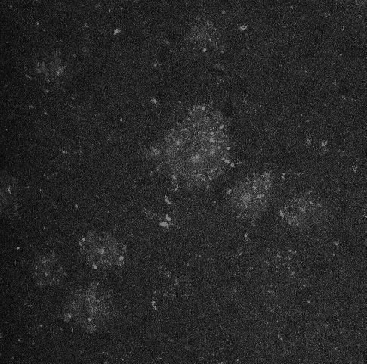
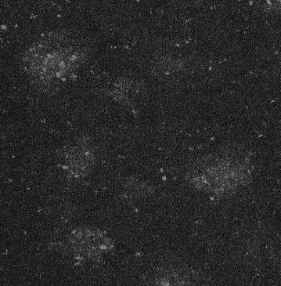
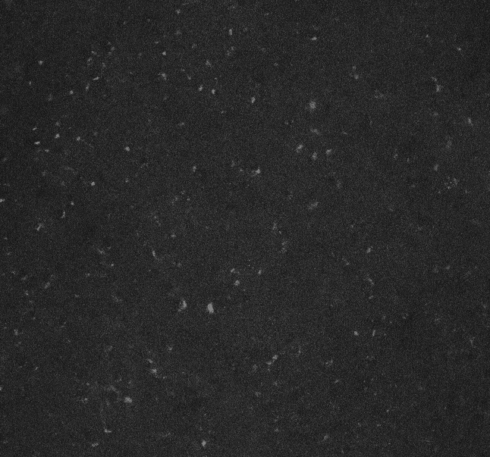
The Problem:
can we tell whether an image has Aβ plaques or not using computer vision?
5xFAD (AD mouse model) Hippocampus
C57 (control, no AD) Hippocampus
Confocal Microscope
λ_{ex} = 405 nm
λ_{em} = 425 – 475 nm
GOAL OF THIS PROJECT: classify the images between AD (has plaques) and NOT AD (no plaques)
Notes:
These images were taken on a confocal microscope using a DAP excitation and emission filter (ex 405 em 425-475). They are part of a proof-of-concept project I worked on last year.
These are slices of hippocampus brain tissue from 5xFAD transgenic mice – they get plaques starting at 5 months old.
The “blobs” you see are allegedly AB plaques. They may be hard to see at times, but they are there. I have a collection of ~40 of these images, all from various slices from 3 different mice.
THE GOAL: to classify the images between AD and not AD.

Slide 4
Roadblocks
Both AD and control images have speckling.
Comes from proteins we cannot avoid because they autofluoresce at our current λ_{ex} and λ_{em}
Not all images are the same size.
Notes:
Both AD and control images have noise in the form of speckling. This speckling comes from some proteins that we cannot really avoid because they autofluoresce when imaging using certain wavelengths of light.
Also, the images are all different sizes.

Slide 5
