Slide 1
Loan Data Challenge
Skylar Quan, September 6, 2019

Slide 2

Introduction
Data
50,000 loan applications
116 features
Target
“Good” loan: loan_status is current or fully paid
“Bad” loan: loan_status is charged off, default, in grace period, late (16-30 days), or late (31-120 days)
Approach
XGBoost in R

Slide 3
Data Cleaning
Data Summary Overview
15 Factor, 2 Logi (id, member_id), 1 Character (term), 98 Numeric
16 variables have missing values more than 80% of the time while id and member_id have 100% of its values missing
Create Variables
Target (bad rate: 8.89%)
Months since earliest reported credit line opened (distance between earliest_cr_line and August 2019)
Percentage of satisfactory accounts (num_sats/total_acc)
Transform Character Variable to Factor
Transform Factor to Dummy Variable
Split Dataset into Training and Test Set
training 70% vs. test 30%

Slide 4

XGBoost [1]
Extreme Gradient Boosting (XGBoost) is an optimized distributed gradient boosting library
It has provision for regularization to avoid overfitting in linear and tree-based models
Missing values are handled internally
if there exists any trend in missing values, it is captured by the model
A tree is grown one after other and attempts to reduce misclassification rate in subsequent iterations. In this, the next tree is built by giving a higher weight to misclassified points by the previous tree
Process flow
Tune Parameters
Train XGBoost model on training set
Predict on test set
Evaluate model performance/prediction
This Photo by Unknown Author is licensed under CC BY-SA-NC

Slide 5
XGBoost – Parameters [1]
nrounds
It controls the maximum number of iterations, it is similar to the number of trees to grow
Eta
range: (0,1); default = 0.3
It controls the learning rate
Gamma
range: (0,Inf); default = 0
It controls regularization to prevent overfitting
Higher the value, higher the regularization and to penalize large coefficients which don't improve the model's performance
max_depth
range: (0,Inf); default = 6
It controls the depth of the tree; larger the depth, more complex the model and higher chances of overfitting
min_child_weight
range:(0,Inf); default = 1
It blocks the potential feature interactions to prevent overfitting
Subsample
range: (0,1); default = 1
It controls the number of samples (observations) supplied to a tree
colsample_bytree
range: (0,1); default = 1
It control the number of features (variables) supplied to a tree

Slide 6
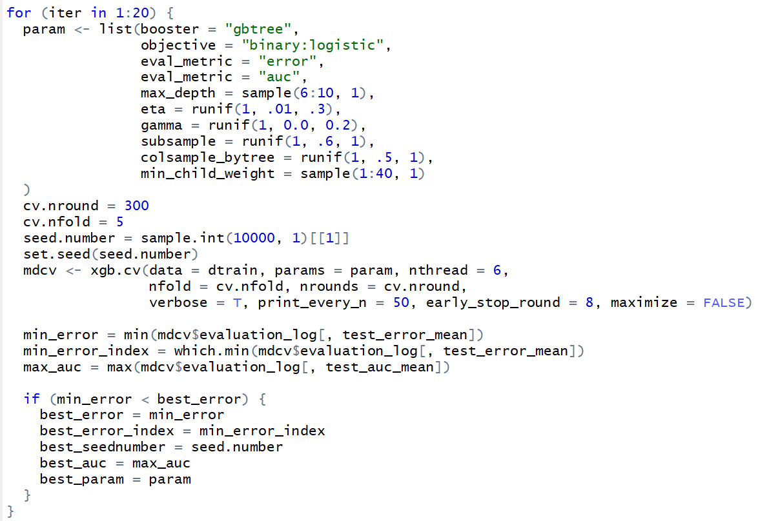
XGBoost – Parameters Tuning
Set parameter value manually and then repeat cross-validation
Run cross validation 20 time and each time with random parameter values
Get the best parameter set and the minimum test_error_mean in each iteration
Get the best global minimum test_error_mean and its index (round)
Parameters Tuning Result
nround = 268
eta = 0.193
max_depth = 10
min_child_weight = 3
subsample = 0.9331344
colsample_bytree = 0.5744458
gamma = 0.1489346

Slide 7
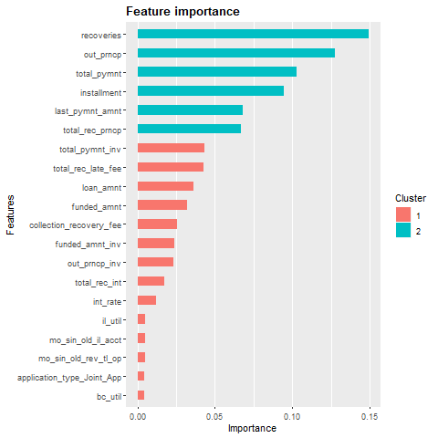
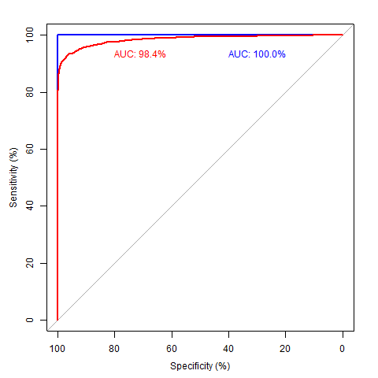
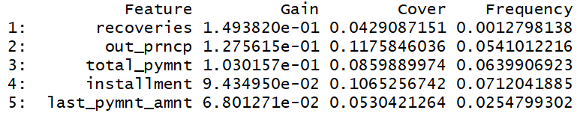
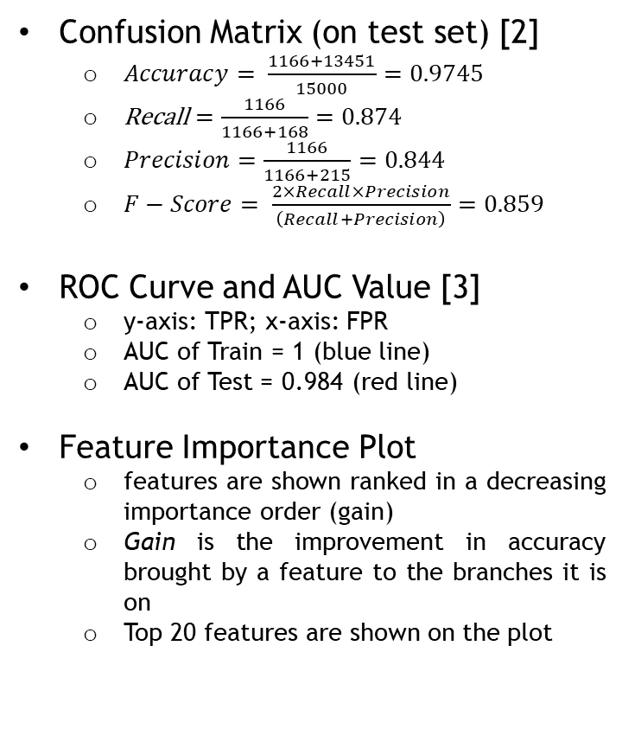
XGBoost – Model Performance
Confusion Matrix (on test set) [2]
$Accuracy= \frac{1166+13451}{15000}=0.9745$
$\text{Recall}=\frac{1166}{1166+168}=0.874$
$Precision=\frac{1166}{1166+215}=0.844$
$F−Score= \frac{2×Recall×Precision}{\left(Recall+Precision\right)}=0.859$
ROC Curve and AUC Value [3]
y-axis: TPR; x-axis: FPR
AUC of Train = 1 (blue line)
AUC of Test = 0.984 (red line)
Feature Importance Plot
features are shown ranked in a decreasing importance order (gain)
Gain is the improvement in accuracy brought by a feature to the branches it is on
Top 20 features are shown on the plot
 |  | Actual
 |  | 0 | 1
Predicted | 0 | 13,451 (TN) | 168 (FN)
 | 1 | 215 (FP) | 1,166 (TP)

Slide 8
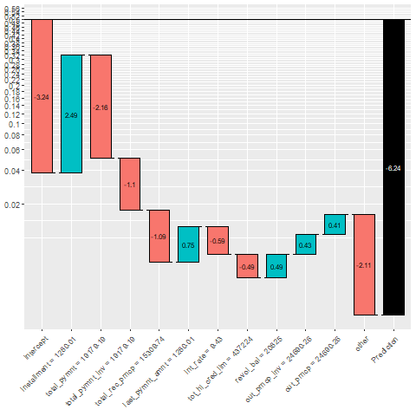
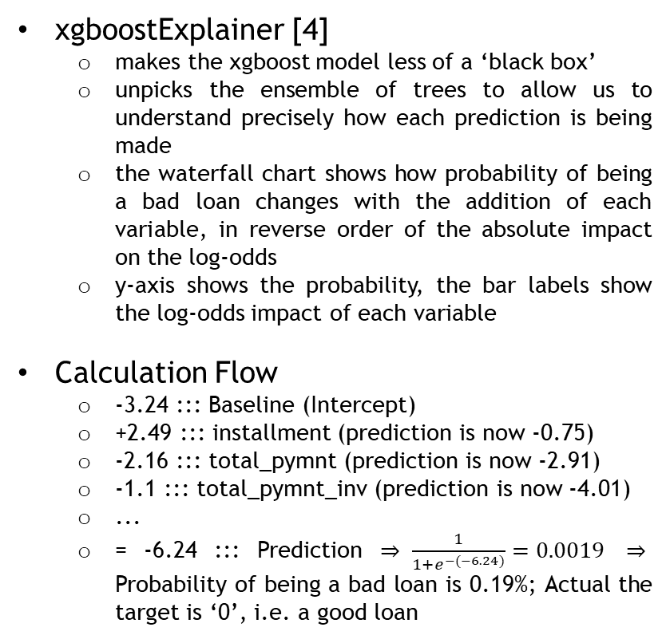
XGBoost – Result
xgboostExplainer [4]
makes the xgboost model less of a ‘black box’
unpicks the ensemble of trees to allow us to understand precisely how each prediction is being made
the waterfall chart shows how probability of being a bad loan changes with the addition of each variable, in reverse order of the absolute impact on the log-odds
y-axis shows the probability, the bar labels show the log-odds impact of each variable
Calculation Flow
-3.24 ::: Baseline (Intercept)
+2.49 ::: installment (prediction is now -0.75)
-2.16 ::: total_pymnt (prediction is now -2.91)
-1.1 ::: total_pymnt_inv (prediction is now -4.01)
...
= -6.24 ::: Prediction $⇒ \frac{1}{1+e^{−(−6.24)}}=0.0019$ $⇒$ Probability of being a bad loan is 0.19%; Actual the target is ‘0’, i.e. a good loan

Slide 9
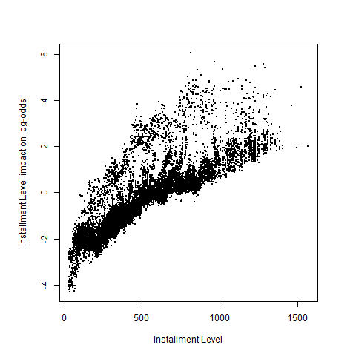
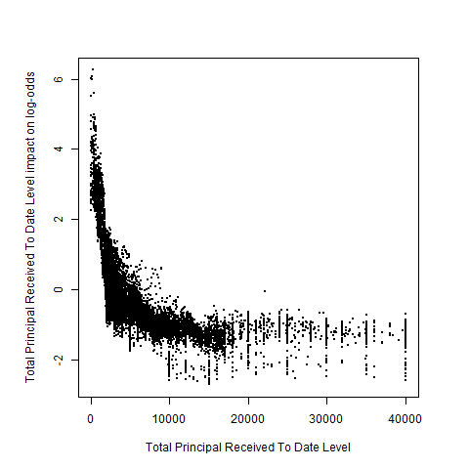
Conclusion and Further Improvement
XGBoost model achieved high level accuracy (0.9745)
We are able to explain the business insights behind the model by looking at the water-fall chart (shown in previous slide) and variable level impact on log-odds char (shown on the right)
Further Improvement
Further clarify on the definition of loan_status; is it life-time status or monthly status?
Potential additional variable(s)
Oversampling (possible existing imbalance data)
Synthetic Minority Over-sampling Technique (SMOTE) [5]
Set a different iteration number in manual tuning process
Try different hyperparameters tuning method
MLR package
Grid Search
Use a separate time-period sample to further tune parameters or test the model

Slide 10
Reference
[1] Beginners Tutorial on XGBoost and Parameter Tuning in R. Retrieved from https://www.hackerearth.com/practice/machine-learning/machine-learning-algorithms/beginners-tutorial-on-xgboost-parameter-tuning-r/tutorial/
[2] Narkhede, Sarang (2018). Understanding Confusion Matrix. Retrieved from https://towardsdatascience.com/understanding-confusion-matrix-a9ad42dcfd62
[3] Narkhede, Sarang (2018). Understanding AUC - ROC Curve. Retrieved from https://towardsdatascience.com/understanding-auc-roc-curve-68b2303cc9c5
[4] Foster, David (2017). NEW R package that makes XGBoost interpretable. Retrieved from https://medium.com/applied-data-science/new-r-package-the-xgboost-explainer-51dd7d1aa211
[5] How to handle Imbalanced Classification Problems in machine learning? Retrieved from https://www.analyticsvidhya.com/blog/2017/03/imbalanced-classification-problem/

