Slide 1


Job Scheduling
Team Members : Anmol Mishra(19BCE1316)
Ansh Khattar(19BCE1319)
Ritik Agarwal(19BCE1063)
http://www.free-powerpoint-templates-design.com

Slide 2
Content
01
Abstract
02
Problem Statement
04
Output
03
Algorithms Analysis
05
Sample Test Case
06
Conclusion

Slide 3
Abstract
The number of processes performed together has grown exponentially from the improvement in development of multitasking processors in computer systems. The Multi-programmed operating system executes the process simultaneously to increases the uses of CPU. A number of programs can be in memory at the same time, allows overlap of CPU and I/O.
Scheduling deals with the problem of choosing a process from the ready queue to be executed by the system. This paper attempts to summarize and present the comparative analysis of various scheduling algorithms such as First Come First Serve, Shortest Job First, Round Robin and Priority Scheduling. These algorithms are compared on the basis of their average waiting time and average turnaround time providing the best optimal schedular for different set of jobs.

Slide 4
P
ROBLEM
STATEMENT
The increasing demand to handle large amounts of digital data in many scientific and commercial areas has led to growing importance of data centers as these centers are supposed to provide better service at lower costs.
Job scheduling is a necessary and revolutionary step forward in IT automation, allowing IT operations to eliminate much of the manual processes filling their schedules and opening a world of possibilities for digital enterprises.
Even if we schedule our tasks often we fail to give proper time to all our tasks and even get under pressure regarding the certainty of its competition.

Slide 5
Proposed Work
An application that allows to select the desired algorithm for Job Scheduling
Apart from scheduling, user will be able to compare the waiting time and total time of complete and choose the best Algorithm they prefer for scheduling.
A review paper consisting detailed comparisons between all the algorithms.
This application will have all the algorithms listed for scheduling and the user will be allowed to select the preferred algorithm to schedule the task

Slide 6
Algorithms
In this type of algorithm, the process which requests the CPU gets the CPU allocation first. This scheduling method can be managed with a FIFO queue.
SCHEDULING ALGORITHMS
First Come First Serve
Priority Scheduling
Shortest Job First
Round Robin Scheduling
Shortest Remaining Time
Multilevel Queue Scheduling
This algorithm separates the ready queue into various separate queues. In this method, processes are assigned to a queue based on a specific property of the process, like the process priority, size of the memory, etc.
The processes with higher priority should be carried out first, whereas jobs with equal priorities are carried out on a round-robin or FCFS basis. Priority can be decided based on memory requirements, time requirements, etc.
As the term is generally used, time slices are assigned to each process in equal portions and in circular order, handling all processes without priority.
The process will be allocated to the task, which is closest to its completion.
In this method, when the CPU is available, the next process or job with the shortest completion time will be executed first.

Slide 7
Algorithms
1. Priority Scheduling
In priority scheduling algorithm each process has a priority associated with it and as each process hits the queue, it is stored in based on its priority so that process with higher priority are dealt with first. Equal priority processes are scheduled in FCFS order.

Slide 8
Inputs:
Burst Time
Priority Value
Outputs:
Jobs in Priority Order
Average Waiting Time
Average Turn Around Time*
*TAT: Time interval from the time of arrival of a job to the time of the completion of the job.

Slide 9
Algorithms
2. First Come First Serve
First come first serve (FCFS) scheduling algorithm simply schedules the jobs according to their arrival time. The job which comes first in the ready queue will get the CPU first. The lesser the arrival time of the job, the sooner will the job get the CPU. FCFS scheduling may cause the problem of starvation if the burst time of the first process is the longest among all the jobs.

Slide 10
Inputs:
Arrival Time
Burst Time Value
Completion Time: Time at which process completes its execution.
Turn Around Time(TAT): Time Difference between completion time and arrival time.
Turn Around Time = Completion Time – Arrival Time
Waiting Time(WT): Time Difference between turn around time and burst time.
Waiting Time = Turn Around Time – Burst Time
Outputs:
Jobs in Order with Time chart including (CT, TAT, WT)
Average Waiting Time
Average Turn Around Time*
*TAT: Time interval from the time of arrival of a job to the time of the completion of the job.

Slide 11
Algorithms
3. Round Robin Scheduling
This job scheduler algorithm saves the progress of the job that is being executed currently and moves to the next job present in the queue when a particular process is executed for a given time quantum.
We first have a queue where the processes are arranged in first come first serve order.
A quantum value is allocated to execute each process.
The first process is executed until the end of the quantum value. After this, an interrupt is generated and the state is saved.
The CPU then moves to the next process and the same method is followed.
Same steps are repeated till all the processes are over.

Slide 12
Inputs:
Arrival Time
Burst Time Value
Time Quantum
Outputs:
Jobs in Order with Time chart including (TAT, WT)
Average Waiting Time
Average Turn Around Time*
*TAT: Time interval from the time of arrival of a job to the time of the completion of the job.

Slide 13
Algorithms
4. Shortest Job First
In shortest job first scheduling algorithm, the processor selects the waiting process with the smallest execution time to execute next.

Slide 14
Inputs:
Burst Time Value
Outputs:
Jobs in Order with Time chart including (TAT, WT)
Average Waiting Time
Average Turn Around Time*
*TAT: Time interval from the time of arrival of a job to the time of the completion of the job.

Slide 15
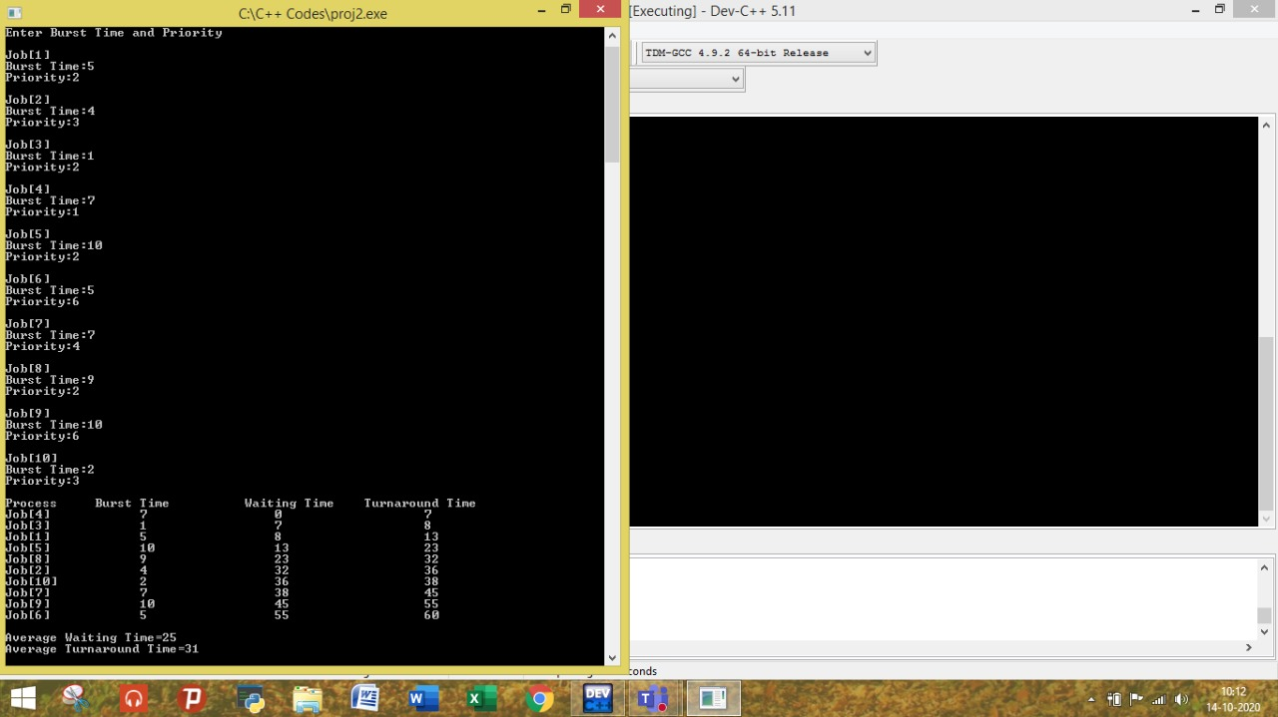
Outputs:
Priority Scheduling

Slide 16
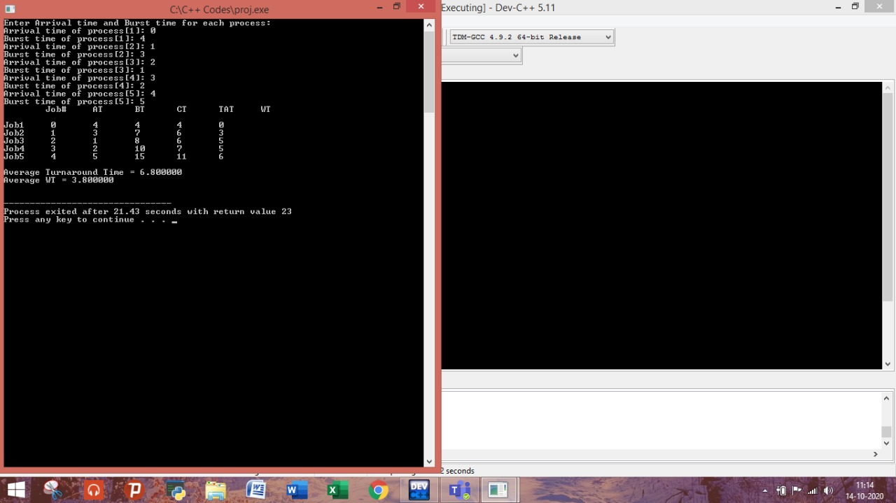
Outputs:
First Come First Serve Scheduling

Slide 17
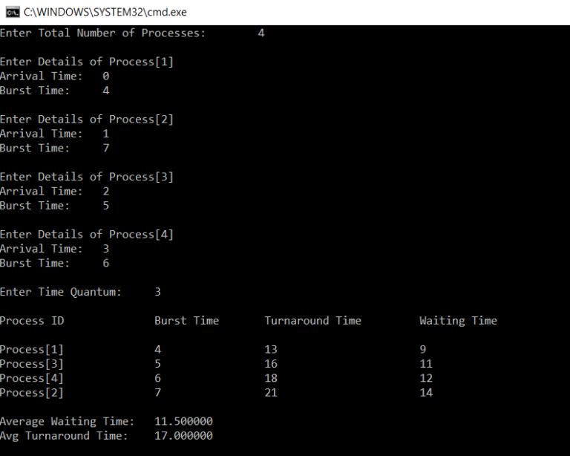
Outputs:
Round Robin Scheduling

Slide 18
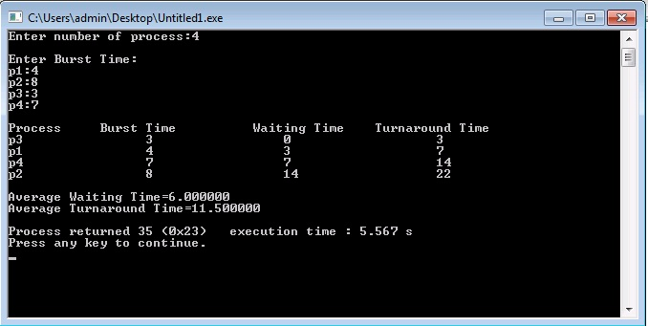
Outputs:
Shortest Job First

Slide 19
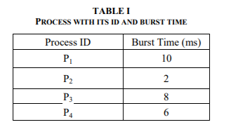
Comparisons
Consider the following set of processes:

Slide 20



Comparisons
First Come First Serve:
Shortest Job First:
Round Robin Scheduling:
P₁
P₂
P₃
P₄
P₁
P₃
P₄
P₂

Slide 21
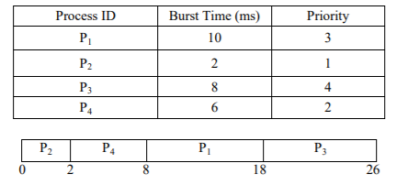
Comparisons
Priority Scheduling:

Slide 22
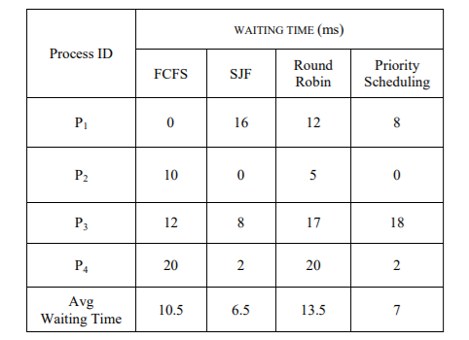
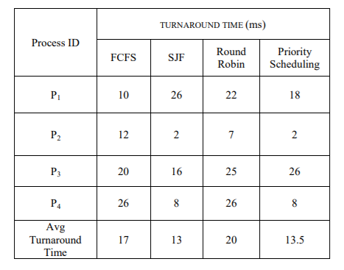
Comparisons
Average Waiting Time Chart:
Average Turnaround Time Chart:

Slide 23
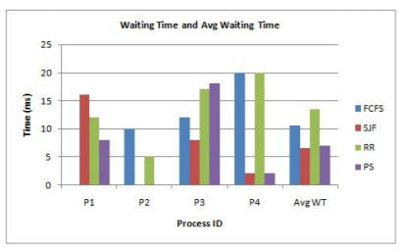
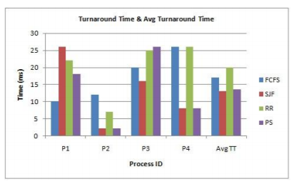
Comparisons
Average Waiting and Turnaround Time Comparisons

Slide 24
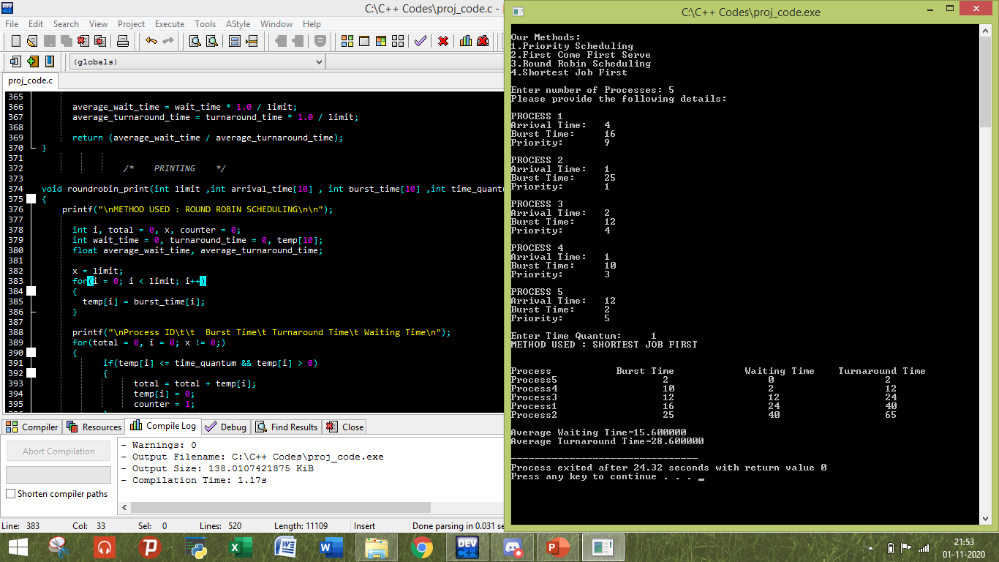
SAMPLE TEST CASE
TIME QUANTUM : 1

Slide 25
Conclusions:
Conclusions from all the comparisons:
FCFS is simple to understand and suitable only for batch system where waiting time is large.
Turnaround time, Waiting time and Response time of the processes are optimum for SJF scheduling algorithm compared to all other fundamental algorithms.
The priority scheduling algorithm is based on the priority in which the highest priority job can run first and the lowest priority job need to wait.
The treatment of shortest process in SJF scheduling tends to result in increased waiting time for long processes. And the long process will never get served, though it produces minimum average waiting time and average turnaround time.

Slide 26
Conclusions:
Conclusions from all the comparisons:
The shortest job first scheduling algorithm deals with different approach, in this algorithm the major benefit is it gives the minimum average waiting time.

Slide 27
Thank You

