Slide 1
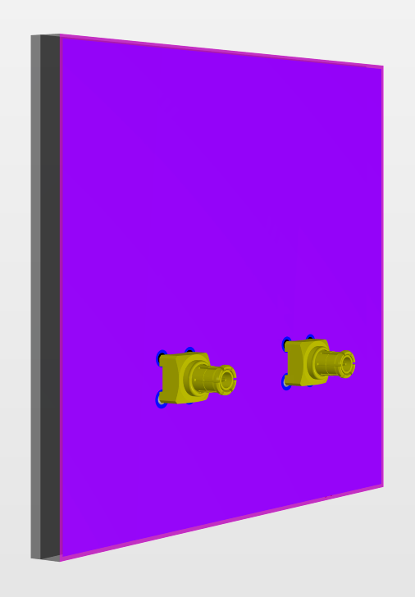
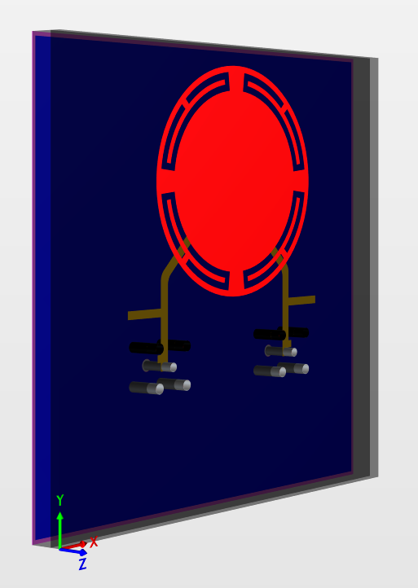
UU-PCBA-MANT
Dual-band BRS/CBRS path antenna for Massive MIMO
Pre-production Release
2020-01-07

Slide 2
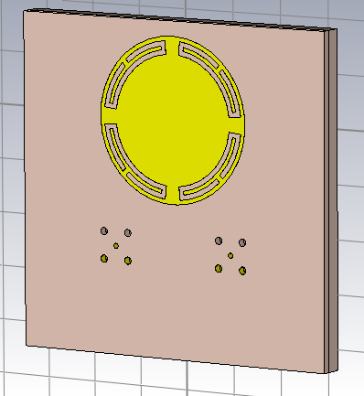
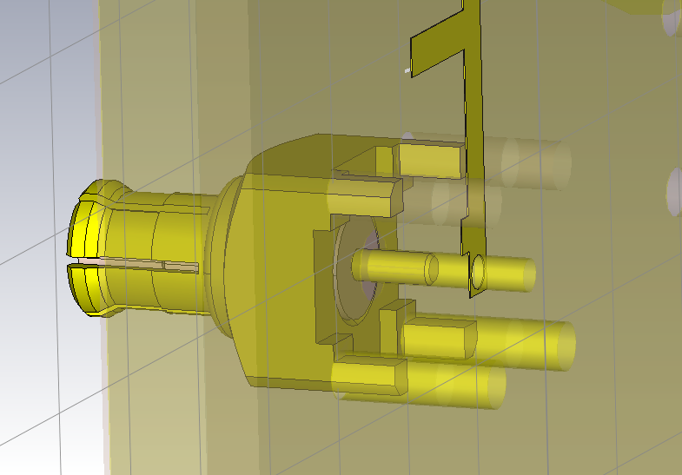
Front view of panel & Perspective view of MCX connector with vias
Center pin and bottom : PTH ; top 2 : NPTH

Slide 3
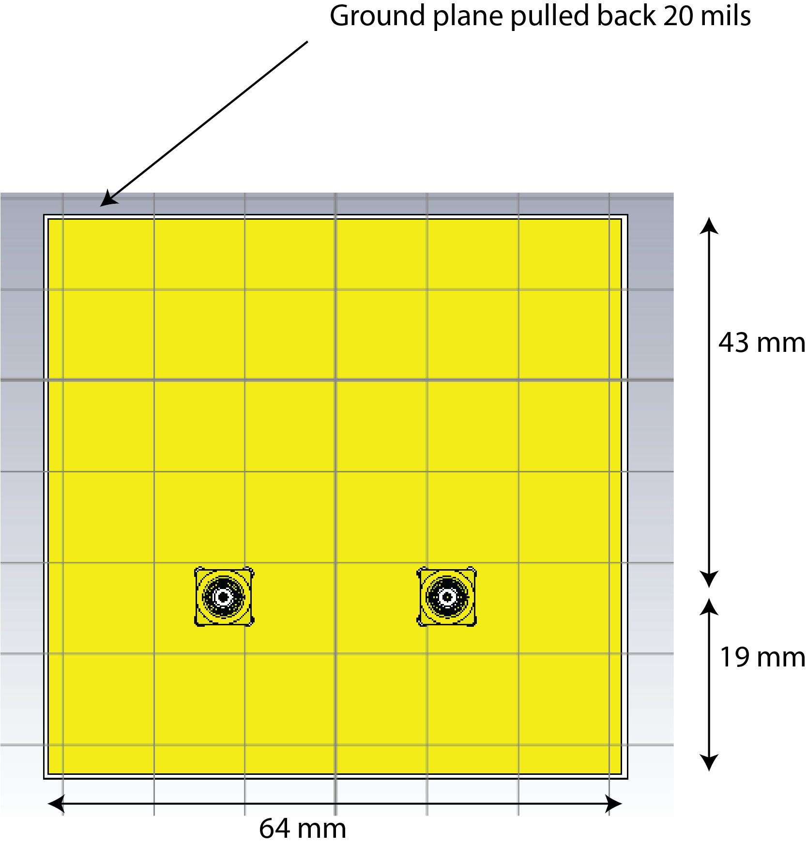
Back view of panel

Slide 4
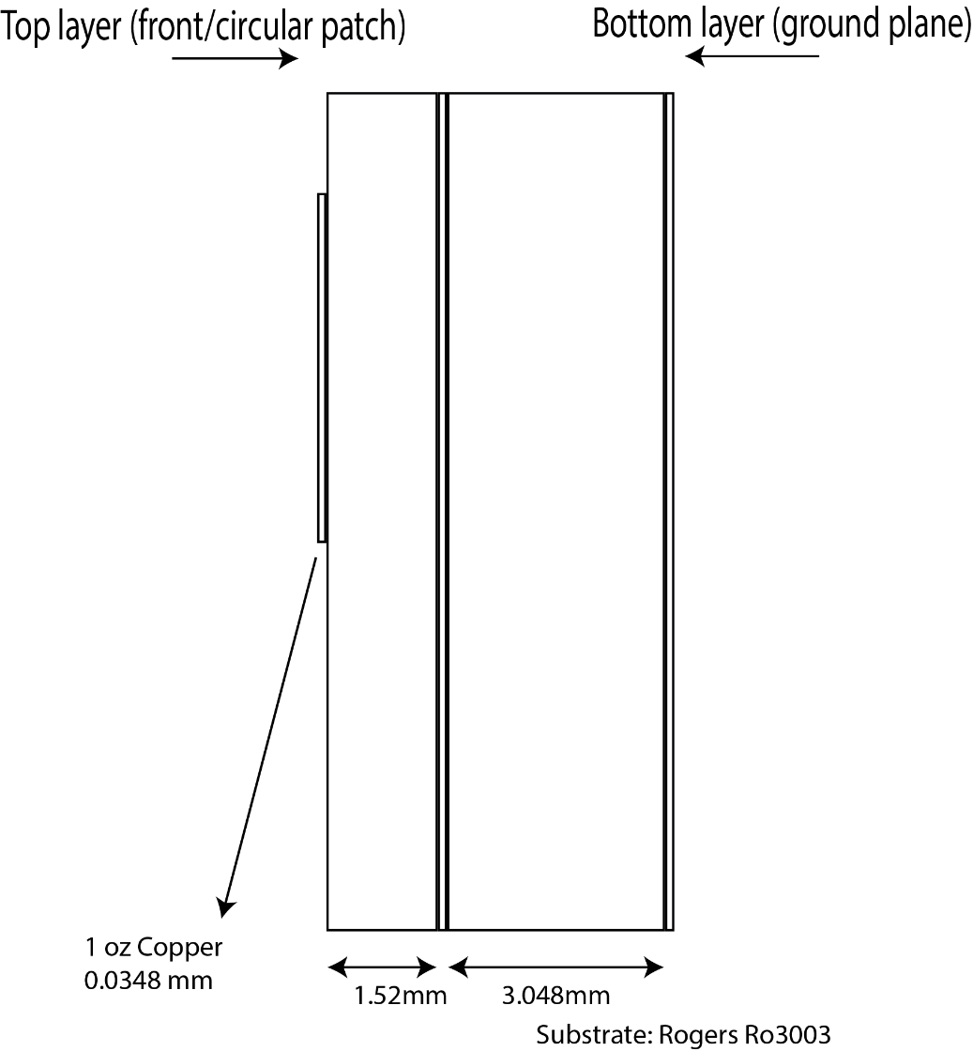
Side view
Need to stack 2 boards for bottom layer substrate. (Max thickness of RO3003 : 1.52mm??)

Slide 5
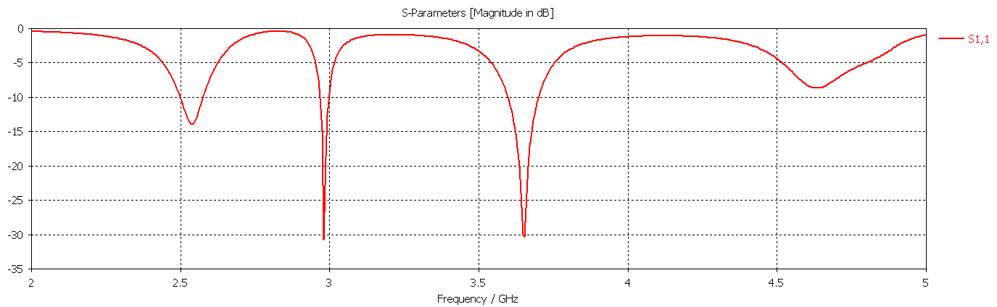
S11
CBRS: good specs
2.5 GHz: Center at ~ 2.54GHz and dips only to -14 dB (but radiation efficiency is as desired, shown in next slide)

Slide 6
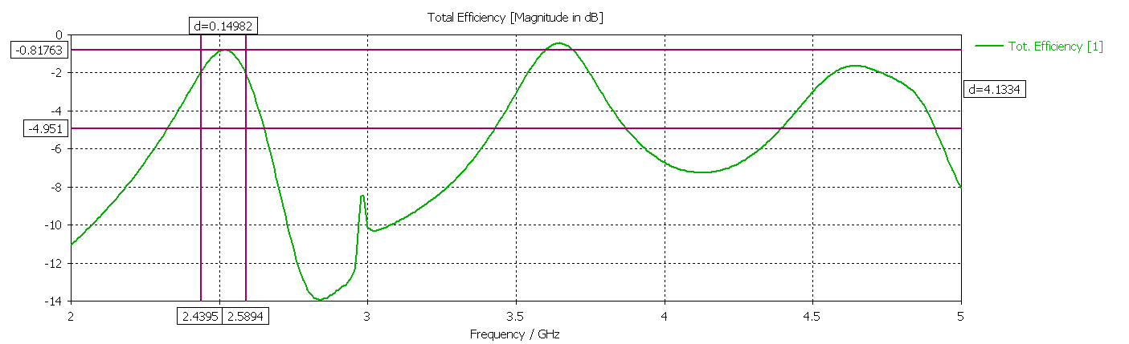
Total (radiation) efficiency
2.5G: -2dB BW of 150 MHz (63% efficiency). Peak efficiency : -0.8 dB (83% efficiency)
CBRS: -2dB BW of 200 MHz (63% efficiency). Peak efficiency : -0.44 dB (90% efficiency)

Slide 7
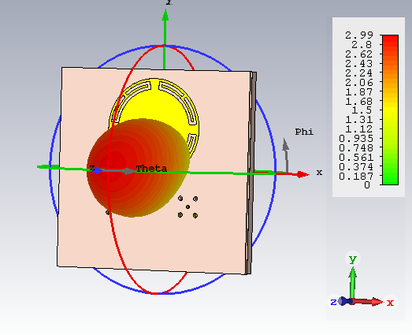
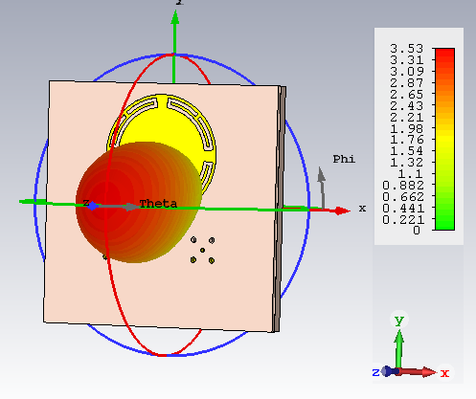
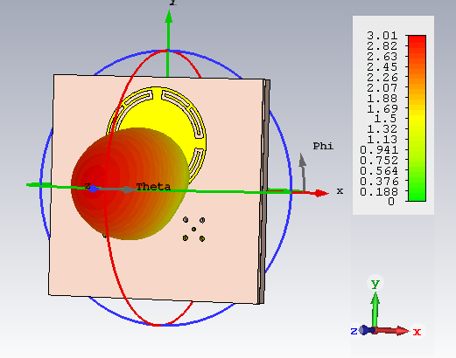
Farfield gain patterns (2.5 GHz band)
Gain : 2.99 @ 2.45GHz ; 3.5 @ 2.5GHz ; 3 @ 2.57GHz
HP Beam width : varies between 80-90 degrees

Slide 8
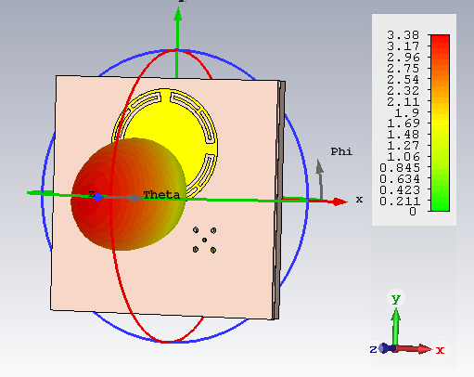
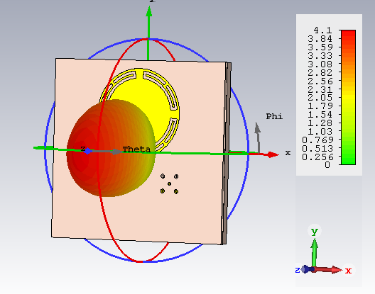
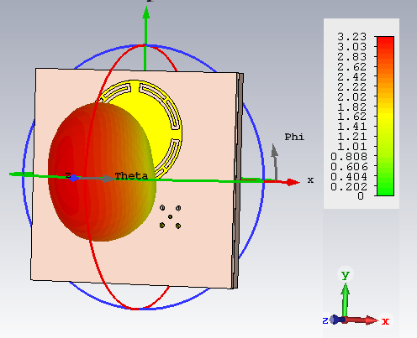
Farfield gain patterns (CBRS)
Gain : 3.4 @ 3.55GHz ; 4.1 @ 3.63GHz ; 3.2 @ 3.7GHz
HP Beam width : varies between 80-90 degrees

Slide 9
Sensitivity of total efficiency due to R (radius of patch)
R = 15.4mm (shown in black) : Exact value
Perturbation by +/- 0.05mm leads to negligible variation in performance
Total efficiency is shown in absolute units here.

Slide 10
Sensitivity of total efficiency due to r1 and r2 (radius of inner and outer arc slots
r1 = 14.6mm & r2 = 13mm(shown in black) : Exact value
Perturbation of r1 by +/- 0.05mm leads to ~20MHz shift on either side (both bands)
Similar perturbation leads to ~ 15 MHz on either side only in the 2.5GHz band

Slide 11
Sensitivity of total efficiency due to Rogers Dk
Dk = 3 (shown in black) : Exact value
Perturbation by +/- 0.05 leads to freq shift of 20 MHz on either side (both bands)
Sensitivity due to perturbations in all other parameters (geometry of feedlines, stubs, etc.) is minimal as well.

