Slide 2
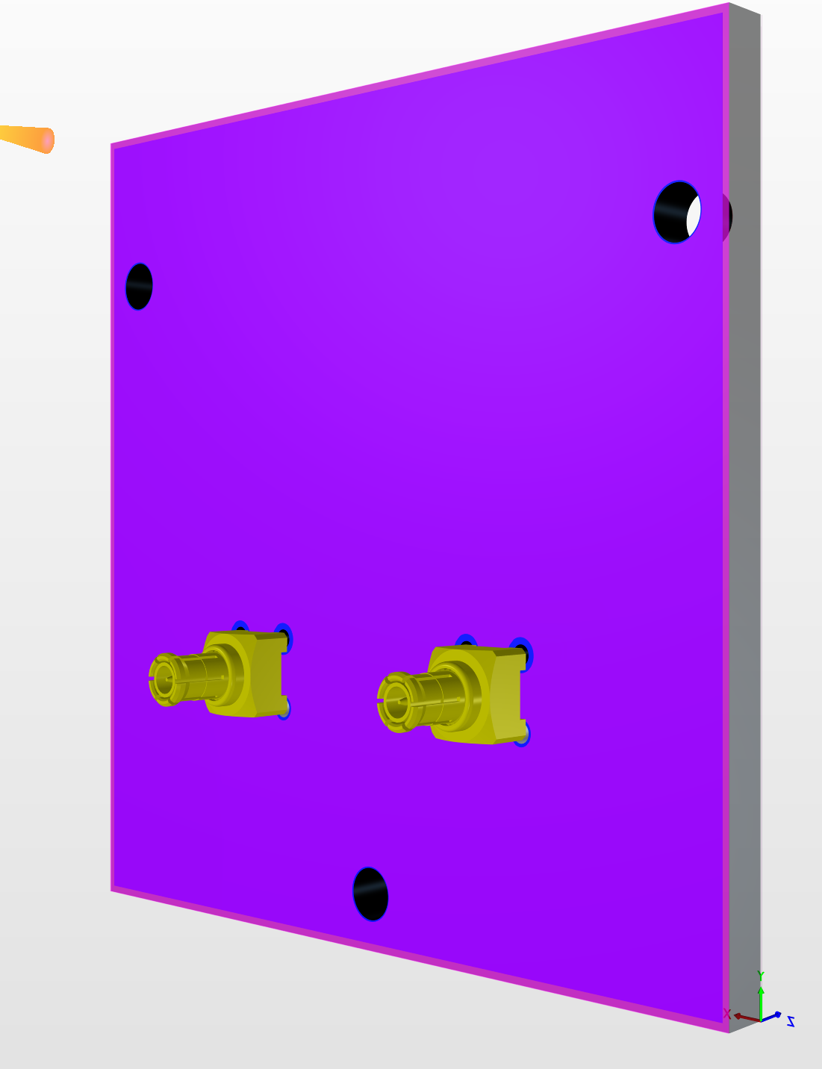
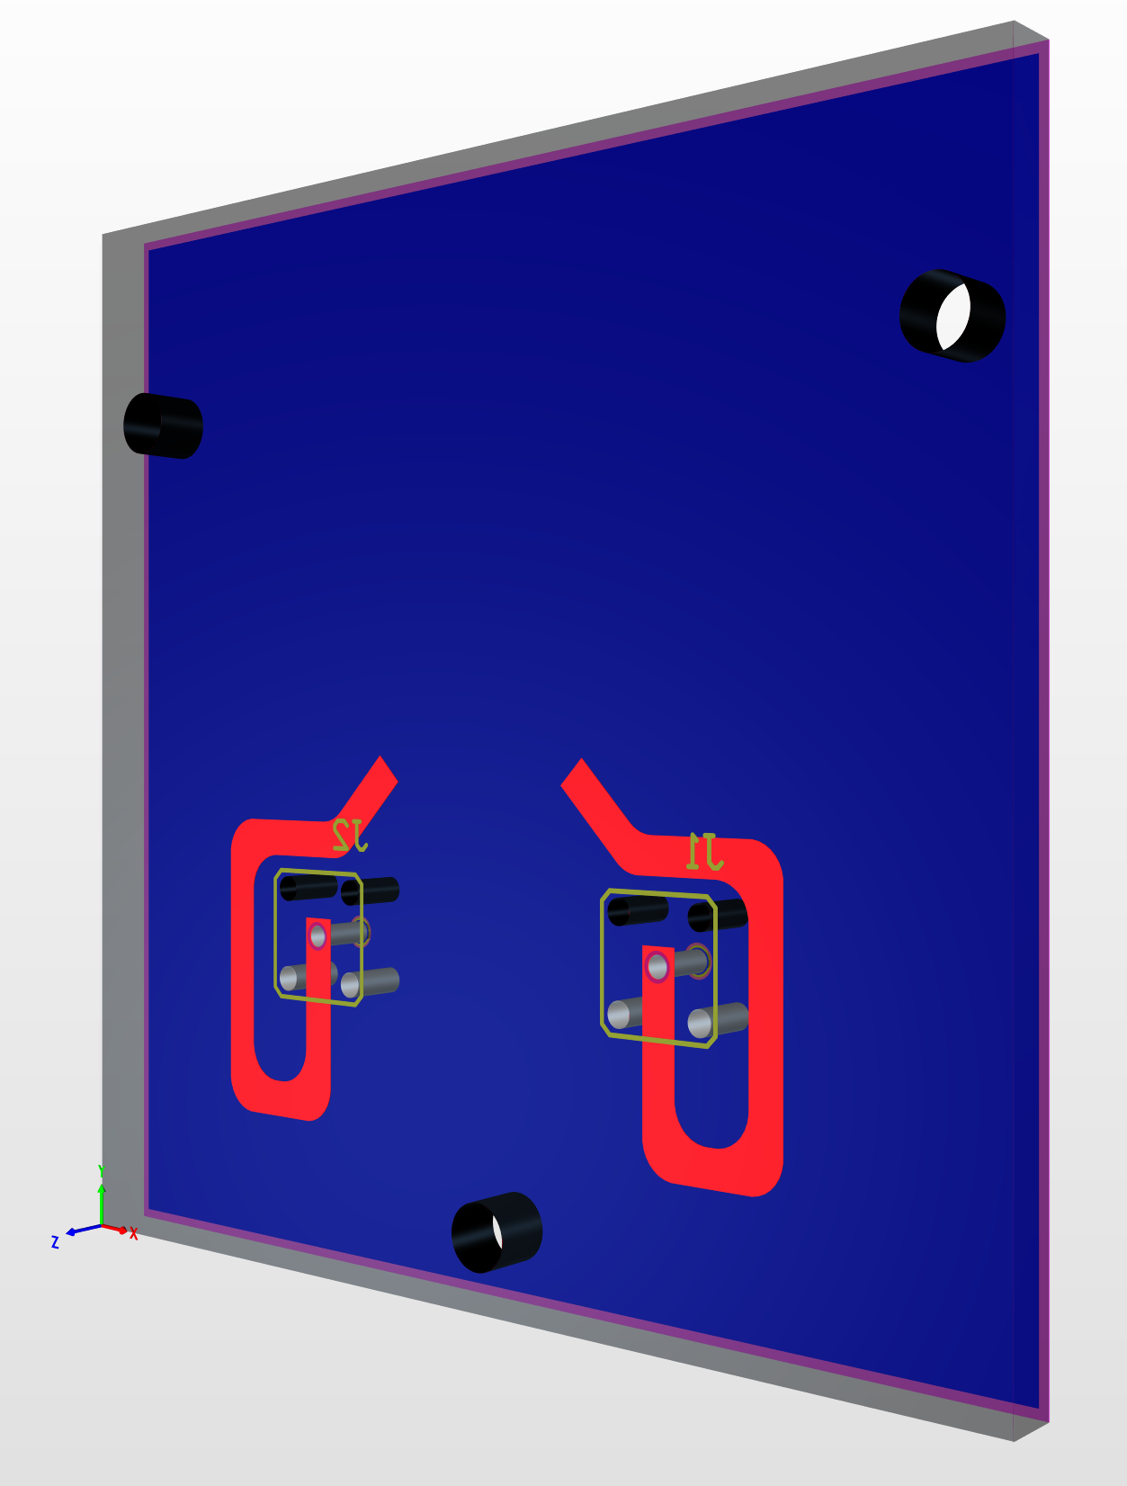

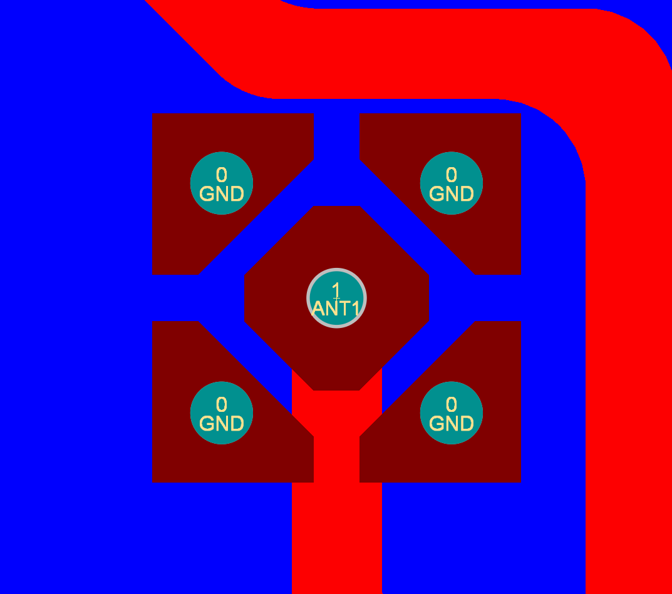
Solder mask detail,
Non-component side
Small ring of solder mask keeps PIH solder contained.
Paste-in-hole (PIH) detail for component side

