Slide 1

Shiny App for Infectious Disease Surveillance and Analysis
Skylar Nguyen
BIO 5202

Slide 2
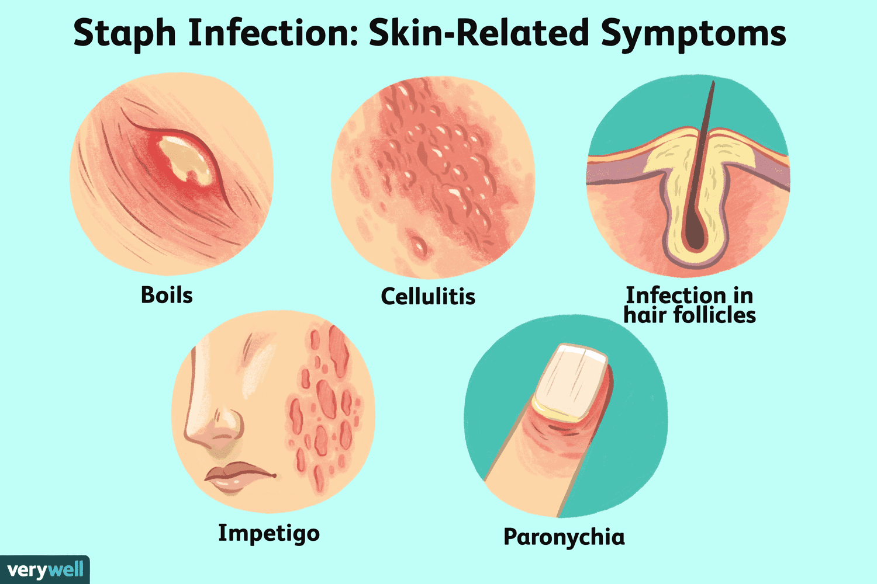
Methicillin-Resistant Staphylococcus aureus
Leading cause of hospital-acquired infection
Symptoms:
Swelling
Rashes
Heart inflammation

Slide 3
Antibiotic-Resistant Development
New strains, evolution, and adaptation
Research question: How has MRSA genomic identity change over time?

Slide 4
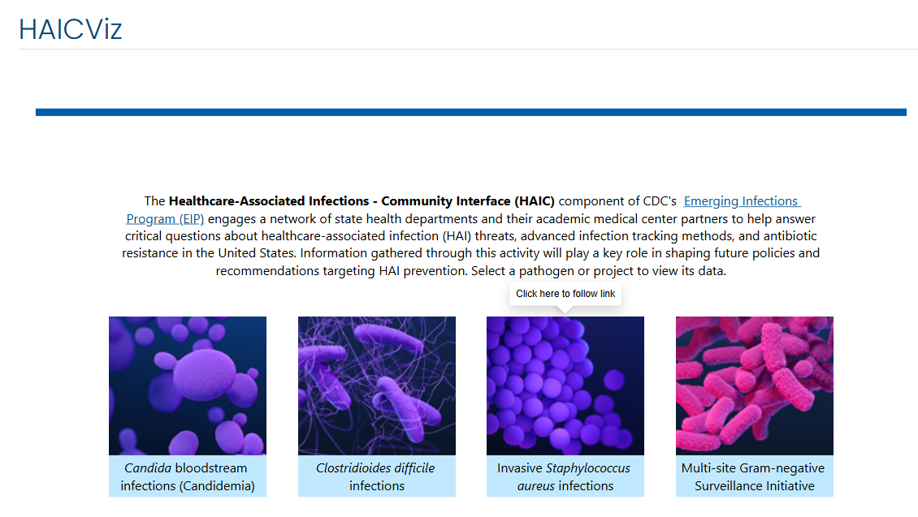

Slide 5
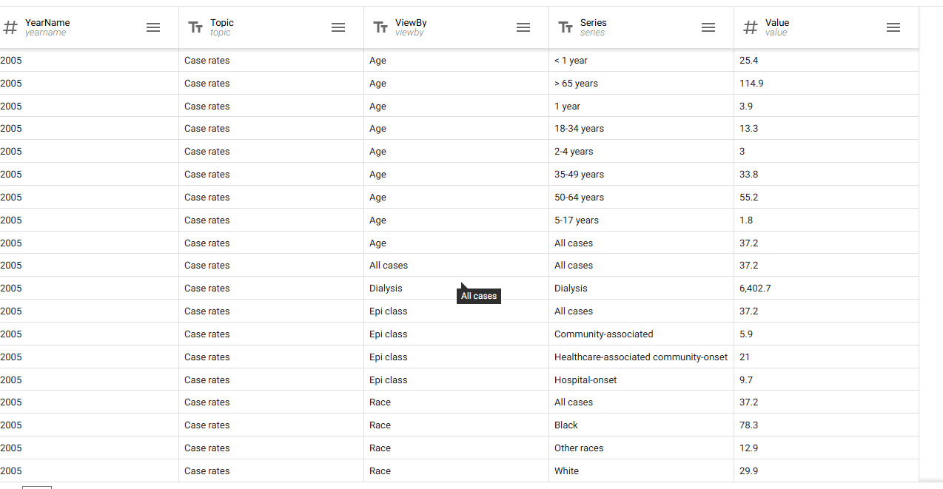

Slide 6


Slide 7
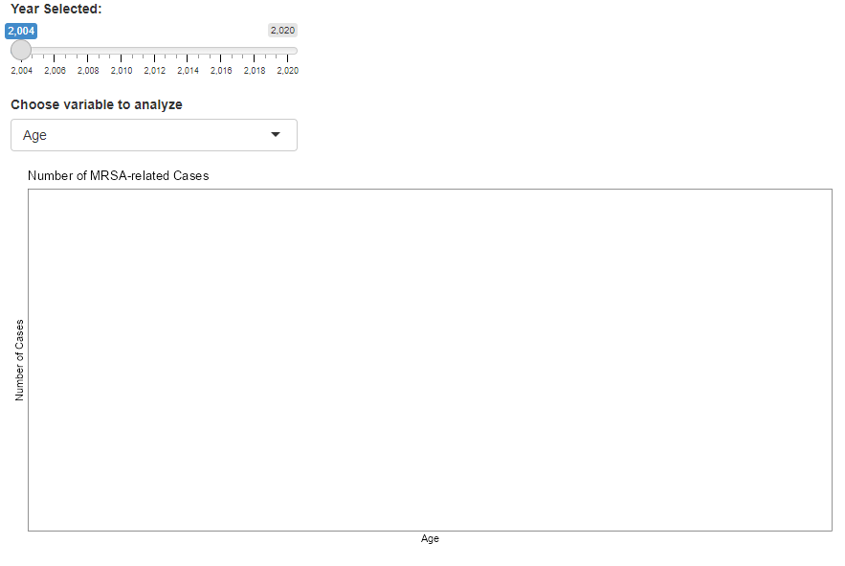

Slide 9
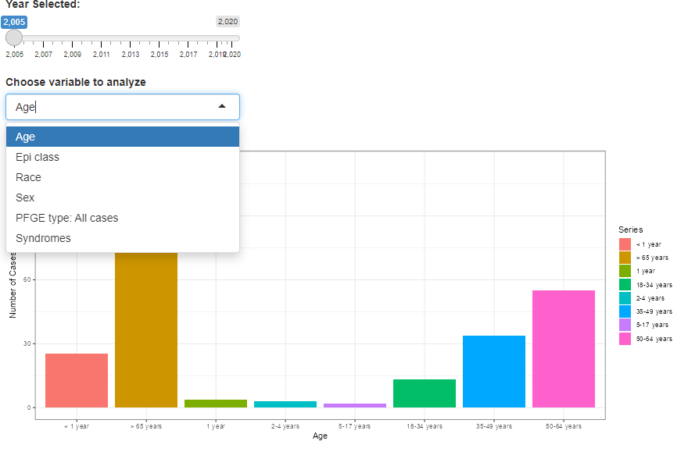

Slide 10
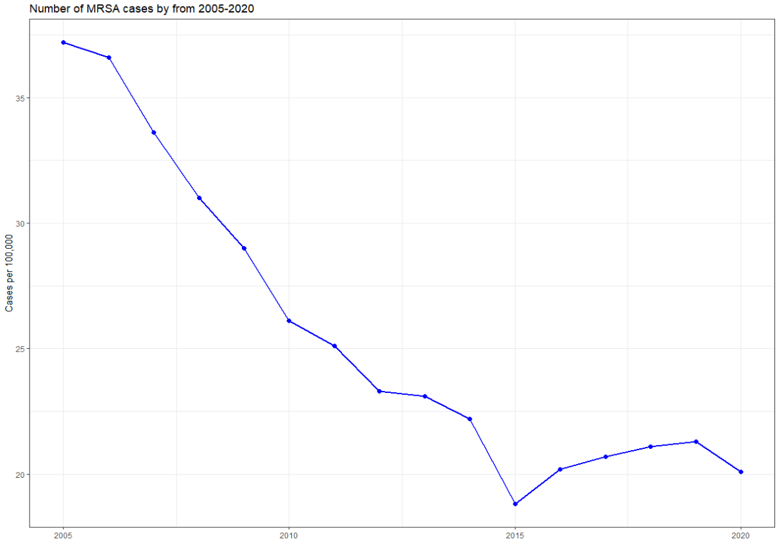
Cases declined since 2005
Improvements in protocol to reduce MRSA transmission in the hospital setting

Slide 11

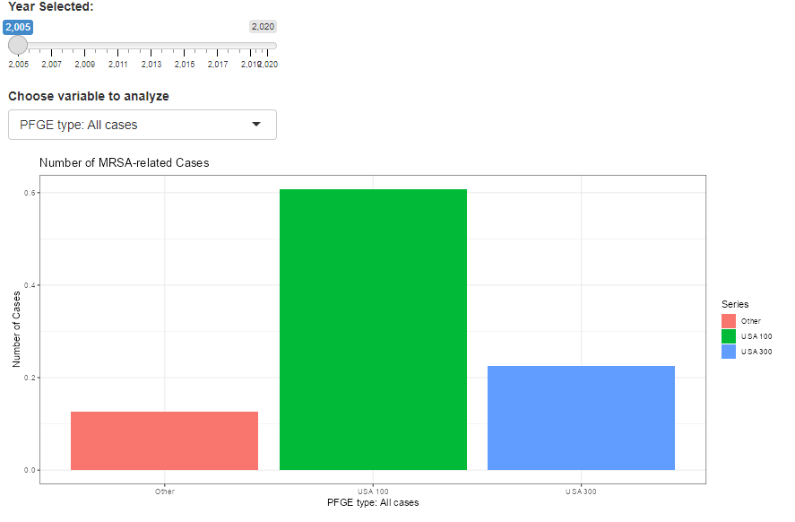
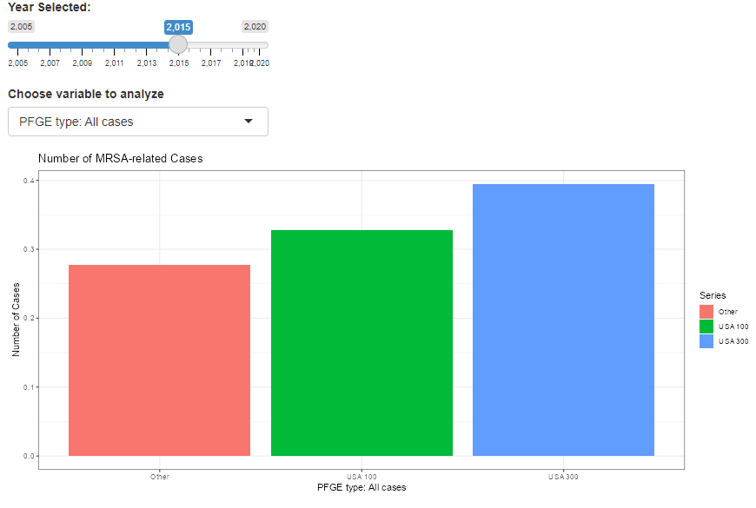
Emergence of new pathogenic strains
USA100-300: Common MRSA strains
“Others”: More resistant strains

Slide 12
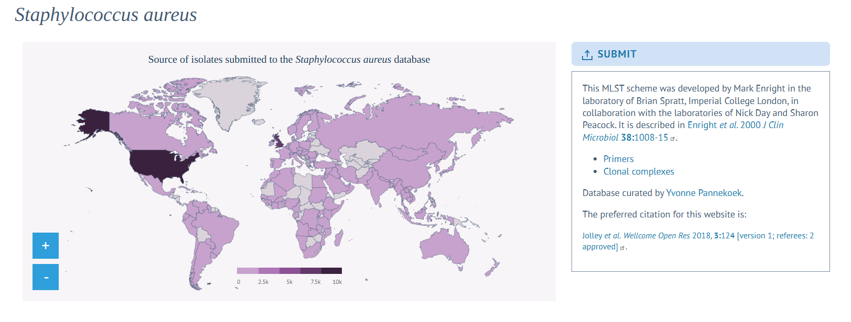
Future Work
Genomic analysis of new MRSA variant:

Slide 13
References
Liu, C., & Chambers, H. F. (2003). Methicillin-resistant Staphylococcus aureus: An overview of clinical features and management strategies. Clinical Infectious Diseases, 36(6), 199-206. https://doi.org/10.1086/368712
Boucher, H. W., & Corey, G. R. (2008). Epidemiology of Methicillin-Resistant Staphylococcus aureus and its Impact on Clinical Outcomes. Clinical Infectious Diseases, 46(5), 1-19. https://doi.org/10.1086/523340
Hidron, A. I., & Patel, J. B. (2011). Antimicrobial-resistant pathogens associated with healthcare-associated infections: A review of the literature. American Journal of Infection Control, 39(3), 152-160. https://doi.org/10.1016/j.ajic.2010.04.011
Enright, M. C., Day, N. P., Davies, C. E., Peacock, S. J., & Spratt, B. G. (2000). Multilocus sequence typing for characterization of methicillin-resistant and methicillin-susceptible clones of Staphylococcus aureus. Journal of clinical microbiology, 38(3), 1008–1015. https://doi.org/10.1128/JCM.38.3.1008-1015.2000
Jolley, K. A., Bray, J. E., & Maiden, M. C. J. (2018). Open-access bacterial population genomics: BIGSdb software, the PubMLST.org website and their applications. Wellcome open research, 3, 124. https://doi.org/10.12688/wellcomeopenres.14826.1
Kourtis AP, Hatfield K, Baggs J, et al. Vital Signs: Epidemiology and Recent Trends in Methicillin-Resistant and in Methicillin-Susceptible Staphylococcus aureus Bloodstream Infections — United States. MMWR Morb Mortal Wkly Rep 2019;68:214–219. DOI: http://dx.doi.org/10.15585/mmwr.mm6809e1
Dai, Y., Liu, J., Guo, W., Meng, H., Huang, Q., He, L., Gao, Q., Lv, H., Liu, Y., Wang, Y., Wang, H., Liu, Q., & Li, M. (2019). Decreasing methicillin-resistant Staphylococcus aureus (MRSA) infections is attributable to the disappearance of predominant MRSA ST239 clones, Shanghai, 2008-2017. Emerging microbes & infections, 8(1), 471–478. https://doi.org/10.1080/22221751.2019.1595161

