Slide 1

Agent-MedRAG: Design and Evaluation of an Agent-Driven Retrieval-Augmented Question Answering System Based on Biomedical Literature
- Chuyang Su, Xinglan Zhao
- GitHub Link: https://github.com/skylarzhao1/GR5293finalproject-Rag

Slide 2
目录
Introduction
Data
Pubmed 2400 article
提取“abstract”，用户输入“query”-》返回“answer”
Methods
Chorma
使用mistral-7B模型（add one same scale）
Prompt engineering
Zero shot vs Few shot
BGE reranker & Fine-tune Rerank (hard sample vs negative sample)
ColBERT

Slide 3
Interpret
Retrieval & Generation
Retrival: Percision & Recall (Confusion Matrix)
Generation: Response Relevance & Faithfulness
Benchmark
bioasq
Conclusion

Slide 4
Background and Motivation
What Is The Challenge?
Overwhelming volume of medical literature.
Medical professionals’ limited timeframes.
What Can We Do?
Design Goal: Domain-specific, reliable, and multidimensional analysis
Goal: Forecast NVIDIA’s monthly closing prices using the Informer model.
Value: Explore how deep learning can enhance stock prediction accuracy in real-world financial data.
Some papers have high complexity and it takes time for readers to figure it out if it is or not what they want.

Slide 5
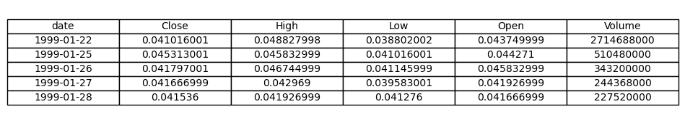
Dataset Overview
Source: Historical stock data of NVIDIA Corporation (1999/01/22–2025/02/14)
Frequency: Daily observations
Total Records: 6558
Features:
Date: Trading date
Close: Daily closing price (used as target)
Adj Close, Open, High, Low, Volume: Auxiliary numeric features

Slide 6
Problem Definition
We aim to forecast the next 21-day trend of Nvidia’s daily closing stock prices based on historical daily data from January 1999 to February 2025.
Input: Daily financial data including open, high, low, close, volume
Output: 21-day future predictions of closing prices
Model: Informer-based deep learning architecture with attention mechanism
Purpose: Evaluate the Informer’s ability to model long-term dependencies in financial time series

Slide 7
Why Informer
Designed for Long Sequences
Informer is tailored for long-sequence time series forecasting (like financial data used from 1999–2025).
ProbSparse Attention
Reduces attention computation from quadratic to log-linear complexity, making it suitable for long historical data.
Encoder-Decoder Structure
Separates historical encoding and future prediction, aligned with stock forecasting.
Non-Autoregressive Decoder
Predicts the full 21-day future sequence in one shot — improves inference speed and stability.

Slide 8
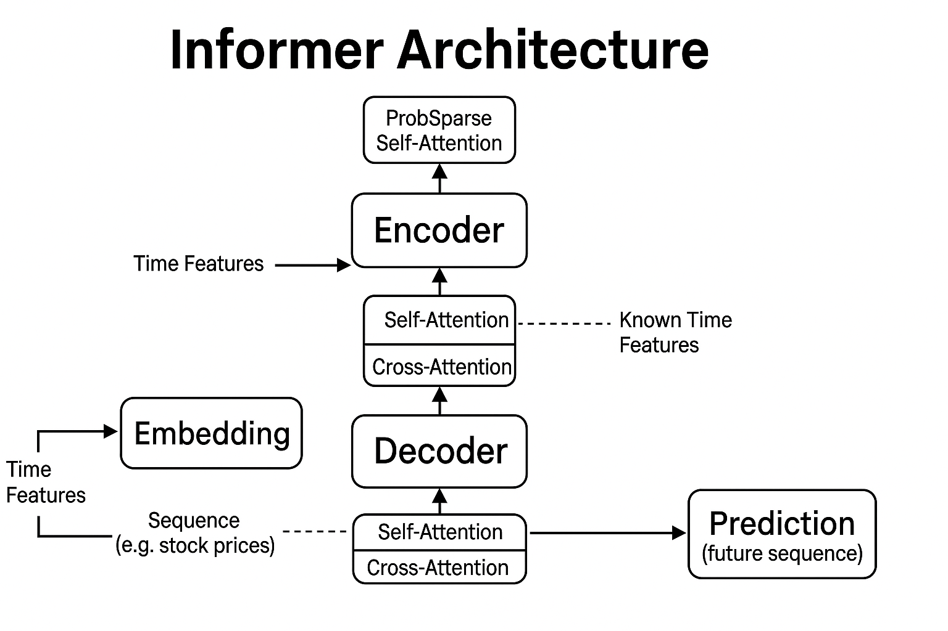
Model Detail
Embedding: projects raw numeric sequences and temporal features into a shared representation space for downstream processing.
Encoder: leverages ProbSparse Self-Attention to efficiently capture long-range dependencies in the input sequence.
Decoder: Generates future predictions by attending to both encoded history and known future time features via self- and cross-attention.
Prediction: output the forecasted future sequence, which is 21 days of stock prices.
Notes:
Self-Attention & Cross-Attention（自注意力和交叉注意力）
自注意力：关注自身序列的内部关系（例如过去的价格之间的依赖）。
交叉注意力：连接编码器输出和解码器输入，实现信息交互。
Self-Attention: Captures intra-sequence dependencies.
Cross-Attention: Connects encoder outputs with decoder inputs to fuse historical and future context.

Slide 9
Experimental Setup & Hyperparameters
Typical Data Split Strategy:
Training Set: 60%
Validation Set: 20%
Test Set: 20%
Sliding Window Strategy
Input Window (seq_len): 4 months ≈ 84 days
Label Window (label_len): 1 month ≈ 21 days
Prediction Horizon (pred_len): 1 month ≈ 21 days
Hyperparameters:
d_model = 256
Heads = 4
Encoder layers = 3
Decoder layers = 4
Dropout = 0.1
Factor = 5
Learning Rate = 1e-4(halved per epoch)
early_stopping_patience = 3

Slide 10
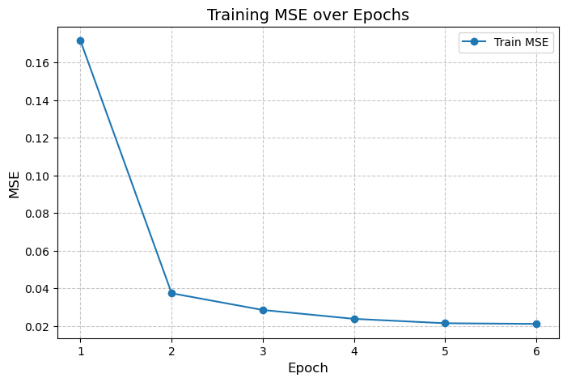
Training Process & Loss Curve
MSE was used as the loss function to measure prediction error.
Training was set for 8 epochs, but early stopping triggered at epoch 6, to prevent overfitting when validation loss plateaued.
Training error decreased steadily, while validation error flattened, showing potential overfitting after epoch 4.

Slide 11
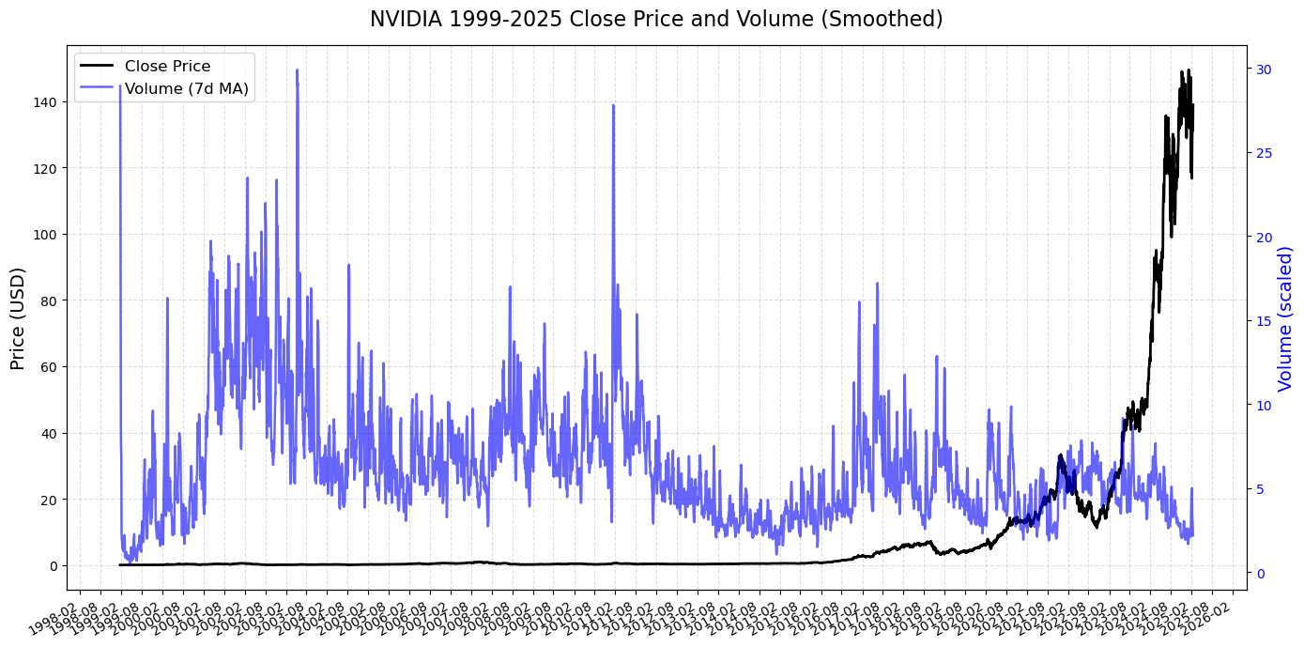
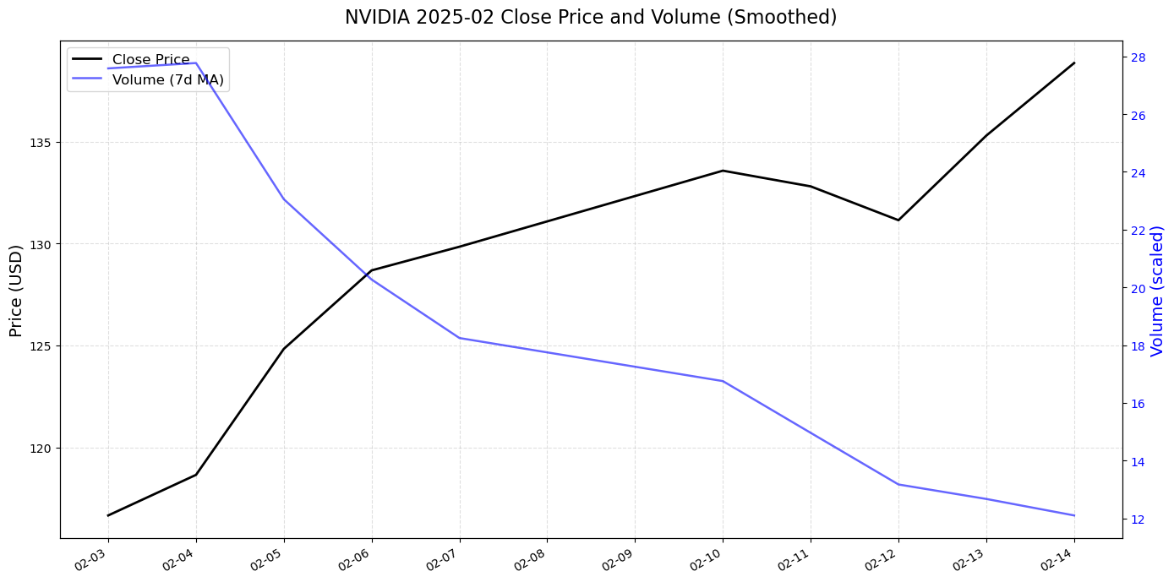
Historical Trends
NVIDIA 1999–2025 Close Price and Volume (Smoothed)
NVIDIA Close Price and Volume (Feb 2025)
Notes:
Black line: Daily closing prices over the past 25 years
Blue line: Trading volume, smoothed by a 7-day moving average
Reveals long-term growth trend and volume surges during high-volatility periods (e.g., 2020–2023)
Highlights the last days of actual data before our prediction window
Shows an upward trend in closing price while volume gradually declines
Serves as a reference for evaluating prediction plausibility

Slide 12
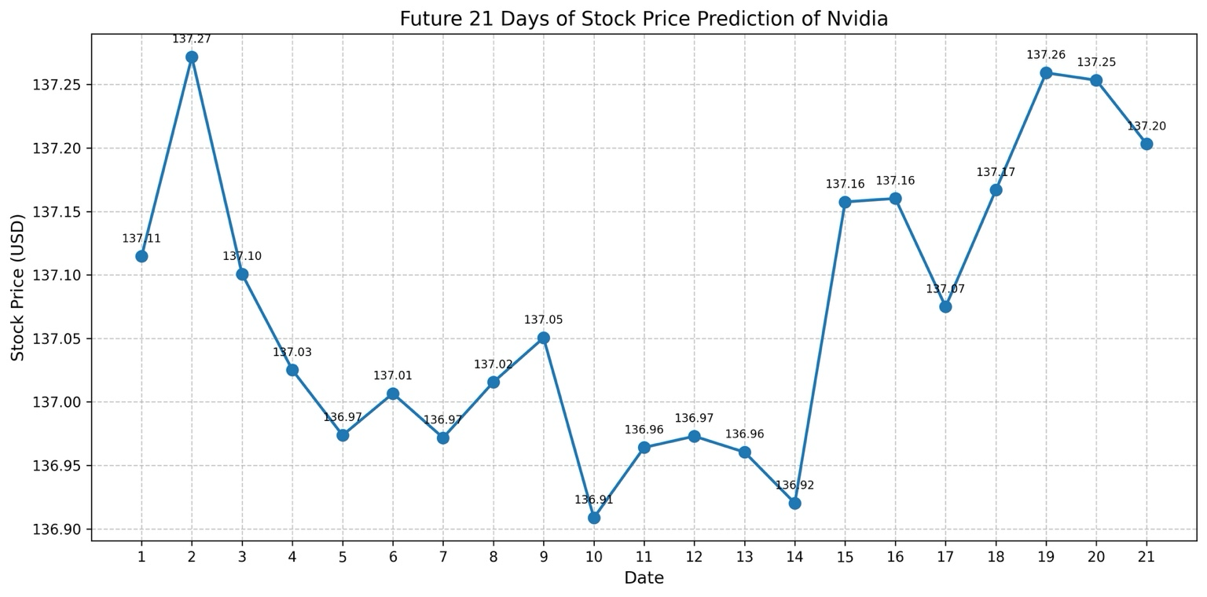
21-Day Forecast Result
Predicted Trend Explanation (Feb–Mar 2025)
The predicted stock price fluctuates gently around $137, showing short-term micro-volatility rather than a strong directional trend.
Around day 10–14, the model detects a local dip, followed by a sharp rebound, which may reflect recognition of cyclical behavior or past momentum patterns.
The last few points show a slight correction after peaking, indicating the model’s awareness of mean-reversion tendencies in financial time series.

Slide 13

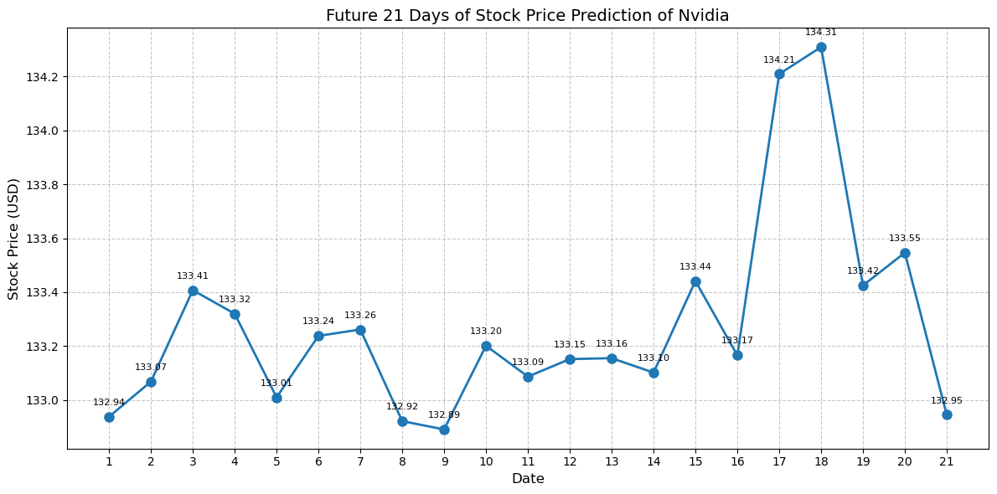
Comparison of predictions between GPU and CPU
Forecast Results with gpu
Forecast Results with cpu
Notes:
This slide presents the prediction results of NVIDIA stock prices for the next 21 days using our model. The left plot shows results generated on a GPU, while the right plot shows results produced on a Mac CPU.
Although the same model parameters and data were used, hardware differences such as numerical precision and weight initialization can lead to variation in outputs.
As shown, the overall trends are fairly similar, but there are slight differences in specific value fluctuations. For instance, the GPU prediction exhibits a noticeable spike around Day 15, whereas the CPU prediction remains more stable.
This comparison highlights that in deep learning, hardware configurations can influence model results—especially when random seeds are not fixed or if the model includes stochastic elements.

Slide 14

Evaluation and Future Work
Advantages of Informer:
Efficient in modeling long time series
Non-autoregressive forecasting for faster inference
Challenges faced:
Complex structure, sensitive to hyperparameters
Performance is sensitive to input window settings
Predictions are smoother than real market volatility
Future Directions:
Incorporate macroeconomic features (e.g., CPI, interest rates)
Extend to multivariate forecasting tasks
Experiment with alternative models (FEDformer, PatchTST)

Slide 15
References
Britannica, T. Editors of Encyclopaedia (2025, May 6). NVIDIA Corporation. Encyclopedia Britannica. https://www.britannica.com/money/NVIDIA-Corporation
Informer: Beyond Efficient Transformer for Long Sequence Time-Series Forecasting (Zhou et al., AAAI 2021)

