Slide 2
Black dots: significant variables by the permutation testing of OPLS Regression loadings (regression vector)
Those have 1 at the 4th column in tpPCRoutput.csv
Usually, they are outside the 95% confidence intervals depicted by red triangles.
Green circles: significant variables by individual regression analysis but not by the permutation testing of OPLS Regression loadings (regression vector)
Those have 0 at the 4th column in tpPCRoutput.csv
Blue dots: loadings from OPLS Regression
A two-sided 95% confidence intervals of the variables coefficient (,i.e., effect) by permutation tests

Slide 3
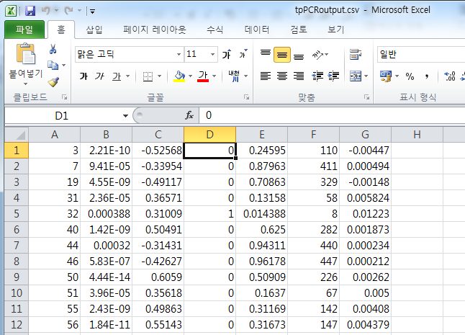
Don’t need to care about column F for now.
G: OPLS regression coefficient for the variable
The sign means the contribution of the individual variable to the response variables in a collective manner
E: the achieved significance level (i.e, p-value) from the testing of the OPLS regression vector
A: All significant variables by (initially) testing regression coefficients
C: Individual regression coefficients from the initial regression
The sign means the contribution of the individual variable to the response variables in an individual manner
D: 1 if significant by permutation testing of the OPLS regression vector
These are collectively significant and important variables.
B: P-values from (initially) testing regression coefficients

