Slide 1
Lecture 17
Pseudo Random Numbers

Slide 2
Announcements
Project 2: Posted Monday.
Due Tuesday, April 9 and April 16
Prelim 2: In-class. Tuesday, April 16
(Not Tuesday after spring break)

Slide 3

Interested in Volunteering over Spring Break?
Come join Habitat on our...
SPRING BREAK WORK TRIP
Morgantown, West Virginia
Sign up and find more information here:
habitatcornell.org

Slide 4
Continuous Random Variables
Clicker Question:
Is it possible for someone to be exactly six feet (72 inches) tall?
A: Yes
B: No
C: Impossible to tell

Slide 5
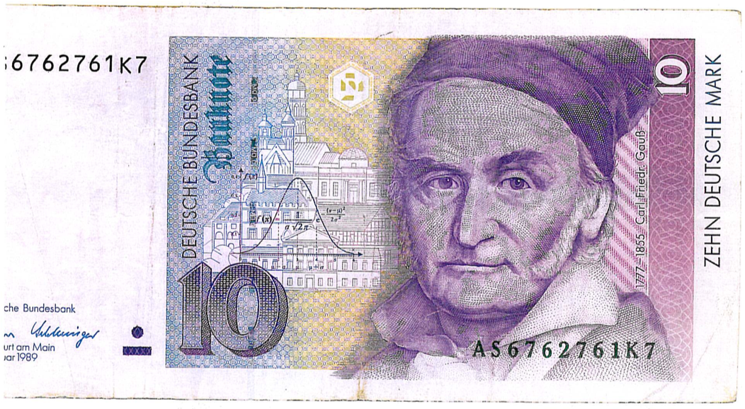
Zehn Deutsche Mark

Slide 6
Uniform Distribution on (a,b)
Informally: All values in the interval (a,b) are equally likely
More formally: Every interval of the same width within (a,b) has the same probability
How to simulate a random sample from a uniform distribution?

Slide 7


Linear Congruential Generator (LCG)
Generate a sequence of integers as follows:
where
and
. Set
https://en.wikipedia.org/wiki/Linear_congruential_generator

Slide 8
Does the LCG work?
Does the LCG generate samples that are indistinguishable from random samples from the uniform distribution?
Null Hypothesis: The LCG generates random samples from the uniform distribution
Alternative Hypothesis: The LCG does not generate samples from the uniform distribution

Slide 9
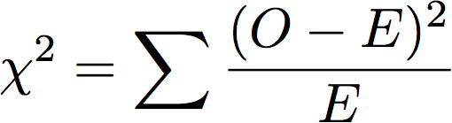
Chi-square Statistic
Divide the unit interval into 10 non-overlapping intervals of equal width 0.1
Determine the observed and expected counts in each interval
Calculate test statistic:

Slide 10
Null Distribution!
Cannot use LCG generated values to test the validity of LCG as a uniform random number generator!
Statistical theory shows that the null distribution of the chi-square statistic has a particular form: a chi-square distribution
We can compare the LCG-simulated histogram of chi-square values to what the theory predicts

Slide 11
One- versus Two-sided Tests
Mendel’s Peas
Null Hypothesis: Probability of purple flower is 0.75 (p = 0.75)
Alternative Hypothesis: Probability is not 0.75 (p != 0.75)
Test Statistic: | p_hat - 0.75 |
Two-sided test: ‘Large’ deviation from the null in either direction leads to rejection (of the null hypothesis)
Jelly Beans
Null Hypothesis: No effect on the probability of acne (p = 0.2)
Alternative Hypothesis: Increase the probability of acne (p > 0.2)
Test Statistic: p_hat - 0.2
One-sided test: ‘Large’ positive deviation from the null leads to rejection

Slide 12
Conclusions From a Test
Fail to reject the null hypothesis (data is not inconsistent with the null hypothesis - inconclusive)
Hypothesis test
Reject the null hypothesis (data is inconsistent with the null hypothesis - accept the alternative)

Slide 13
Definition of P-value
The P-value is the chance,
under the null hypothesis,
that the test statistic
is equal to the value that was observed in the data or is even further in the direction of the alternative.

Slide 14
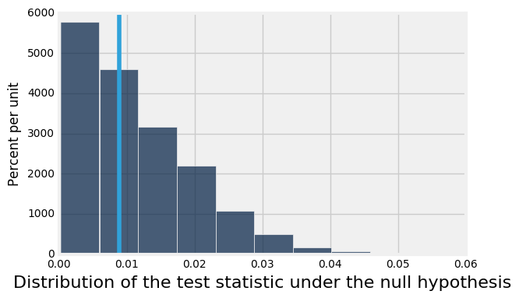
Quantifying Conclusions
P(the test statistic would be equal to or more extreme than the observed test statistic under the null hypothesis)
Evaluating Mendel's pea flower hypothesis
This area is the P-value (approximately)

Slide 15
Conventions of Consistency
“Inconsistent”: The test statistic is in the tail of the null distribution.
“In the tail,” first convention:
The area in the tail is less than 5%.
The result is “statistically significant.”
“In the tail,” second convention:
The area in the tail is less than 1%.
The result is “highly statistically significant.”

Slide 16
Can the Conclusion be Wrong?
Yes.
 | Null is true | Alternative is true
Test rejects the null | ❌ | ✅
Test doesn’t reject the null | ✅ | ❌
(Demo)

Slide 17
An Error Probability
The cutoff for the P-value is an error probability.
If:
your cutoff is 5%
and the null hypothesis happens to be true
(but you don’t know that)
then there is about a 5% chance that your test will reject the null hypothesis anyway.

