Slide 1
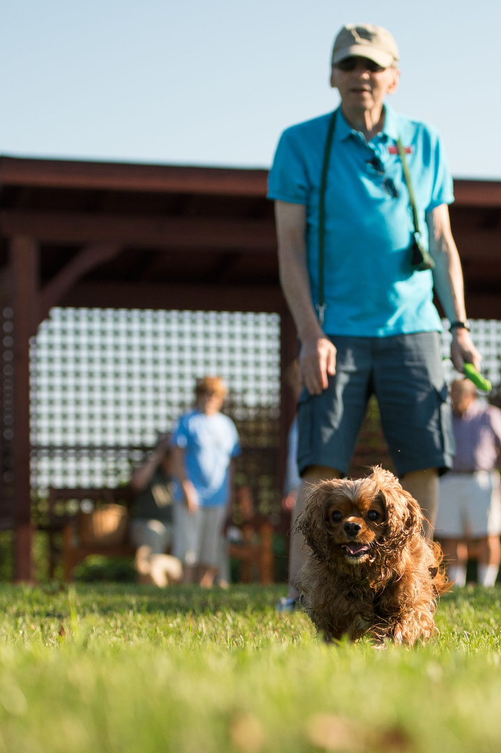
Building a Pet Community Dapp on Solana
Discover the technical implementation and market operations of creating a pet community dapp on Solana - a blockchain platform that offers fast, secure, and scalable solutions.
wX
by wang Xing

Slide 2

Overview of the Project
Explore the concept and goals of the pet community dapp, designed to connect and empower pet owners, facilitate animal care, and create a vibrant community.

Slide 3

Why Solana?
Learn why Solana is the ideal blockchain platform for the pet community dapp, with its high-performance capabilities, low transaction fees, and efficient consensus mechanism.

Slide 4
Technical Implementation
1
Architectural Design
Discover the well-structured architecture of the pet community dapp, ensuring optimal performance and seamless user experience.
2
Smart Contract Development
Explore the development and deployment of smart contracts on Solana, enabling secure and transparent interactions within the dapp.
3
User Interface Design
Delve into the intuitive and visually appealing design of the pet community dapp, enhancing user engagement and satisfaction.

Slide 5
Market Operations
User Acquisition
Monetization Models
Partnerships & Collaborations
Uncover effective strategies for attracting and onboarding pet owners, creating a thriving community of engaged users.
Explore various monetization models, such as premium features, sponsored content, and partnerships, ensuring sustainable growth of the dapp.
Learn how strategic partnerships and collaborations with pet-related businesses can expand the reach and offerings of the pet community dapp.

Slide 6

Conclusion
Wrap up the presentation by highlighting the immense potential of building a pet community dapp on Solana, driving innovation, connectivity, and accessibility in the pet industry.

