Slide 1
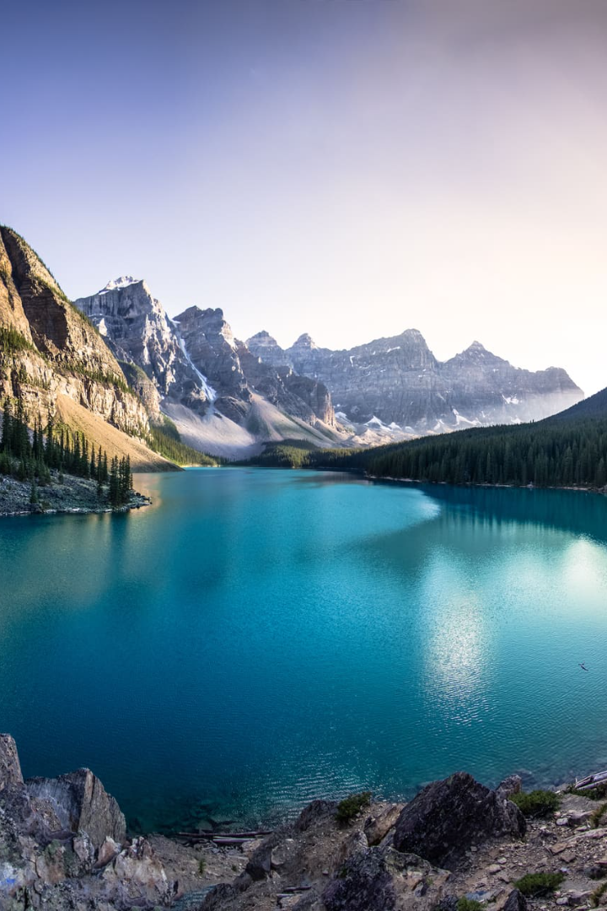
Creating a Solana-Based Social Dapp for Photography Enthusiasts
Welcome to a world of creative possibilities. Our Solana-based social dapp is a game changer for photography enthusiasts. Join the revolution and discover a new way to share your passion.
by Skyler Cao

Slide 2
What is Solana?
Fast and Low Cost 💸
Secure 🔒
Scalable 📈
Solana processes 65,000 transactions per second at a fraction of the cost of other blockchains.
Solana uses advanced cryptographic technology to ensure your data and photos remain safe.
With the ability to support multiple decentralized apps, Solana can accommodate growth and demand.

Slide 3

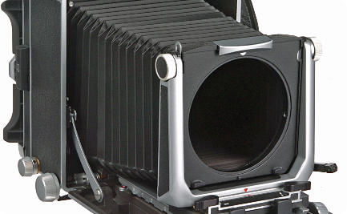
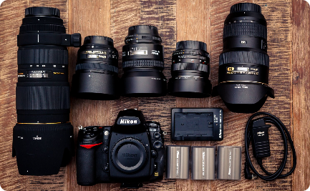
Understanding the Need for a Social Dapp for Photography Enthusiasts
Connect With Fellow Photographers
Showcase Your Work
Learn and Grow
Get recognition for your photography by sharing it with fellow enthusiasts in a dedicated social space..
Get tips from experts, learn new techniques, and improve your skills to take your photography to the next level.
Get inspired, share ideas and build relationships with a community of like-minded individuals.

Slide 4
Features and Benefits of the Solana-Based Social Dapp
1
Decentralized Network
Eliminates the need for intermediaries and enables peer-to-peer transactions.
Low Transaction Fees
2
Minimal transaction fees allow users to transact funds with ease.
3
Direct Monetization Opportunities
Earn money through direct monetization, without the need for third parties.

Slide 5
How the Social Dapp Works
User-Friendly Interface 📱
Easy-to-Use Tools 🛠️
Seamless Integration with Solana 💻
A range of features, including editing tools and filters, are available to enhance your photos.
The intuitive interface allows users to easily navigate the app, making it accessible to everyone.
The integration with Solana ensures quick and secure transactions.

Slide 6
Potential Challenges and Solutions
Scalability Issues 🆙
Security 💪
By using Solana, we ensure scalability and avoid potential issues with limited transaction processing.
Advanced cryptography and algorithms are used to ensure data is safe and secure.

Slide 7
Technical Solution Implementation
Smart Contract Architecture 🧑‍💻
Our team uses smart contract architecture to handle transactions, ensuring secure and transparent processing.
IPFS Storage 🗄️
The IPFS storage system is used to handle data storage and management, allowing for fast and easy retrieval of photos and other content.

Slide 8

Desired Result
1
Revolutionize the Photography World 📸
We aim to create a social dapp that is accessible to anyone, enabling photographers to connect, collaborate and earn money in a secure and decentralized environment.

Slide 9

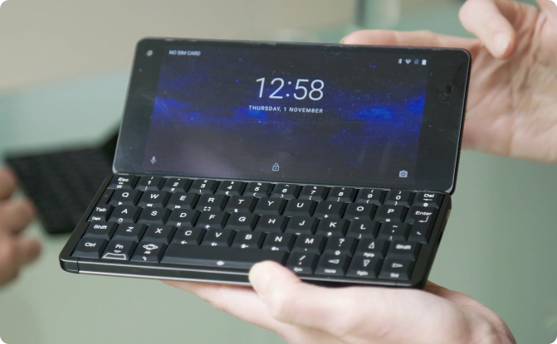
Contact Our Team
Our Team 💼
Contact Us 📲
We are a dedicated team of blockchain and photography experts, passionate about creating innovative solutions.
Reach us via our website or social media to learn more about our project and business opportunities.

