Slide 1
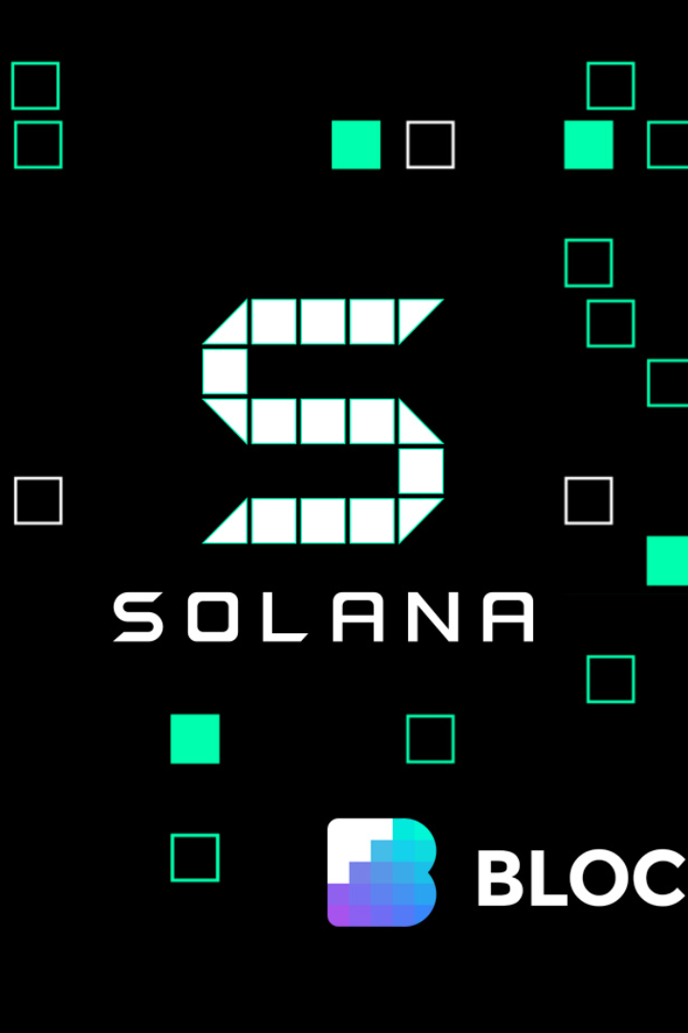
Building a Multi-Language Learning Dapp on the Solana Ecosystem
Explore the vast potential of the Solana blockchain for creating an immersive and decentralized language learning experience.
wX
by wang Xing

Slide 2

Overview of Solana Ecosystem
1
Solana Blockchain
2
Key Features
3
Advantages
Incredible throughput, sub-second finality, and secure architecture make Solana ideal for building Dapps.
Seamless integration with existing programming languages, robust developer tools, and a thriving community.
A high-performance and scalable blockchain platform known for its lightning-fast transaction speed and low fees.

Slide 3
Implementation Plan for the Multi-Language Learning Dapp
1
Defining the Goal
Clearly identify the objective of the Dapp: creating an engaging and effective language learning experience.
User Interface
2
Design an intuitive user interface that facilitates easy navigation and encourages active participation.
3
Backend & Smart Contracts
Develop a robust backend infrastructure and implement secure smart contracts for seamless operations.
Language Learning Resources
4
Integrate a wide range of resources, such as vocabulary exercises and grammar lessons, tailored to different languages.

Slide 4
Future Plans and Potential Enhancements
Expanding Language Support
Gamification and Rewards System
Social Features and Community Building
Include support for additional languages to cater to a diverse user base and global language learners.
Implement gamification elements and a rewards system to motivate users and make learning more enjoyable.
Create a vibrant community where users can interact, practice languages, and share their learning experiences.

Slide 5

Conclusion and Key Takeaways
Empowering Language Learning
The Solana ecosystem provides a powerful foundation for building immersive Dapps that revolutionize language learning.
Scalability and Interoperability
Solana's speed and seamless integration capabilities fuel the development of innovative edtech solutions.
Unlocking Global Potential
By leveraging Solana, we can create a platform that connects language learners from all around the world.

