Slide 1

RNA-Seq: Alignment Jessica Holmes
Pick up a name tag or make new one
Pick up red and green sticky note
Workshop page: go.illinois.edu/rna-seq
If you missed or didn’t get trimming to work, see the next slide

Slide 2
Catch up
If you were not able to get trimming steps to work, feel free to copy over the key results:
$ cp /home/classroom/hpcbio/sp20-rnaseq/subset/results/trimmomatic/* ~/mouse-rnaseq-2020/results/trimmomatic/

Slide 3
Outline
Review relevant file formats
Discuss alignment and downstream methods for various scenarios
Obtain reference data
Align trimmed data using STAR

Slide 4
Transcriptome:
the sum total of all of the RNA molecules expressed from the genes of an organism

Slide 5
How do transcriptome’s get saved?
FASTA
Saves sequences
GTF
Saves annotations
GFF
Saves annotations

Slide 6
Formats: FASTA
E.g. a read
E.g. a chromosome
>unique_sequence_ID
ATTCATTAAAGCAGTTTATTGGCTTAATGTACATCAGTGAAATCATAAATGCTAAAAATTTATGATAAAA
>Group10 gi|323388978|ref|NC_007079.3| Amel_4.5, whole genome shotgun sequence
TAATTTATATATCTATTTTTTTTATTAAAAAATTTATATTTTTGTTAAAATTTTATTTGATTAGAAATAT
TTTTACTATTGTTCATTAATCGTTAATTAAAGATAGCACAGCACATGTAAGAATTCTAGGTCATGCGAAA
TTAAAAATTAAAAATATTCATATTTCTATAATAATTAAATTATTGTTTTAATTTAAGTAAAAAAATTTCT
AAGAAATCAAAAATTTGTTGTAATATTGAAACAAAATTTTGTTGTCTGCTTTTTATAGTAACTAATAAAT
ATTTAATAAAAAATTACTTTATTTAATATTTTATAATAAATCAAATTGTCCAATTTGAAATTTATTTTAT
CACTAAAAATATCTTTATTATAGTCAATATTTTTTGTTAGGTTTAAATAATTGTTAAAATTAGAAAATGA
TCGATATTTTCAAATAGTACGTTTAACTAATACTTAAGTGAAAGGTAAAGCGGTTATTTAAAATATTGAT
TTATAATATTCGTGACATAATATATTTATAAATAGATTATATATATATATATACATCAAAATATTATACG
AGAACTAGAAAATATTACAGATGCAAAATAAATTAAATTTTGTAAATGTTACAGAATTAAAAATCGAAGT

Slide 7
Feature formats : GTF Gene transfer format
Tab-delimited file to store genomic features, e.g. genomic intervals of genes and gene structure
Differences in representation of information make it distinct from GFF
1-based coordinates
AB000381 Twinscan CDS 380 401 . + 0 gene_id "001"; transcript_id "001.1";
AB000381 Twinscan CDS 501 650 . + 2 gene_id "001"; transcript_id "001.1";
AB000381 Twinscan CDS 700 707 . + 2 gene_id "001"; transcript_id "001.1";
AB000381 Twinscan start_codon 380 382 . + 0 gene_id "001"; transcript_id "001.1";
AB000381 Twinscan stop_codon 708 710 . + 0 gene_id "001"; transcript_id "001.1";
Source
End location
Strand
Attributes (hierarchy)
Chromosome ID
Start location
Reading frame
Gene feature
Score (user defined)

Slide 8
Feature formats : GTF Gene transfer format
Differences in representation of information make it distinct from GFF
1-based coordinates
Source of GTF is important – Ensembl GTF is not quite the same as UCSC GTF
AB000381 Twinscan CDS 380 401 . + 0 gene_id "001"; transcript_id "001.1";
AB000381 Twinscan CDS 501 650 . + 2 gene_id "001"; transcript_id "001.1";
AB000381 Twinscan CDS 700 707 . + 2 gene_id "001"; transcript_id "001.1";
AB000381 Twinscan start_codon 380 382 . + 0 gene_id "001"; transcript_id "001.1";
AB000381 Twinscan stop_codon 708 710 . + 0 gene_id "001"; transcript_id "001.1";
Source
End location
Strand
Attributes (hierarchy)
Chromosome ID
Start location
Reading frame
Gene feature
Score (user defined)

Slide 9
Feature formats : GFF3 Gene feature format (v3)
Tab-delimited file to store genomic features, e.g. genomic intervals of genes and gene structure
Meant to be unified replacement for GFF/GTF (includes specification)
All but UCSC have started using this (UCSC prefers their own internal formats)
1-based coordinates
Chr1 amel_OGSv3.1 gene 204921 223005 . + . ID=GB42165
Chr1 amel_OGSv3.1 mRNA 204921 223005 . + . ID=GB42165-RA;Parent=GB42165
Chr1 amel_OGSv3.1 3’UTR 222859 223005 . + . Parent=GB42165-RA
Chr1 amel_OGSv3.1 exon 204921 205070 . + . Parent=GB42165-RA
Chr1 amel_OGSv3.1 exon 222772 223005 . + . Parent=GB42165-RA
Source
End location
Strand
Attributes (hierarchy)
Chromosome ID
Start location
Gene feature
Phase
Score (user defined)

Slide 10
Feature formats: GFF3 vs. GTF
GFF3 – Gene feature format
GTF – Gene transfer format
Always check which of the two formats is accepted by your application of choice, sometimes they cannot be swapped
Chr1 amel_OGSv3.1 gene 204921 223005 . + . ID=GB42165
Chr1 amel_OGSv3.1 mRNA 204921 223005 . + . ID=GB42165-RA;Parent=GB42165
Chr1 amel_OGSv3.1 3’UTR 222859 223005 . + . Parent=GB42165-RA
Chr1 amel_OGSv3.1 exon 204921 205070 . + . Parent=GB42165-RA
Chr1 amel_OGSv3.1 exon 222772 223005 . + . Parent=GB42165-RA
AB000381 Twinscan CDS 380 401 . + 0 gene_id "001"; transcript_id "001.1";
AB000381 Twinscan CDS 501 650 . + 2 gene_id "001"; transcript_id "001.1";
AB000381 Twinscan CDS 700 707 . + 2 gene_id "001"; transcript_id "001.1";
AB000381 Twinscan start_codon 380 382 . + 0 gene_id "001"; transcript_id "001.1";
AB000381 Twinscan stop_codon 708 710 . + 0 gene_id "001"; transcript_id "001.1";

Slide 11
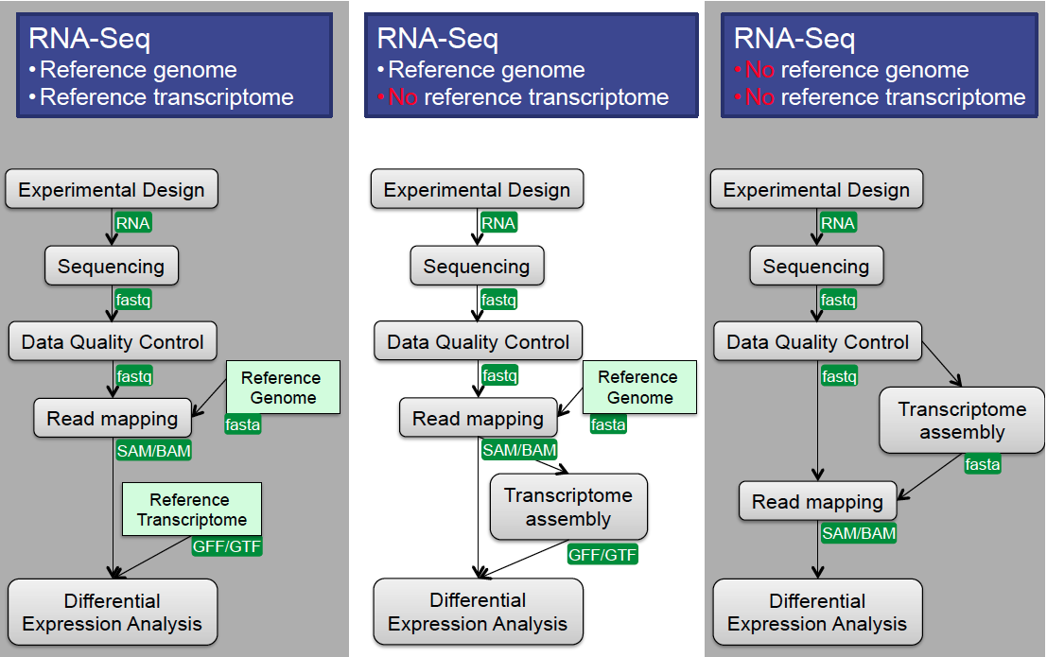
Differential Gene Expression
Methods
Options for DGE analysis

Slide 12
Differential Gene Expression
Methods
Options for DGE analysis

Slide 13
Differential Gene Expression
Methods
Options for DGE analysis

Slide 14
Differential Gene Expression
Methods
Options for DGE analysis
Closely-related
species’ reference genome
Closely-related
species’ transcriptome

Slide 15
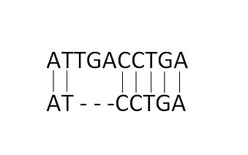
What is an alignment?
Wikipedia - “a way of arranging the sequences of DNA, RNA, or protein to identify regions of similarity that may be a consequence of functional, structural, or evolutionary relationships between the sequences”
How can we store this information about millions of reads that align to our reference genome?

Slide 16
Transcriptome Analysis
Data Alignment
We need to align the sequence data to our genome of interest
If aligning RNASeq data to the genome, almost always pick a splice-aware aligner
Genome
Alignment
Reads
Gene
Versus
Genome
Splice-Aware
Alignment
Reads
Gene

Slide 17
Alignment Software
Splice-aware aligners: STAR, HiSAT2, GSNAP
All of these perform better with an annotation file (i.e. GTF or GFF3)
General aligners: BWA, Novoalign, HiSAT2 (DNA mode)
Recommended for bacteria or organisms that don’t undergo alternative splicing

Slide 18
Tips for choosing/running software
Choose software that’s appropriate for your organism
Standard vs. splice-aware aligner
Pay careful attention to all the possible parameters
Are the default setting good enough for your species of interest?

Slide 19
Outline
Review relevant file formats
Discuss alignment and downstream methods for various scenarios
Obtain reference data
Align trimmed data using STAR

Slide 20
How can I acquire reference files?
FTP site
NCBI, Ensembl, UCSC are the most comprehensive
FTP = File Transfer Protocol
Download to your own computer and then use scp to upload to Biocluster
Or get on Biocluster head node and download directly to your directory using wget

Slide 21
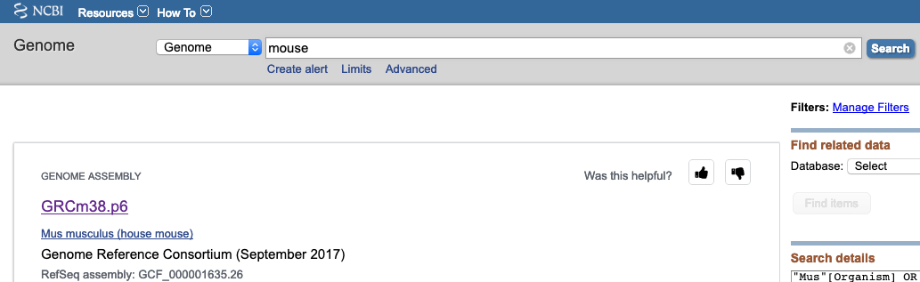
NCBI Genome Resources
Genomes in .fna (fasta) format (sequence of each chromosome)
Gene model sets in .gff format (start and end locations)
NCBI actually has multiple copies in multiple locations. Easiest way:
1. Search only genome database
2. Put in common or scientific name
3. Click to search

Slide 22
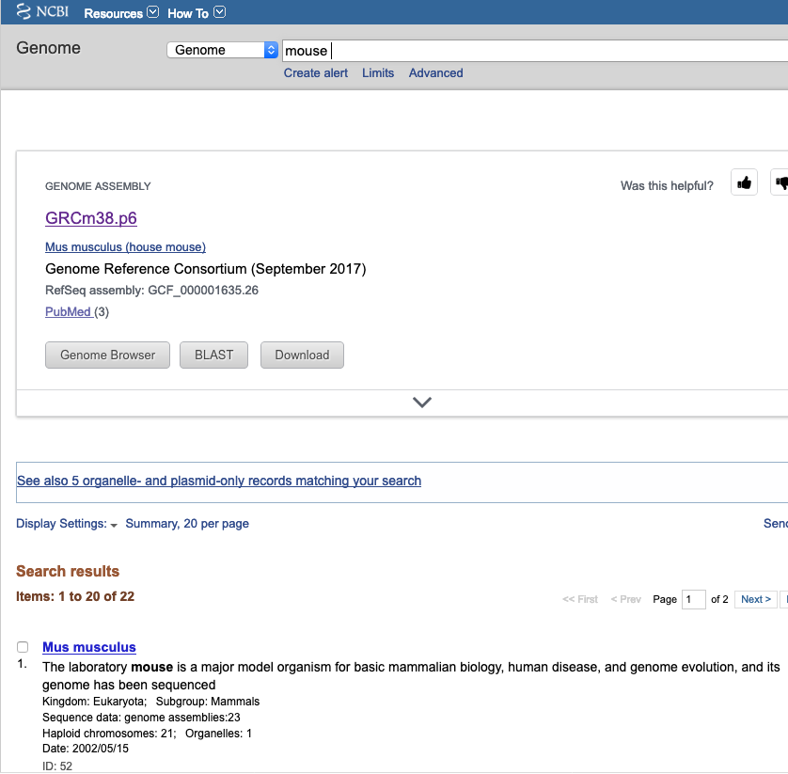
NCBI Genome Resources
4. Select correct version

Slide 23
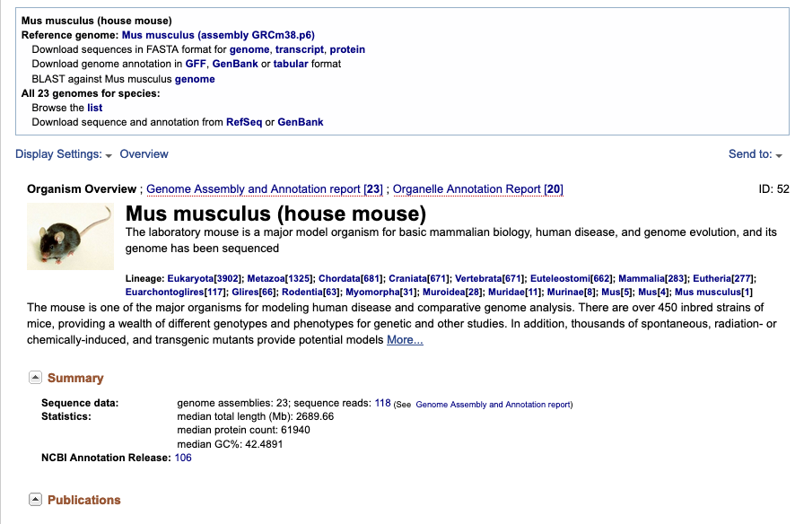
Document genome AND gene annotation versions
Gene models updated more frequently than genome, but their file name only has genome version in it!!
Genome version
Gene annotation version
If missing, NCBI didn’t make genes

Slide 24
Don’t just click on the download links!
Instead, right click on any one and pick “Copy link address”
Genome version

Slide 25
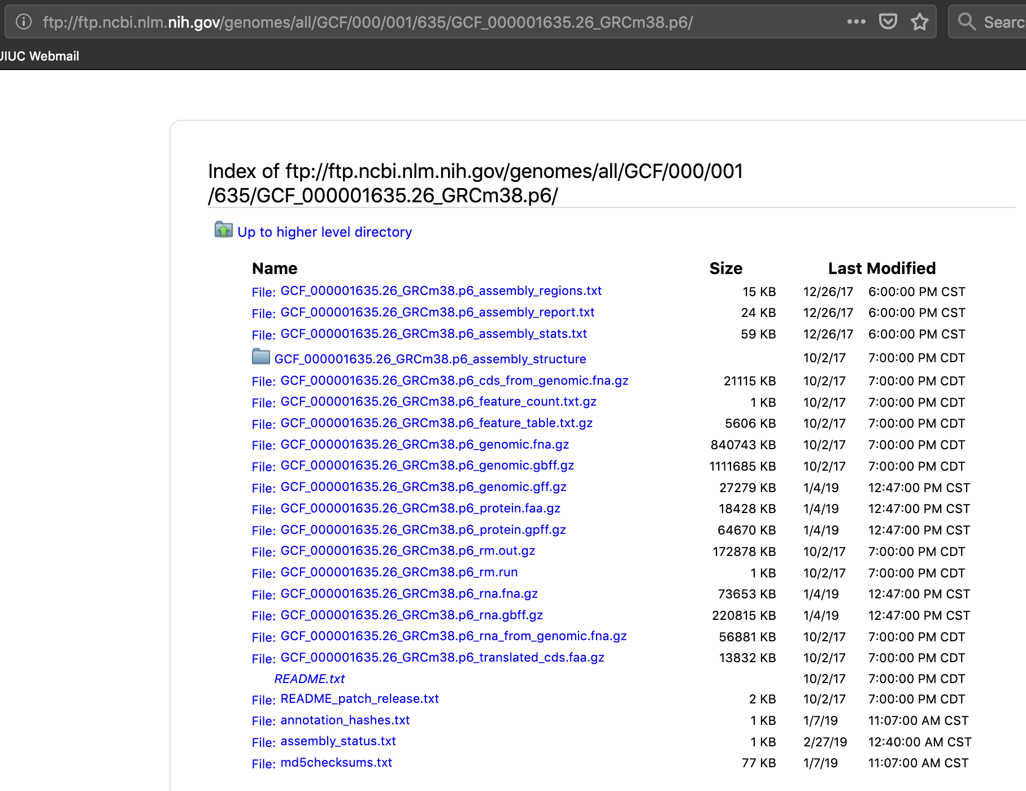
Paste address in new tab, but don’t hit enter yet!
Delete file name and hit enter to go to directory instead
Genome .fasta (.fna.gz)
Gene set (.gff.gz) Right-click, select “Save link as”
Want these also for documentation

Slide 26
Download FASTA & GFF
Get on the head node (type ‘exit’ once)
Move to the data/genome/ directory
Copy the FTP address in the web browser
Type ‘wget’ in the terminal and paste the FTP address
Type in the name of the file you want, then press enter
Files we want:
GCF_000001635.26_GRCm38.p6_genomic.gff.gz
GCF_000001635.26_GRCm38.p6_genomic.fna.gz
annotation_hashes.txt (so we know when the GFF was updated)
Notes:
ftp://ftp.ncbi.nlm.nih.gov/genomes/all/GCF/000/001/635/GCF_000001635.26_GRCm38.p6/GCF_000001635.26_GRCm38.p6_genomic.fna.gz

Slide 27
Okay so I’m done right?
Well...we have to consider the needs of our downstream program, STAR...
STAR requires that patches and alternative haplotypes have to be removed
Currently, this pertains to human, mouse, and zebrafish
GFF annotation files are often inaccurately read in, so it’s better to convert it to GTF
We have a script you can use for NCBI GFF files

Slide 28
Okay so I’m done right?
Well...we have to consider the needs of our downstream program, STAR...
STAR requires that patches and alternative haplotypes have to be removed
We are only using chromosome 12, so we will skip this. However, you can find an example script here: /home/classroom/hpcbio/sp20-rnaseq/full_example/src/removeAltsPatches.sh
GFF annotation files are often inaccurately read in, so it’s better to convert it to GTF
We will try this on a chromosome 12 GFF file.

Slide 29
Copy over small reference files
$ cp /home/classroom/hpcbio/sp20-rnaseq/chr12_ref/*.fna ~/mouse-rnaseq-2020/data/genome/
cp /home/classroom/hpcbio/sp20-rnaseq/chr12_ref/*.gff ~/mouse-rnaseq-2020/data/genome/

Slide 30
Convert GFF to GTF
Our aligner (STAR) works more accurately with GTF files, so we’ll need to convert this file
We have an R script in the following path which can make this conversion for NCBI GFFs only
If using Ensembl database, both GTF and GFF available
If using other database, conversion can be complex

Slide 31
Convert GFF to GTF
$ cp /home/classroom/hpcbio/sp20-rnaseq/full_example/src/gff2gtf_rtracklayer.R ~/mouse-rnaseq-2020/src/
$ cd ~/mouse-rnaseq-2020/data/genome/
$ srun --pty -p classroom bash

Slide 32
Convert GFF to GTF
Run the following commands to use this script.
Rscript gff2gtf_rtracklayer.R GCF_000001635.26_GRCm38.p6_genomic.chr12.gff GCF_000001635.26_GRCm38.p6_genomic.chr12.gtf putEGin_gene_id
If you have time, feel free to read the script using “less” and see what helpful information is provided there.

Slide 33
Outline
Review relevant file formats
Discuss alignment and downstream methods for various scenarios
Obtain reference data
Align trimmed data using STAR

Slide 34
STAR (2.7.3a)
Underlying algorithm allows it to outperform other aligners in speed by more than 50x
Splice-aware - can discover de novo splice junctions
STAR prefers GTF feature format
Accepts GFF3, but does not work correctly for all GFF3
STAR has a counting option
Default values of htseqcount (can’t change option values)
Paper: http://bioinformatics.oxfordjournals.org/content/early/2012/10/25/bioinformatics.bts635
GitHub page: https://github.com/alexdobin/STAR
Make sure defaults are okay for your organism and your GTF (see parameters near end of manual)!

Slide 35
Genome Index
All alignment programs require a genome index to be made
And index is like a table of contents for your genome
They are usually specific to the software
mouse and human are available on STAR’s github
Will need to make your own if one is not available

Slide 36
STAR genome INDEX script - Example
#!/bin/bash
#SBATCH -N 1
#SBATCH --ntasks 2
#SBATCH --mem 15G
#SBATCH -p classroom
#SBATCH --mail-type ALL
#SBATCH --mail-user yourEmail@illinois.edu
#SBATCH -J make.index
cd ~/mouse-rnaseq-2020/data/genome/
module load STAR/2.5.3a-IGB-gcc-4.9.4
STAR --runThreadN $SLURM_NTASKS \
--runMode genomeGenerate \
--genomeDir STAR-2.5.3a-R64_Index \
--genomeFastaFiles GCF_000146045.2_R64_genomic.fna \
--limitGenomeGenerateRAM 14500000000

Slide 37
STAR index
cd ~/mouse-rnaseq-2020/src/
cp /home/classroom/hpcbio/sp20-rnaseq/subset/src/STAR-index-mouse-genome.sh .
Change the email address in the script
Run the script
Where will the index output to?
What does the index look like?

Slide 38
STAR alignment preparation
mkdir ~/mouse-rnaseq-2020/results/star/
cd ~/mouse-rnaseq-2020/src/
cp /home/classroom/hpcbio/sp20-rnaseq/subset/src/align_mouse_array_exercise.sh .
Notes:
cp /home/classroom/hpcbio/sp20-rnaseq/subset/src/align_mouse_array_exercise.sh .

Slide 39
Alignment Exercise
Edit this job array script (align_mouse_array_exercise.sh). All the information you need is below or in the manual.
Make sure emails are sent to your address
Add 3 extra parameters/options:
Output your alignment file in BAM format, sorted by coordinate
Give your output files a UNIQUE name/prefix
Do not let STAR use more than 5.9 GB of memory

Slide 40
Bonus Exercise
If you finish early, try reading about and adding the following:
(Beginner topic) Gene counting
(Advanced topic) Two-pass mode

Slide 41
iClicker Question
Turn on your iClickers
How many files did STAR output for each sample?
1
2
5
6
12

Slide 42
Most important files
*Aligned.sortedByCoord.out.bam - alignments of all reads, in .bam format sorted by coordinate
*Log.final.out - summary of alignment statistics including:
Number of input reads
Number of uniquely mapped reads
Number of multiply mapped reads

Slide 43
Formats : SAM
SAM – Sequence Alignment/Map format
SAM file format stores alignment information
Plain text
Specification: http://samtools.sourceforge.net/SAM1.pdf
Contains quality information, meta data, alignment information, sequence etc.
Files can be very large: Many 100’s of GB or more
Normally converted into BAM to save space (and text format is mostly useless for downstream analyses)
@HD [format version]
@SQ SN:chr_1 LN:12345678
@PG [information about program that made this]
HWI-D00758:59:C7U2JANXX:1:1101:1398:2079 0 chr_1 130447256 255 1S9M * 0 0 NAGCTCTTTA #/<<BFBBFF NH:i:1 HI:i:1 AS:i:93 nM:i:2

Slide 44
Formats : BAM
BAM – BGZF compressed SAM format
Compressed/binary version of SAM and is not human readable. Uses a specialized compression algorithm optimized for indexing and record retrieval (bgzip)
Makes the alignment information easily accessible to downstream applications (large genome file not necessary)
Unsorted, sorted by sequence name, sorted by genome coordinates
May be accompanied by an index file (.bai) (only if coordinate sorted)
Files are typically very large: ~ 1/5 of SAM, but still very large

Slide 45
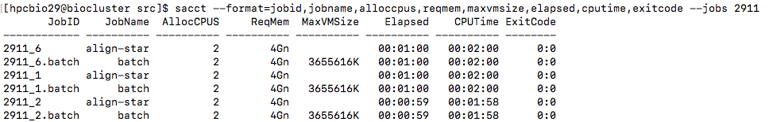
Estimating memory usage
Run a single job on one file and request more memory than you think you will need
Make sure that the job finished correctly without errors
Run the following command (see the notes on this slide):
Convert kb to gb
3655616 kb = 3.655 gb
Next time request a little more than the test job used to account for variation (~5 gb in this example)
Notes:
sacct --format=jobid,jobname,alloccpus,reqmem,maxvmsize,elapsed,cputime,exitcode --jobs 2911

Slide 46
How much memory does STAR need?
Requested memory needs to be larger than limit specified; default is 31 GB!!
#SBATCH mem=40gb
...
module load STAR/2.5.3a-IGB-gcc-4.9.4
line=$(sed -n -e "$SLURM_ARRAY_TASK_ID p” mouse_filenames.txt)
STAR --runThreadN $SLURM_NTASKS \
--genomeDir ../2015-07-09-STAR-index \
--quantMode GeneCounts\
--readFilesIn ${line}.trimmed.fastq \
--sjdbGTFfile /home/mirrors/igenome/Saccharomyces_cerevisiae/Ensembl/R64-1-1/Annotation/Genes/genes.gtf \
--outFileNamePrefix temp/${line}.star.count \
--limitGenomeGenerateRAM 39000000000 \
--outSAMtype BAM SortedByCoordinate

