Slide 1


Homelessness Response in Salt Lake City
Skyler Gray

Slide 2
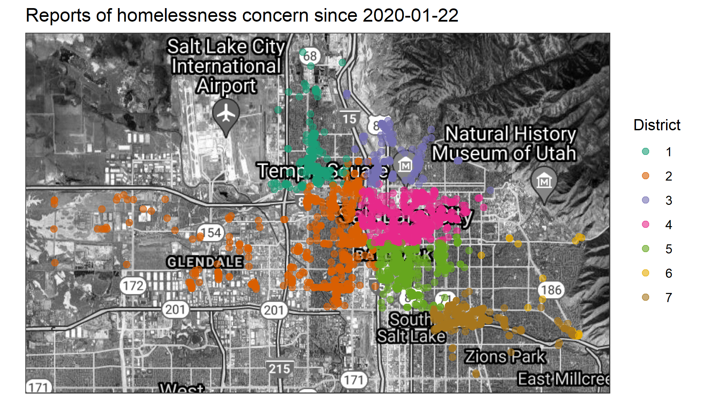
Background

Slide 3
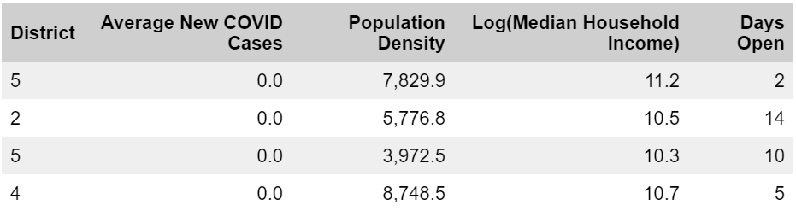
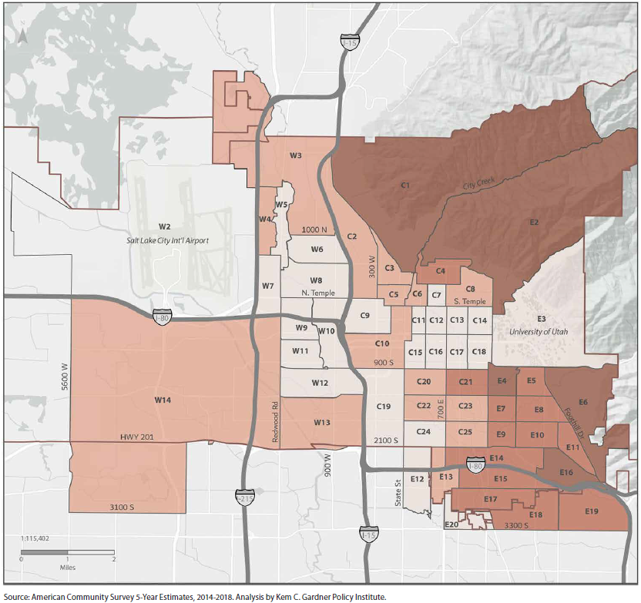
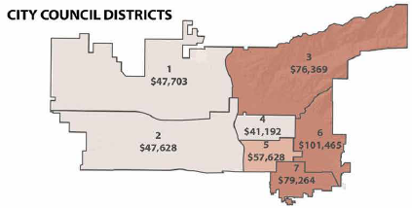
The Data
2010 Census Tracts
SLC Council Districts

Slide 4
Research Question
Primary: Is there a difference in response time among city districts?
Secondary: How does the presence of COVID-19 affect response time?

Slide 5
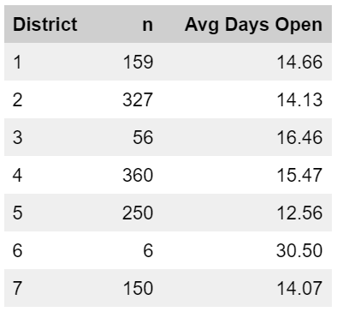
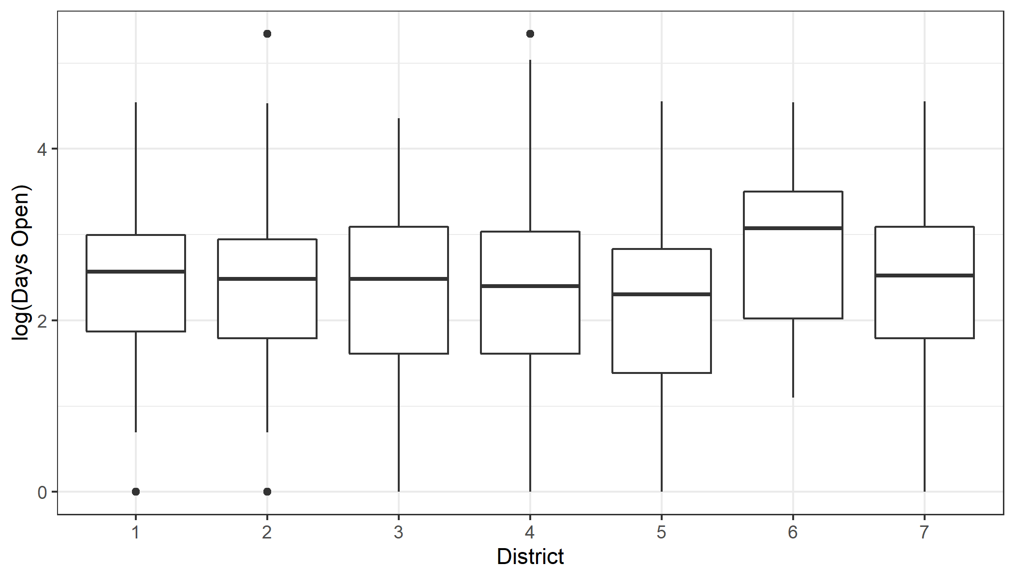
EDA

Slide 6
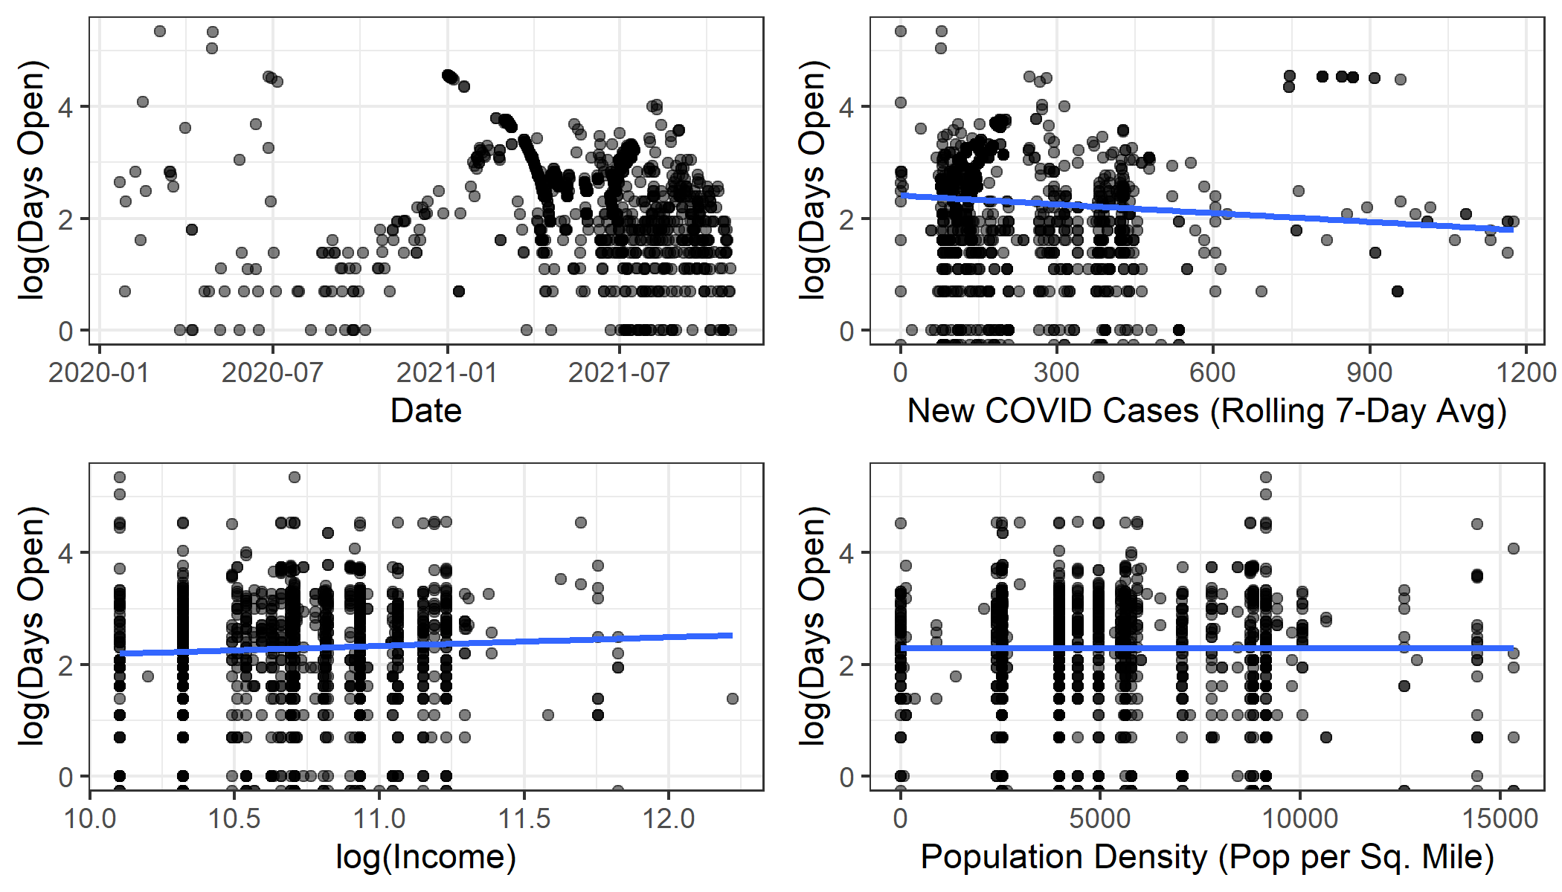
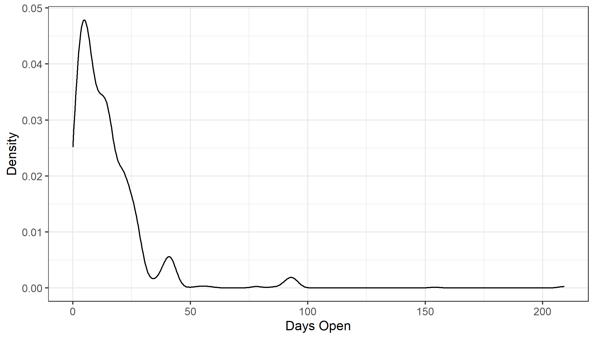
EDA

Slide 7

Methods: Poisson Regression
$$Y_{i} | μ_{i} \sim Poisson\left(μ_{i}\right),$$
$${log⁡(μ}_{i})=Xβ,$$
$$β_{1}, …, β_{10} \sim N(μ_{0}, τ_{0}^{2})$$
Interpretation
$β_{1}$: Log mean days request is open for district 1 with an average population density, median household income, and new COVID cases
$β_{2}, …, β_{7}$: District coefficients
$β_{8}, …, β_{10}$: population density, median household income, new cases

Slide 8

Methods: Sampling
$β_{1}, …, β_{10}$
Univariate slice sampling
Initial betas are MLE from GLM

Slide 9
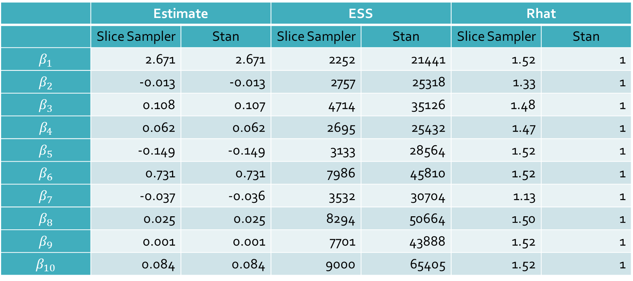
Diagnostics
 | Estimate |  | ESS |  | Rhat
 | Slice Sampler | Stan | Slice Sampler | Stan | Slice Sampler | Stan
$$β_{1}$$ | 2.671 | 2.671 | 2252 | 21441 | 1.52 | 1
$$β_{2}$$ | -0.013 | -0.013 | 2757 | 25318 | 1.33 | 1
$$β_{3}$$ | 0.108 | 0.107 | 4714 | 35126 | 1.48 | 1
$$β_{4}$$ | 0.062 | 0.062 | 2695 | 25432 | 1.47 | 1
$$β_{5}$$ | -0.149 | -0.149 | 3133 | 28564 | 1.52 | 1
$$β_{6}$$ | 0.731 | 0.731 | 7986 | 45810 | 1.52 | 1
$$β_{7}$$ | -0.037 | -0.036 | 3532 | 30704 | 1.13 | 1
$$β_{8}$$ | 0.025 | 0.025 | 8294 | 50664 | 1.50 | 1
$$β_{9}$$ | 0.001 | 0.001 | 7701 | 43888 | 1.52 | 1
$$β_{10}$$ | 0.084 | 0.084 | 9000 | 65405 | 1.52 | 1

Slide 10
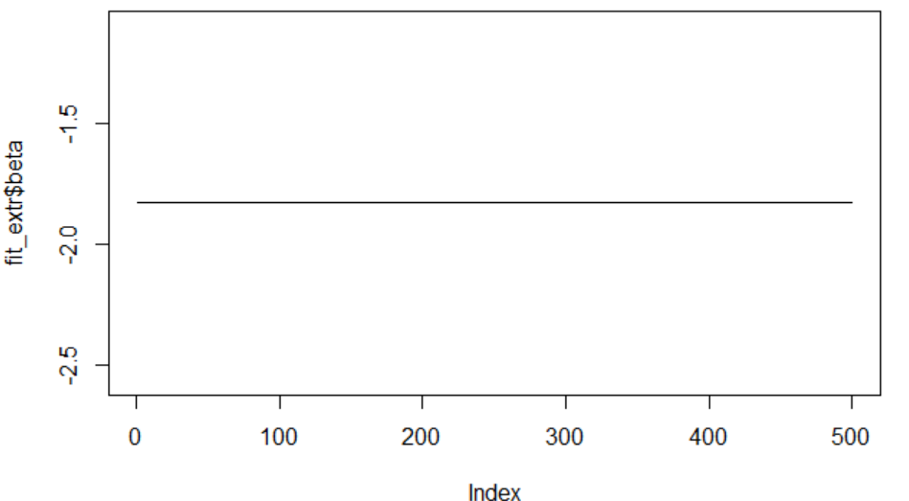
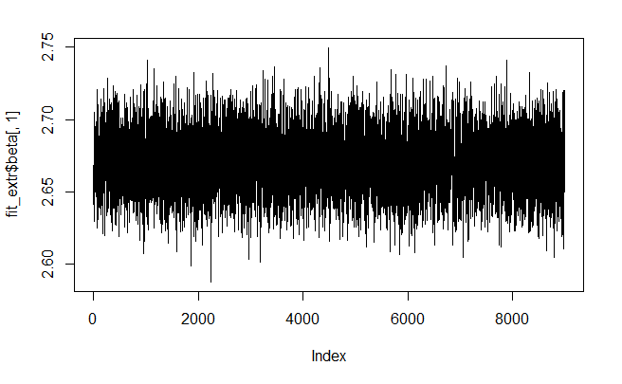
A Note on Stan
Warmup Draws = 0
Warmup Draws = 1000

Slide 11
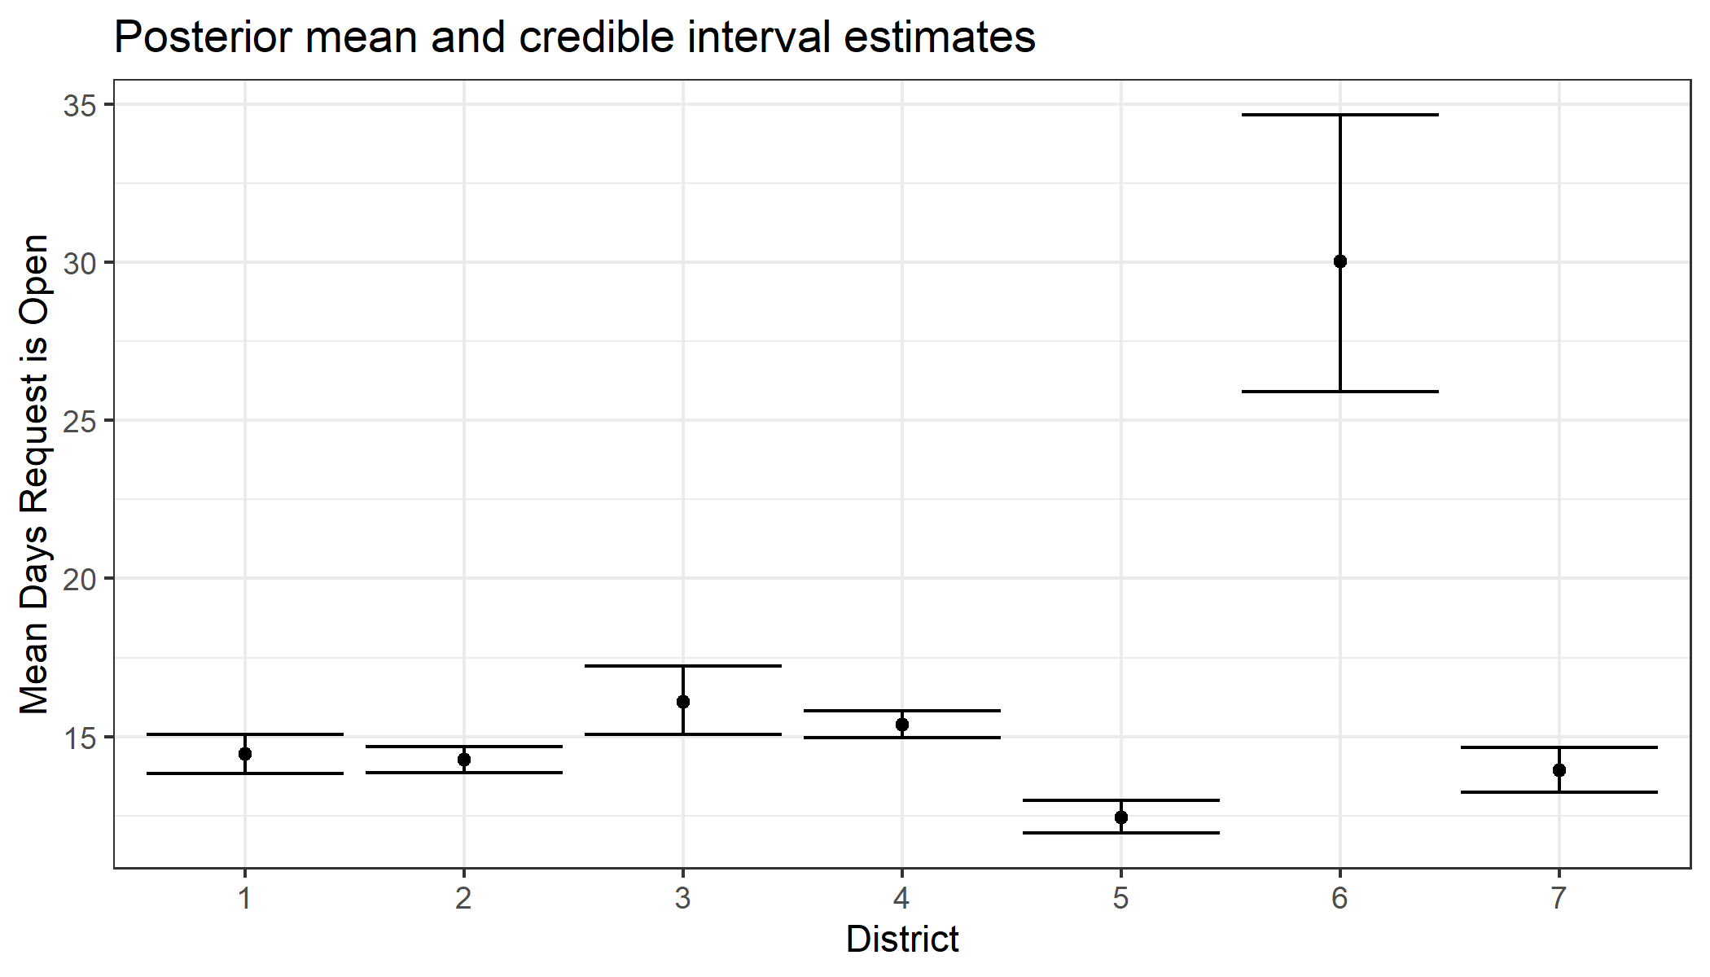
Results

Slide 12
Conclusion
Next Steps
Adjust district coefficient uncertainty by district sample size
Consider modeling data previously filtered out
Model with an overdispersion parameter (Negative Binomial)

