Slide 1


Homelessness Response in Salt Lake City
Skyler Gray

Slide 2
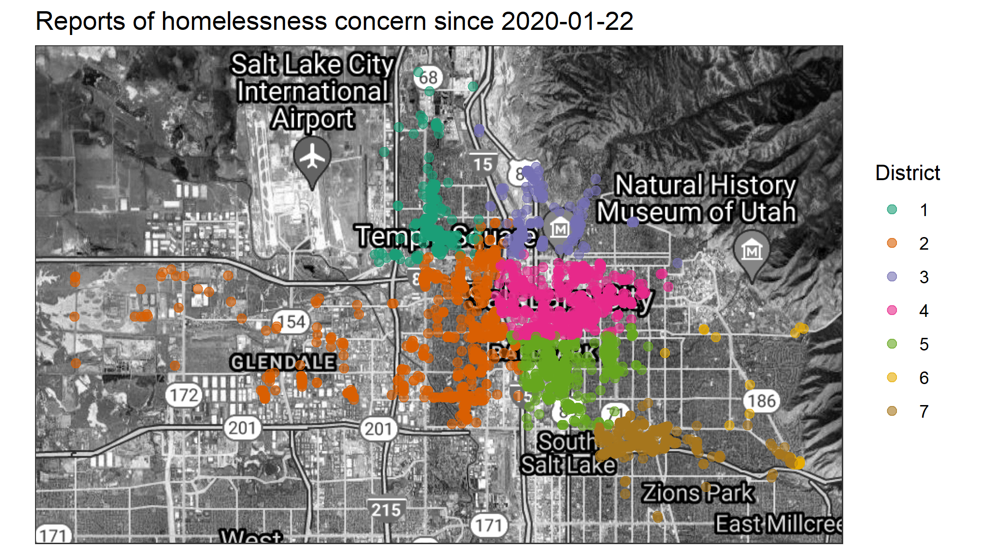
Background

Slide 3
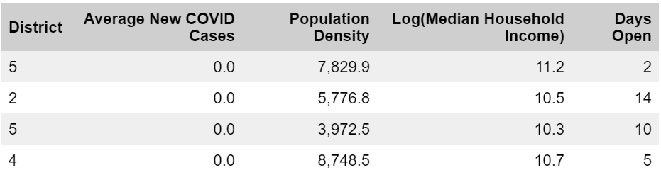
The Data

Slide 4
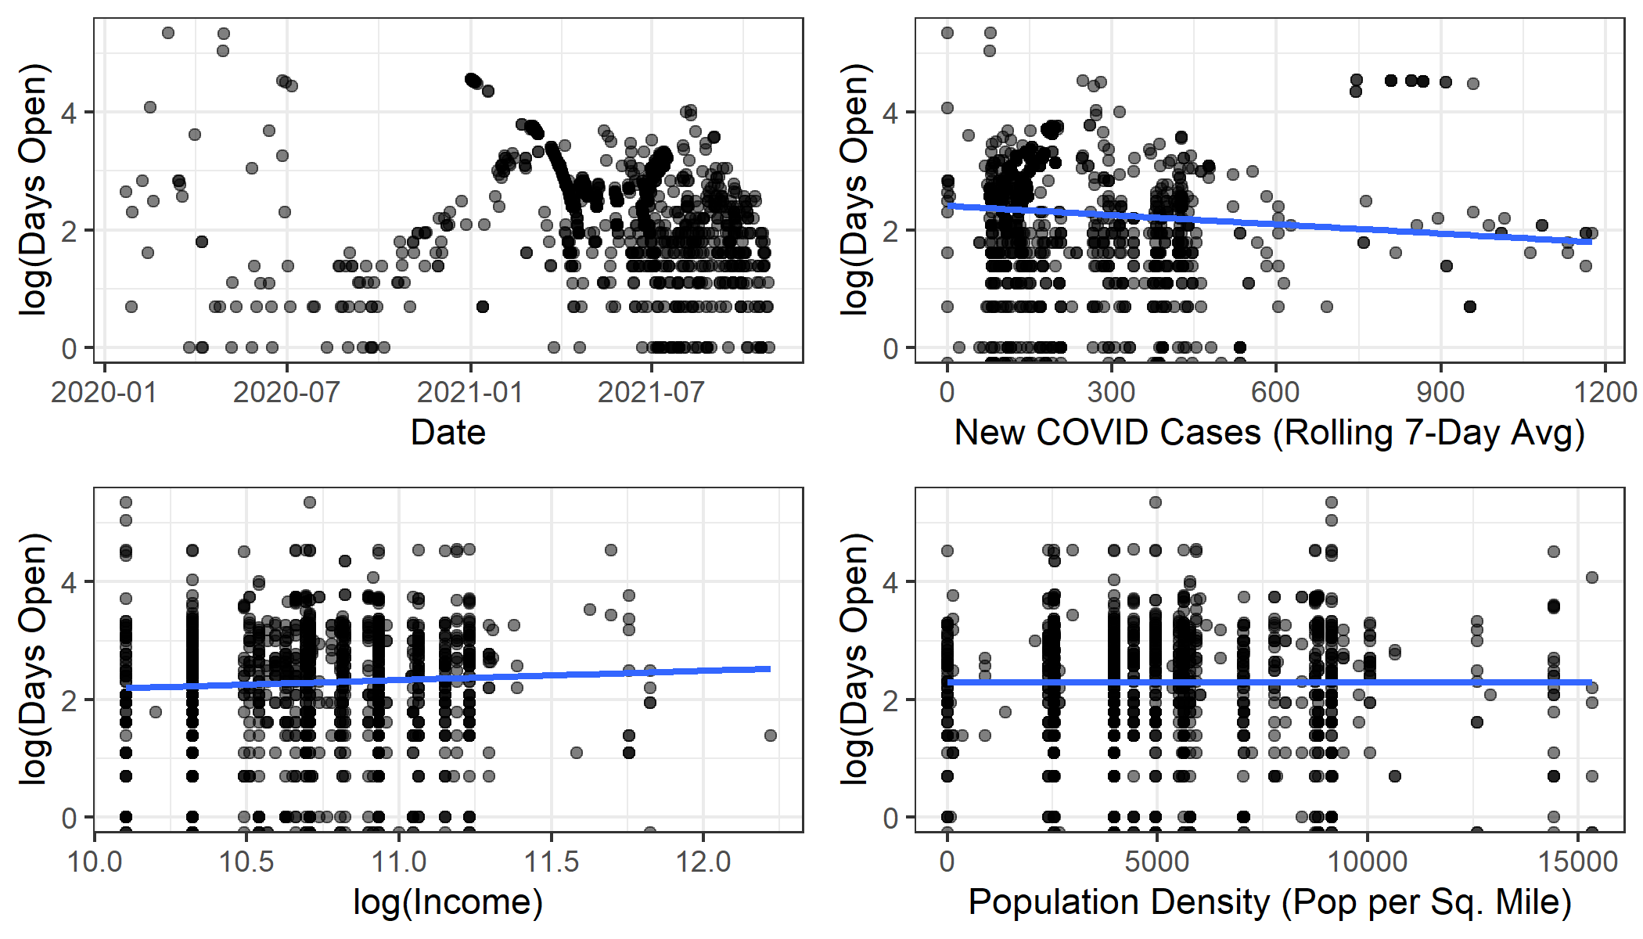
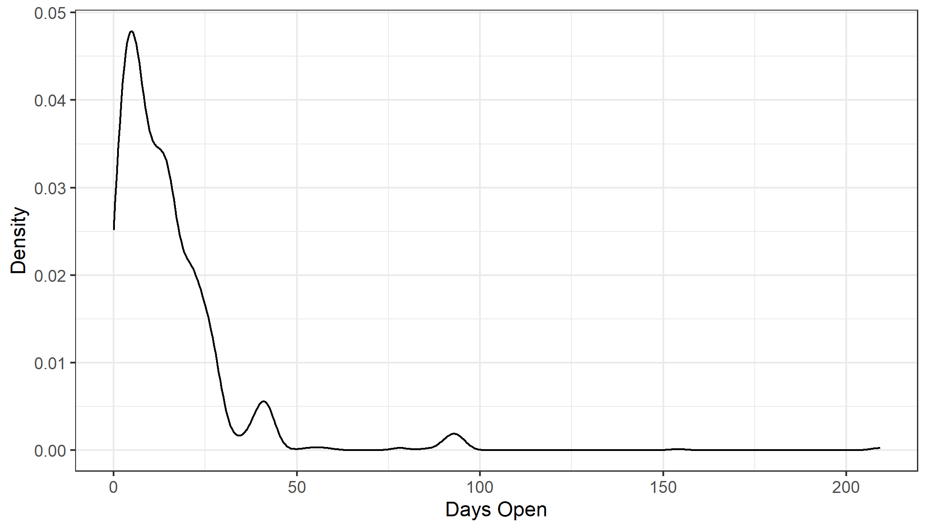
EDA

Slide 5
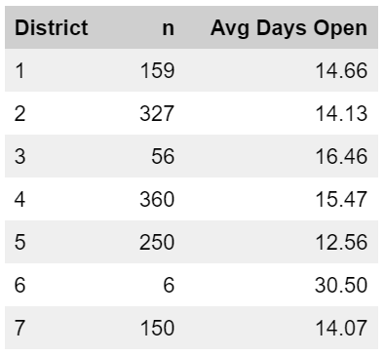
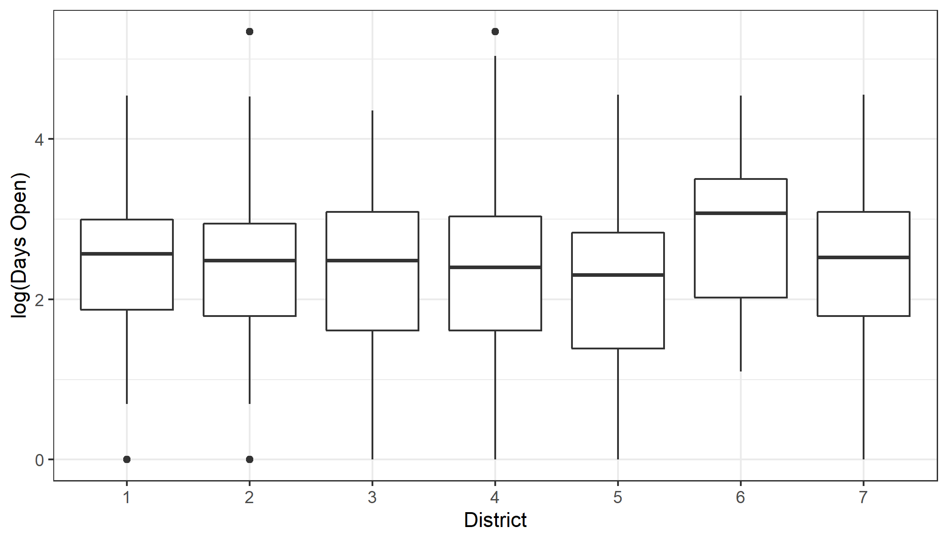
EDA

Slide 6
Research Question
Primary: Is there a difference in response time among city districts?
Secondary: How does the presence of COVID-19 affect response time?

Slide 7

Methods: Poisson Regression
$$Y_{i} | μ_{i} \sim Poisson\left(μ_{i}\right),$$
$${log⁡(μ}_{i})=Xβ,$$
$$β_{1}, …, β_{10} \sim N(μ_{0}, τ_{0}^{2})$$
Interpretation
$β_{1}$: Log mean days request is open for district 1 with an average population density, median household income, and new COVID cases
$β_{2}, …, β_{7}$: District coefficients
$β_{8}, …, β_{10}$: population density, median household income, new cases

Slide 8

Methods: Sampling
$β_{1}, …, β_{10}$
Slice Sampling

Slide 9
Diagnostics

Slide 10
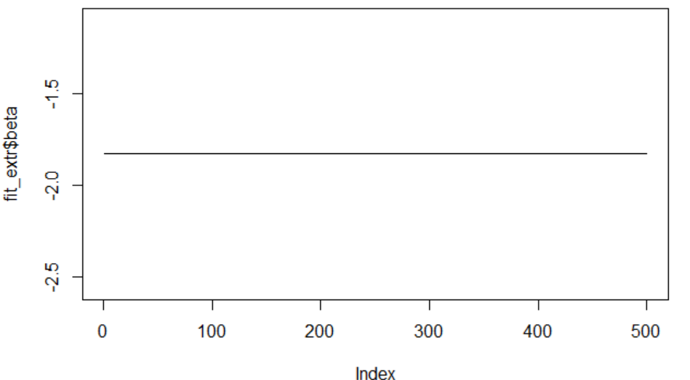
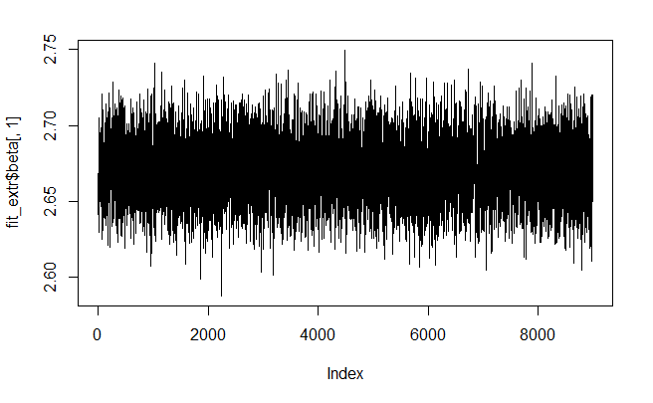
A Note on Stan

Slide 11
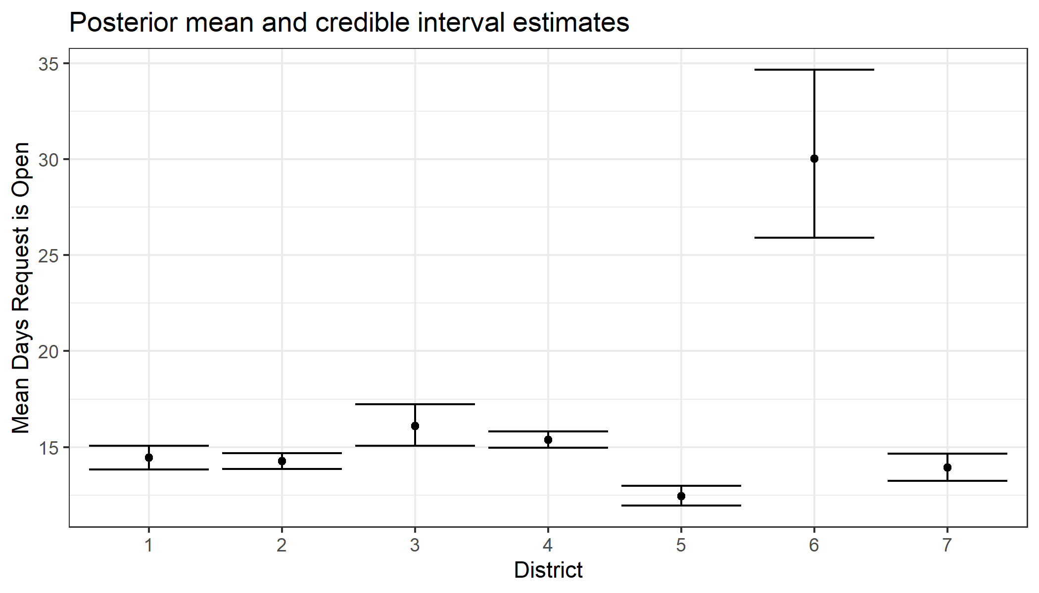
Results

Slide 12
Conclusion
Next Steps
Adjust district coefficient uncertainty by district sample size
Model with an overdispersion parameter (Negative Binomial)

