Slide 1



Human Centered Robotic Automation Laboratory
Institute of Electrical and Control Engineering
PDDL Tutorial
Planning Domain Definition Language
Presented by: Skyler Kuo

Slide 2


PDDL
Domain file
Task plan
(High level)
action、rule of action
PDDL
planner
Problem file
objects、initial state、goal state

Slide 3
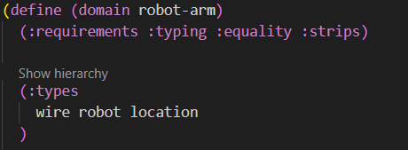
Domain file
(define (domain robot-arm)
Define your domain called robot-arm.
:requirements
Like the python import.
Ex: :typing you can use “types”
Ex: :strips you can use add and delete
Ex: :equality you can use “=“
https://planning.wiki/ref/pddl/requirements

Slide 4
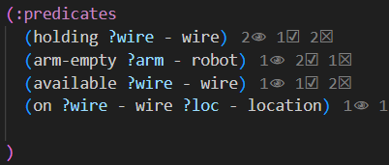
Domain file
Predicates:
List all the possible states.
(holding ?wire – wire)
?wire: it can be red_wire、green wire…
This state means that the wire is being held.
Ex:
(holding red_wire)
(holding black_wire)

Slide 5

Domain file
(arm-empty ?arm – robot)
?arm: it can be arm1、arm2
The arm is empty.
Ex:
(arm-empty arm1)
(on ?wire – wire ?loc - location)
?wire: it can be red_wire、black_wire…
?loc: it can be table or power_supply…
The wire is placed on the location.
Ex:
(on red_wire table)

Slide 6
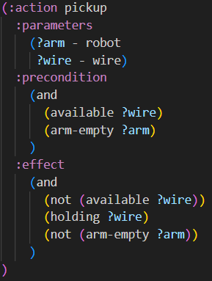
Domain file
Parameters:
The things you need for “pickup”.
Ex: need a (robotic) arm and a wire
Precondition:
The conditions require to use the action “pickup”.
Ex: the picked wire should be available
and (robotic) arm should be empty.
Effect:
What is the result after the action “pickup”.
Ex: the wire is not available.
Instead, the wire is being held.
(robotic) arm are not empty.

Slide 7
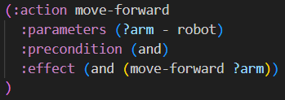
Domain file
If no precondition:
It can not be empty.
If there is no precondition, write “and”.

Slide 8
Whole Domain file

Slide 9
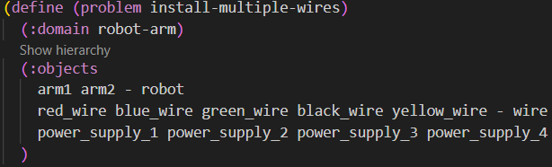
Problem file
…. - location
(define (problem install-multiple-wires)
Define the name of problem file.
(:domain robot-arm)
robot-arm is the domain name (same in the domain file)
(:object)
List all the things in each type.
https://github.com/skylerkuo/pddl/tree/master

Slide 10
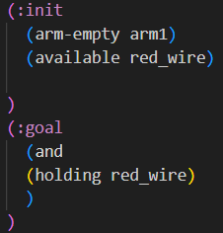
Problem file
Initial state:
Ex: arm1 is empty and red wire is available.
Goal state:
Ex: red wire should be held.
(pickup arm1 red_wire)
https://github.com/skylerkuo/pddl/tree/master

Slide 11
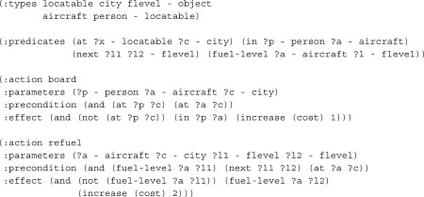
Project PDDL
Pyperplan https://github.com/aibasel/pyperplan
Clean code over fast code
Written in python
Do not support action cost
(can not add cost in the PDDL file)

Slide 12
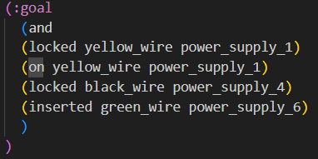
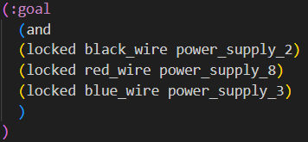
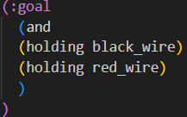
What PDDL Can’t Do
one object but 2 goal states.
PDDL doesn’t care about order.
Some logic errors.
Black wire may not be the first wire locked.

Slide 13
How does PDDL work?
Step1: building operators、task
Step2: state-space searching
Step3: show the result

Slide 14
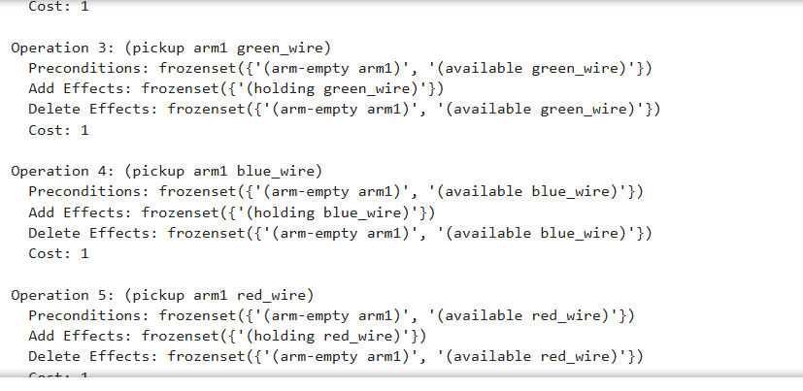
Building operators
If preconditions are a subset of the current state, the operator can be applied.

Slide 15
Building Tasks
Task
Operators
Initial state
Goal
task can check if the current state is goal state

Slide 16
State-space Searching
Greedy algorithm:
the next step is the best choice given the current situation
HADD (hAddHeuristic):
It is a method used to calculate the cost of each choice, by summing all the costs from the next state to the goal state.
Greedy algorithm + HADD:
Each choice selects the option with the minimum cost from the next step to the goal state.

Slide 17
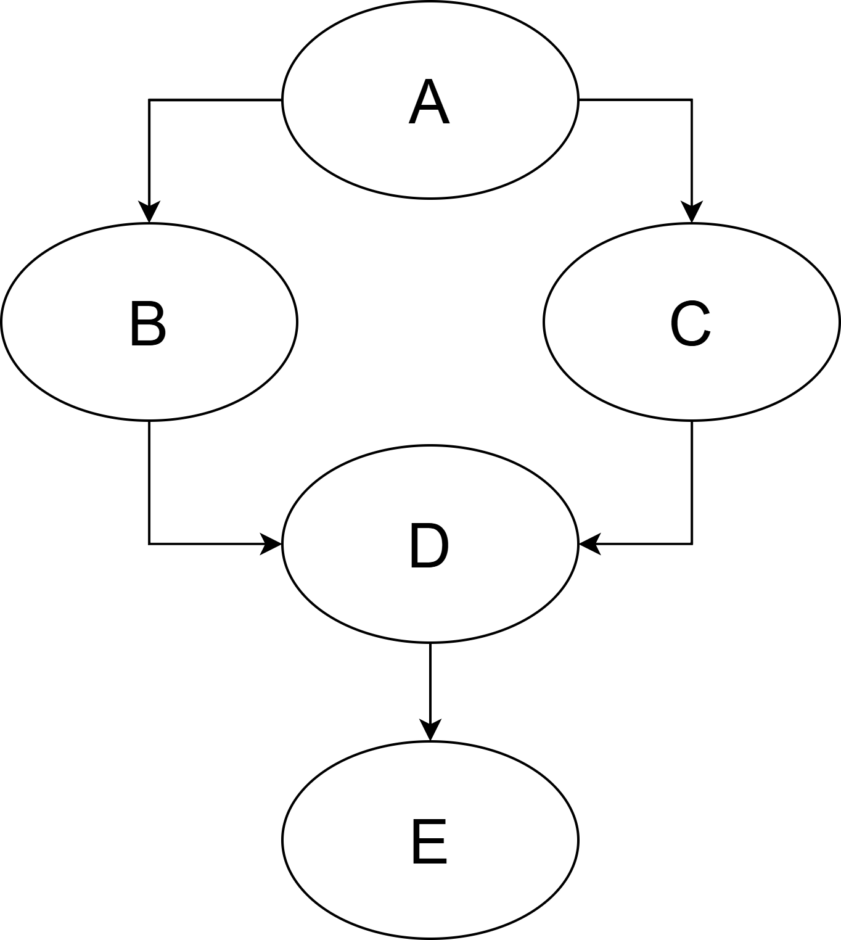
State-space Searching Example
Initial state: A
Goal state: E
op1: A to B cost: 1
op2: A to C cost: 3
op3: B to D cost: 2
1
3
op4: C to D cost: 1
op5: D to E cost: 4
2
1
4

Slide 18
State-space Searching Example
Step1: A can go to B or C
redefine B and C respectively as starting points to calculate the cost.
1
3
Start from B: set dis(B)=0
B to D dis(D)=dis(B)+2=2
D to E dis(E)=dis(D)+4=6
Start from C:set dis(C)=0
C to D dis(D)=dis(C)+1=1
D to E dis(E)=dis(D)+4=5
dis(E)=6
2
1
4
cost is lower
C is the next step
dis(E)=5

Slide 19
State-space Searching Example
Step2: C can go to D
redefine D as starting points to calculate the cost.
Although there is only one option, it still calculate.
1
3
Start from C: set dis(D)=0
D to E dis(E)=dis(D)+4=4
cost is lower
D is the next step
dis(E)=4
2
1
4

Slide 20
State-space Searching Example
Step3: D can go to E
redefine E as starting points to calculate the cost.
Although there is only one option, it still calculate.
1
3
Start from E: set dis(E)=0
dis(E)=0
cost is lower
E is the next step
dis(E)=0
2
1
4

Slide 21
State-space Searching Example
1
3
2
1
4
Result: A to C to D to E
Task plan: op2、op4、op5

Slide 22
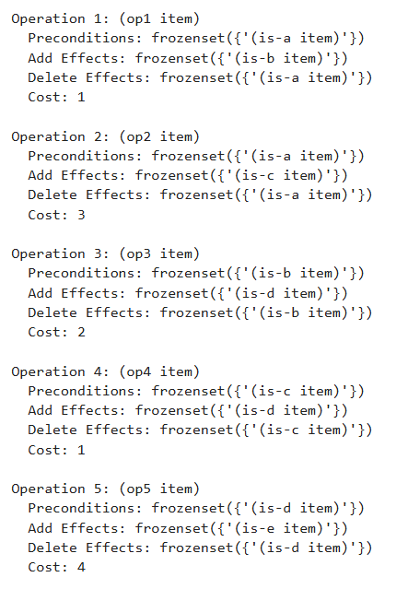

State-space Searching Demo

Slide 23
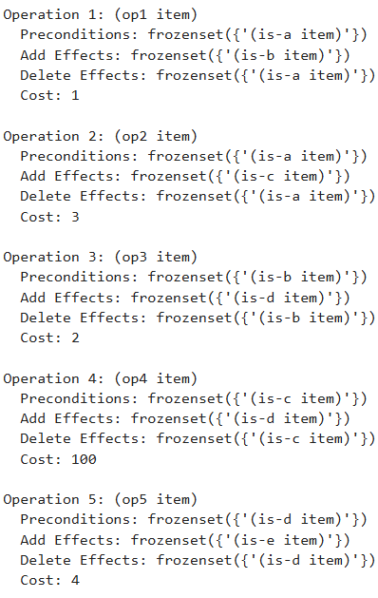

State-space Searching Demo
If I change the cost of the op4 from 1 to 100…
1
3
2
100
4

Slide 24


State-space Searching Demo
Start from B
Go to D and go to E, get dis(E)
Start from C
1. Go to D and go to E, get dis(E)
2. Go to F and go to E, get dis(E)
Choose the task plan with lower dis(E)
Compare
If is lower, the next step of A is B, otherwise is C.
B
dis(E)
C
F

Slide 25
State-space Searching Demo
Start from B
Go to D and go to E, get dis(E)
Start from C
1. Go to D and go to E, get dis(E)
2. Go to F and go to E, get dis(E)
Choose the task plan with lower dis(E)
Compare
If is lower, the next step of A is B, otherwise is C.
B
dis(E)
C
F

Slide 26
State-space Searching Demo
Start from B
Go to D and go to E, get dis(E) = 2+4=6
Start from C
1. Go to D and go to E, get dis(E) = 1+4=5
2. Go to F and go to E, get dis(E) = 2+2=4
Choose the task plan with lower dis(E)
Compare
Since is lower, choose C to be the next step
1
3
B
2
1
2
dis(E) = 4
4
C
2
F
dis(E)
C

Slide 27
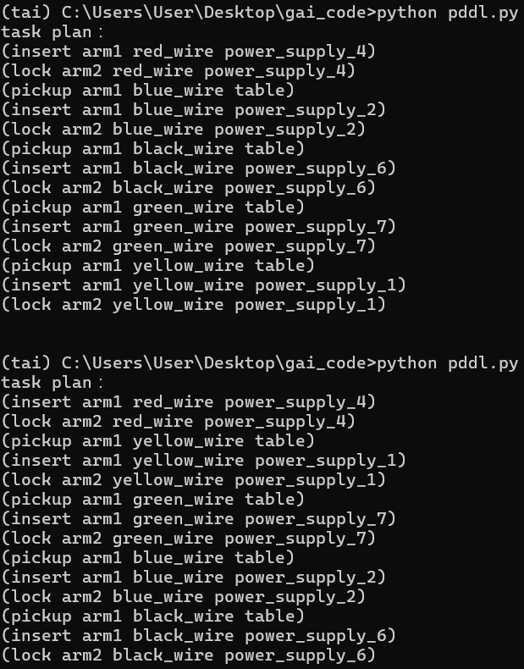
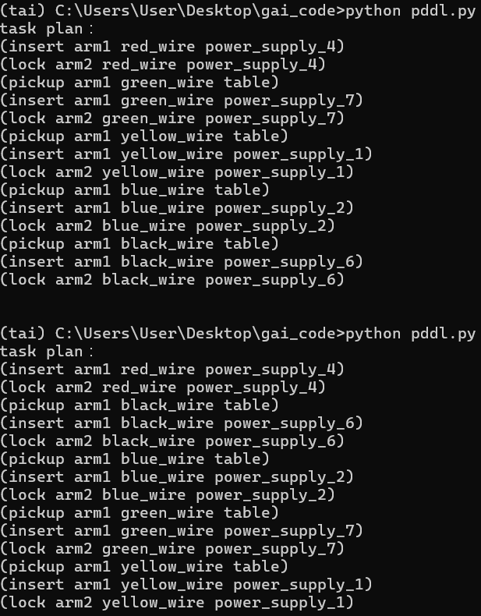
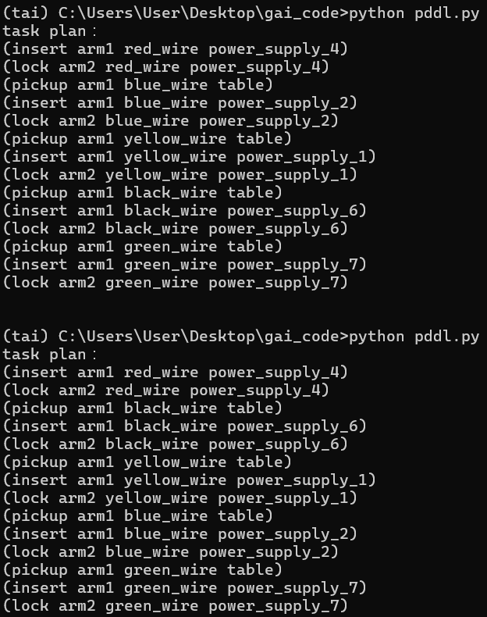
Project Example & Live Demo
Lock red、green、black、blue and yellow wires on the power supply.
Initial state: red is held by arm1, without editing cost, the first step will always be insert and lock the red wire.

Slide 28
Project Example & Live Demo
If I edit the cost of the operators that related to “black_wire” from 1 to 0.1…

Slide 29
Human Centered Robotic Automation Laboratory
Institute of Electrical and Control Engineering
Thank You

