Slide 1
HMEI

Slide 2
Background
Propose solar radiation management (not using reflective, but using absorbative aersols)
Shows much more effective traditional geoengineering
High cloud (black carbon on lower atmosphere, see high cloud decrease)
  Higher in the stratosphere, more cooling effective than reflective aersols effect (10x)
Notes:
1 minute

Slide 3
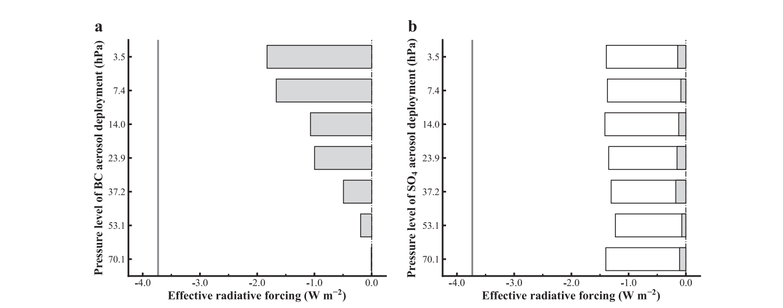
Notes:
High cloud change (include with previous slide) (more cooling effects)

Slide 4
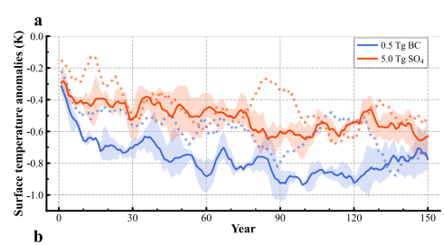
Notes:
So show the cooling effect, lower
0.5 terragram
5.0 is 10x the amount of aersols
(1/10 of bc has more cooling effect than the sulfate)

Slide 5
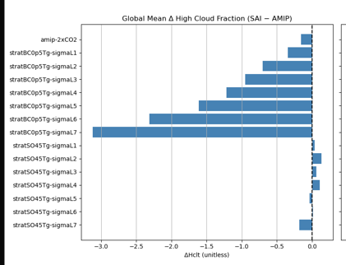
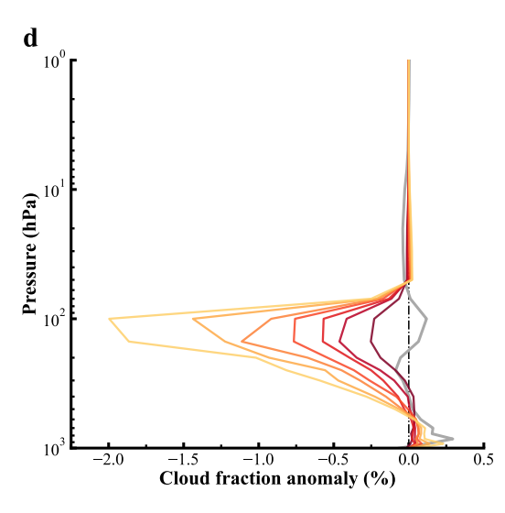
Notes:
MAKE THIS LOOK BETTER (like hoazhe’s one)
Motivation of the project
so when we do the sensitivity test (altitude test) , when we put bc in the lower, more high cloud decrease, hence we want to understand why?
We try to find the explanation of the high cloud decrease through a different pathway, although the final conclusion is the circulation slow down , but we also found it from the stability iris (the circulation changes comes from the upper troposphere stability iris)

Slide 6
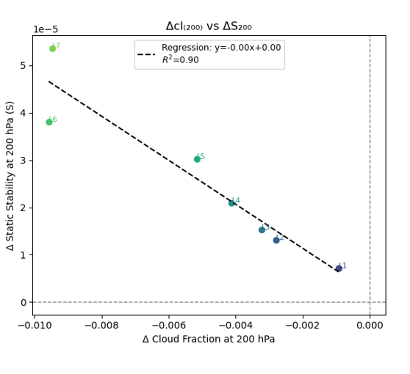

Slide 7
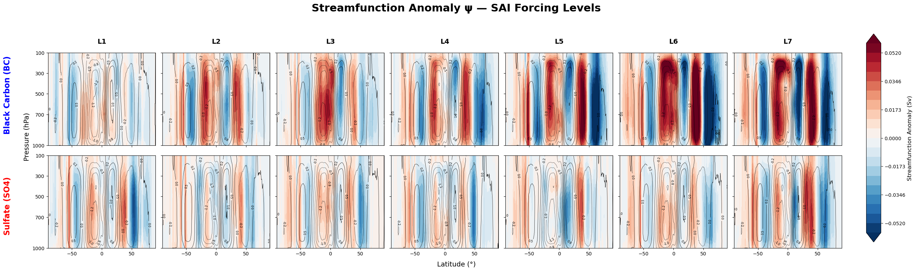
Notes:
Explain this
The climatology graph
Weakening of the circulation (
Take out bottom row, highlight first row
Readjust figures with collor bar on bottom, to make figure larger
Lower then higher
This also helps to understand presecitpation
Shows them how ti contributes to precipitation decrease ****
Surface temperature doesn’t change (fix the oean temrpature)
Aersols make the temrpeature change

Slide 8
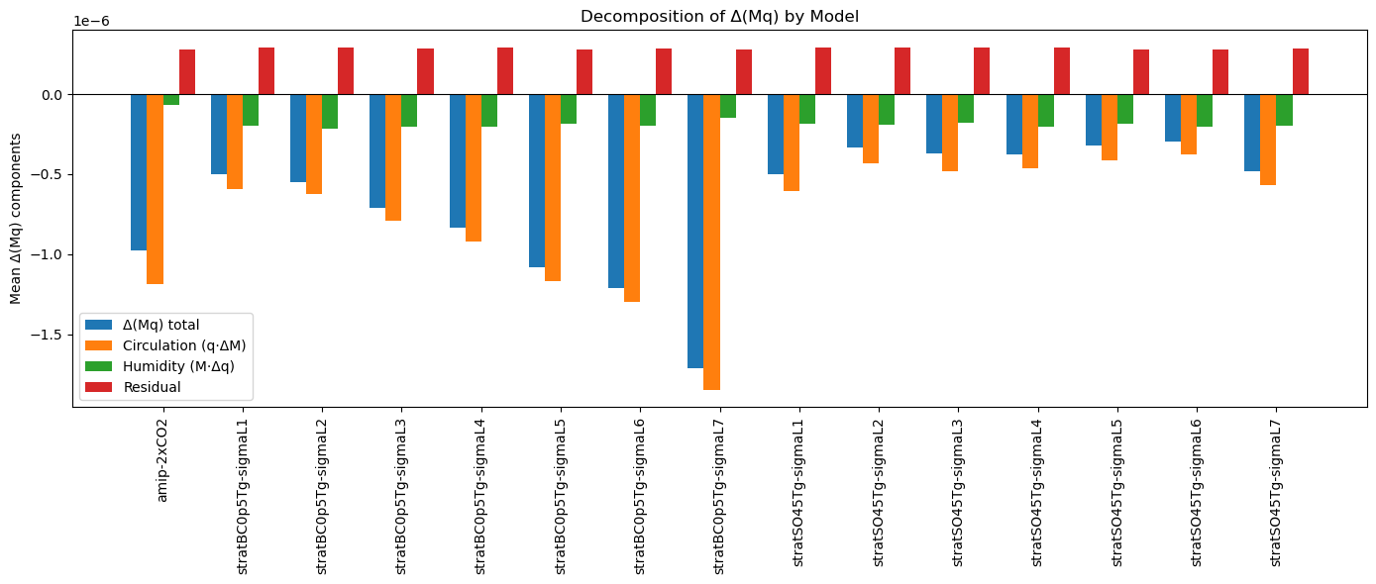
P = mq *(latex)
Notes:
High light the BC part,
From left to the right, is higher to lower (make it easier to understand)
What each bar means
P = mq
Consdiering the previous stream function, we canconsdier
Circulation slowdown why the max flux is less
Infrenerence the preciptaiotn
Take out sulphate
Stream function really explains this preciptaiton decrease
Precitpation change from the energy budget constraint

Slide 9
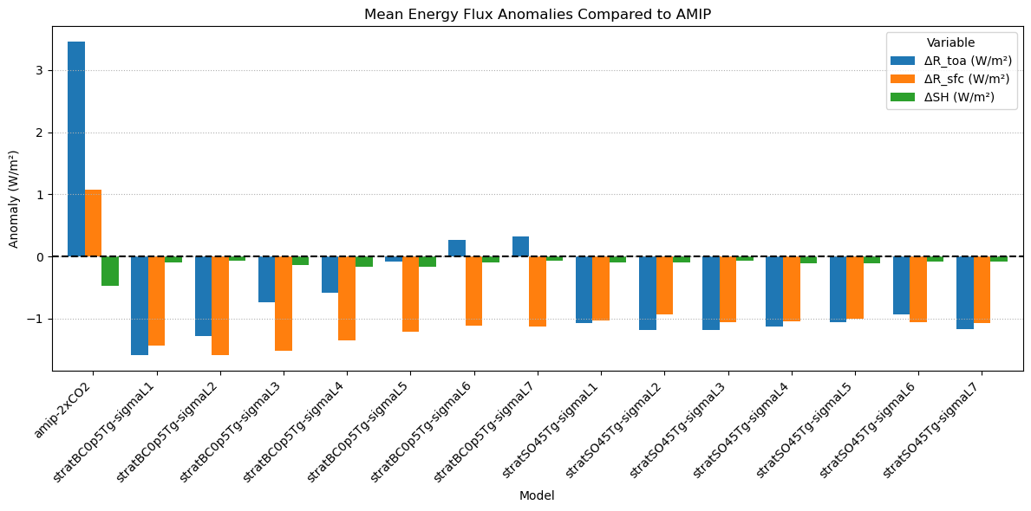
Notes:
R atm from the precipitation

Slide 10
Contributions
Vecchi group
Gabroes
Adam Sokol
Haozhe

Slide 11
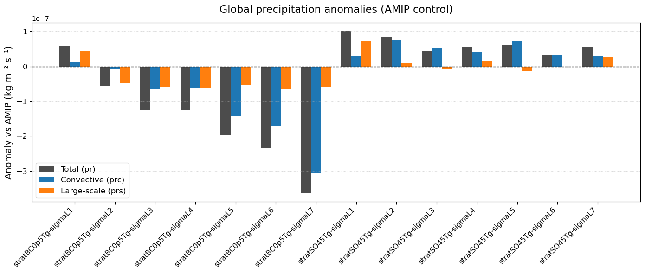
Supplementals

Slide 12
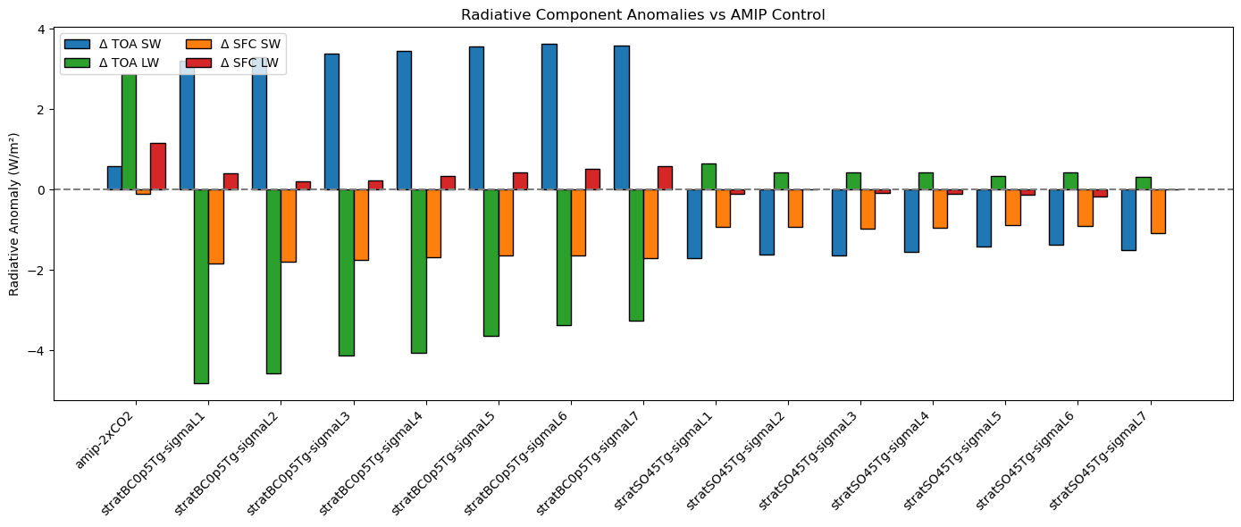

Slide 13
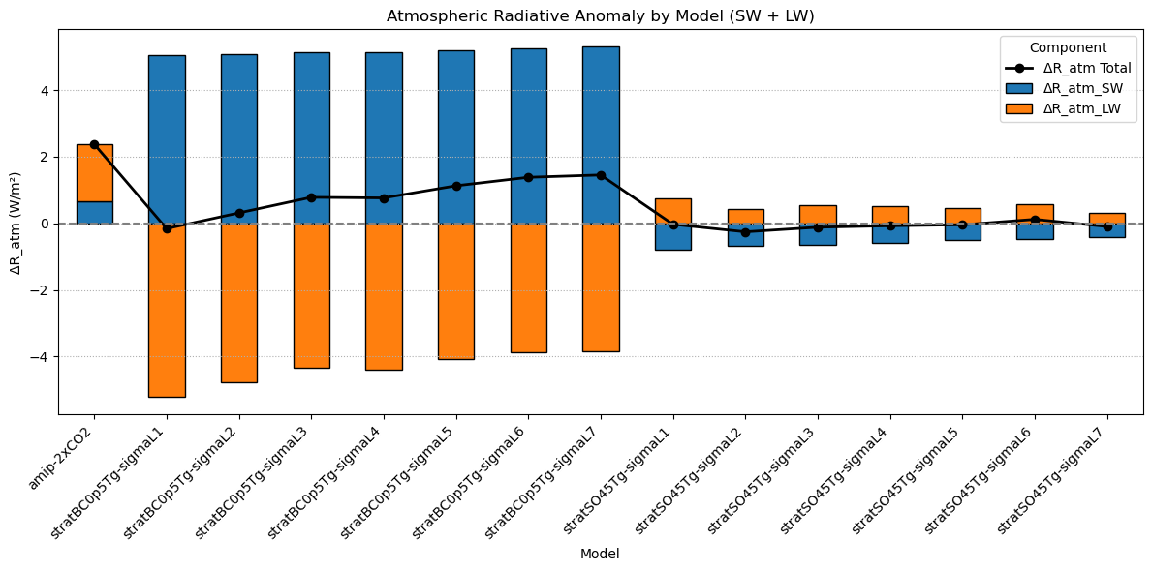
Notes:
Atmospheric radiative anomalies by model: decomposition into shortwave and longwave components
This figure shows atmospheric radiative flux anomalies (ΔR_atm) relative to AMIP across different forcing experiments, decomposed into shortwave (SW) and longwave (LW) contributions. Blue bars indicate ΔR_atm_SW (primarily reflecting changes in solar absorption and scattering), while orange bars show ΔR_atm_LW (mainly tied to thermal emission changes). The total anomaly (black line with points) is the net atmospheric radiative cooling or heating.
The stratBC cases exhibit large positive SW anomalies combined with strong negative LW anomalies, resulting in substantial net atmospheric radiative cooling. In contrast, SO₄ cases show smaller anomalies in both SW and LW, leading to weaker total ΔR_atm. The 2xCO₂ experiment exhibits net atmospheric heating, driven by a strong LW trapping effect exceeding SW changes.
These patterns highlight forcing-specific atmospheric radiative responses, which strongly govern column energy balance and thus precipitation adjustments.

Slide 14
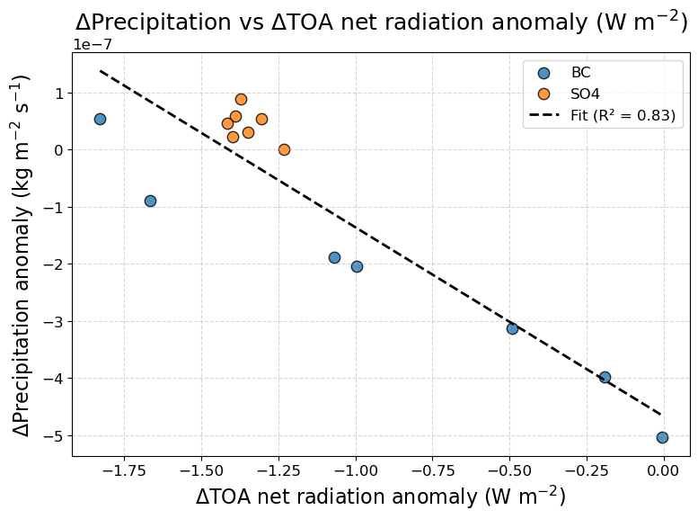

Slide 15
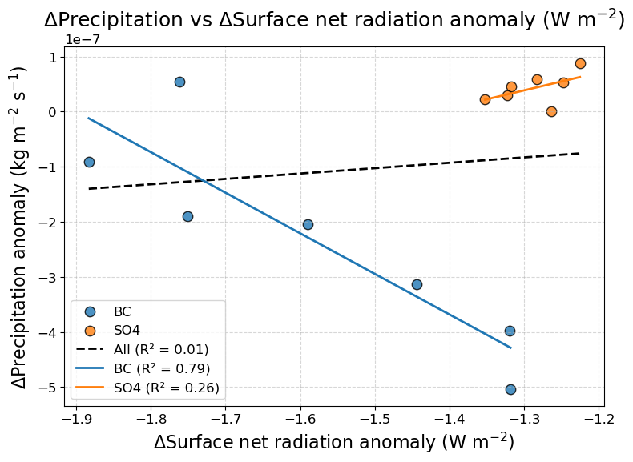
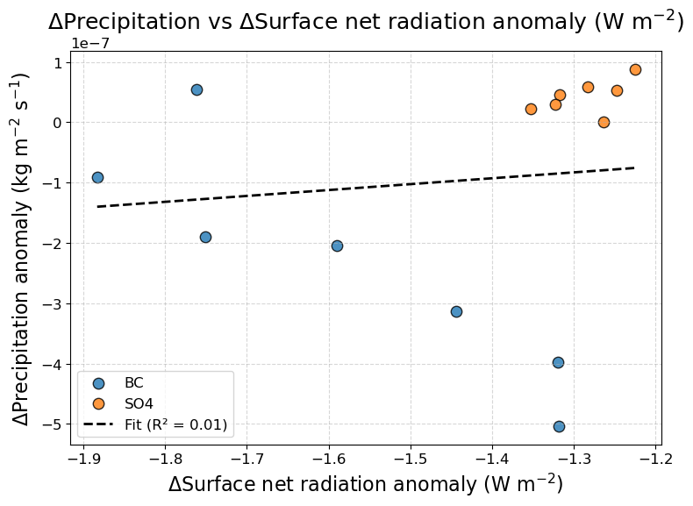
Notes:
Add to specific regression lines (BC for SO4)

Slide 16
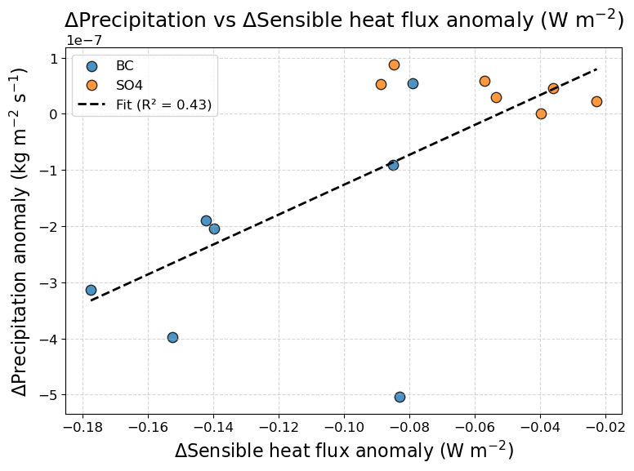
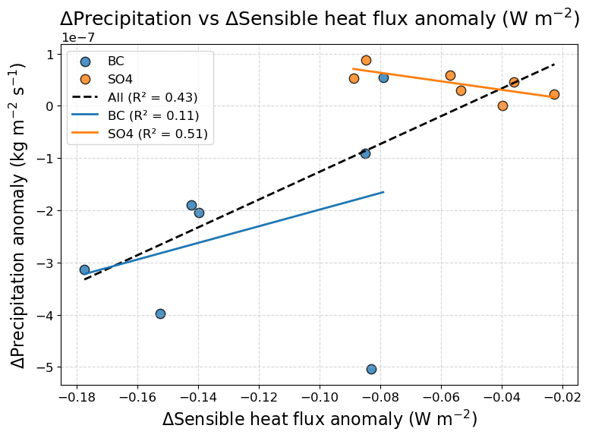
Notes:
Give it two lines

Slide 17
