Slide 1
Fuel Efficiency
Skyler Tom and Leo Choi

Slide 2
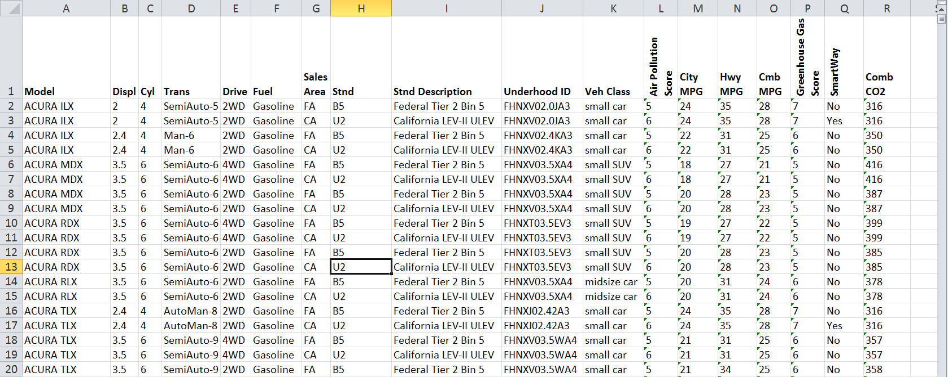
Dataset
From vehicle testing done at EPA’s National Vehicle and Fuel Emissions Lab in Ann Arbor
Data from 2000-2015

Slide 3
Dataset
Only going to look at cars that use gasoline
Compare MPG of different vehicle types
Which companies produce which vehicle types?
Which companies produce the most fuel efficient vehicle types?

Slide 4
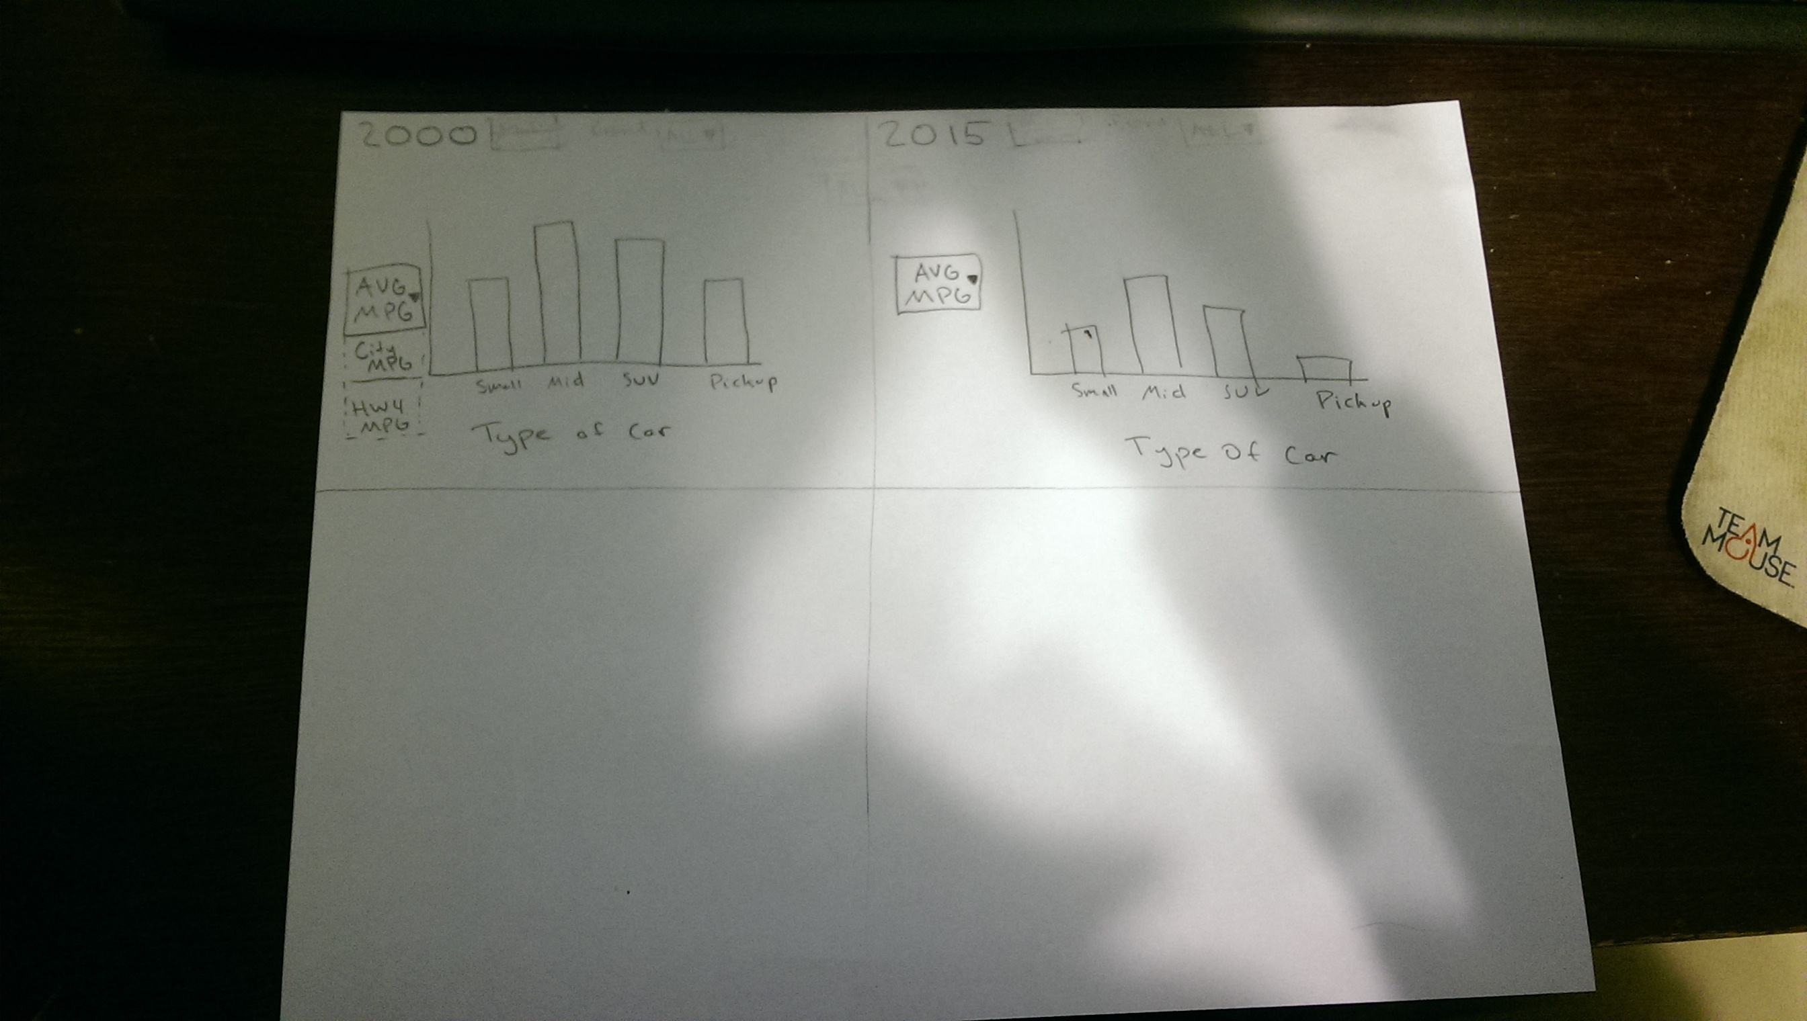
Design

Slide 5
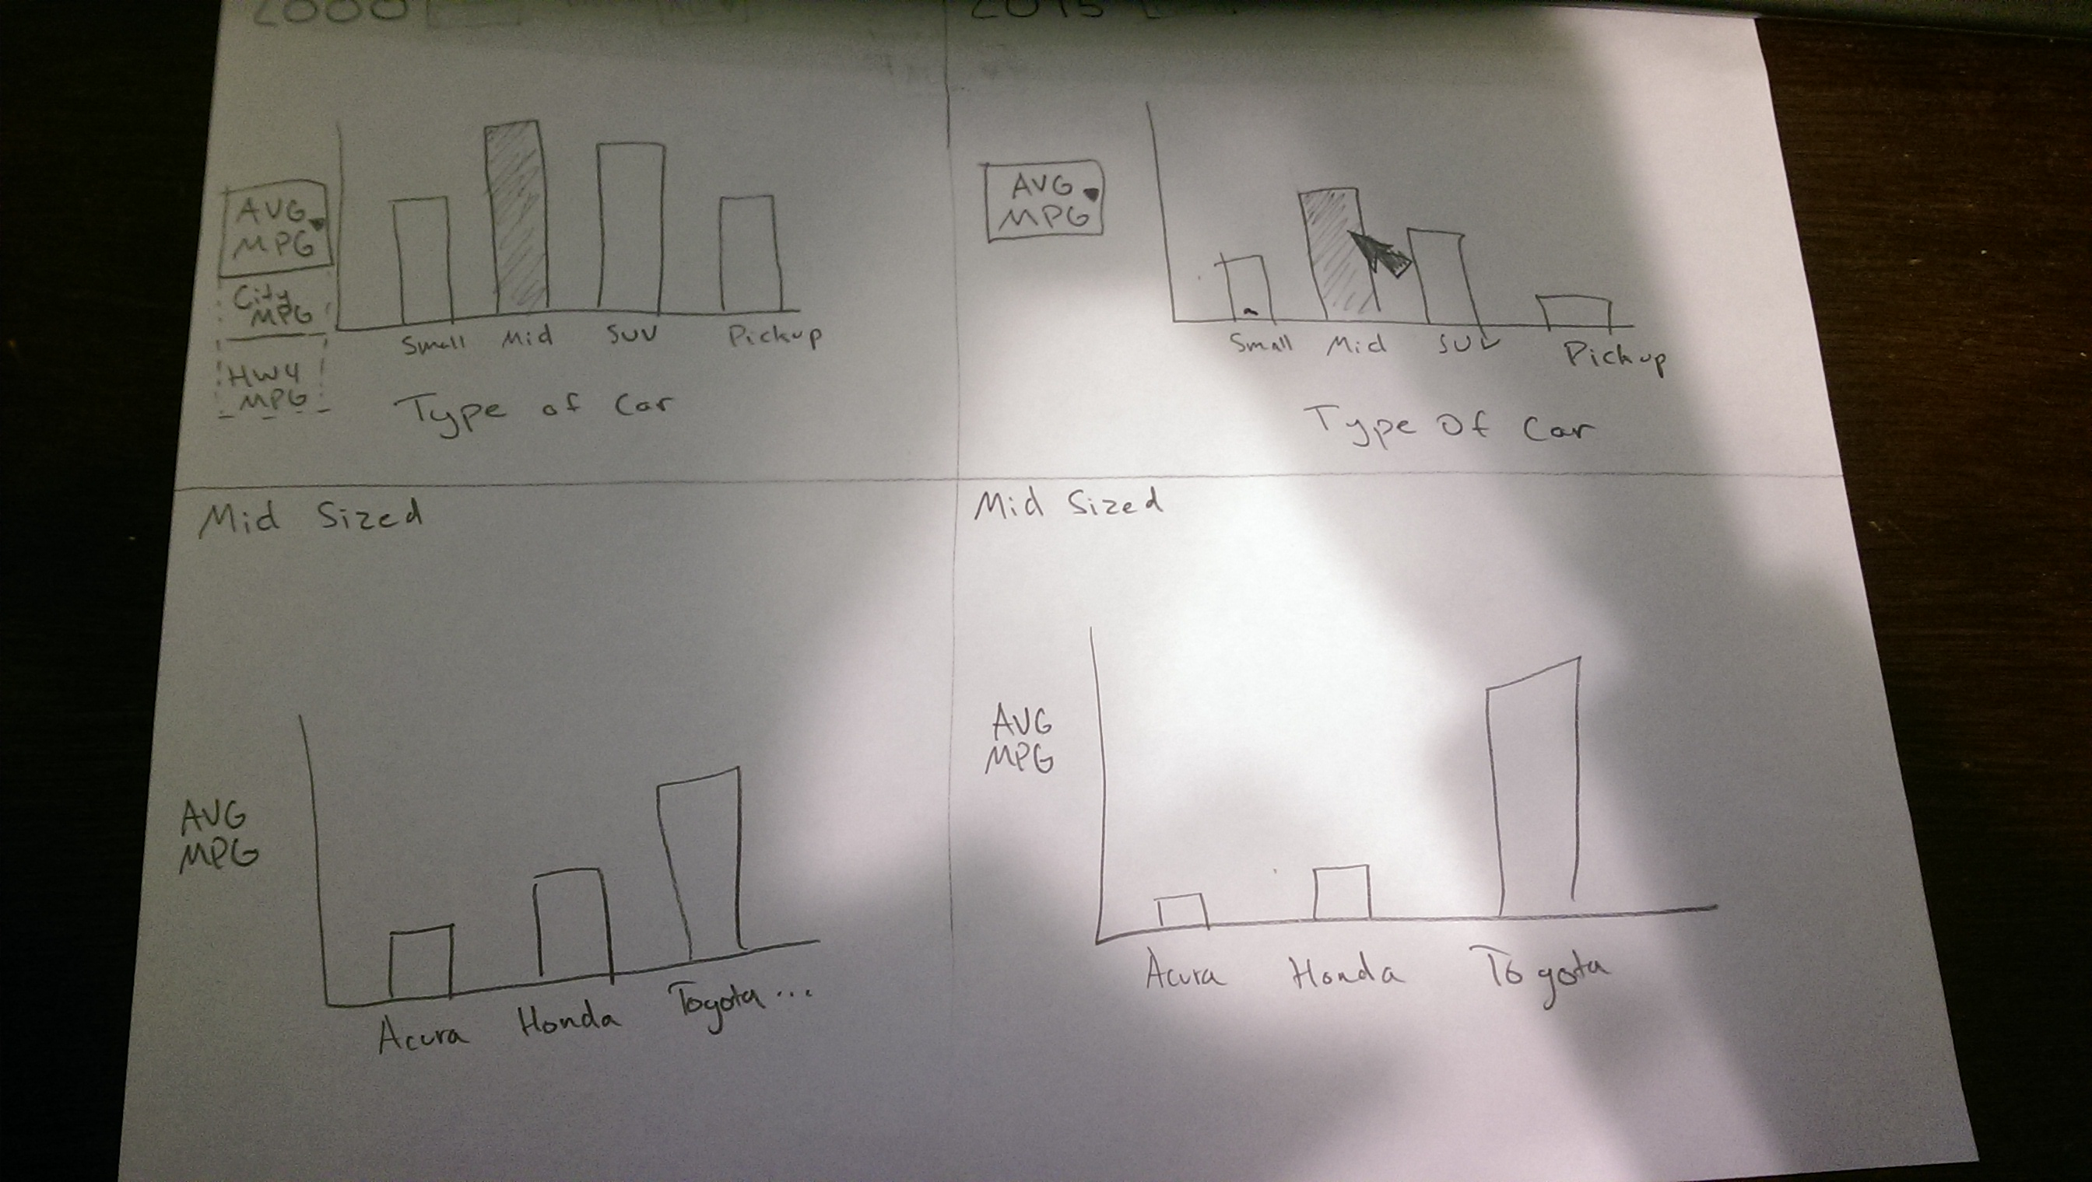
Design

Slide 6
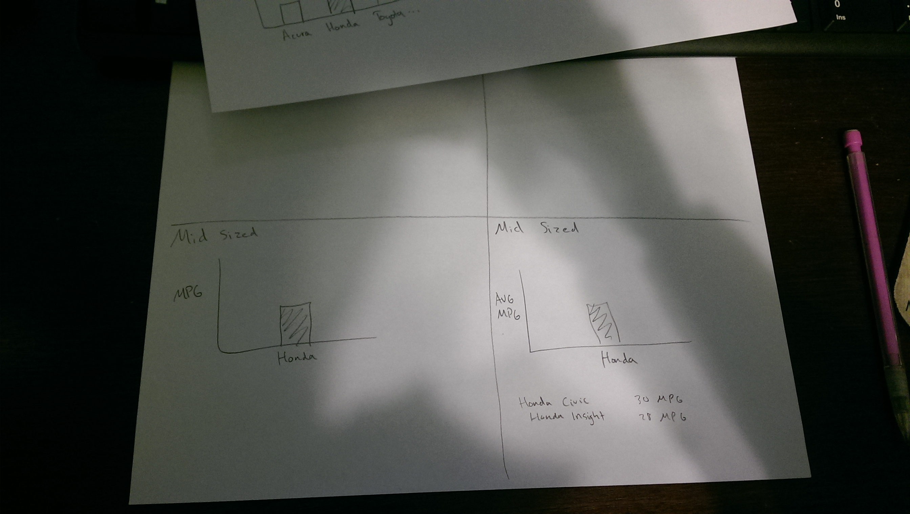
Design

Slide 7
System Architecture
Processing
Classes:
Bar graph
Pie graph
Controller
Abstract View
Similar to Assignment 4 (Coordinated-Multiple Views)

Slide 8
Usage Scenario
Useful for anybody who wants to view trends in MPG
For different vehicle types
For different car companies
Could be used by anybody looking to buy a fuel efficient car

