Slide 1
Car Fuel Efficiency
Leo Choi
Skyler Tom

Slide 2
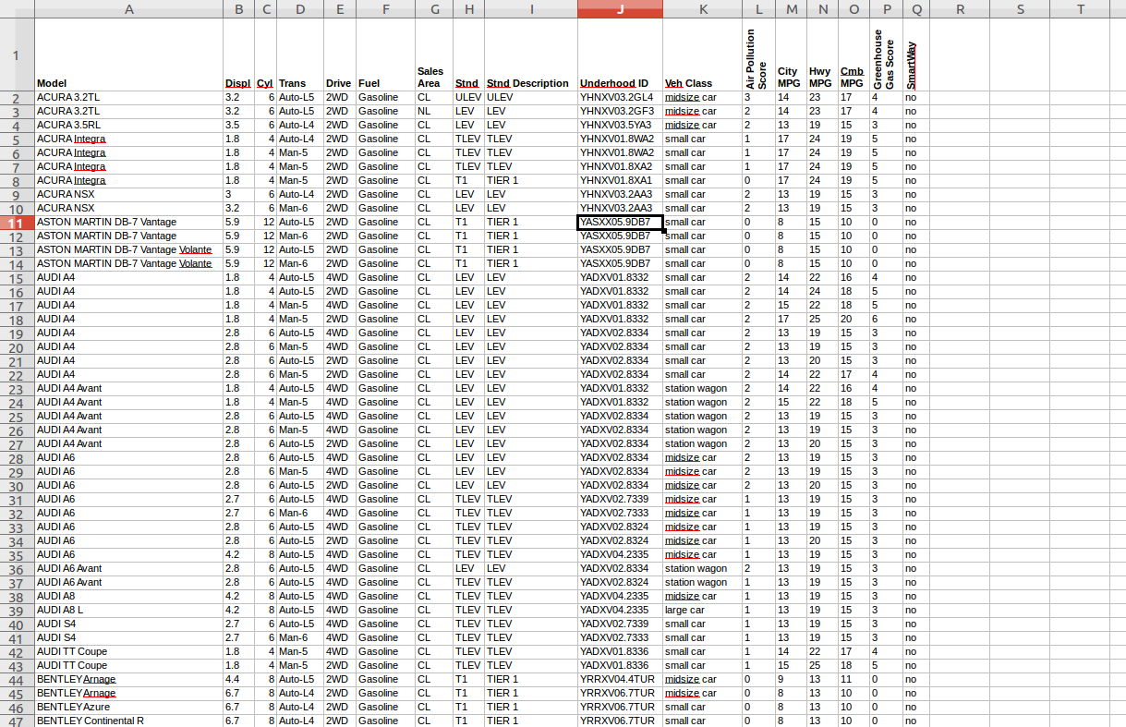
Dataset

Slide 3
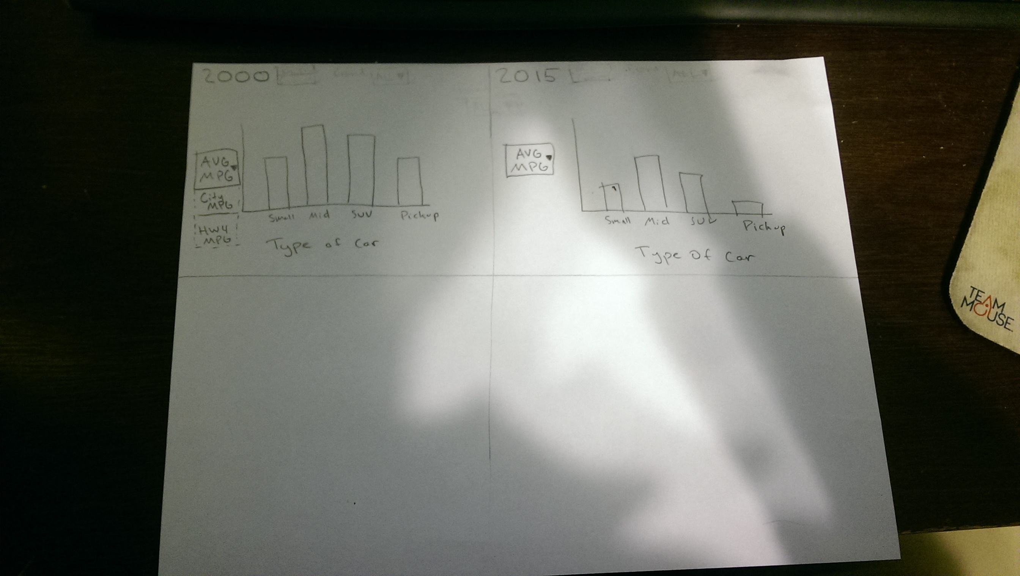
Design

Slide 4
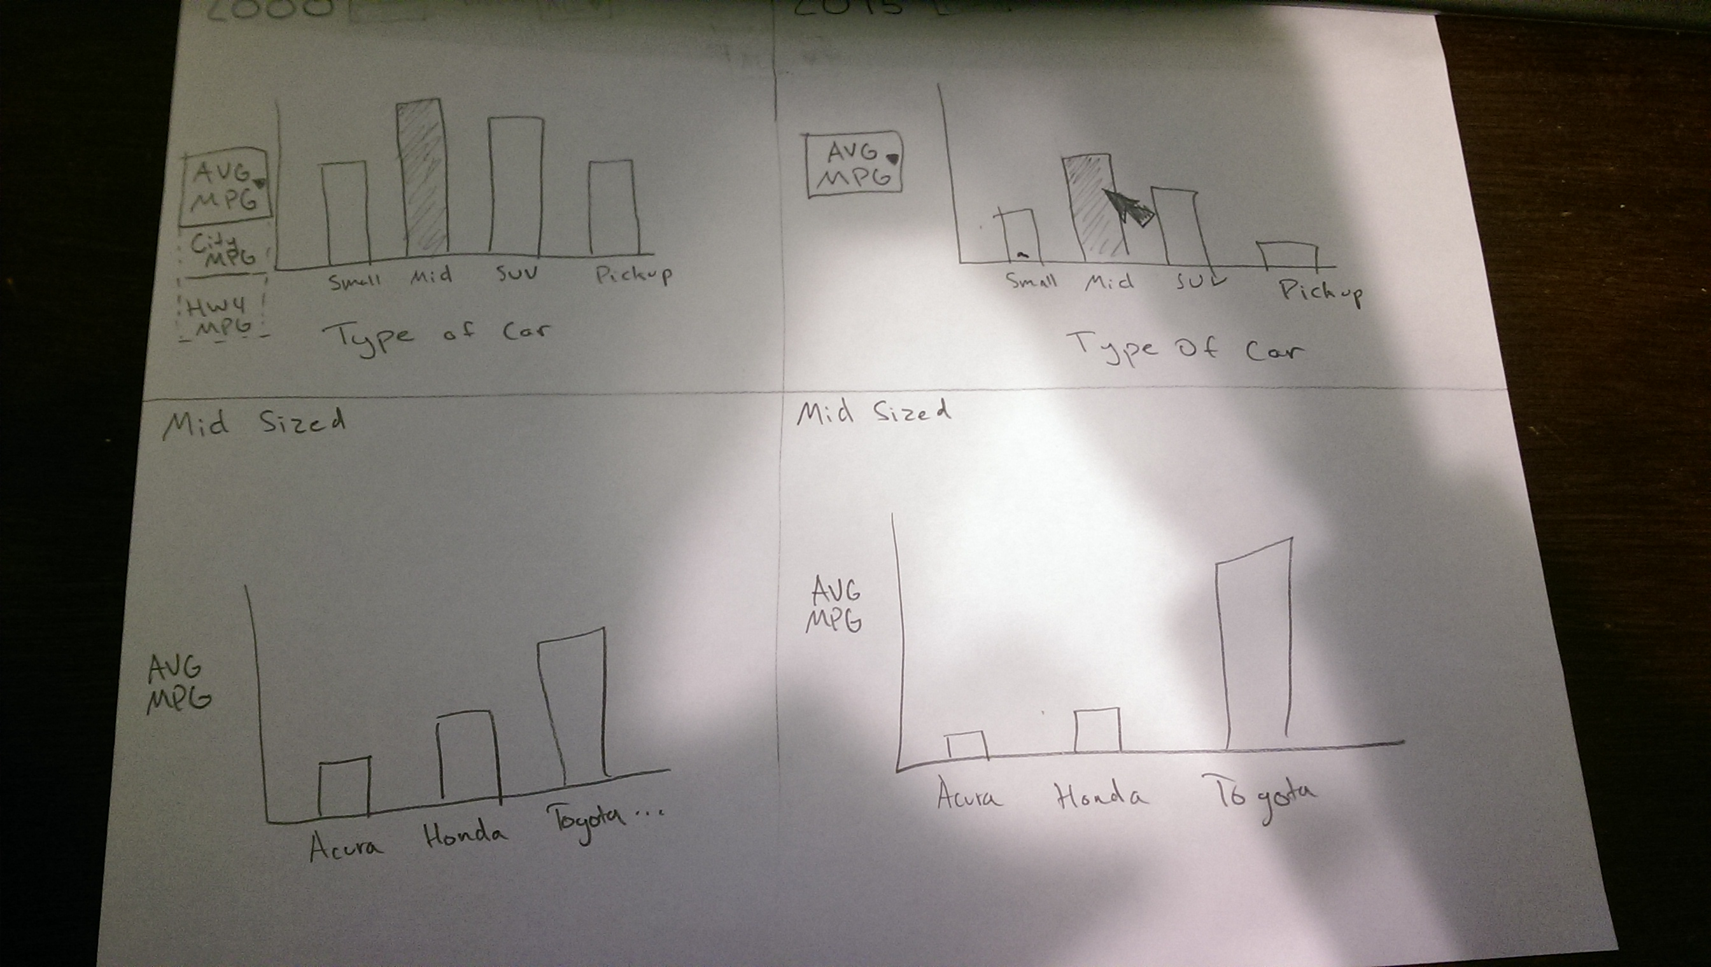
Design

Slide 5
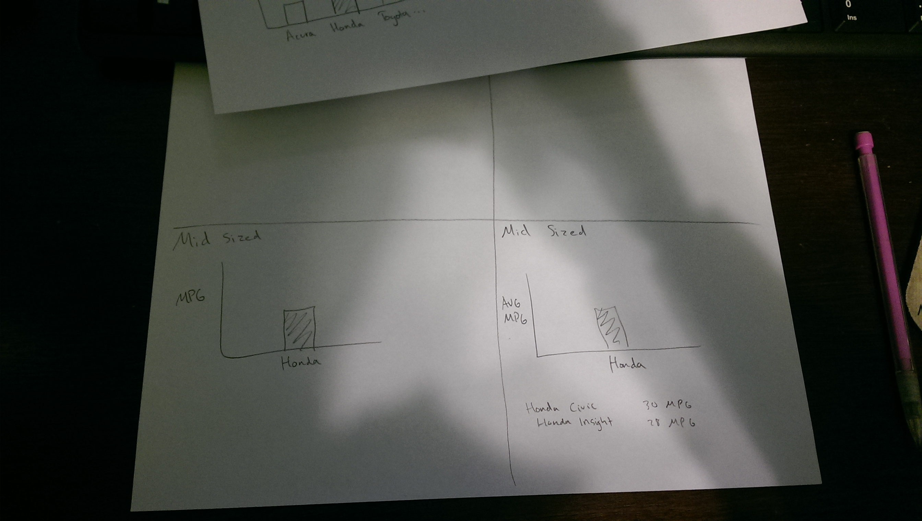
Design

Slide 6
Design

Slide 7
System Architecture
Using Processing

Slide 8
Usage Scenario

