Slide 1
AlertBell
By Ayush and Yanda

Slide 2
Overview
A ring knockoff…
Basically, allows you to monitor a given area with a camera. Sends alert to user when a target object is detected (like a person).
Useful for monitoring restricted or off-limits areas.
Useful for maintaining productivity.

Slide 3
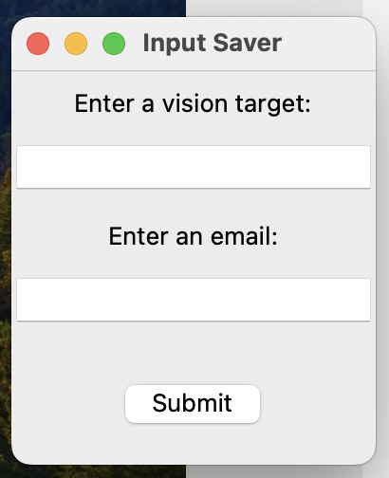
UI
For the UI, we are using Tkinter.
Saves a desired vision target and receiver email to local variables
Performs input validation to affirm that the vision target and email are valid
Creates and deletes UI upon correct input
Allows for editing of variables later on

Slide 4
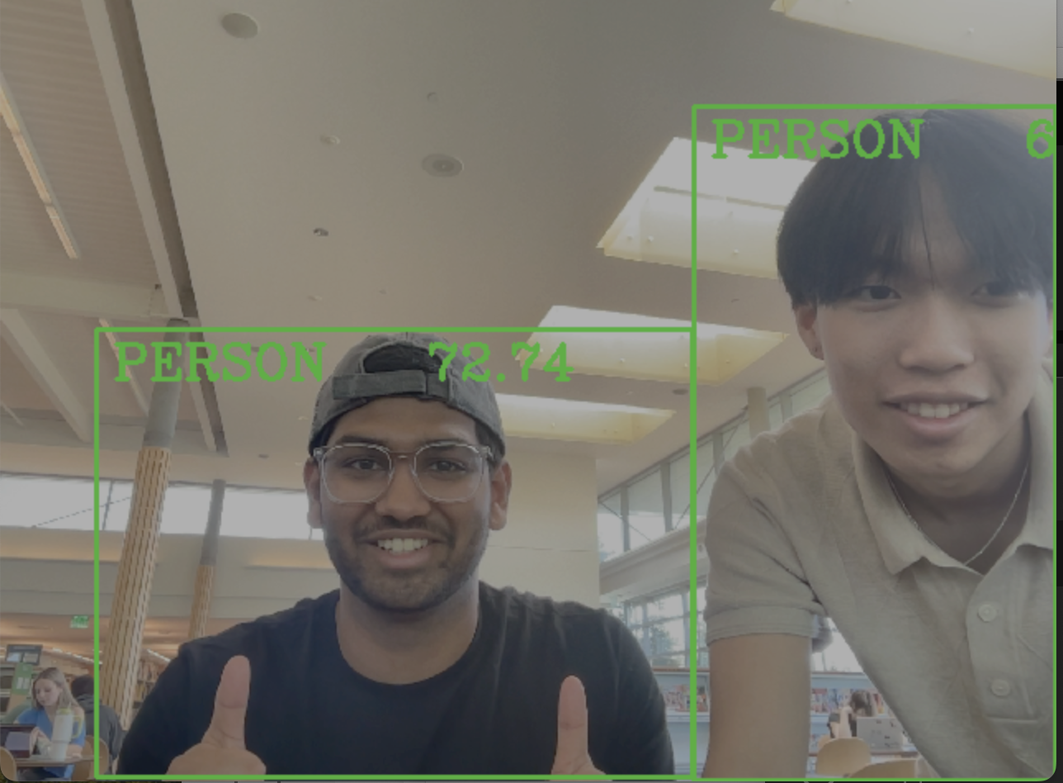
Computer Vision
An OpenCV model pre-trained using example code (Code Project) and an external Kaggle database.
Input size of 320 x 320
91 different objects
We extract image bounds and IDs as output to match objects up with their names and validate that they exist within our video feed.
Training code: https://www.codeproject.com/Articles/5270244/Training-a-Custom-Model-with-OpenCV-and-ImageAI
Training data: https://www.kaggle.com/datasets/valentynsichkar/yolo-coco-data

Slide 5
Email Alerts
Creates a local Simple Mail Transfer Protocol (SMTP) server that signs into a Gmail account.
Uses a Google app password to bypass 2Factor authentication
Auto generates a message custom to the vision target alerting the user that the target was detected
In the case of a cell phone, tells you to get off your phone
Multithreading: creates a parallel thread in order to delay emails (avoids spamming you, hopefully)

Slide 6
Live Demo

Slide 7
Possible Expansions
A search bar so that the user can search for the name of the vision target
Further training for the CV2 model.
Allowing the user to send alerts from a custom email

Slide 8
Questions?

