Slide 1
Training Deep Q-Network for Stochastic Process Environments
Gerald He
Notes:
Hello everyone, today I would like to present my project on building and training a DQN for stochastic process environments. The goal of this project is to explore the potential of DQN in real-world scenarios.

Slide 2

Part 1: Flappy bird environment
Notes:
In the first part, I built and trained a DQN to play the old-fashioned game Flappy Bird, which was popular ten years ago. I feel that the game is a good candidate for further research on stochastic process simulation. Due to the time limit and my preference to focus more on researching the stochastic process, I used the state value directly from the environment instead of using a convolutional neural network to capture the game screen.

Slide 3
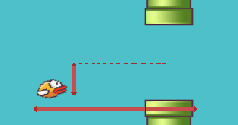
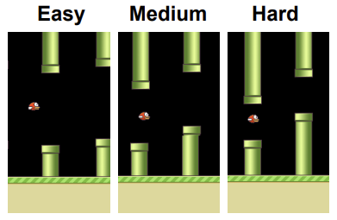
Flappy bird environment
1 Observation: – the position of the bird
2 Actions: – the bird goes up and down
Reward: +1 each time when the bird passes through the pipe
Done: When the bird crashes at the pipe
Note: The initial reward is 101 in the hard mode
Chen, Kevin. 2017

Slide 4
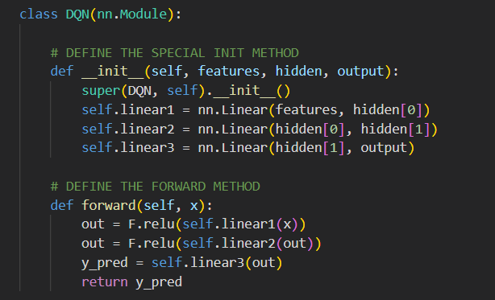
My first dqn
Notes:
Like what we did in Homework 3.2, I first used a similar 3-layer DQN with a forward function that included three fully connected layers. However, I found that the training process was slow and the performance was not satisfying enough compared to others' previous work.

Slide 5
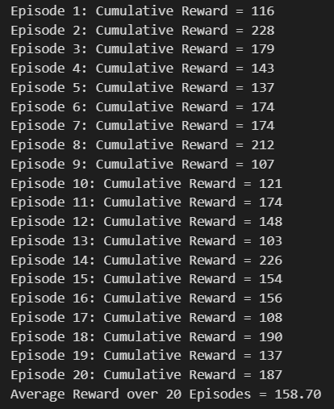
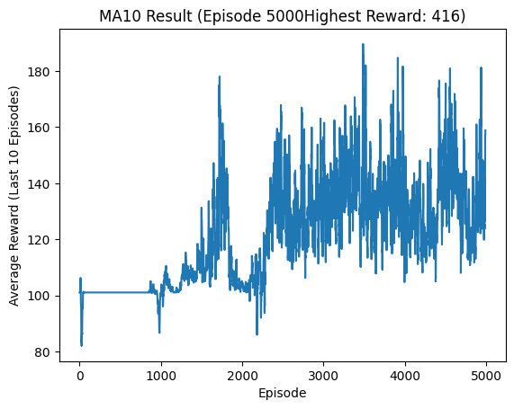
result
BATCH_SIZE = 128
GAMMA = 0.99
EPS_START = 0.9
EPS_END = 0.05
EPS_DECAY = 1000
TAU = 0.005
LR = 1e-4
HIDDEN = 64
MEMORY = 50000
The actual score is 57.70

Slide 6
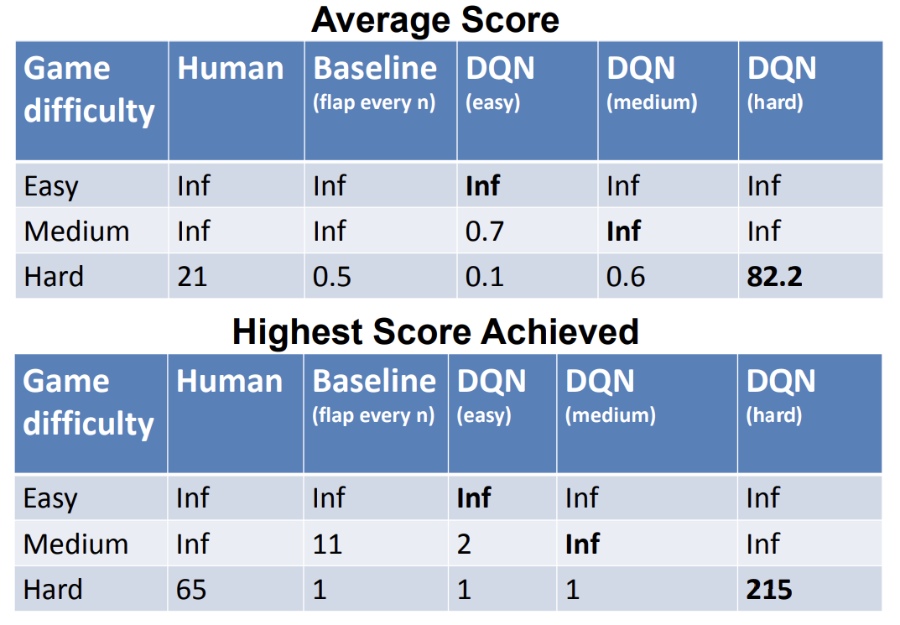
Compare to reference
Chen, Kevin. 2017
Notes:
Here is the previous work from Stanford University by Kevin Chen in 2017, which was able to achieve an average score of 82.2, significantly better than my results.

Slide 7
Notes:
In my opinion, there is a major difference between the Lunar Landing and Flappy Bird environments. Lunar Landing is giving a continuous reward, where the agent can receive a reward for every action it takes, whereas in Flappy Bird, the agent only receives rewards when it passes through the pipes correctly.

Slide 8
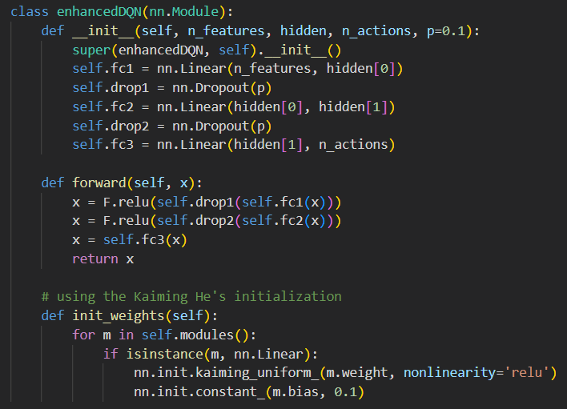
Improvement with drop out layer
Notes:
Therefore, to address this, we need a more stable activation, a larger memory replay size, and a more robust network. To improve performance, I implemented a new enhanced DQN that included dropout layers and used the Kaiming initialization method, which takes into account the non-linearity of activation functions. This enhanced DQN triggered a faster training process.

Slide 9
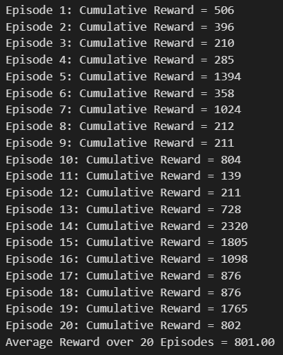
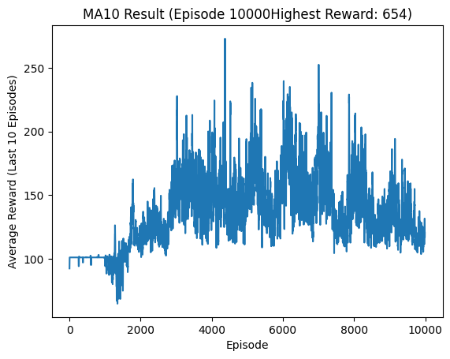
better outcome
BATCH_SIZE = 256
GAMMA = 0.99
EPS_START = 0.99
EPS_END = 0.01
EPS_DECAY = 1000
TAU = 0.005
LR = 1e-4
HIDDEN = 256
MEMORY = 50000
The actual score is 701.00
Notes:
The test results improved significantly, with the Average Reward over 20 Episodes increasing from 158.70 to 801.00.

Slide 10
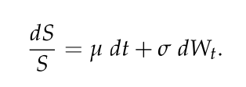
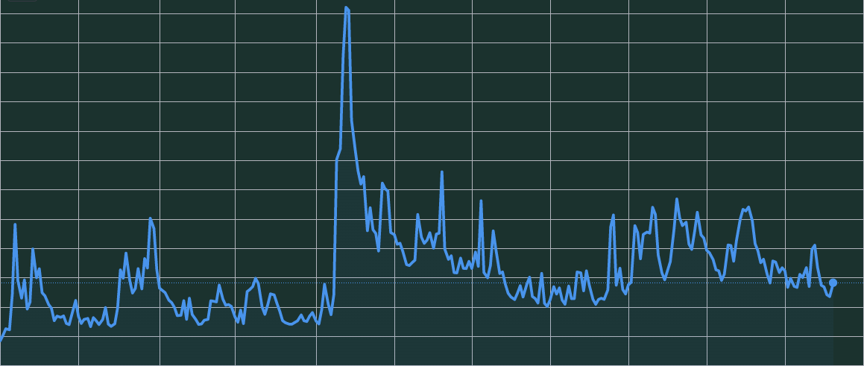
Part 2: Stochastic Process with Stock trading simulation
What is the relationship between the Flappy Bird and stock price?
A stochastic process is a mathematical model that describes the evolution of a random system over time. It involves the study of the probability distribution of a sequence of random variables.
VIX Index from 2018 to Today

Slide 11
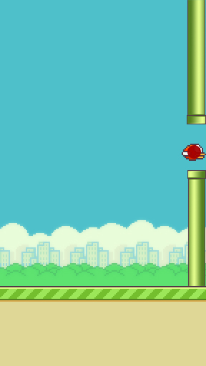
Back to Flappy bird environment
Notes:
To position the bird on the rightmost side of the screen, the bird's x-coordinate to a fixed value that corresponds to the rightmost edge of the screen. The y-coordinate can be randomized within a range to simulate the starting price of the stock.

Slide 12
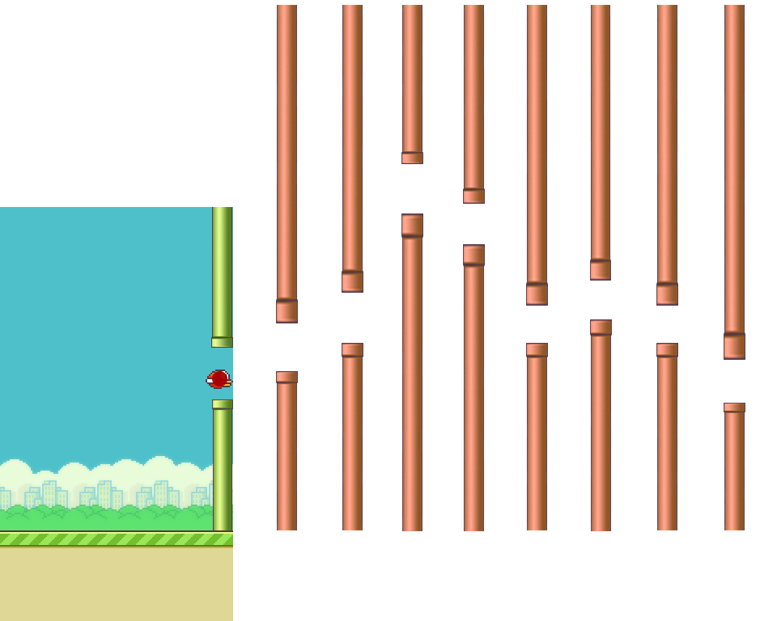
Notes:
To generate the ideal trajectory, sampling from a normal distribution following the Brownian motion to simulate the stock price movements. The mean and standard deviation of the distribution can be adjusted to simulate different market conditions. You can generate a new value at each time step and use it as the position of the pipes in the original Flappy Bird game.

Slide 13
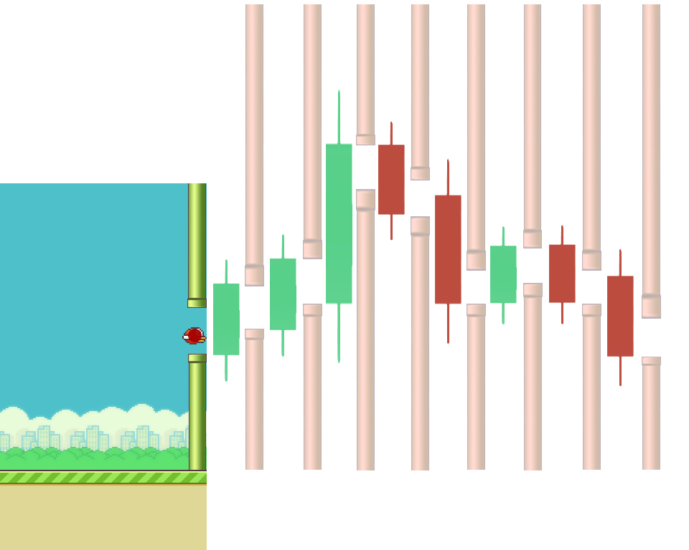
Notes:
To implement three actions - 'up', 'down', and 'keep' - that correspond to buying, selling, and holding the stock, respectively. These actions will change the bird's y-coordinate, which corresponds to the stock price.
To calculate the reward, comparing the bird's y-coordinate to the ideal trajectory at each time step. If the bird is higher than the trajectory, the reward can be positive, and if it's lower, the reward can be negative. The value of the reward can be determined by the distance between the bird's y-coordinate and the trajectory.
To set the initial reward to 100 and the stop condition to when the reward is below 0 or after 1000 trajectory points, you can initialize the reward to 100 at the start of the game and decrement it by the absolute value of the reward at each time step. The game should stop if the reward falls below 0 or if the game reaches 1000 time steps.

Slide 14
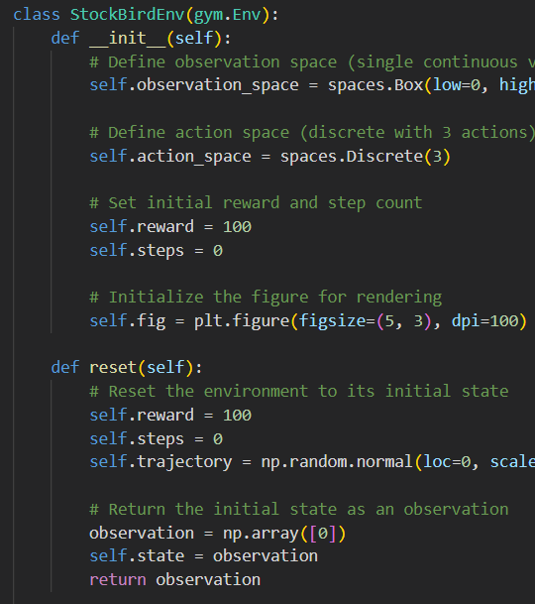
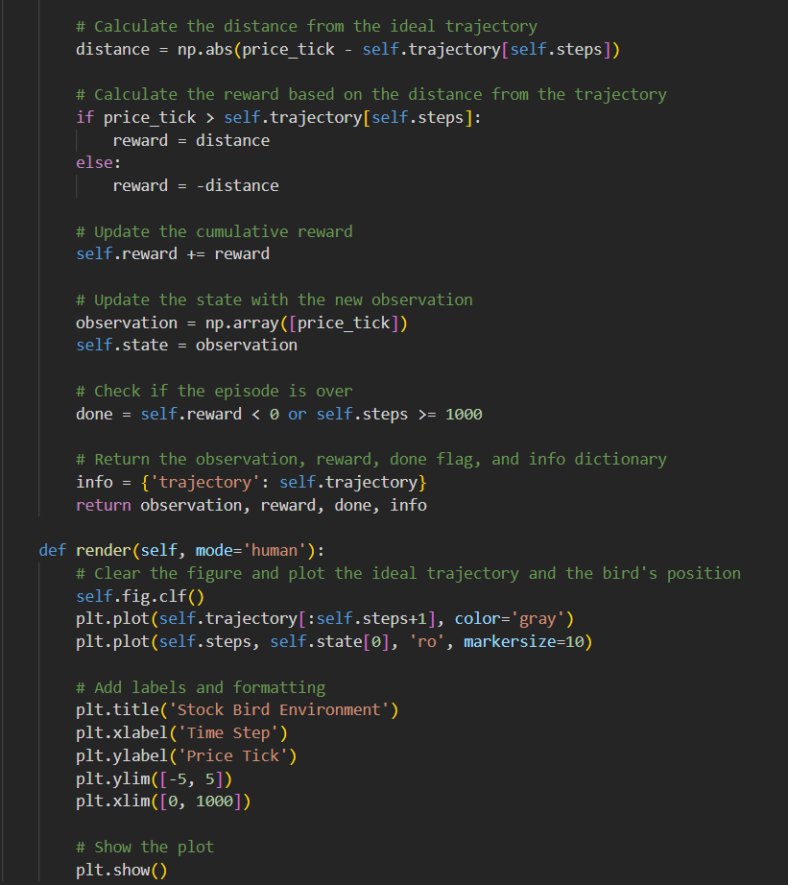
FLAPPY BIRD stock environment
Notes:
Here was my first attempt at the environment. However, after a long simulation session, I realized that the destination position of the bird was too far away from the initial point, making the image impossible to render. As a result, I decided to deprecate the rendering environment and created a new data-only environment.

Slide 15
My trading environment
Initial state: $1M cash balance
4 Observations:
The current price of the stock
The current value of the account
The current position of the account (how many stocks the account holds)
The current cash balance of the account
2 Actions: Buy/Sell $100k stock
Reward: The total profit made by trading
Done: When the time comes to an end (1700 steps total)
Data: 20 stocks with the highest trading volume from 2017 to 2020

Slide 16
DQN Design
class DQN(nn.Module):
def __init__(self, lr, input_dims, fc1_dims, fc2_dims, n_actions):
super(DQN, self).__init__()
self.lr = lr
self.input_dims = input_dims
self.fc1_dims = fc1_dims
self.fc2_dims = fc2_dims
self.n_actions = n_actions
self.fc1 = nn.Linear(*self.input_dims, self.fc1_dims)
self.BN1 = nn.BatchNorm1d(fc1_dims)
self.drop1 = nn.Dropout(p)
self.fc2 = nn.Linear(self.fc1_dims, self.fc2_dims)
self.drop2 = nn.Dropout(p)
self.BN2 = nn.BatchNorm1d(fc2_dims)
self.fc3 = nn.Linear(self.fc2_dims, self.n_actions)
self.optimizer = optim.Adam(self.parameters(), lr=lr)
self.loss = nn.MSELoss()
self.device = torch.device('cuda:0' if torch.cuda.is_available() else 'cpu')
self.to(self.device)
def forward(self, state):
state.to(self.device)
x = self.fc1(state.to(torch.float32))
x = F.relu(x)
x = self.fc2(x)
x = F.relu(x)
actions = self.fc3(x)
return actions
def init_weights(self):
for m in self.modules():
if isinstance(m, nn.Linear):
nn.init.kaiming_uniform_(m.weight, nonlinearity='relu')
nn.init.constant_(m.bias, 0.1)
Notes:
I created the DQN with dropout layers and kaiming initialization as my previous experience. 2 Batch normal layer was added to make training of networks trigger faster and more stable.

Slide 17
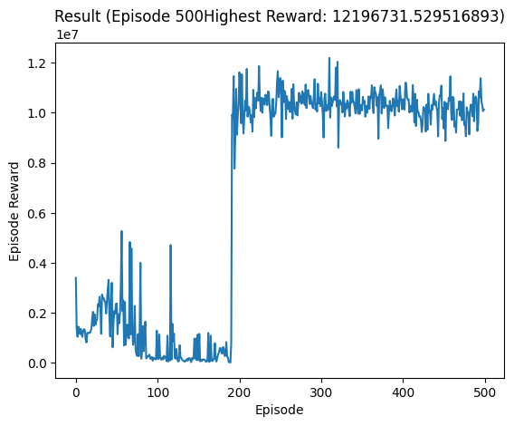
result
BATCH_SIZE = 256
GAMMA = 0.99
EPS_START = 0.9
EPS_END = 0.01
EPS_DECAY = 2000
TAU = 0.005
LR = 1e-4
HIDDEN = 256
MEMORY = 100000
Notes:
The result is impressive, with the policy trained after 500 episodes, the average profit for 1700 steps is 10 times the starting fund, and it tends to hold the stocks longer and sell when the stock surges, like a professional investor. However, it is important to note that this is not financial advice nor a financial practice. It is just a simulation using historical data. The model must be overfitted.

Slide 18
Backtest class
I am still working on testing the policy in the real world using real-time data.
I am currently using the Alpha Vantage API to test the "strategy".

Slide 19
reflection
1. Use convolutional layers to play the rendering environment like a human.
2. Improve the performance of the trading environment by exploring additional strategies and techniques.
3. Add more observations to the trading environment, such as trading volume, financial reports, and other relevant data.
4. Enable the agent to trade multiple stocks simultaneously with customized trading volumes. This will allow for more diverse and sophisticated trading strategies.
Notes:
To further improve my project, I plan to:
1. Use a convolutional layer to capture the game image rather than directly using the state value. This should improve the agent's ability to understand the game environment.
2. Improve the performance of the environment and agent training process, which currently takes 2 minutes per episode. By changing all data types to tensors and running directly on the GPU, the performance should improve significantly.
3. Enable the environment to trade multiple stocks simultaneously, which will simulate the real trading environment more accurately and allow for more sophisticated trading strategies.
4. Improve the backtest class and preprocess the input data to improve the generalization performance of the model. Currently, the model is only suitable for dealing with transactions in a specific range for a particular stock.
However, I also encountered some limitations and challenges during the project. For example, the DQN approach can be slow to converge, and the stock trading environment can be complex due to the multiple factors that influence the stock prices.

Slide 20
Conculusion
DQN approach was effective in both Flappy Bird and Stock Trading environments.
Even in information missing environment, the well-trained agent can still find a way to solve the problem.
Notes:
In conclusion, this project has demonstrated that DQN can be an effective approach for learning optimal policies in various environments, including both game environments and real-world trading environments. It has also highlighted the potential of reinforcement learning in solving complex problems.

Slide 21
Citation and source
Chen, Kevin. Deep Reinforcement Learning for Flappy Bird - Stanford University. 2017, https://cs229.stanford.edu/proj2015/362_report.pdf.
Chuchro, Robert, and Deepak Gupta. Game Playing with Deep Q-Learning Using Openai Gym. 2017, http://cs231n.stanford.edu/reports/2017/pdfs/616.pdf.
He, Kaiming, et al. “Delving Deep into Rectifiers: Surpassing Human-Level Performance on ImageNet Classification.” 2015 IEEE International Conference on Computer Vision (ICCV), 2015, https://doi.org/10.1109/iccv.2015.123.

Slide 22
Thank you!
Any questions?

