Slide 1



DG INTERNS HUB - CYBER SECURITY INTERNSHIP
I Hunt
Threats.
Week 10 SOC Case Study - Wazuh SIEM Setup & Alert Monitoring
How I turned an isolated VirtualBox lab into a working Security Operations center - and caught a simulated SSH attacker red-handed.
✦
Mah Noor
Cyber Security Intern
Wazuh 4.14.9
Snort IDS
Ubuntu 24.04

Slide 2
01
CASE FILE 01
The Lab - Mission Briefing
Everything ran inside an authorized, isolated VirtualBox lab on a host-only network - safe to attack, safe to defend.
▦
Wazuh Server
▢
Monitored Endpoint
Official Wazuh 4.14.9 OVA on Amazon Linux 2023 - manager, indexer and dashboard all running
Ubuntu 24.04 VM (soc-snort) running the Wazuh agent plus Snort IDS from Week 9
192.168.56.103
192.168.56.102
✦
Network
✓
Deployed Components
Host-only adapter for traffic + NAT for updates - fully isolated from real networks
wazuh-manager active
wazuh-indexer active
wazuh-dashboard active
wazuh-agent active on endpoint
2
VMs
1
agent
3
core services
0
budget spent - fully open source

Slide 3
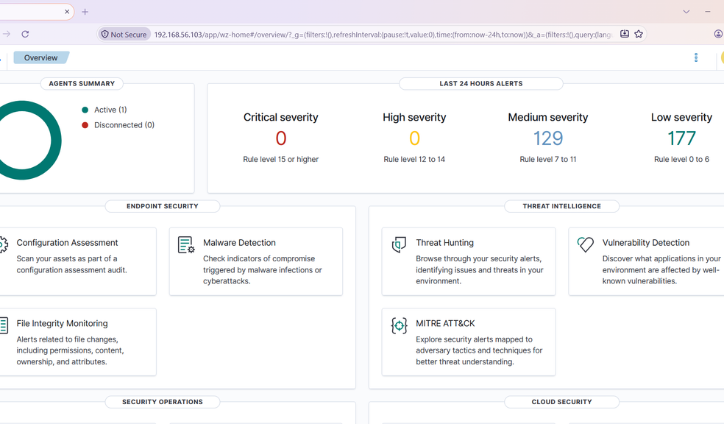
02
CASE FILE 02
The Alert Storm
In one monitored day the endpoint produced a full spread of security events - every one visible in a single pane of glass.
358
total alerts on snort-agent (001)
0
0
Critical (15+)
High (12-14)
129
177
Medium (7-11)
Low (0-6)
⌇
Wazuh Overview - agents summary & alerts by severity
7
14
6
auth failures
auth successes
FIM events
Severity snapshot from the Overview dashboard (last 24 hours); totals from Threat Hunting events view.

Slide 4
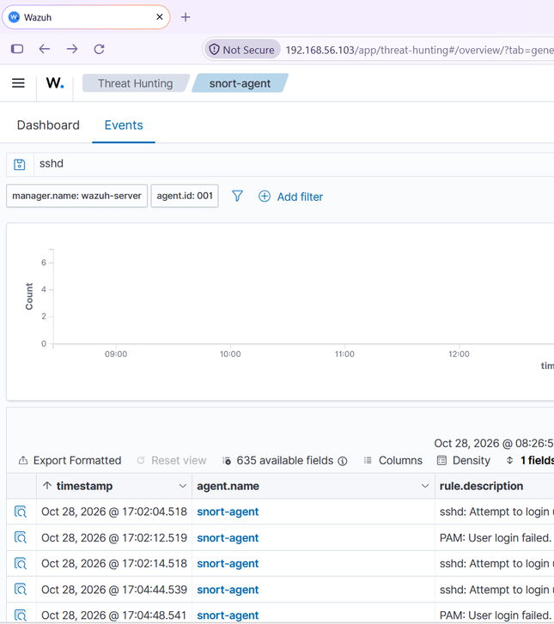
THE CASE
Someone Is Knocking - an SSH Intrusion Attempt
At 17:02 the dashboard lit up: repeated SSH logins using a user that does not exist. wronguser knocked on soc-snort again and again - first from localhost, then from the host machine 192.168.56.1 on the host-only network.
Rule 5710
- sshd: attempt to login using a non-existent user
Rule 5503
- PAM: user login failed
MITRE ATT&CK T1110
- Credential Access / Password Guessing
✦
The Pattern
⚠
Why It Matters
Every attempt fired an alert PAIR: sshd (5710) plus PAM (5503) within seconds - two independent logs confirming the same event.
Username guessing is classic brute-force behavior. In a real network, a burst like this from one IP deserves an immediate block - not a shrug.
✦
Threat Hunting events - sshd search, 7 hits

Slide 5
05
EVIDENCE BOARD
Five Alerts, One Story
17:02:04
sshd: attempt to login using a non-existent user - first knock with wronguser
A01
- Rule 5710
✓
Analyst read: repeated invalid-user attempts from two sources, always paired sshd + PAM, zero successful logins. A controlled test - and a true detection.
17:02:12
PAM: user login failed - the OS confirms the rejection
A02
- Rule 5503
17:02:14
Second attempt just 10 seconds later - a guessing pattern, not a typo
A03
- Rule 5710
17:04:44
Second wave, this time from the host machine 192.168.56.1
A04
- Rule 5710
17:04:48
Final failed password - after this, silence. No success ever followed.
A05
- Rule 5503

Slide 6

THE VERDICT
What Happened - and What It Means
✓
Findings
✦
Severity Assessment
LOW
LVL 5
✓
All login attempts FAILED - no account was ever compromised
severity level
✓
No privilege escalation, no sudo abuse, no suspicious files
✦
Rated LOW (level 5) by Wazuh rules
✓
Sources identified: localhost + 192.168.56.1 (my own host)
↗
Escalates to MEDIUM/HIGH if: many attempts per minute, a valid user is targeted, or any login succeeds
✓
True positive: a simulated attack detected exactly as designed
▤
MITRE ATT&CK T1110 - Credential Access technique confirmed
⚖
Analyst call: treat every invalid-user burst as reconnaissance - today a test, tomorrow a real attacker probing the same way.

Slide 7
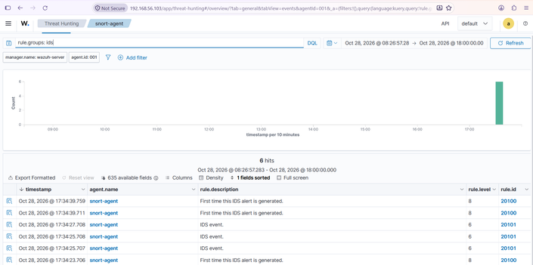
BONUS HUNT
Snort x Wazuh - Network Meets Host
I wired the Week 9 Snort IDS straight into Wazuh, so network alerts and host alerts finally live in one dashboard.
01
Snort detects
ICMP ping rule sid 1000001 fires
02
Alert log
/var/log/snort/snort.alert.fast written
◉
Snort IDS alerts inside Wazuh Threat Hunting (rule.groups: ids)
03
Wazuh agent
localfile block, log_format snort-fast
Dashboard
✦
One attacker ping becomes two correlated detections - network-side by Snort, host-side by Wazuh.
04
decoded under rule group ids (20100 / 20101)
⚡
6 IDS alerts
▤
rules 20100 + 20101
✦
source 192.168.56.1 to 192.168.56.102

Slide 8
⛨
RESPONSE PLAYBOOK
If This Were Real - My Next Moves
01
⊘
02
⚿
03
⌕
Contain
Harden
Verify
Block the source IP at the firewall and enable fail2ban or Wazuh active response
Disable SSH password login, switch to key-based auth, restrict trusted IPs
Review last and auth.log for any successful login from the source; check for new accounts
04
⚿
05
↻
06
♥
Recover
Patch
Monitor
Rotate credentials for targeted accounts if compromise is suspected
Keep the endpoint updated so known holes stay closed
Keep watching rules 5710/5503 and confirm the alerts stop after blocking
✦
Each step maps to the incident investigation I documented in the Week 10 report.

Slide 9
DEBRIEF
Lessons From the Hunt
◉
⌘
Paired alerts confirm truth
✦
Thresholds matter
sshd + PAM agreeing on the same event kills false positives
One failed login is noise, five in three minutes is a pattern - alerting needs both
Logs are early warning
Authentication logs caught the attacker before any damage could exist
◉
✦
Correlate everything
Snort network alerts + Wazuh host alerts in one dashboard = the full attacker story
LESSON 01
✦
Skills I sharpened this week
Wazuh SIEM
Snort IDS
Log Analysis
Incident Response
MITRE ATT&CK
File Integrity Monitoring

Slide 10

▦
Week 10 of my cyber security internship
The Hunt Continues.
Week 10 complete - 358 alerts monitored, one simulated attacker caught, one SOC lab built from scratch.
✦
GitHub: github.com/skymahnoor
⛨
Mah Noor - Cyber Security Intern - DG Interns Hub

