Slide 1
SOC Threat Detection, Alert Correlation & Incident Response
Wazuh + Snort | Incident DG-SOC-001
Cyber Security Internship - Week 11 | DG Interns Hub
Mah Noor | 5 November 2026

Slide 2
Objective and Lab Setup
Correlate Snort (network) and Wazuh (host) alerts like a SOC analyst
Investigate, classify severity and prepare an incident response plan
All tests done in my own isolated VirtualBox lab
Machine | Role | IP
Windows host (PowerShell) | Test / attacker machine | 192.168.56.1
soc-snort (Ubuntu 24.04) | Target, Snort IDS + Wazuh agent (snort-agent) | 192.168.56.102
wazuh-server (Wazuh 4.14.9) | Manager, indexer, dashboard | 192.168.56.103
Logs are in UTC; Pakistan time = UTC+5.
DG-SOC-001 | Week 11 | Mah Noor
2

Slide 3
SOC Alert Correlation - Key Ideas
Concept | Meaning (short)
Alert correlation | Linking alerts from different tools/time into one story (Wazuh rule 40112 did this)
True / False Positive | TP = alert and real threat. FP = alert but harmless activity
IOC | Evidence of an attack: IP, username, file path, port, rule/SID
Event / Alert / Incident | Event = any log line. Alert = rule matched. Incident = confirmed issue needing response
Detection vs Response | Detection finds suspicious activity. Response contains, removes and recovers
L1 / L2 / L3 | L1 triage. L2 investigate and contain. L3 hunt, tune rules, lead major incidents
DG-SOC-001 | Week 11 | Mah Noor
3

Slide 4
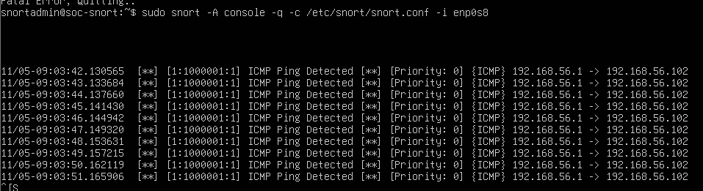
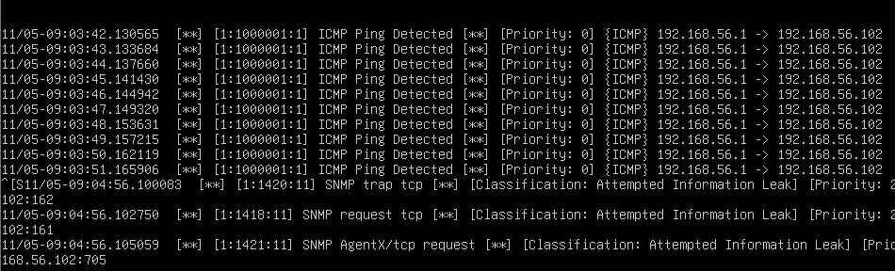
Snort Monitoring
10 pings detected - SID 1:1000001
nmap scan seen via SNMP SIDs 1:1418, 1:1420, 1:1421
Source 192.168.56.1 -> target 192.168.56.102 (interface enp0s8)
nmap found 22/tcp (ssh) and 80/tcp (http, unexpected) open
Custom port-scan rule SID 1000002 did not fire; scan detected indirectly
No Snort alert seen for the encrypted SSH logins
DG-SOC-001 | Week 11 | Mah Noor
4

Slide 5
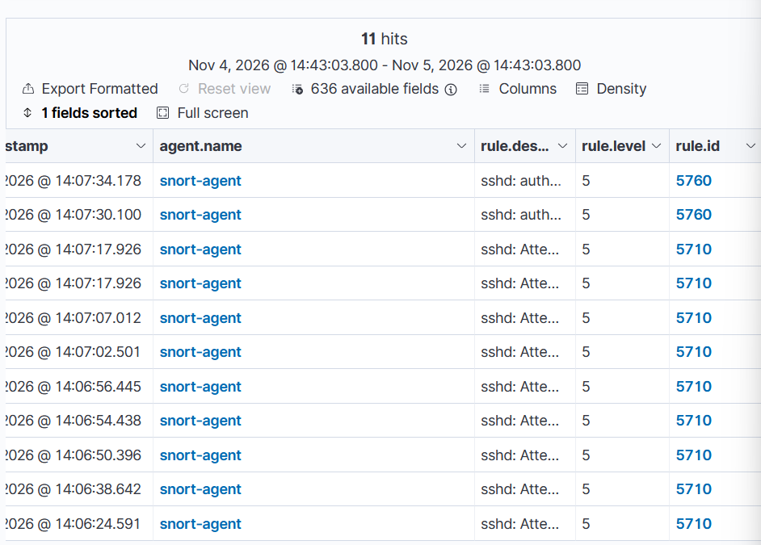
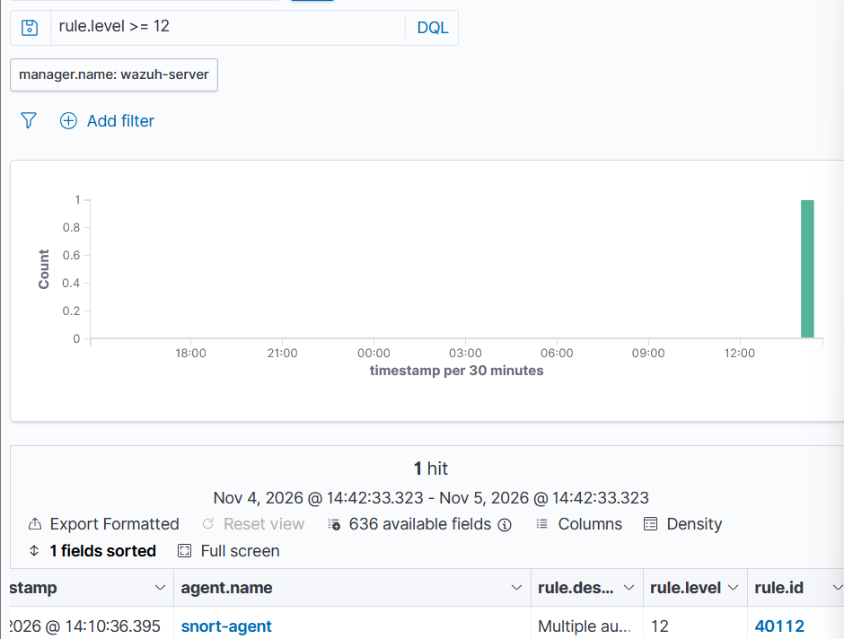
Wazuh Monitoring
Rule 40112, level 12, 14:10:36 PKT
11 alerts: rule 5710 x9, 5760 x2 (level 5)
Agent snort-agent Active | 71 alerts, 17 auth failures, 8 auth successes | MITRE: Brute Force, Valid Accounts
DG-SOC-001 | Week 11 | Mah Noor
5

Slide 6
Snort vs Wazuh Comparison
Event | Snort | Wazuh | Severity | Analyst finding
Ping | Yes (1:1000001) | No | Low | Normal activity
Port scan | Yes (indirect, SNMP SIDs) | No alert seen | Medium | Investigate - own test host
SSH login failure | Not observed | Yes (5710, 5760) | Medium | Authentication event, 8 failures
Success after failures | Not observed | Yes (40112, level 12) | High | Possible account compromise
File change | No | Week 10: 554 / 553 | Low | Expected FIM test file
Snort reads packets on the wire; Wazuh reads host logs and file integrity data
SSH is encrypted, so Snort cannot see wrong passwords; sshd logs them and Wazuh reads the log
Together they show the full attack story
DG-SOC-001 | Week 11 | Mah Noor
6

Slide 7
Incident DG-SOC-001 - Investigation
Time (UTC) | Event
09:03:42 | 10 pings from 192.168.56.1 (Snort)
09:04:56 | nmap scan, SNMP signatures fire (Snort)
09:06:46 | First failed SSH attempt: invalid user wronguser
09:07:00-09:07:57 | 8 failed passwords: wronguser x6, snortadmin x2
09:10:59 | Accepted password for snortadmin
14:10:36 PKT | Wazuh rule 40112 (level 12)
Source IP: 192.168.56.1
Accounts: wronguser, snortadmin
After login: whoami, ls, exit
Verdict: True Positive detection of an authorized lab simulation
Severity: High
DG-SOC-001 | Week 11 | Mah Noor
7

Slide 8
IOCs and Alert Classification
IOC | Value
IP | 192.168.56.1 (source), 192.168.56.102 (target)
Users | wronguser, snortadmin
Files | /var/log/auth.log, /tmp/fim_test.txt
Ports / protocols | 22, 80, 161, 162, 705 | ICMP, TCP, SSH
Wazuh rules | 5710, 5760, 40112
Snort SIDs | 1:1000001, 1:1418, 1:1420, 1:1421
Severity | Count (16 alerts)
Critical | 0
High | 1
Medium | 6
Low | 7
Informational | 2
Scale: Info 0-3, Low 4-6, Medium 7-11, High 12-14, Critical 15 (Wazuh levels)
DG-SOC-001 | Week 11 | Mah Noor
8

Slide 9
Incident Response and Playbooks
Phase | Action for this incident
Preparation | Wazuh agents, Snort, time sync, tuned rules, playbooks
Identification | Rules 5710, 5760, 40112 + Snort ping/scan from same IP
Analysis | auth.log, Wazuh alerts, Snort SIDs, timeline
Containment | Block source IP, lock snortadmin, end session
Eradication | Reset password, check keys/cron, SSH keys only, close port 80
Recovery | Restore access, monitor, check clocks and agents
Lessons learned | fail2ban, MFA, tune Snort rules, real-time FIM
3 playbooks: Multiple Failed Logins | Port Scan | Suspicious File/System Change
DG-SOC-001 | Week 11 | Mah Noor
9

Slide 10
Findings, Recommendations and Conclusion
Snort saw the recon (ping, scan); Wazuh saw the login attacks and the correlated success
Port 80 open and 16 pending updates found
Wazuh clock ~22 s behind Linux logs after VM resume
Harden SSH: keys only, fail2ban, restrict users
Tune Snort: threshold port-scan and SSH brute-force rules
Enable real-time FIM, NTP on all VMs
Conclusion: correlating network + host alerts gives the full story
DG-SOC-001 | Week 11 | Mah Noor
10

