Slide 1

DG INTERNS HUB
WEEK 2
Advanced Networking, Traffic Analysis & Security Concepts
Presented by Mah Noor
Tools Used: Wireshark • Nmap • Cisco Packet Tracer

Slide 2






What This Week Covered
A mix of theory and hands-on practice with real networking & security tools
Ports & Services
Networking Devices
20+ common ports mapped with protocol and use
Router, Switch & Firewall — how they work
Security Basics
Wireshark
MITM, DoS & Packet Sniffing concepts
Captured & analyzed real network traffic
Nmap
Packet Tracer
Scanned ports and detected running services
Built LANs & a safe MITM simulation
DG Interns Hub • Week 2
02

Slide 3
Part 1: Theory Highlights
Ports & Services
Networking Devices
Security Basics
Made a table of 20+ ports (like 22-SSH, 80-HTTP, 443-HTTPS) with their protocol and everyday use.
Explained how a Router, Switch and Firewall work, with real-life examples and the key Router vs Switch difference.
Studied MITM, DoS and Packet Sniffing attacks — how each works and simple ways to prevent them.
DG Interns Hub • Week 2
03

Slide 4
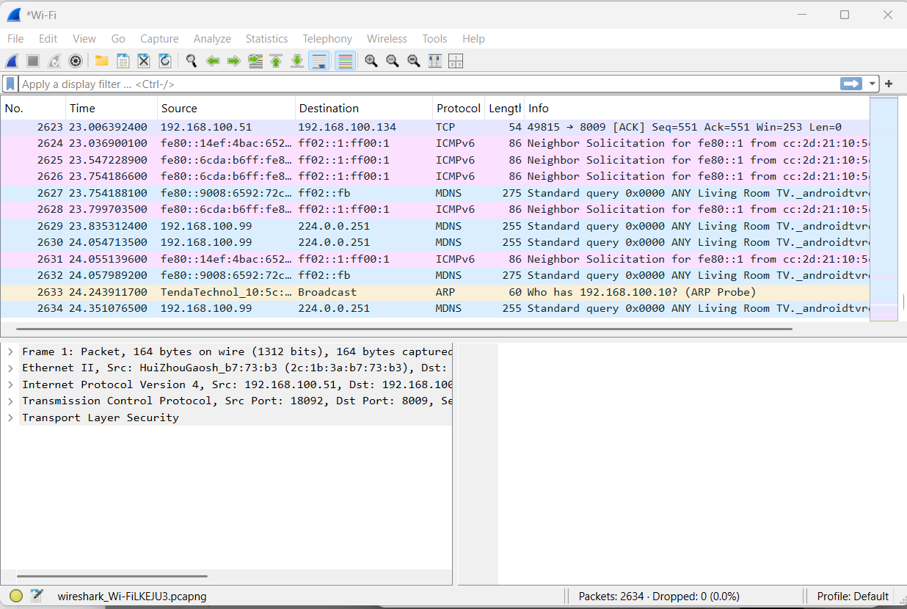
TASK 4 — PACKET ANALYSIS
Wireshark Traffic Capture
Captured live traffic while browsing websites like google.com
Filtered by “dns” to see domain lookups and responses
Filtered by “tls” to confirm HTTPS traffic was encrypted
Identified source & destination IPs for every packet
Live Wireshark capture on my Wi-Fi network
DG Interns Hub • Week 2
04

Slide 5
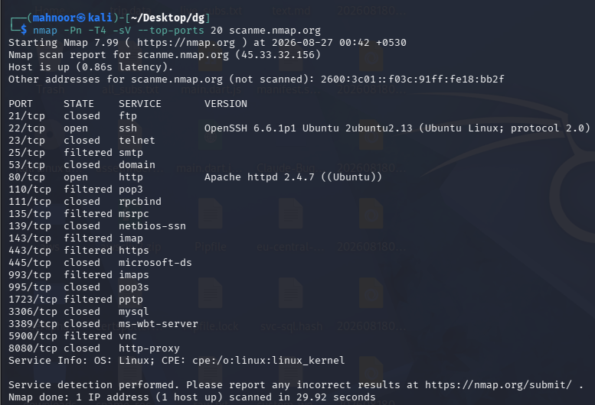
TASK 5 — NETWORK SCANNING
Nmap Port Scan
Scanned the legal practice target scanme.nmap.org
Found open ports: 22 (SSH) and 80 (HTTP)
Used -sV to detect service versions: OpenSSH 6.6.1p1, Apache 2.4.7
Ran a focused scan on ports 22, 80 and 443
Service & version scan on scanme.nmap.org (-sV)
DG Interns Hub • Week 2
05

Slide 6
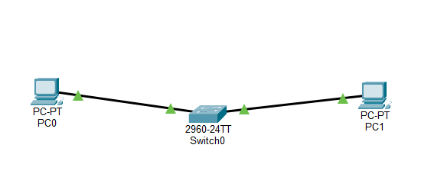
TASK 6 — LAN SETUP
Packet Tracer: Simple LAN
Built a small LAN with 2 PCs and 1 switch in Cisco Packet Tracer
Assigned static IPs: PC0 = 192.168.1.10, PC1 = 192.168.1.11
Both PCs placed on the same subnet (255.255.255.0)
Verified the setup with a successful ping between the PCs
Two PCs connected through a switch
DG Interns Hub • Week 2
06

Slide 7

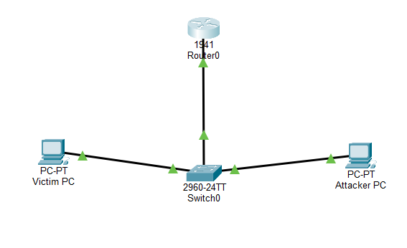
TASK 7 — MITM CONCEPT
Safe MITM Simulation
Built a Victim PC, Attacker PC, Switch & Router topology
Verified connectivity between all devices with ping tests
Learned how an attacker can sit between victim & router
Studied risks (data theft) and prevention (HTTPS, VPN)
Victim PC & Attacker PC sharing a switch with Router0
DG Interns Hub • Week 2
07

Slide 8
Tools Used This Week
Wireshark
Nmap
Packet Tracer
Free packet-capture tool used to study live traffic, DNS lookups and encrypted HTTPS data.
Free scanning tool used to find open ports and detect service versions on a safe target.
Cisco's free simulator used to build LANs, assign IPs, and test a safe MITM topology.
DG Interns Hub • Week 2
08

Slide 9


Key Learnings
Understood how DNS and HTTPS actually look on the wire using Wireshark
Learned responsible scanning with Nmap on a legal practice target
Practiced building LANs and IP addressing in Cisco Packet Tracer
Understood MITM, DoS & Packet Sniffing attacks and how to prevent them
Thank you!

